Slide 1
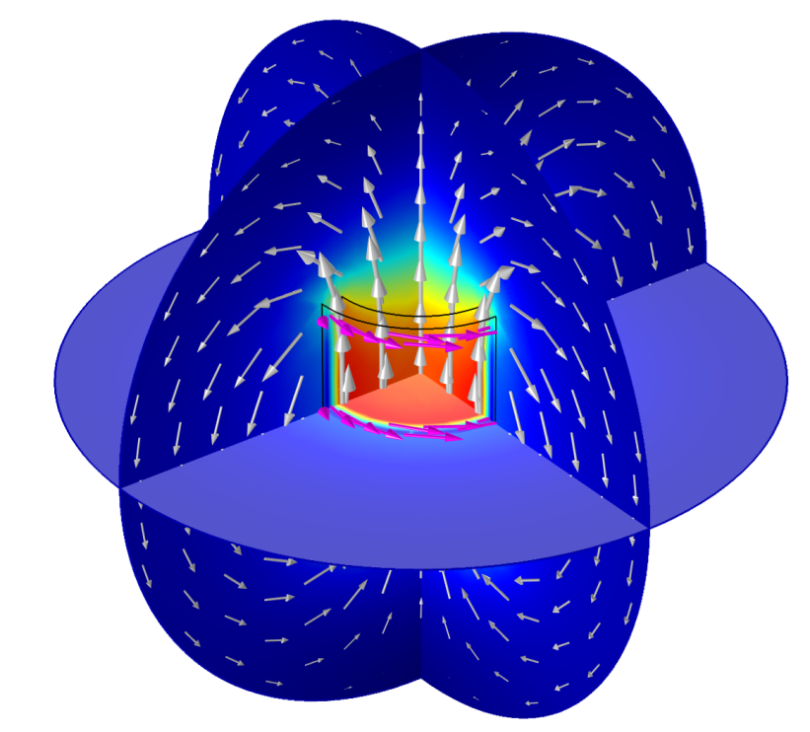
Single-turn and multi-turn coil domains in 3D
© 2012 COMSOL. All rights reserved.

Slide 2
Introduction
This tutorial shows how to use the Single-Turn Coil Domain and Multi-Turn Coil Domain features in COMSOL’s Magnetic Fields interface for modeling coils in 3D
These features are available only with the AC/DC Module
They are suitable for computationally efficient modeling of current-carrying conductors creating magnetic field
Additional information related to suitability of using these coil modeling features in DC and AC are provided

Slide 3
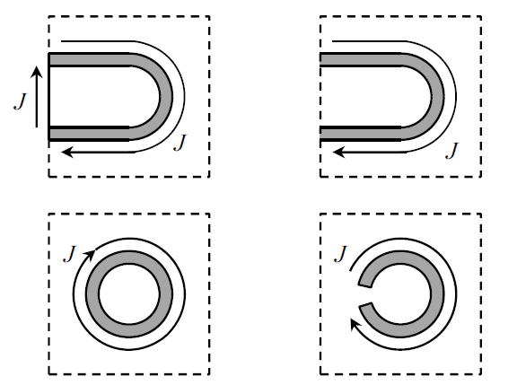


We should have a closed current loop
Use a closed geometry
Specify a closed current path using appropriate modeling techniques

Slide 4
When modeling magnetic field, we need to have a closed current loop
Use appropriate boundary conditions for open geometries

Slide 5
Overview
This tutorial describes how to use the following features
Single-turn coil domain
  Gap feed
  Boundary feed
Multi-turn coil domain
  Linear coil
  Circular coil
  Numeric coil
  Using symmetry
  User-defined coil

Slide 6
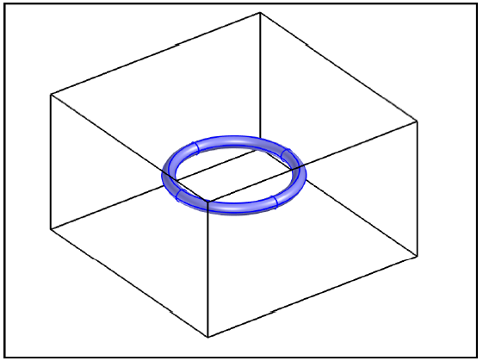
Single-turn coil domain
Model the actual conductor to compute magnitude and direction of current flow
Use this information to find the magnetic field in and around the conductor
Useful when you have a few turns
Also when you want to resolve the current distribution in individual wires and turns
Note: You need to model an air domain around the conductor
Single-turn toroidal coil

Slide 7
Modeling in frequency domain - AC
Always use this when the signal is periodic (e.g. sinusoidal, square wave)
Can be used for single-turn coil domain as long as the skin depth is not too small compared to the conductor thickness
  When the skin depth is smaller than the conductor thickness, use a boundary layer mesh
  When the skin depth is significantly smaller (< 1/20th) than the conductor thickness then we cannot use single-turn coil domain anymore

Slide 8
Modeling in time domain - Transient
Cannot be used for single-turn coil domain
  COMSOL uses an A-V formulation locally within the single-turn coil
  Solves for both magnetic vector potential (A) and electric potential (V)
  Transient simulation is not supported for such cases because V is not uniquely defined at each point in space
  In time domain analysis, the voltage (V) is defined as a path integral between two points in space
For details on the A-V formulation, refer to the AC/DC Module User’s Guide

Slide 9
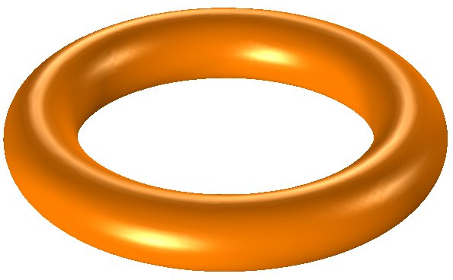
Single-turn coil – Gap feed
Single-turn coil
Leads are not modeled
Geometry must form a closed loop
Cross section and shape can be arbitrary

Slide 10
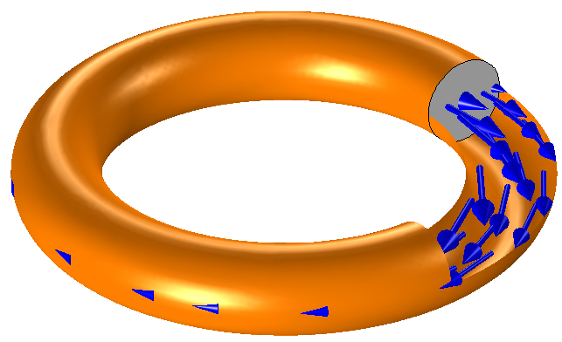
Coil excitation method
Excitation source is modeled as an internal cross section boundary called gap feed
We need to be careful while drawing the geometry so that we create this internal boundary
Gap feed
Specify the voltage across this boundary
Specify the current through this boundary
Options to connect to lumped electrical circuit

Slide 11
Modeling in COMSOL
For detailed modeling steps, see the following file:
  single_coil_gap_feed.mph
This model shows both DC and AC cases

Slide 12
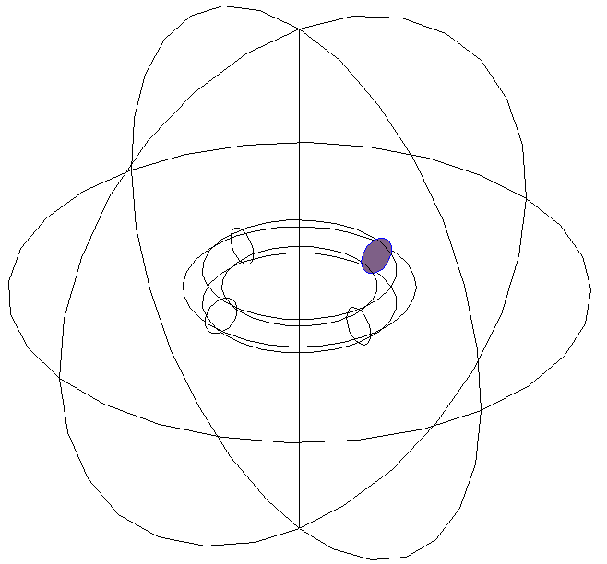
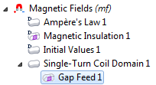
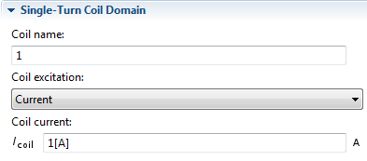
Using single-turn coil domain with gap feed

Slide 13
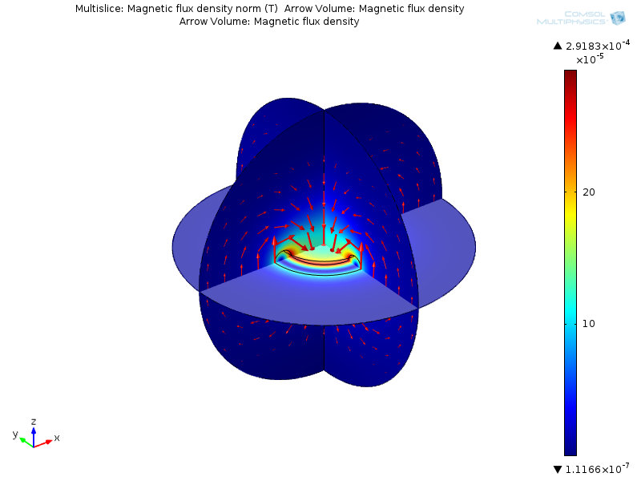
Results – Magnetic flux density (DC)
Inductance = 1.17e-8 H

Slide 14
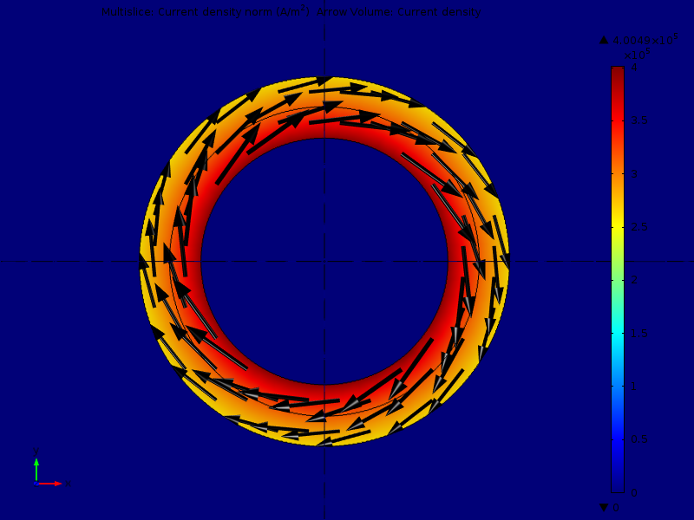
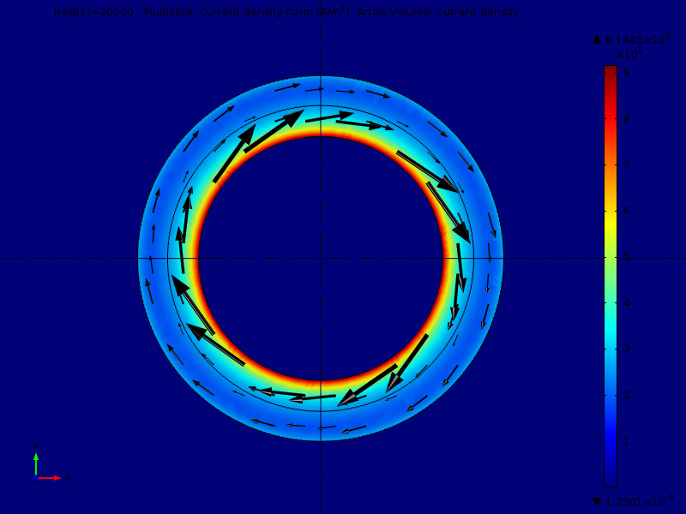
Results – Current density
DC solution
Resistance = 1.65e-4 Ω
Higher current density along the inner radius indicates that more current is concentrated along a shorter conduction path
AC (20 kHz) solution
Impedance = 2.3e-4 + 0.001i Ω
Current distribution clearly shows the skin effect

Slide 15
Using gap feed in AC single-turn coil
Gap feed in AC indicates a connection to a transmission line
In reality there is a capacitive coupling between the two ends of this “gap” feed
  Capacitive coupling is more significant at higher frequencies
  We cannot model it since we assume the gap feed to be a zero thickness surface
  Gap impedance will depend on the actual gap thickness and material property of the “gap”
Gap feed is perfectly accurate for DC models but a good approximation only for low frequency AC models

Slide 16
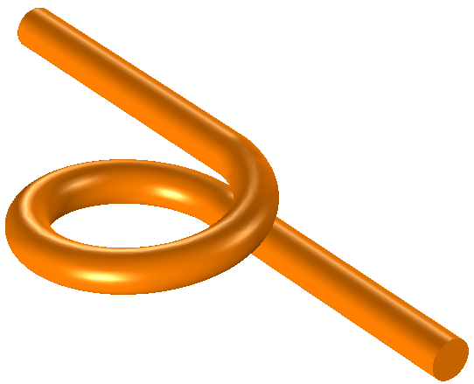
Single-turn coil – Boundary feed
Single-turn coil
Leads are modeled
Geometry does not form a closed loop
Cross section and shape can be arbitrary
You can use this to model more than a single turn

Slide 17
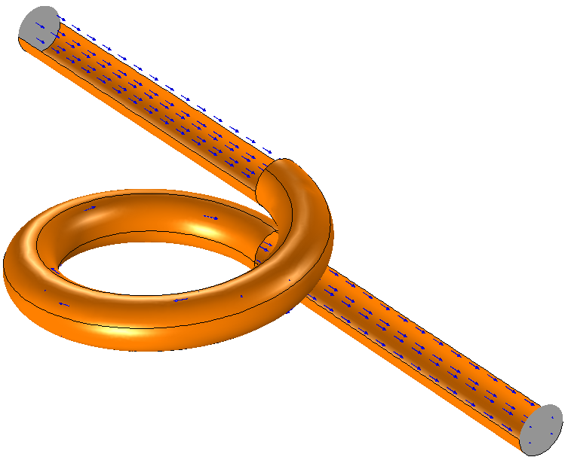
Coil excitation method
Direction of current flow is modeled by specifying a ground surface and a boundary feed
These surfaces should touch the external walls of the air domain surrounding the conductor
Boundary feed
Specify the voltage at this boundary
Specify the current through this boundary
Options to connect to lumped electrical circuit
Ground

Slide 18
Modeling in COMSOL
For detailed modeling steps, see the following file:
  single_coil_boundary_feed.mph
This model shows both DC and AC cases

Slide 19
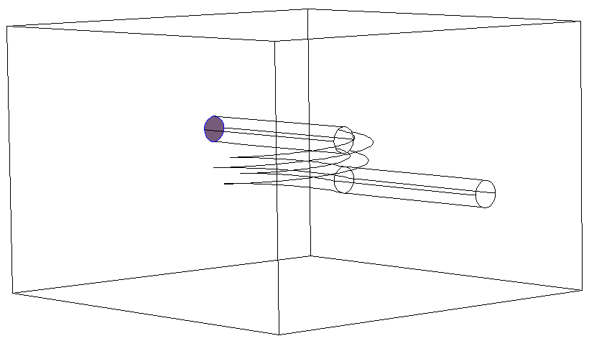
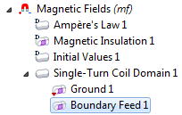
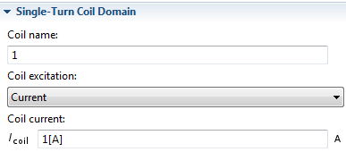
Using single-turn coil domain with ground and boundary feed

Slide 20
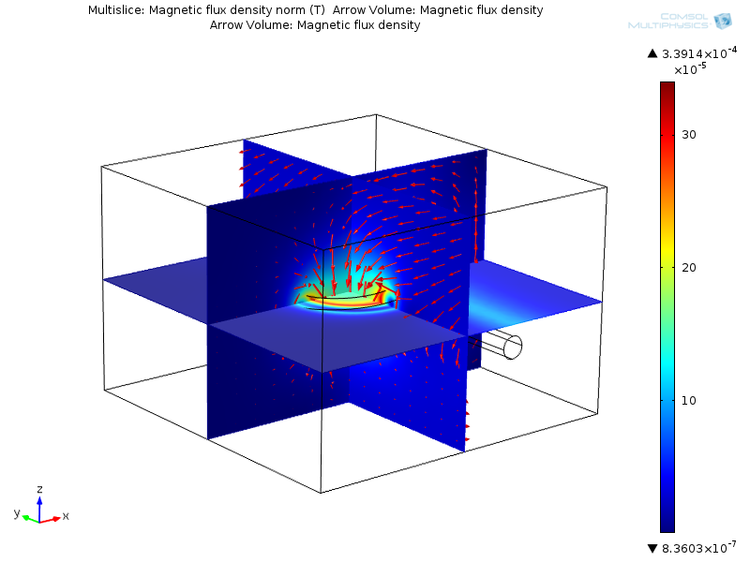
Results – Magnetic flux density (DC)
Inductance = 3.16e-8 H

Slide 21
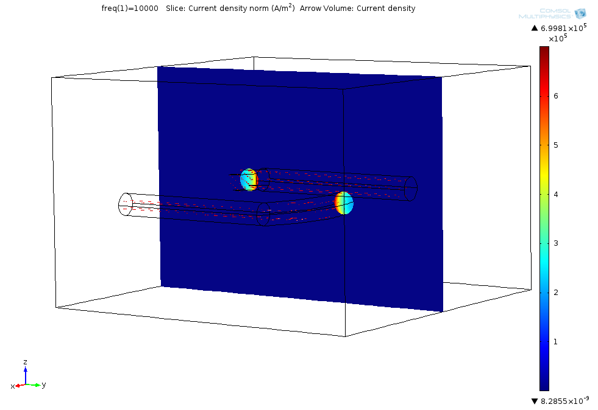
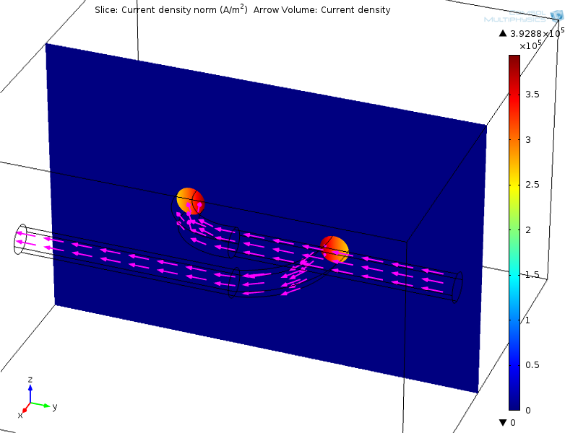
Results – Current density
DC solution
Resistance = 3.25e-4 Ω
Higher current density along the inner edges indicates that more current is concentrated along a shorter conduction path
AC (10 kHz) solution
Impedance = 3.83e-4 + 0.002i Ω
Current distribution clearly shows the skin effect

Slide 22
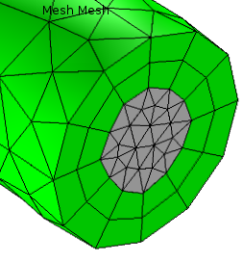
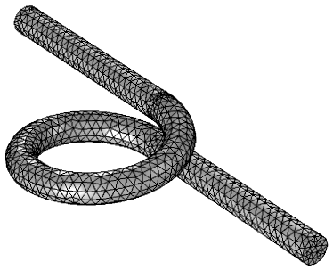

Meshing considerations
Default free tetrahedral mesh is suitable for the DC problem
Boundary layer mesh is better to resolve the skin effect for AC problems where the skin depth is smaller than the conductor cross section

Slide 23

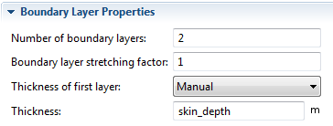
Resolving the skin effect in conductors using boundary layer mesh
Compute skin depth:
If the skin depth is less than ½ the thickness of the conductor, consider using a boundary layer mesh
  Two layers of mesh around the conductor wall is good enough
  Each layer has the same thickness as the skin depth

Slide 24
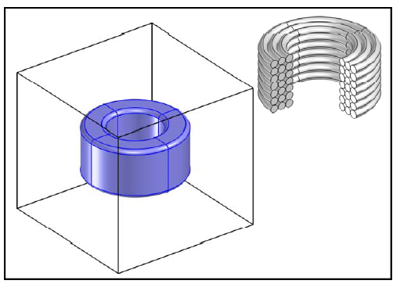
Multi-turn coil domain
Model a homogenized current carrying region to compute magnitude and direction of current flow
Use this information to find the magnetic field in and around the conductor
Useful when you have a lot of turns
Each individual wire is insulated – hence no shorting between conductors
Individual wire and multiple layers are not resolved
Note: You still need to model an air domain around the conductor
Homogenized multi-turn coil

Slide 25
Modeling in frequency and time domain
Always use frequency domain when the signal is harmonic (i.e. sinusoidal)
  Linear problem
  Relatively easy to solve
Can be used for multi-turn coil domain as long as the skin depth is much larger than the individual wire diameter
Use time domain only if the signal is not harmonic (e.g. pulse)
  Nonlinear problem
  Requires more computational time and memory

Slide 26
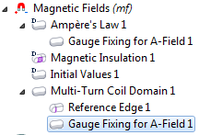
Convergence tips when using 3D Multi-Turn Coil Domain in frequency domain models
Use a small non-zero electrical conductivity for Air
  This is required to avoid creating a singular stiffness matrix
  A value of 1[S/m] is a good guess
  Using smaller values would increase computation time
  Cannot use a very high value because that would affect the “physics” of the model
May need Gauge fixing
  Add Gauge Fixing to Ampere’s Law
  Add Gauge Fixing to Multi-Turn Coil Domain
  Required to get a unique numerical solution

Slide 27
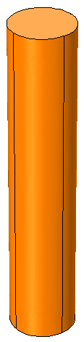
Multi-turn coil – Linear
Multiple parallel straight wires bundled in a sleeve
Leads are modeled
Geometry should not form a closed loop and must have a straight longitudinal axis
Cross section can be arbitrary

Slide 28
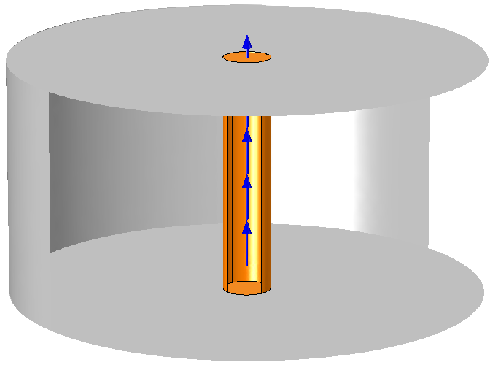
Coil excitation method
Direction of current flow is modeled by specifying a reference edge
Also the two end surfaces should touch the external walls of the air domain surrounding the conductor
Reference edge

Slide 29
Modeling in COMSOL
For detailed modeling steps, see the following file:
  multi_coil_linear.mph
This model shows only the DC case

Slide 30
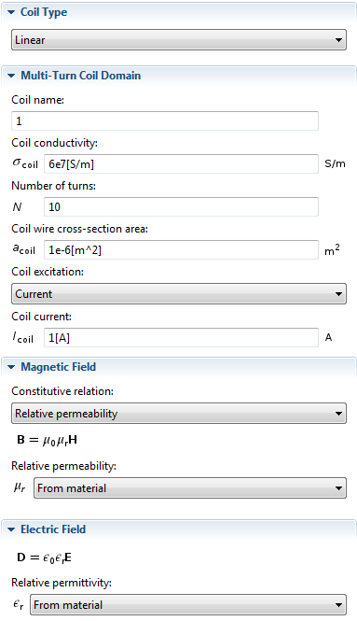

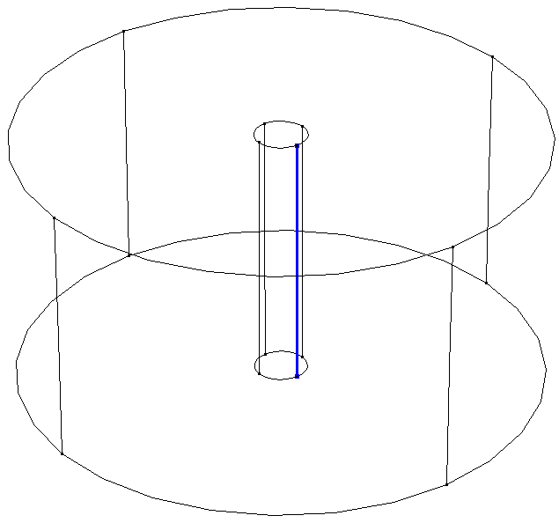
Using multi-turn coil domain: Linear

Slide 31
Note on coil properties
This is the electrical conductivity of the wire material.
This is the cross section area of each wire
COMSOL uses these for computing coil resistance
The relative permeability and relative permittivity values are for the homogenized coil domain

Slide 32
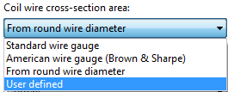
Options for wire cross section
Default is set to User defined cross section area
Can specify the wire diameter of round wire
Can also specify AWG or SWG number
Note: We are still not geometrically resolving the wires

Slide 33
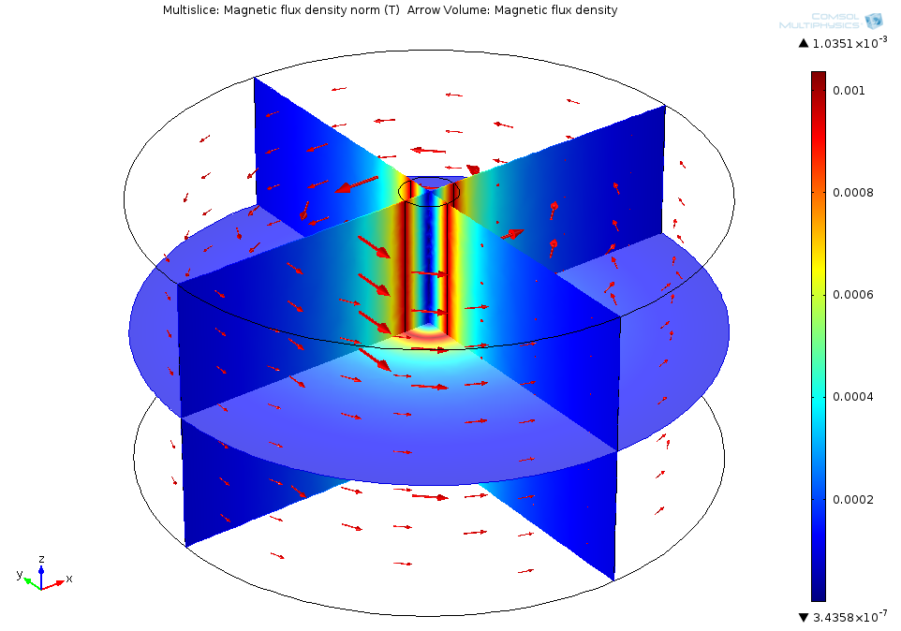
Results – Magnetic flux density
Inductance = 1.02e-6 H

Slide 34
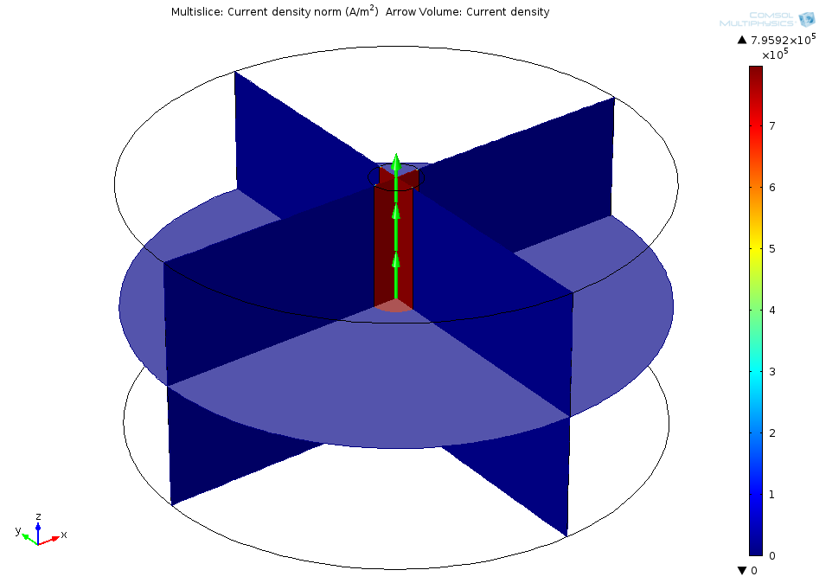
Results – Current density
Resistance = 0.003 Ω

Slide 35
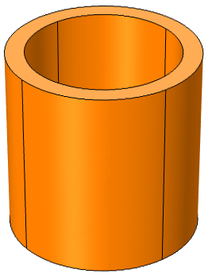
Multi-turn coil – Circular
Multiple wires arranged as a circular coil and placed in a potting material
Leads are not modeled
Geometry must form a closed loop and must have a straight longitudinal axis
Cross section must be circular

Slide 36
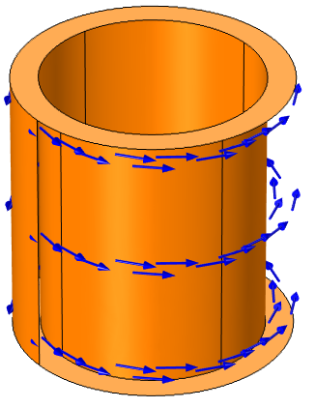
Coil excitation method
Direction of current flow is modeled by specifying a reference edge (typically more than one edge) that should form a closed curve
Reference edges

Slide 37
Modeling in COMSOL
For detailed modeling steps, see the following file:
  multi_coil_circular.mph
This model shows both DC and AC cases
The AC model shows the effect of induced current in a conductor placed in the AC magnetic field created by the multiturn coil

Slide 38
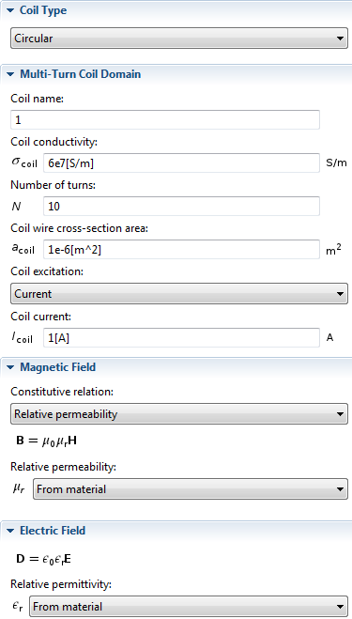

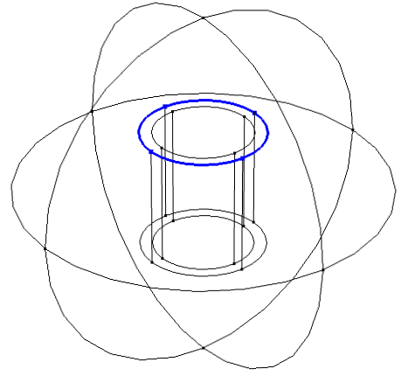
Using multi-turn coil domain: Circular

Slide 39
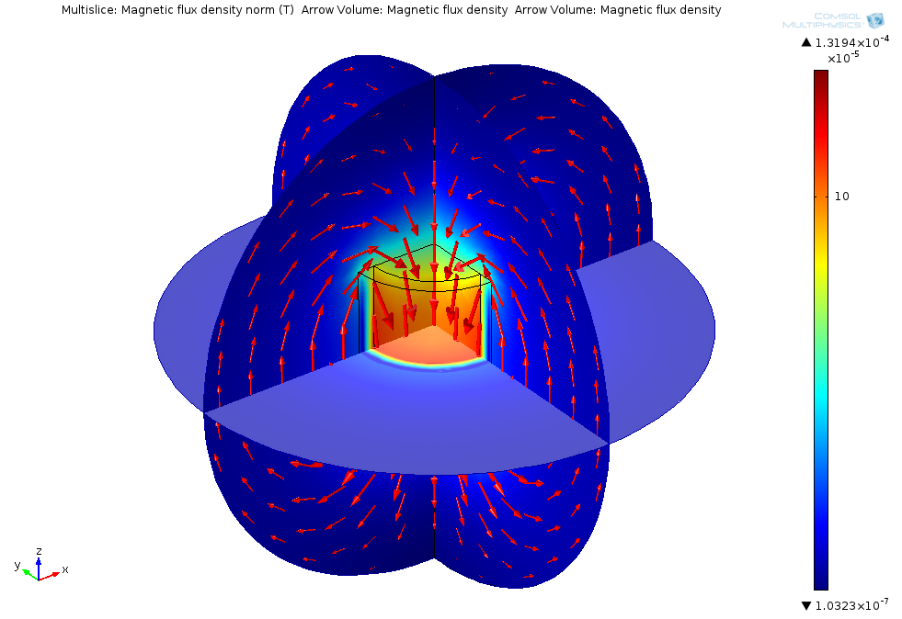
Results – Magnetic flux density (DC)
Inductance = 6.05e-6 H

Slide 40
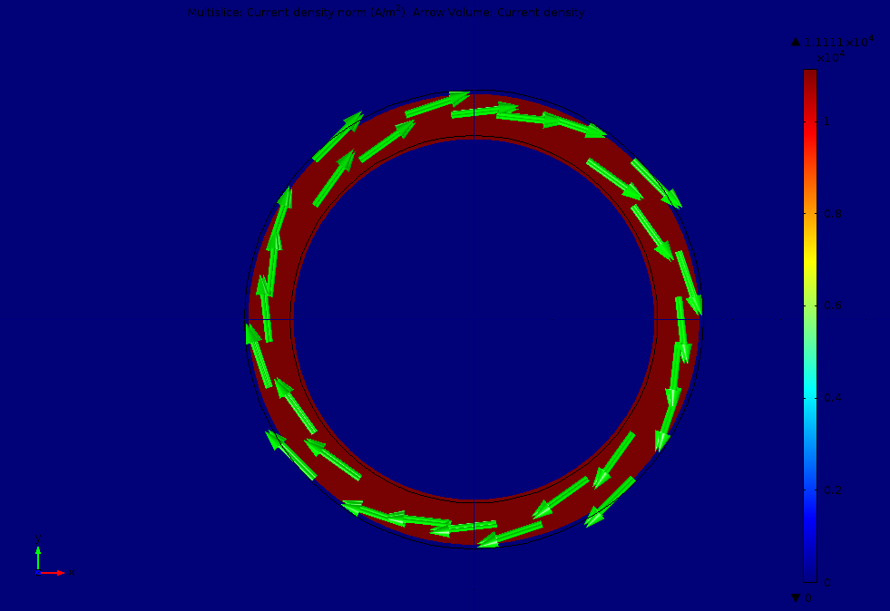
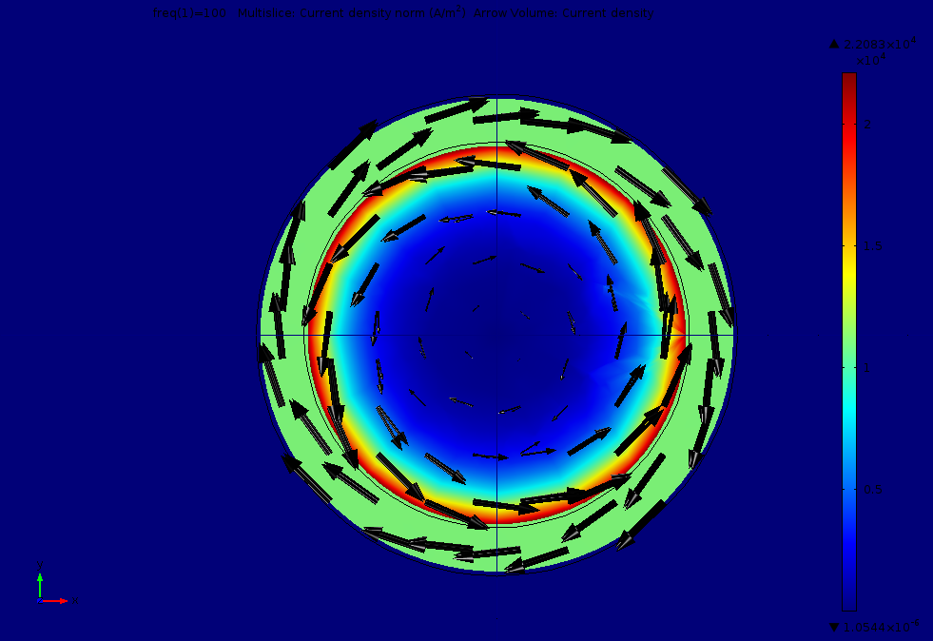
Results – Current density
DC solution
Resistance = 0.052 Ω
Uniform current density in the homogenized coil domain
AC (100 Hz) solution
Impedance = 0.061 + 0.001i Ω
Uniform current density in coil domain but skin effect is visible in the copper core
The arrows show that the current direction is opposite in the coil and the core because of induction effect

Slide 41
Note on reference edge
For circular coil, the “reference edge” is used for:
  Defining the current direction
  Defining the total length (L) of the wire where:
The effective coil resistance (R) is computed as:
N = number of turns
σ_{coil} = electrical conductivity of wires
A_{coil} = cross-section area of individual wire

Slide 42
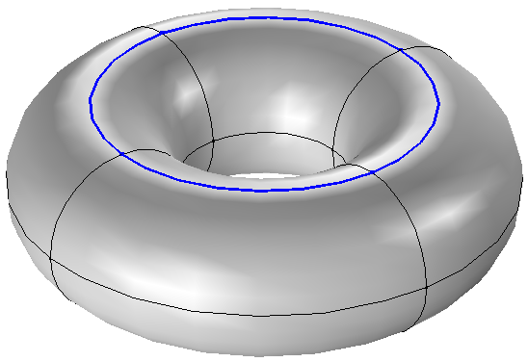
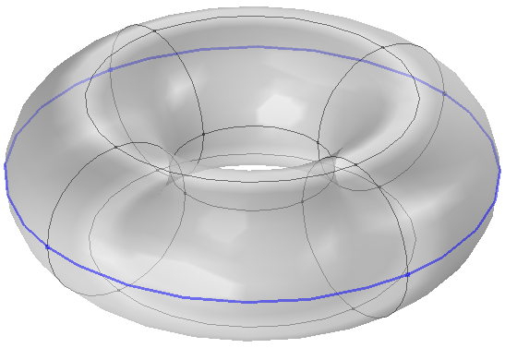
Choice of reference edge
Choice of reference edge can affect the accuracy of computed coil resistance if the cross section is appreciably thick
Choosing a set of edges which run through the middle of the thickness will give a better estimate of resistance
Choosing a set of edges which run around the outer or inner periphery will give an overestimate or underestimate respectively of resistance

Slide 43
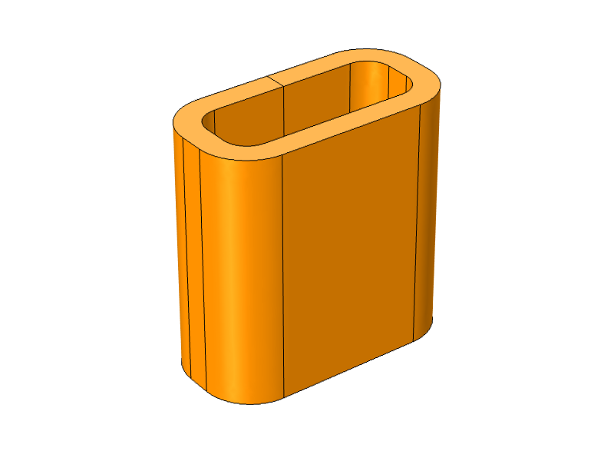
Multi-turn coil – Numeric
Multiple wires arranged as a coil and placed in a potting material
Leads are not modeled
Geometry must form a closed loop
Cross section can have arbitrary shape
  Must have constant cross-section perpendicular to current direction
  Preferable not to have sharp corners in the cross section
  Use fillets

Slide 44
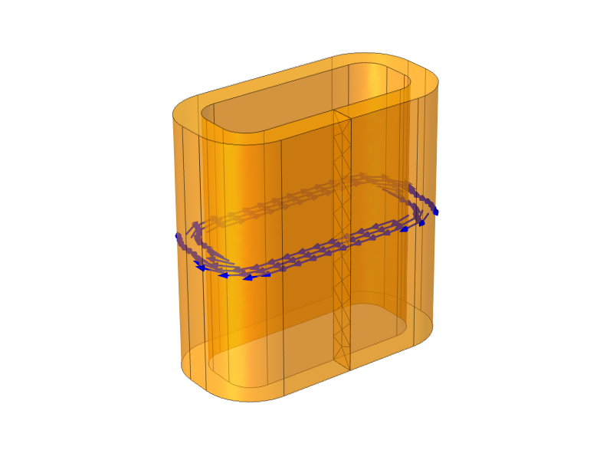
Coil excitation method
Excitation source is modeled as an internal cross section boundary called an Input
Need to take care while drawing the geometry so that we create this internal boundary
Other boundaries of the multi-turn coil domain should be assigned to Electric insulation
  Current flows parallel to these surfaces
Need to add a Coil Current Calculation study step
Input

Slide 45
Modeling in COMSOL
For detailed modeling steps, see the following file:
  multi_coil_numeric.mph
This model shows the DC case

Slide 46
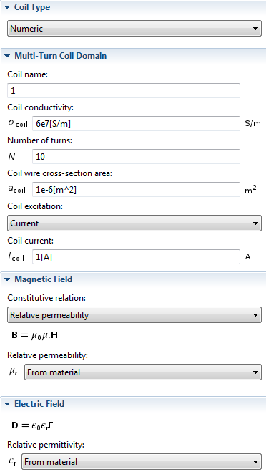

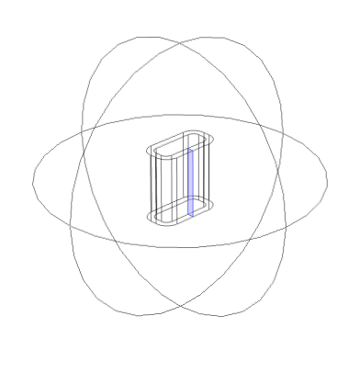
Using multi-turn coil domain: Numeric

Slide 47
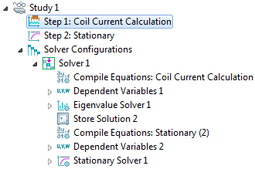
Study settings for numeric multi-turn coil
Add this step manually from Study 1 > Study Steps
Drag this step up and ensure that it is located above Step 2: Stationary under the Study branch
COMSOL will automatically setup the appropriate solvers
An eigenvalue solver will first compute the direction of current flow in the coil domain
This information will be then used in the stationary solver

Slide 48
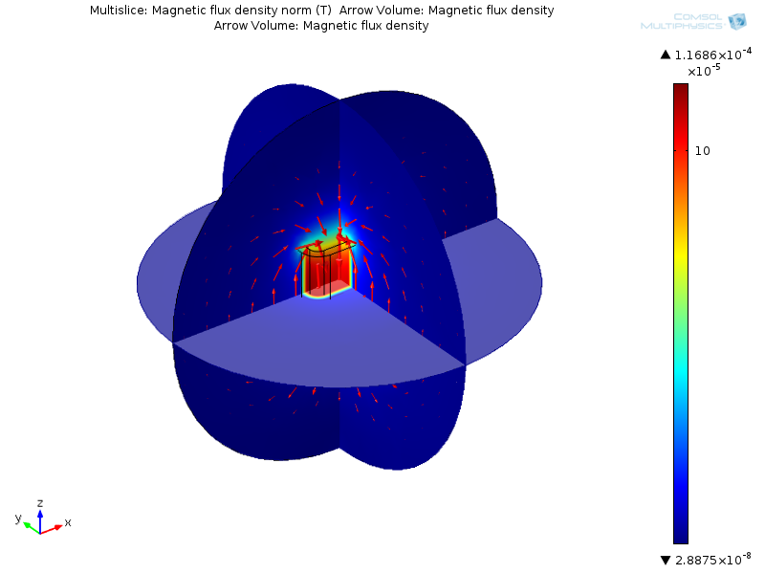
Results – Magnetic flux density
Inductance = 2.88e-6 H

Slide 49
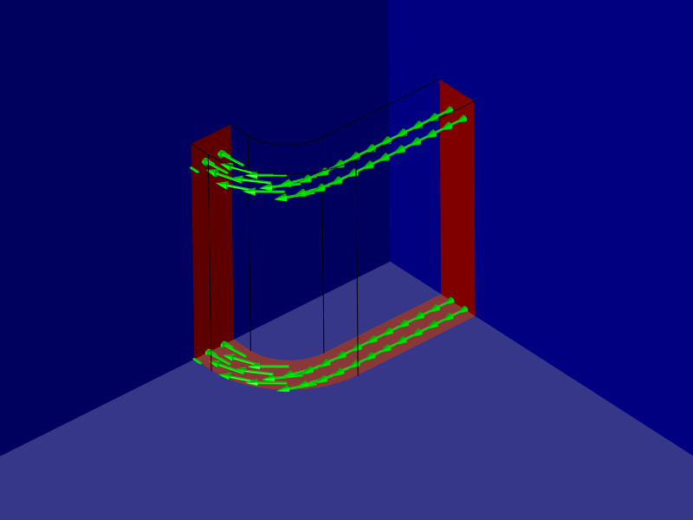
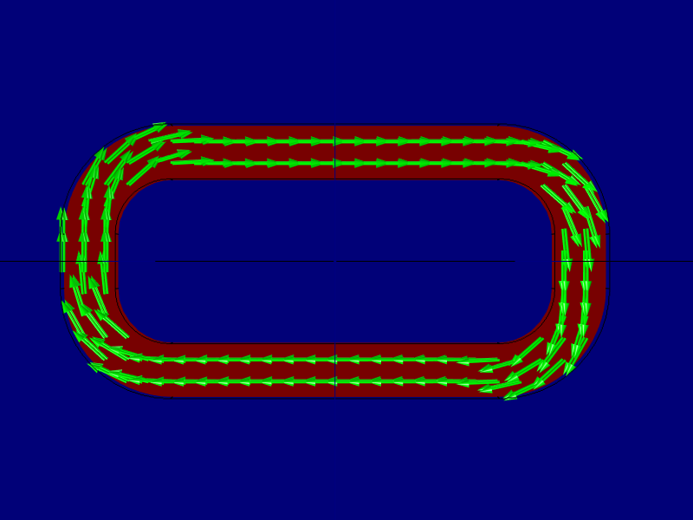
Results – Current density
xy-view
Resistance = 0.039 Ω

Slide 50
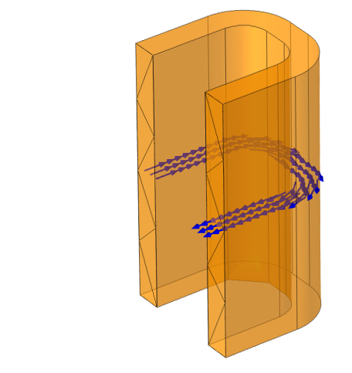
Using symmetry – 1/2
Coil resistance and inductance is 2 times the computed value
Need to use three boundary conditions for a numeric multi-turn coil domain
  Electric insulation: current is parallel to these surfaces
  Input: inlet surface for current flow
  Output: outlet surface for current flow
Input
Output

Slide 51
Modeling in COMSOL
For detailed modeling steps, see the following file:
  multi_coil_numeric_symmetry_half.mph
This model shows the DC case

Slide 52
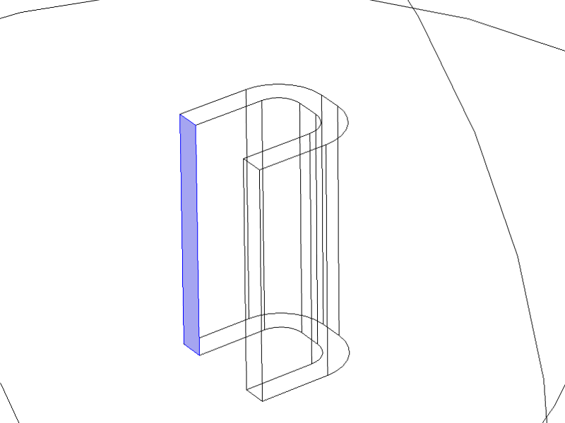


Using multi-turn coil domain: Numeric
All other settings are identical to the full 3D model

Slide 53

Results – Magnetic flux density
Inductance = 2.88e-6 H

Slide 54


Results – Current density
xy-view
Resistance = 0.039 Ω

Slide 55

Using symmetry – 1/8th model
Coil resistance and inductance is 8 times the computed value
Need to use three boundary conditions for a numeric multi-turn coil domain
  Electric insulation: current is parallel to these surfaces
  Input: inlet surface for current flow
  Output: outlet surface for current flow
Input
Output

Slide 56
Modeling in COMSOL
For detailed modeling steps, see the following file:
  multi_coil_numeric_symmetry_octant.mph
This model shows the DC case

Slide 57




Using multi-turn coil domain: Numeric
Use half the number of turns since we have cut the geometry by half along the length of the coil

Slide 58

Results – Magnetic flux density
Inductance = 2.88e-6 H

Slide 59

Results – Current density
Resistance = 0.039 Ω

Slide 60

Note on cross section area
A
A’
B
B’
Longitudinal cross-section area must be constant
Coil Current Calculation study computes the local current direction
It will not compute the local cross-section area
This information is obtained from the area of the “input” boundary
This means that current will not be conserved if the coil cross-sectional area changes along the current path
Sections AA’ and BB’ have significantly different cross section area

Slide 61
Which coil modeling option to choose?
The Linear and Circular coil options are special cases
You can use the Numeric coil option to model linear or circular coils
Remember to add a Coil Current Calculation study whenever you use a Numeric coil

Slide 62

Multi-turn coil – User defined
For general case
Geometry need to form a closed loop
Need to specify coil length
Specify current direction using vectors
  Could be a function of x, y and z coordinates
  We need to ensure that the current direction creates a closed loop
Do not need to add a Coil Current Calculation study step

Slide 63
Summary
This tutorial showed how to use the 3D single-turn and multi-turn coil domain features
New modeling features
  Gap feed, Boundary feed, Reference edge, Input, Output
Considerations while drawing geometry
  Need to create additional internal boundary for Single-turn coil domain with Gap feed and Numeric type Multi-turn coil domain
Study set up
  Coil Current Calculation study required only for Numeric type Multi-turn coil domain
DC vs. AC
  Meshing
  Convergence tips

