Slide 1
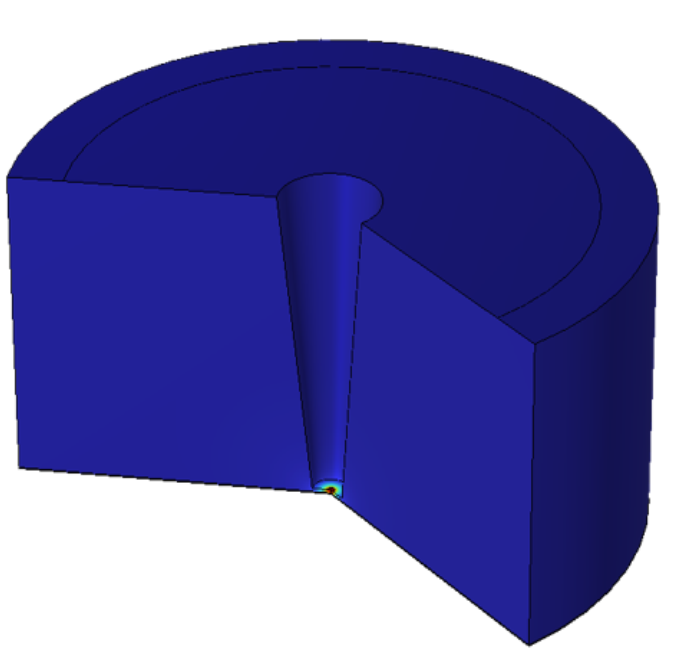
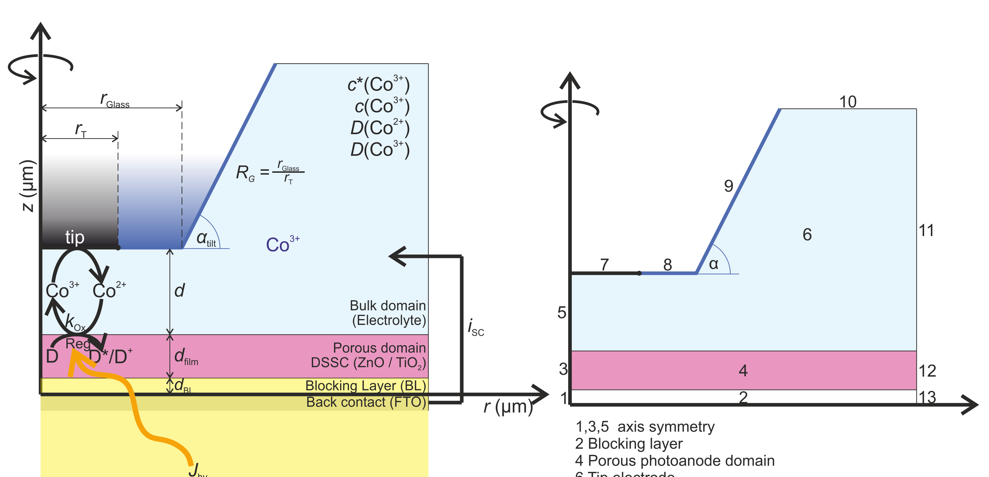
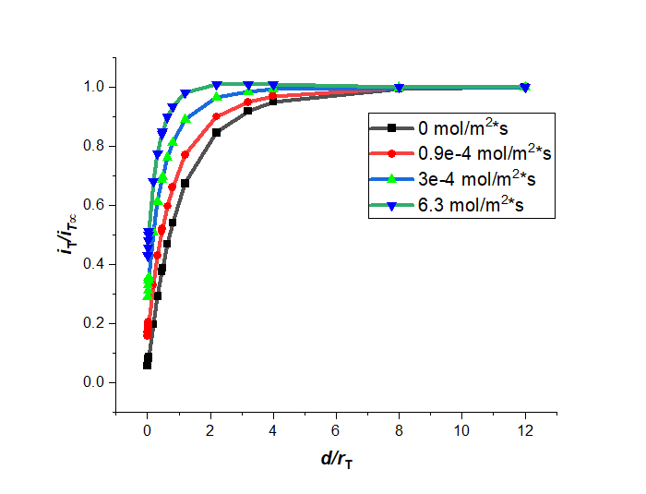
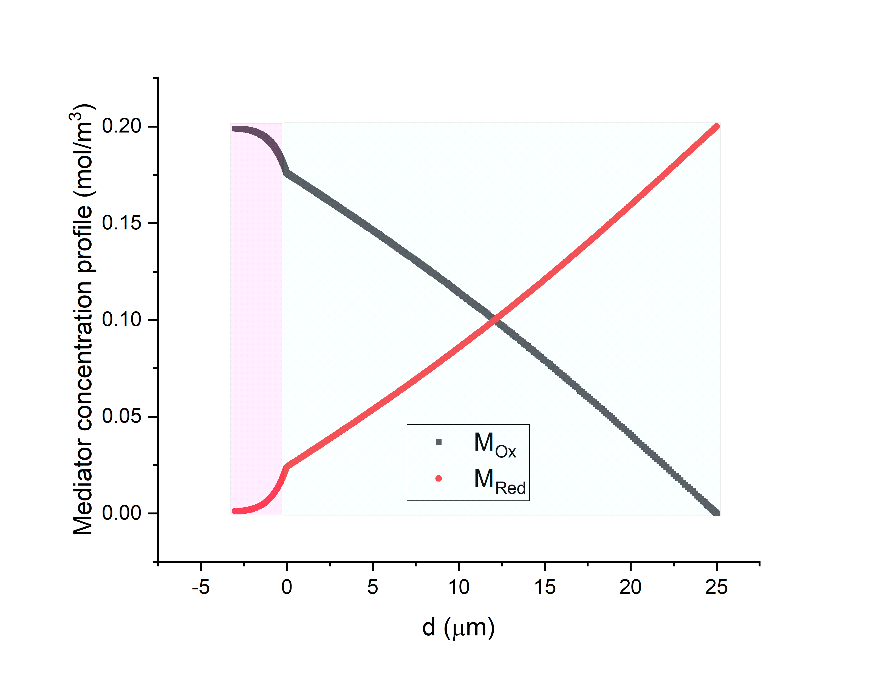
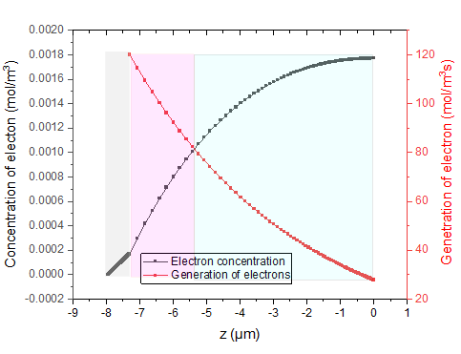
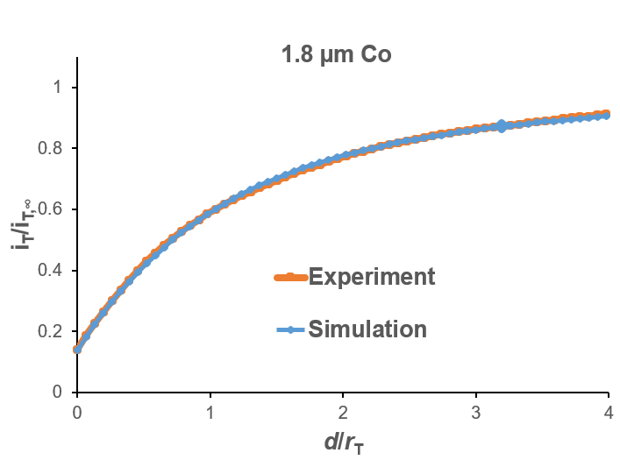

Kinetics of Dye Regeneration in Photoanodes of Dye-Sensitized Solar Cells
Wasiu Abidemi Hamzat, Gunther Wittstock, Dmitry Momontenko,Marius Muhle
The simulation describe diagnostic experiments of photoanodes with scanning electrochemical microscopy (SECM) with the aim of extracting the maximum information content from experiment.
Institute of Chemistry, Carl von Ossietzky University of Oldenburg, D-26111, Germany
contact: wasiu.hamzat@uol.de;
Cooperating partner: Institute of Applied Physics, Justus-Liebig University of Giessen.
Introduction
An approach curve obtained by scanning electrochemical microscopy (SECM) represents the electrolysis current for a mediator at microelectrode as function of sample-microelectrode distance. It contains information about the reaction rate by which the mediator is regenerated at the sample -- here the illuminated photoanode from a dye-sensitized solar cell. Quantitative relations are available for flat electrodes, the overlapping effects of electrode porosity, decaying light intensity on the sample, loss mechanisms in the porous semiconductor on the microelectrode current have not been understood quantitatively. The simulation are made to understand the steady state behavior and also the time-dependent behavior for intermittent illumination which is expected to contain more kinetic information of the studied system. Our simulation describes the process of light absorption, electron injection into the conduction band, dye regeneration by the mediator, loss processes.
Computational Method
Lambert-Beer Law
Physic 1
Physics 2: (e_{CB})
Boundary conditions
At z=-d_film
(back contact) [e_{cB}]=0,
At symmetry
At tip, J_{Mox}=k_{T}[M_{Ox}], R_{MRed} =- k_{ox}[M_{Ox}], k_{T}= 1 m/s
Generation of e_{CB}
Re_{CB}= α J_{hv}e⁻ ^{α z}
Initial condition: [e_{cB}]=0
To be done
consumption terms (loss mechanisms)
Electron injection, photoxidation of dye
Diffusion of dilution species (M_{Red}, M_{Ox})
Boundary conditions
Bulk boundaries: 10, 11
D_{MOx}= D_{MRed}= D_{e-}= 9.1E-10 m²/s,
c_{Mox}=1 mM, c_{Red}=0, r_{T}=25 µM
5,3,1,13,12, no flux
Porous domain
Porosity (por) = 0.6, α = 0.2µm,
K_{eq}=50m²s/mol, D_{por}=D[M_{Ox}]por^{1.5}
Reactions in the porous domain
R_{Mox} =k_{ox}[Dye⁺][M_{red}], R_{MRed} =k_{ox}[Dye⁺][M_{red}], k_{ox}= 10 m³/(smol), D_{dye}=1E-20 m/s,
[Dye] > >
[Dye⁺]
(From experiment)
Dye regeneration by mediator
Figure 1: Simulation model and geometry.
Diffusive mass transport for M_{Red}, M_{Ox}, e_{CB}
Microelectrode current
Simulation results
Figure 3: Concentration of profile of mediator and calculated conduction band electrons along a symmetry axis.
Figure 2: Approach curves with increasing intensity of light of photoanode and its comparison with experiment at 1.8 µm
[1] R. Ruess, S. Scarabino, A. Ringleb, K. Nonomura, N. Vlachopoulos, A. Hagfeldt, G. Wittstock, D. Schlettwein; Phys. Chem. Chem. Phys. 2019, 21, 13047-13057
[2] S. Scarabino, PhD Thesis, University of Oldenburg, 2020
{3] S. Scarabino, K. Nonomura, N. Vlachopoulos, A. Hagfeldt, G. Wittstock; Electrochem 2020, 1, 329-343
[4] H. Ellis, I Schmidt, A. Hagfeldt, G. Wittstock, G. Boschloo; J. Phys. Chem. C 2015, 119, 21775–21783.

