Slide 1
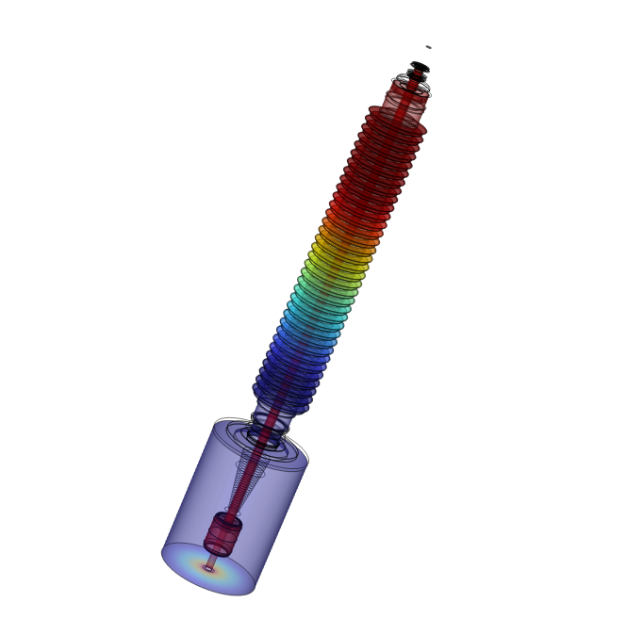
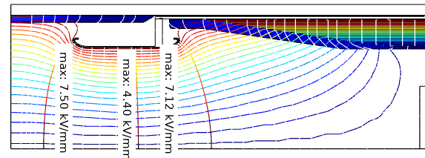
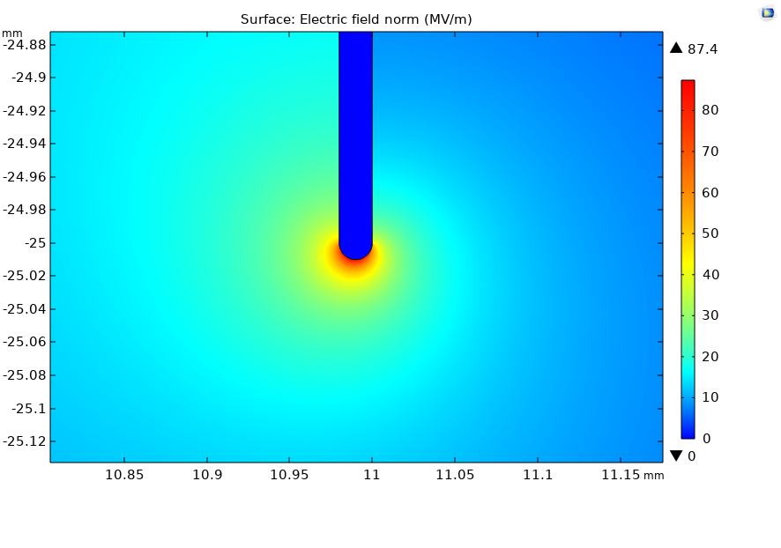

Dielectric Design Validation Through Electric Field Study of Condenser Type Bushing
Dielectric field for condenser type high voltage bushings which are capacitive graded is studied through electrostatic problem. Capacitive graded field simulated by mean of sub model or virtual foil. Maximum field at coated electrode due to nearby ground plane or electrode is determined.
Mitalkumar Ladani
Technology center (Product development engineer), Hitachi energy India limited, Vadodara, India
Abstract
As reliability of transformer is highly dependable on high voltage condenser type bushing, there is need to design bushings with low dielectric stress to insure the large lifespan of components. It is analytically not possible to predict or analyze the stresses generated at foil edges, tangential stress at core surface, point stresses on stress reliving electrode or nearby ground electrodes. It is design essential to evaluate this parameter to successfully pass type test and reliable operation on field. Low frequency electrostatic standard FEM problem is solved to derive necessary result parameters. Foil used for capacitive grading is of 80-120 micron which has limitation in meshing due to large geometry difference ratio. Sub-model approach where few of the foil edges are simulated to have higher accurate simulation. Guidelines for tangential field on core surface, maximum stress on oil shield, partial discharge inception on foil edges are established through simulation.
Methodology
2-D axis symmetry model is used for dielectric problem to reduce the simulation time. Capacitive graded foils are either modelled by floating potential or anisotropic material property. To see the effect of nearby ground plane on bushings, transformer turret is modelled. Recommended turret dimensions could be optimized by allowable maximum stress on oil side high voltage electrode. Boundary PDE and transport of diluted species physics is used to evaluate the stressed oil volume and cumulative stress over field lines for high voltage to ground plane. Stressed oil volume which is criteria for large oil gaps in transformer is being evaluated to check permissible stress on oil shield.
Figure 1. Typical maximum electric field at oil side high voltage electrode while mounted on grounded transformer turret
Results
FEM numerical simulation plays vital role in defining the design criteria for HV condenser bushing where effect of foils on partial discharge inception voltage is concerned checkpoint for reliable design which are illustrated in figure 2. To optimize the transformer turrets and reduce the effect of nearby earthed plane, simulation gives reliable option to look for optimized HV electrode geometry as well as choosing right dimension of turret to safe operating stress limit. Simulation also adds the validation for upper insulation maximum stress under Lightning or switching for different type of sheds or different insulation material like porcelain or silicone or epoxy. HV bushing design criteria like tangential field on core can be predicted which is major cause of failure under HV energy discharge.
Figure 2 Typical maximum Point stress on ground foil edge
IEC 60137-2017 Insulated bushings for alternating voltages above 1 000 V

