Slide 1
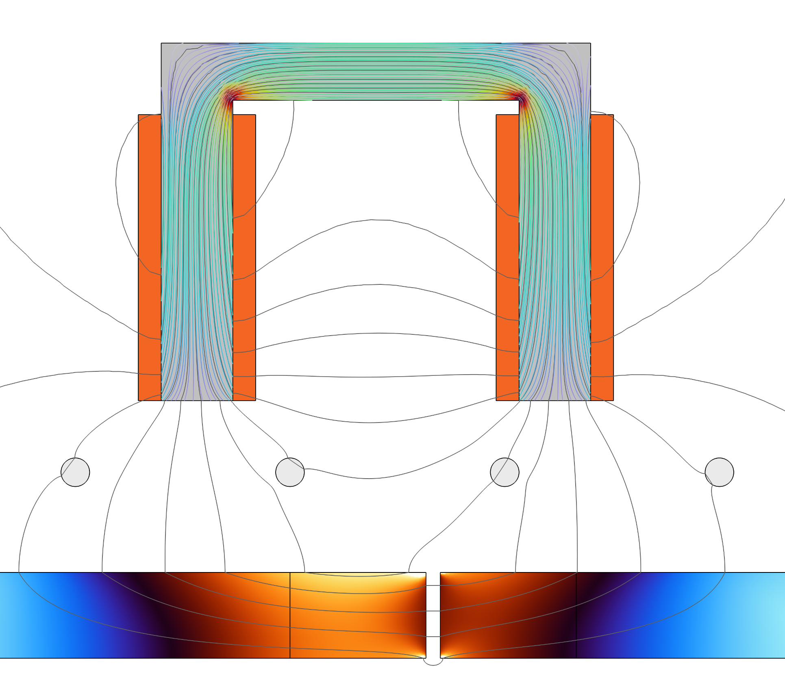
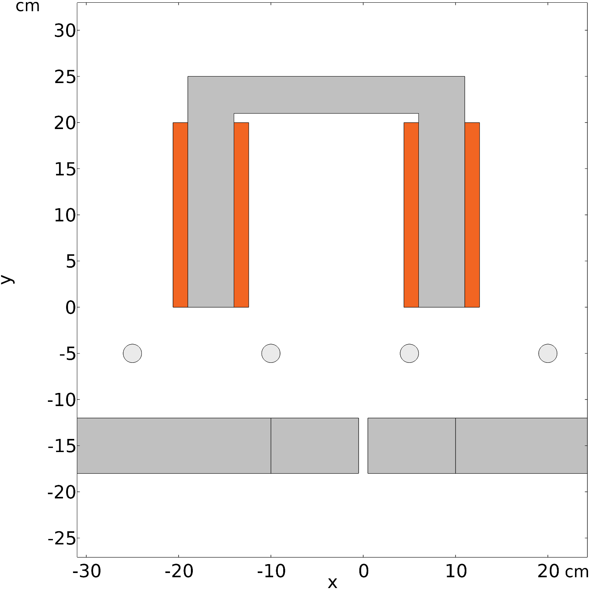
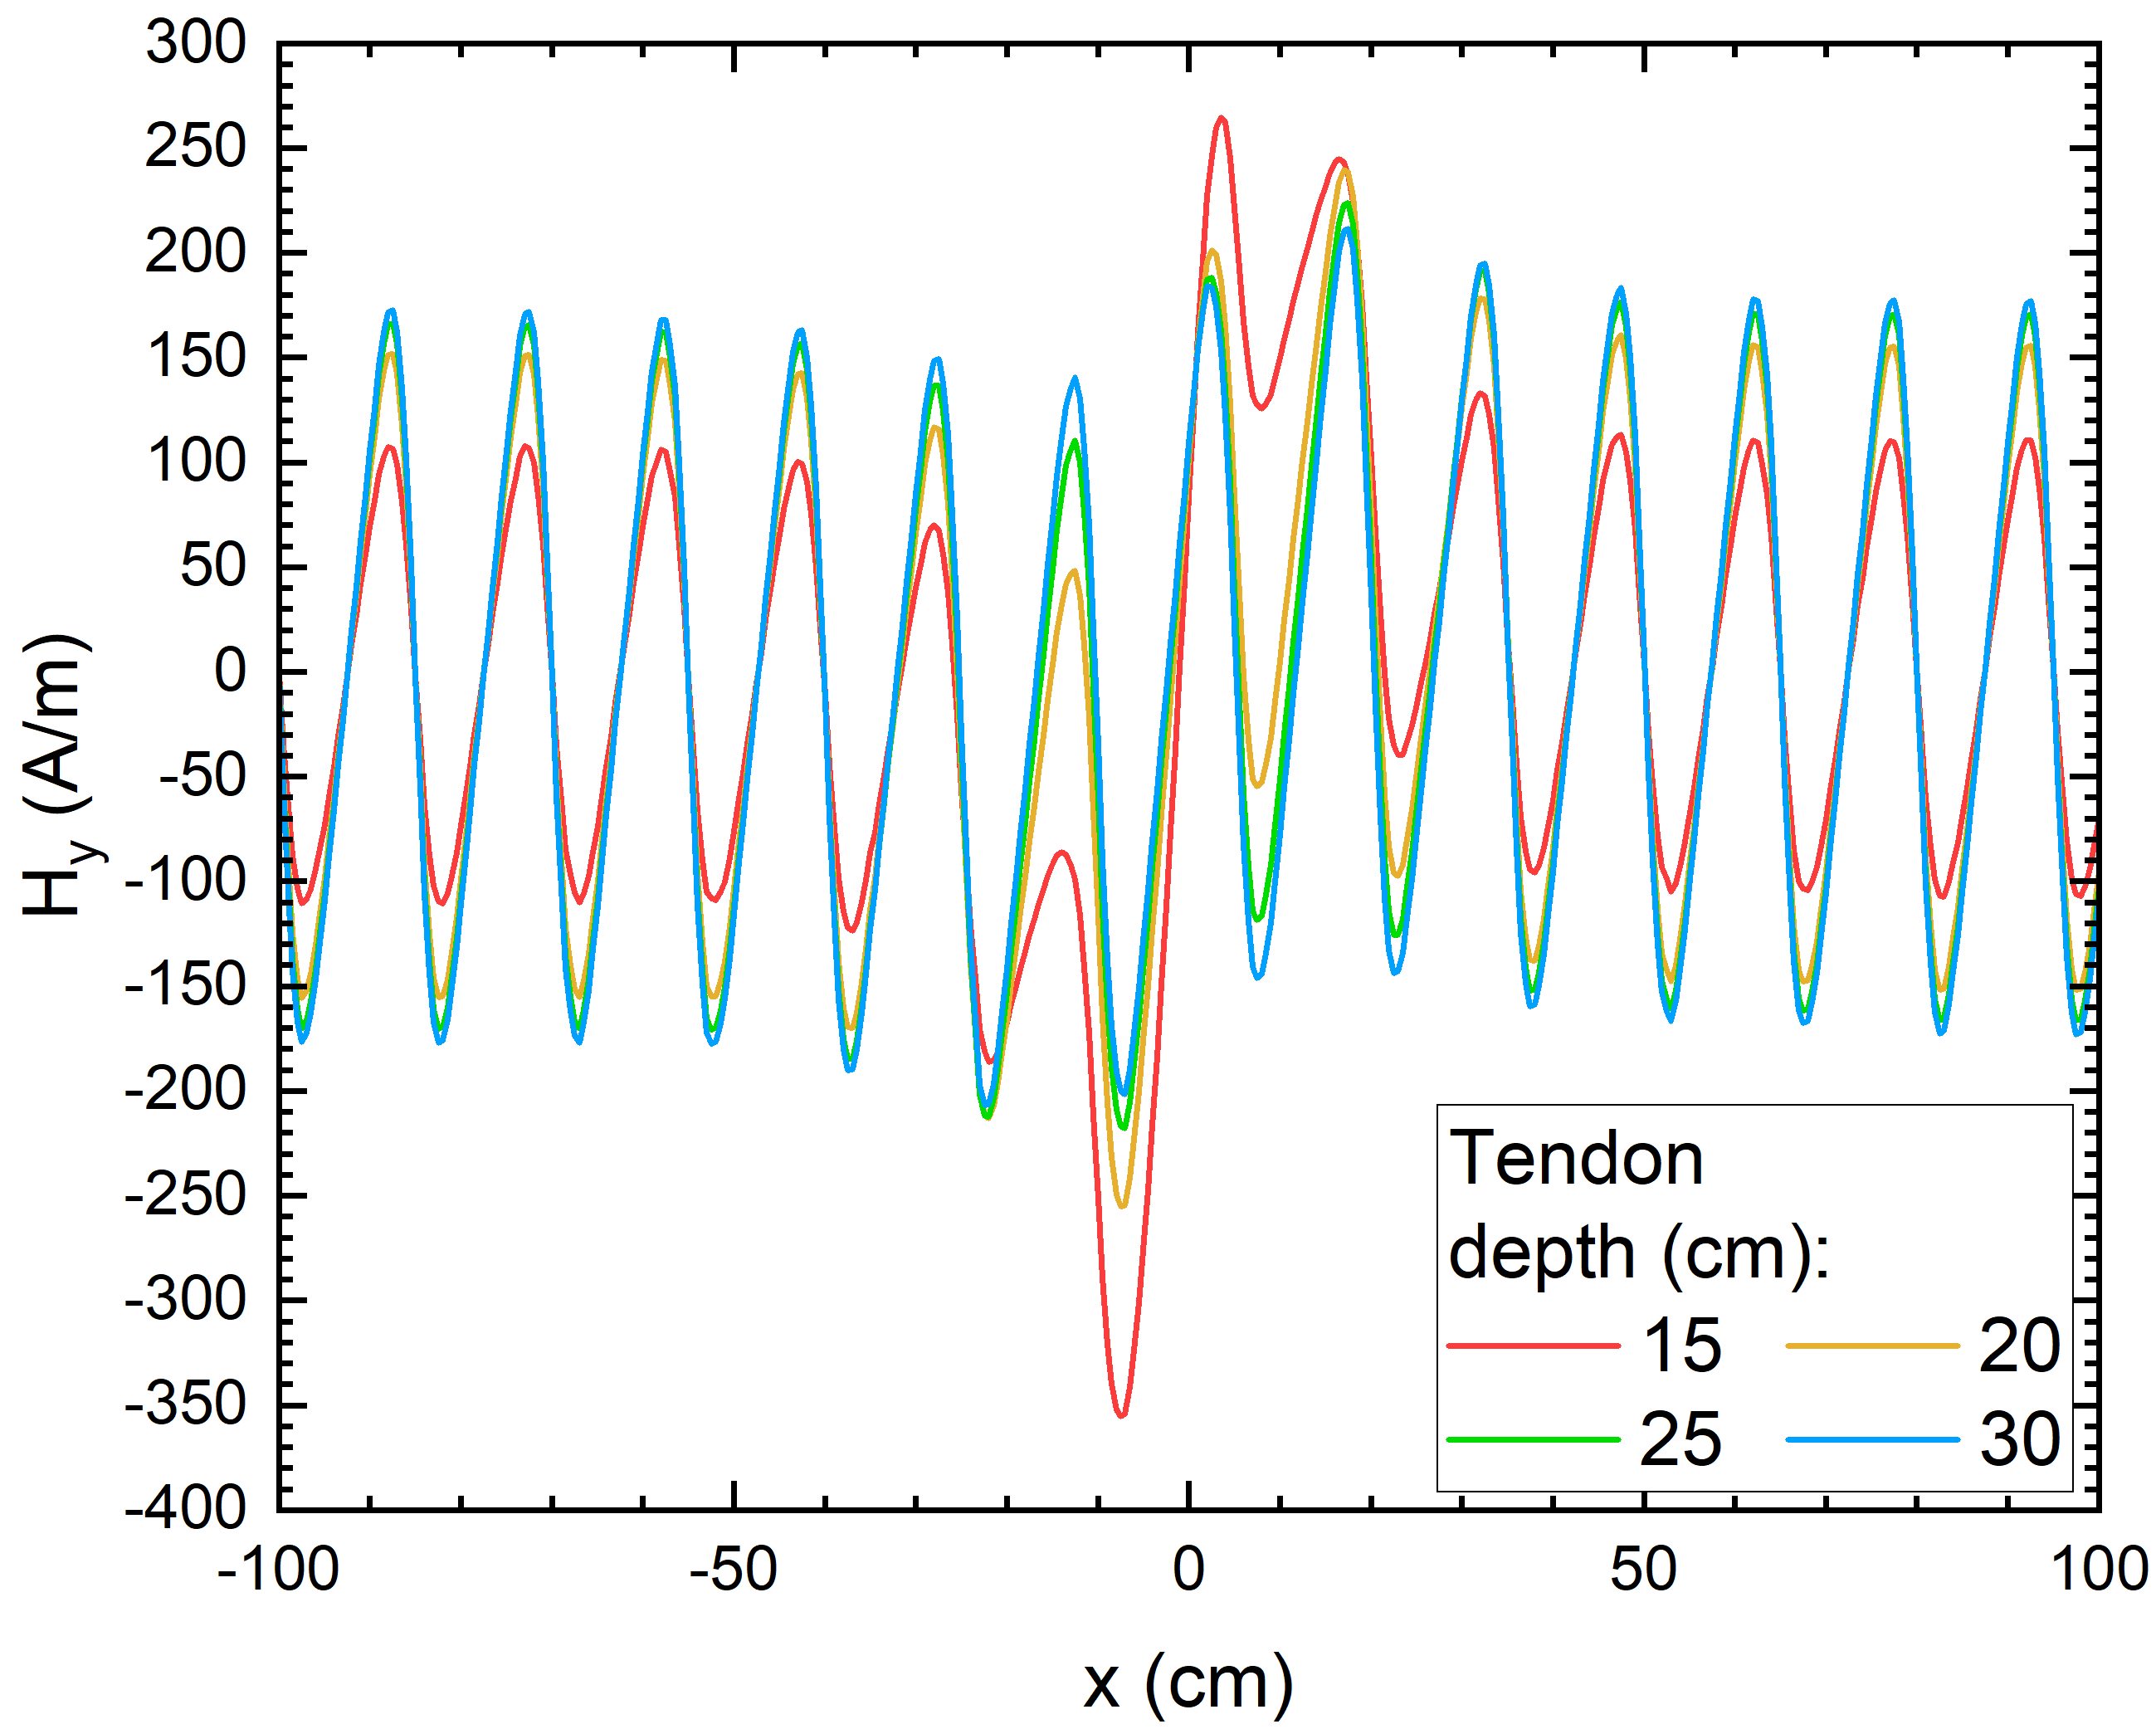
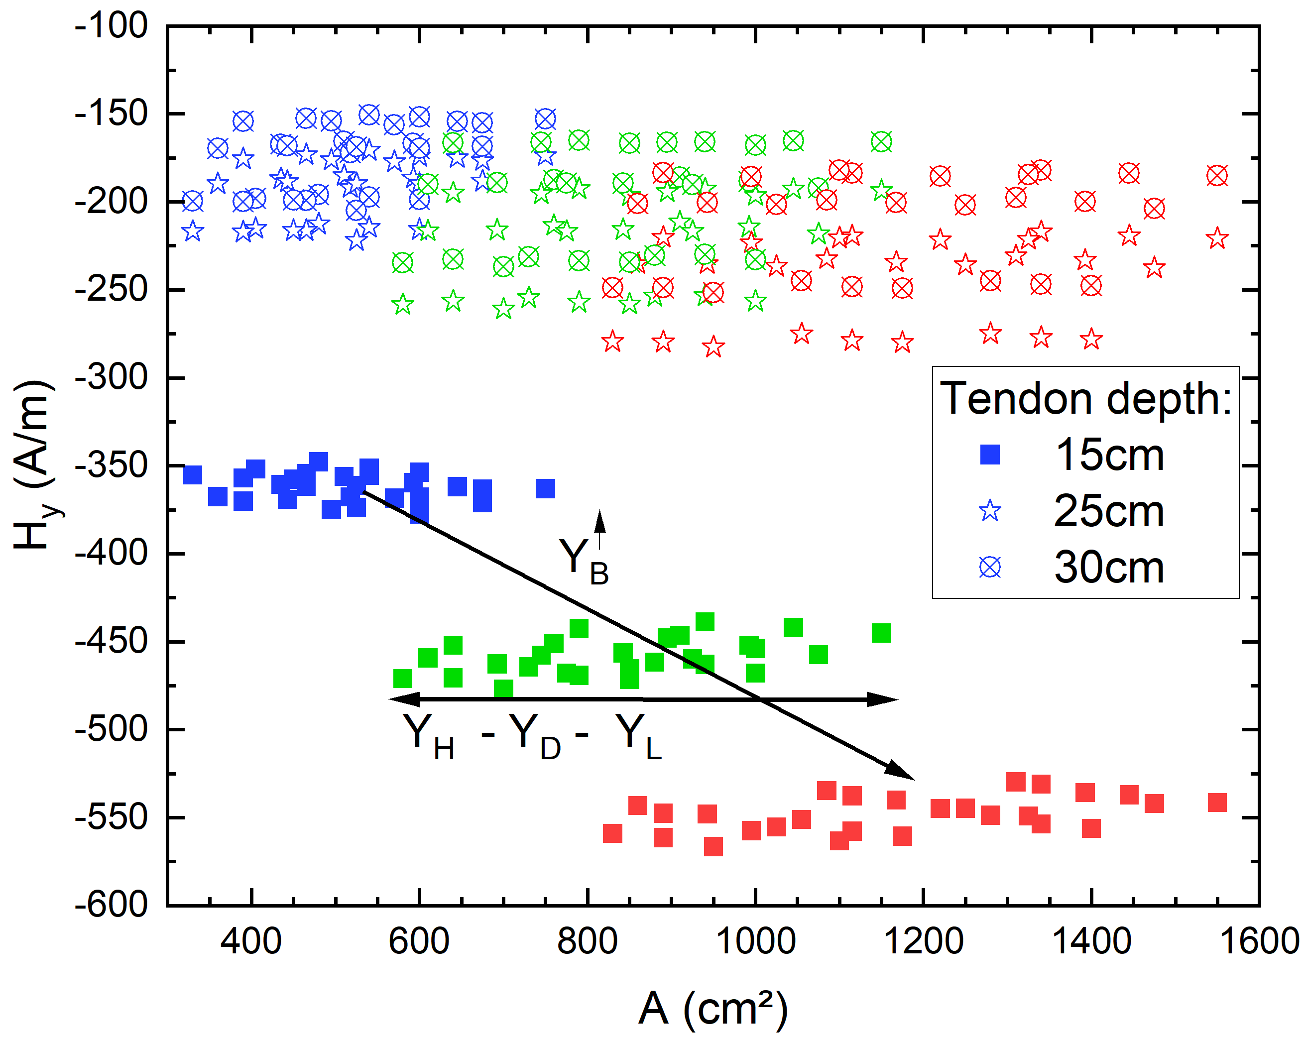
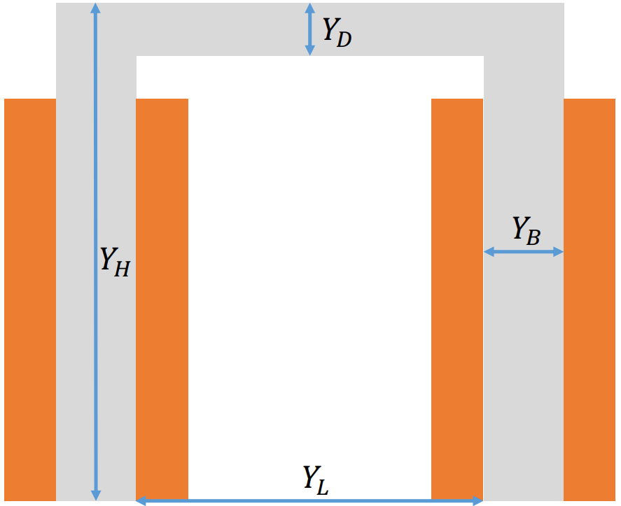

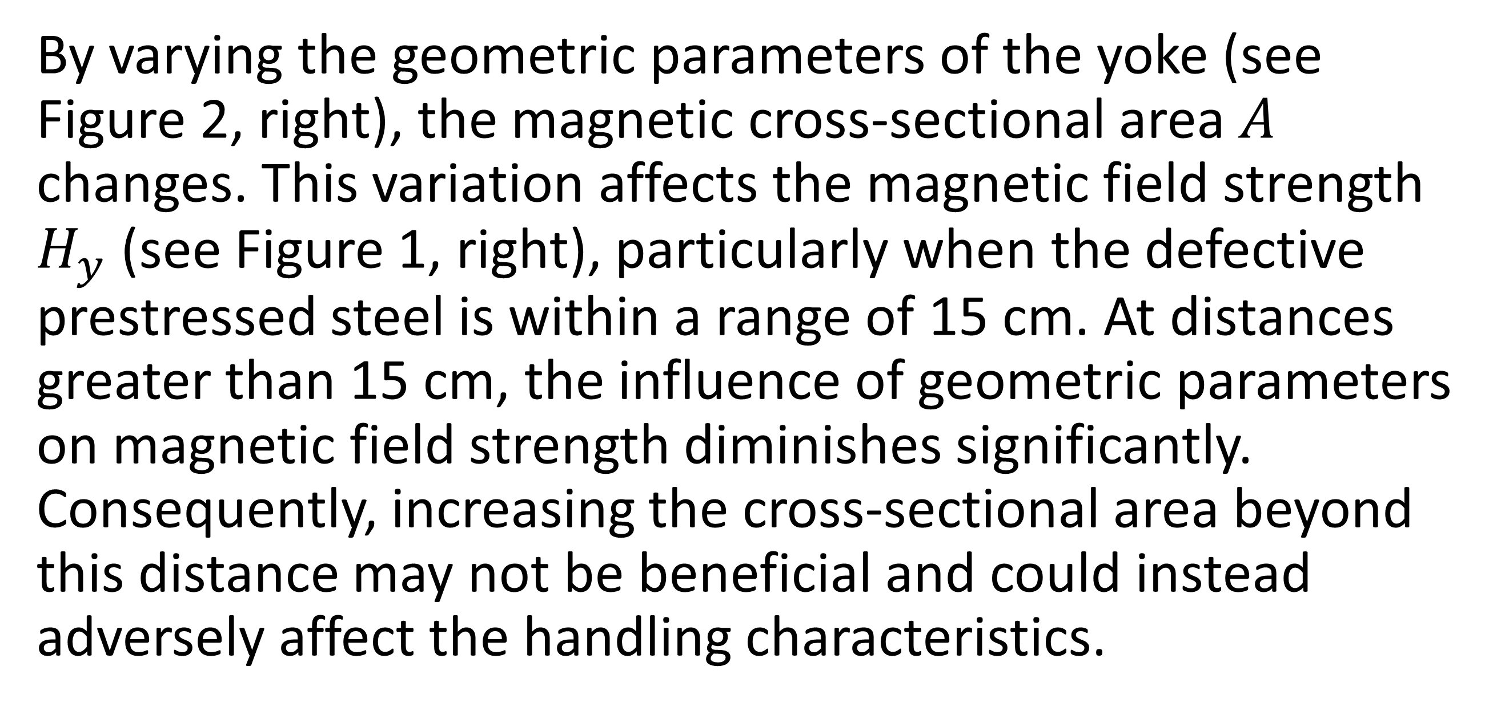
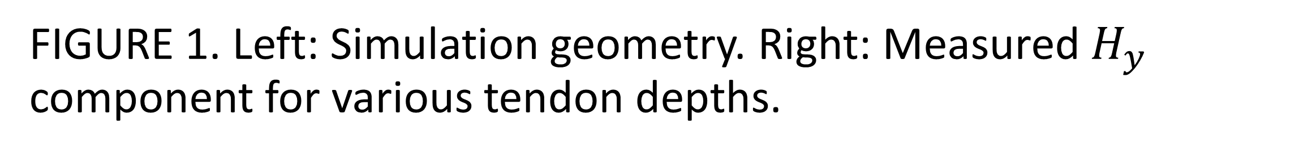
Defect detection in deep-seated tendons using MFL
Design optimization of a magnetic flux leakage (MFL) sensor for the detection of flaws in prestressed tendons buried at critical depths greater than 20 cm.
S. Thieltges¹, C. Zimmer¹, D. Meiser¹, L. Lauck¹, S. Youssef², K. Szielasko¹
Fraunhofer Institute for Nondestructive Testing IZFP, Saarbrücken, Germany
Institut Dr. Foerster GmbH & CO. KG, Reutlingen, Germany
Introduction and Goals
Prestressed tendons are a critical component in construction, contributing to enhanced load-bearing capacity and reduced cracking in concrete structures. However, due to material-related factors, individual strands may corrode and fracture (defects). Magnetic flux leakage (MFL) has proven to be an effective method for defect detection in non destructive testing. A significant challenge lies in detecting defects at depths greater than 20 cm, where detection accuracy is primarily influenced by the design of the MFL sensor.
U shaped yoke
Methodology
The MFL detection system, comprising a U-shaped DC electromagnet and a point probe serving as a Hall effect sensor, is modeled in 2D within a static time domain. Batch sweeps are utilized to vary both the scanning position of the MFL sensor over the specimen and the geometry of the electromagnet. Additionally, the ferromagnetic hysteresis behavior of the involved materials is incorporated into the model.
Coils
Reinforcement
Tendon
Defect
FIGURE 1. Left: Simulation geometry. Right: Measured $H_{y}$ component for various tendon depths.
Results
By varying the geometric parameters of the yoke (see Figure 2, right), the magnetic cross-sectional area $A$ changes. This variation affects the magnetic field strength $H_{y}$​ (see Figure 1, right), particularly when the defective prestressed steel is within a range of 15 cm. At distances greater than 15 cm, the influence of geometric parameters on magnetic field strength diminishes significantly. Consequently, increasing the cross-sectional area beyond this distance may not be beneficial and could instead adversely affect the handling characteristics.
FIGURE 2. Left: Results of parameter variation. Right: Schematic drawing and geometrical parameters.
D. Jiles, (2015). Introduction to Magnetism and Magnetic Materials (3rd ed.). CRC Press. https://doi.org/10.1201/b18948
K. Mandal; D. Atherton (1998): A study of magnetic flux-leakage signals. In: J. Phys. D: Appl. Phys. 31 (22), S. 3211–3217. DOI: 10.1088/0022-3727/31/22/006.

