Slide 1
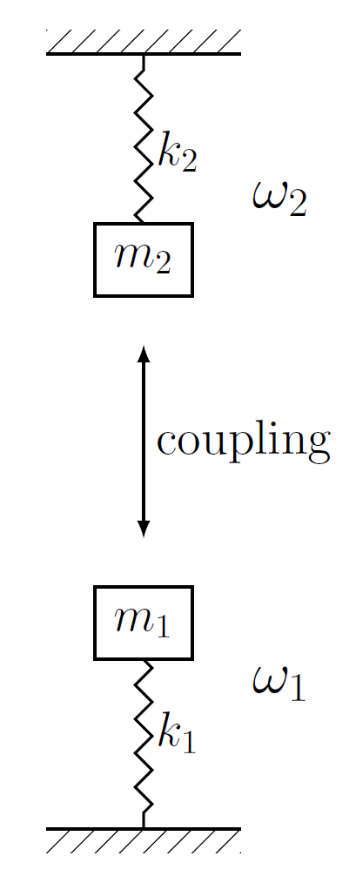
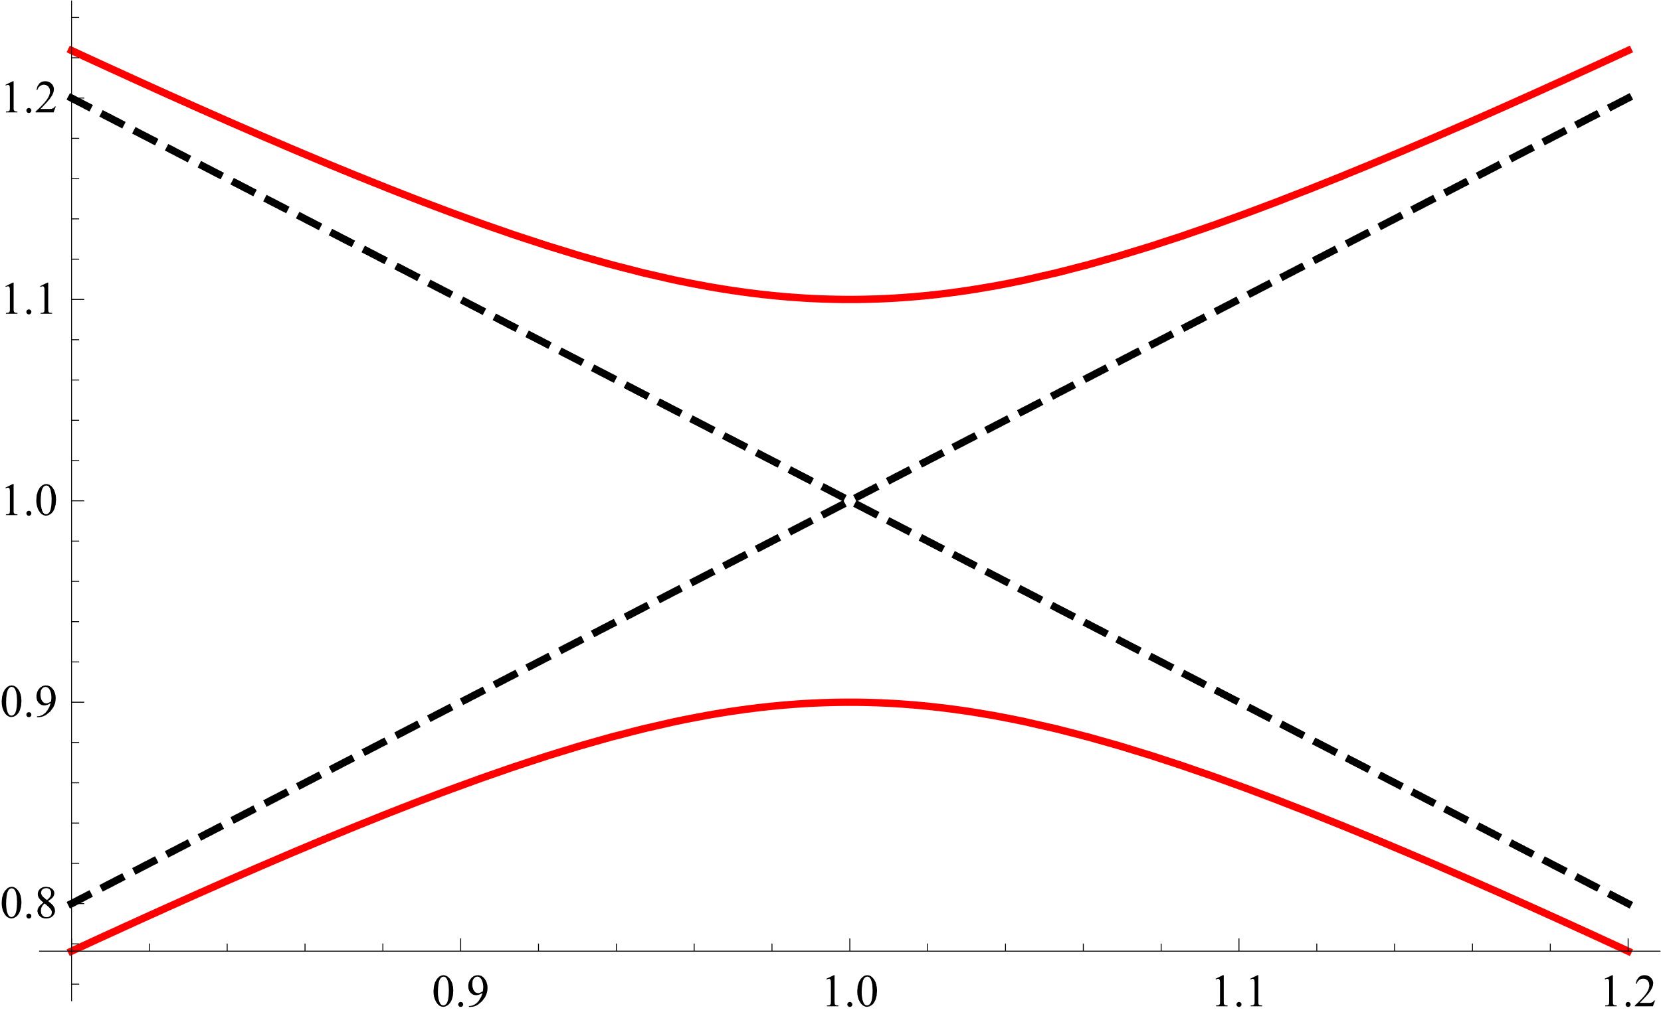
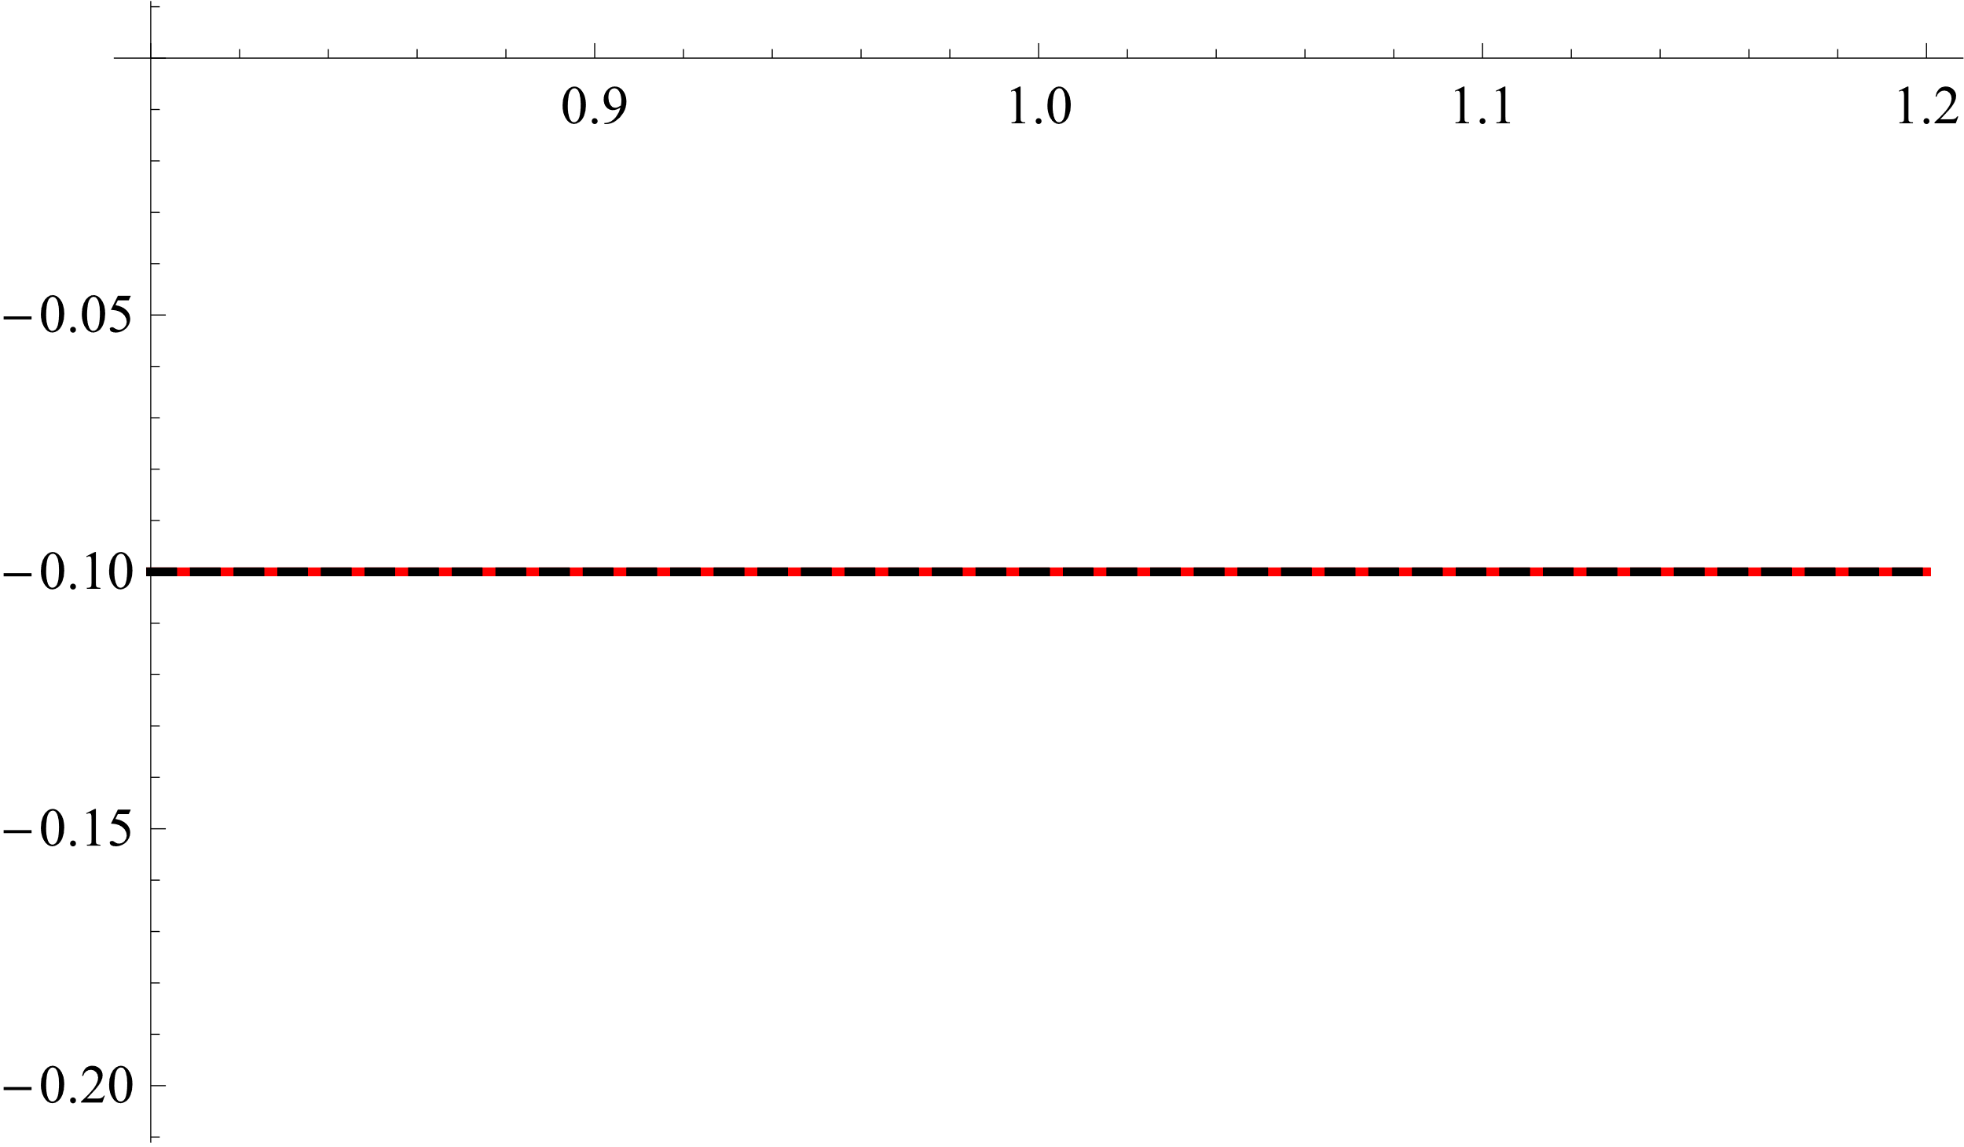
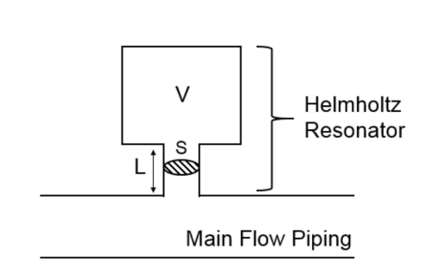
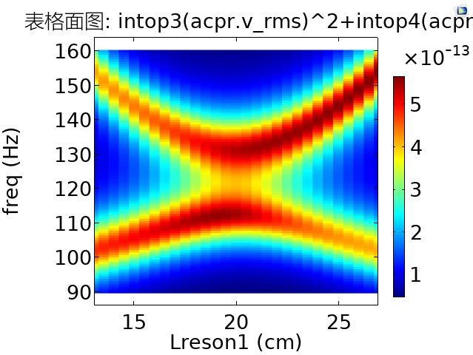
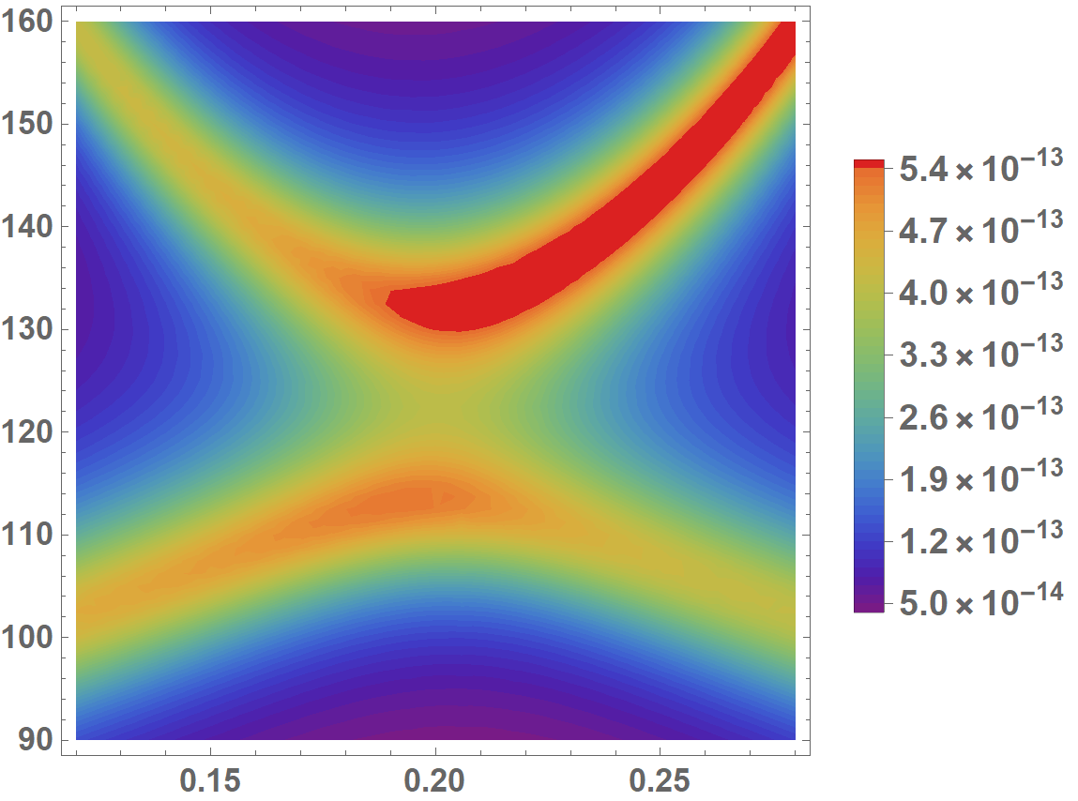
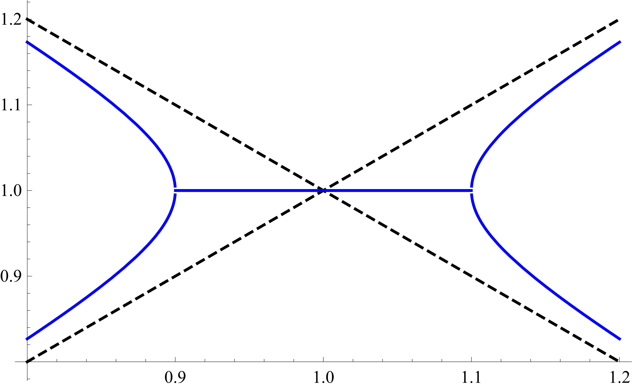
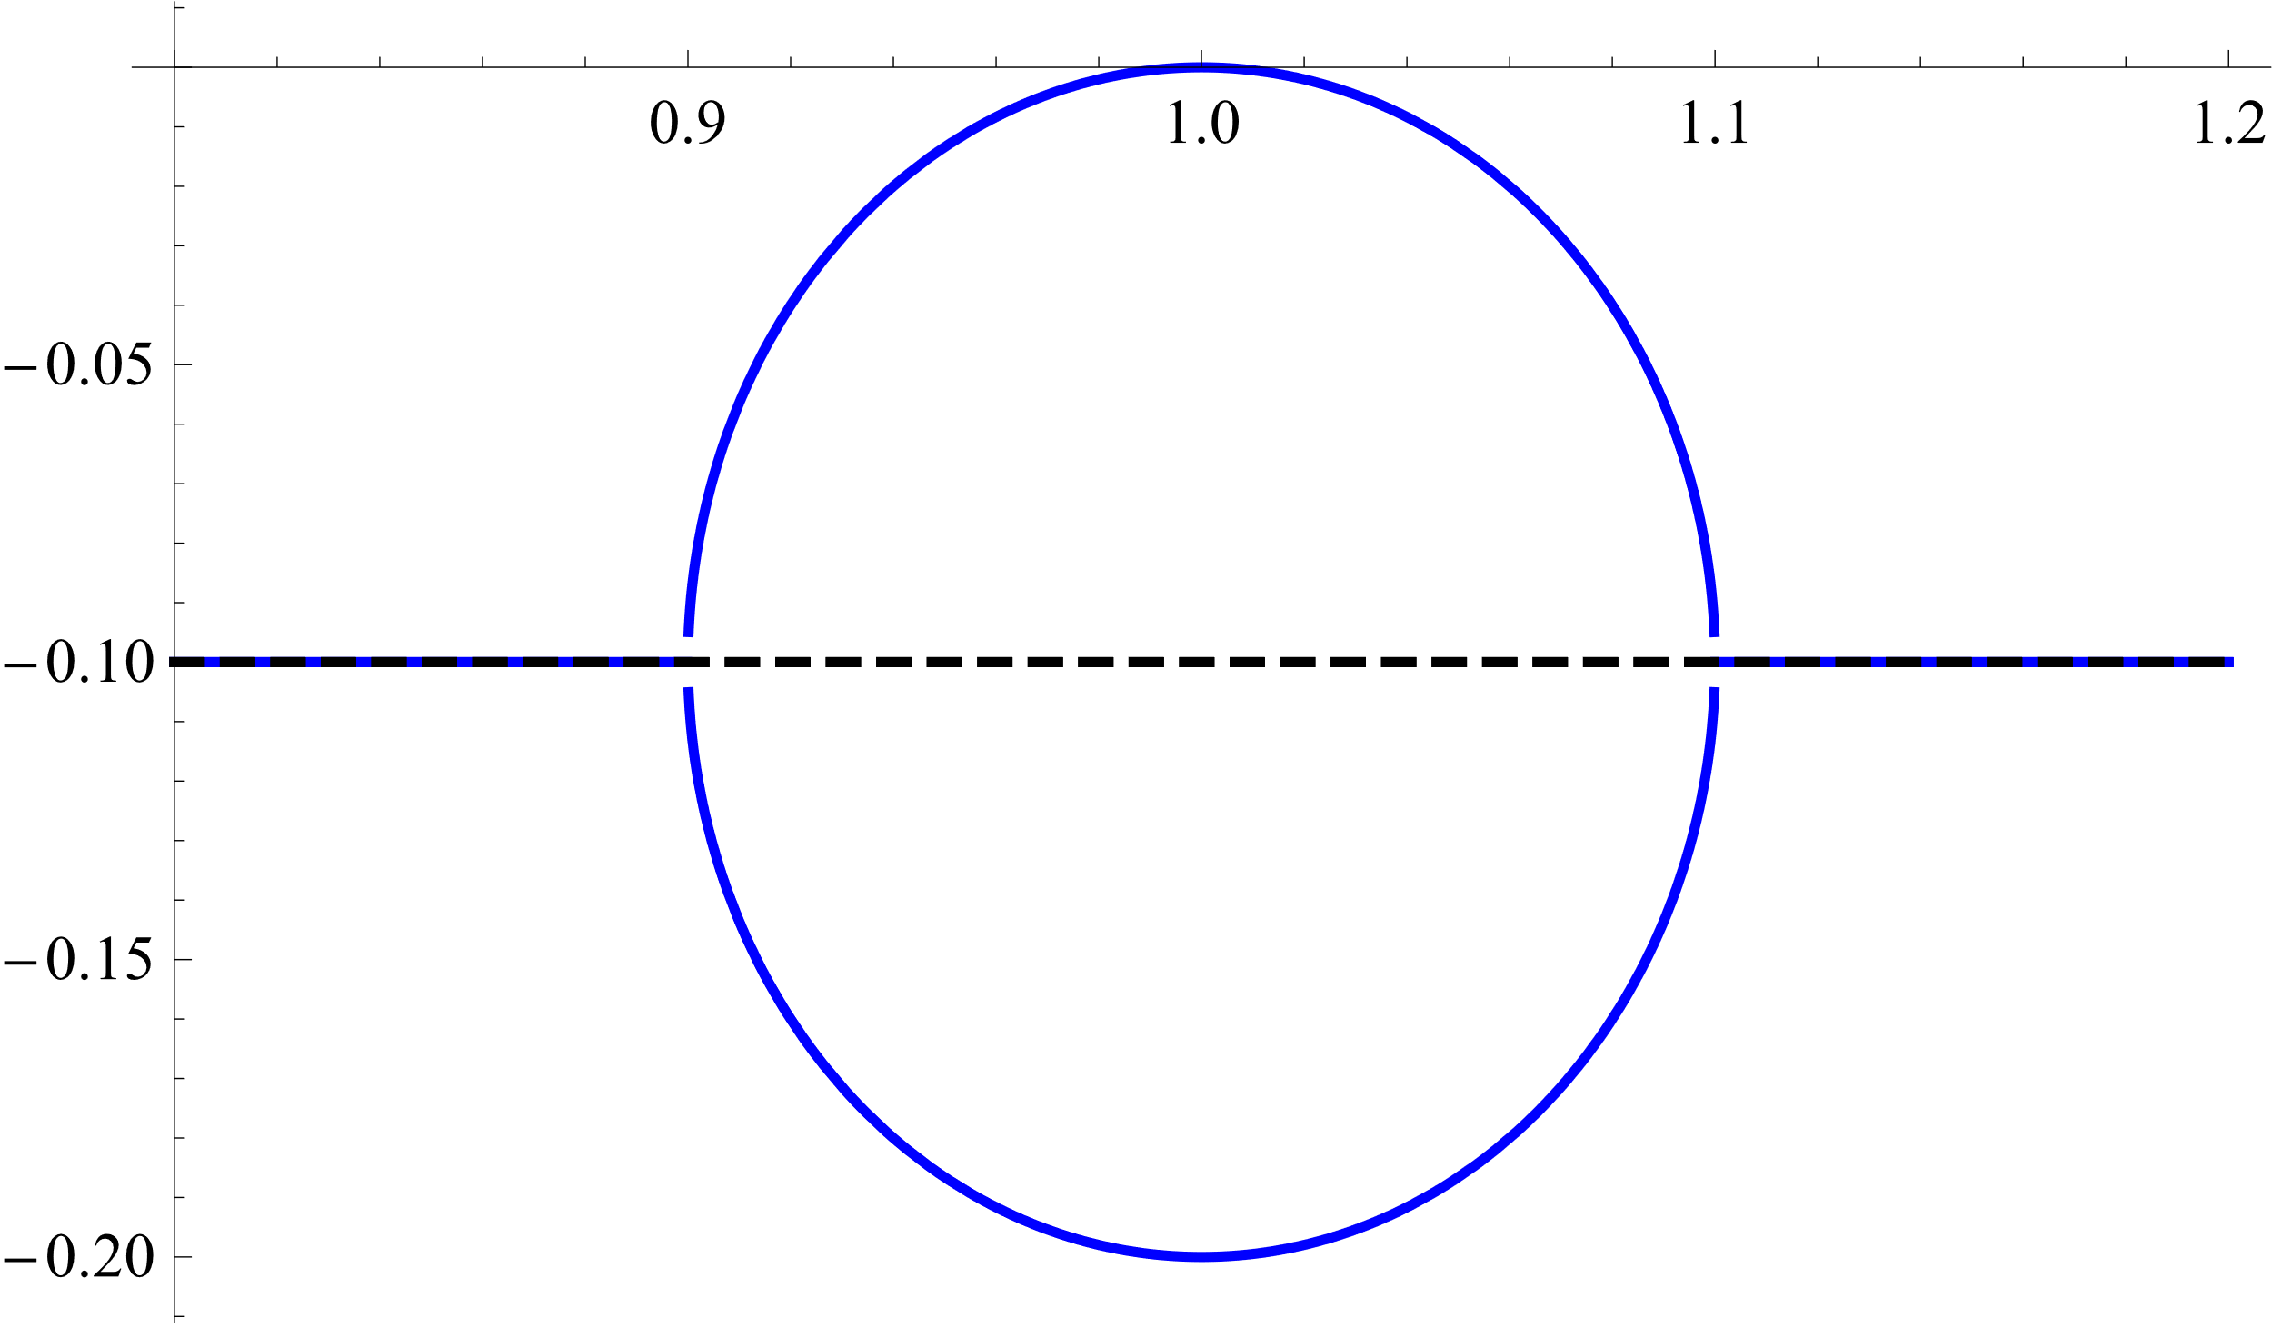
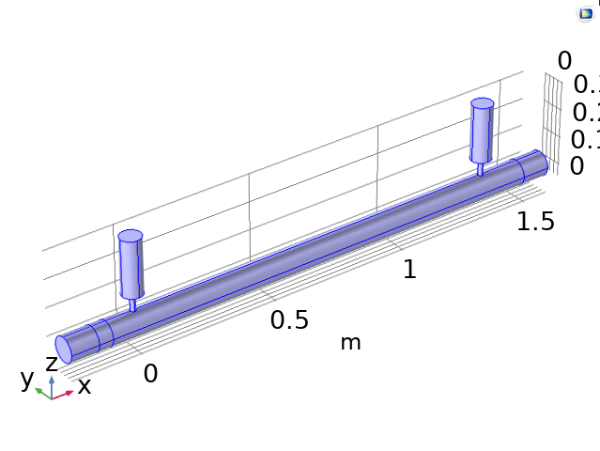
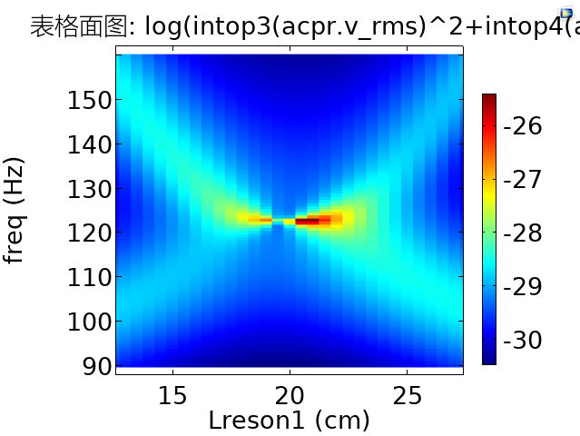
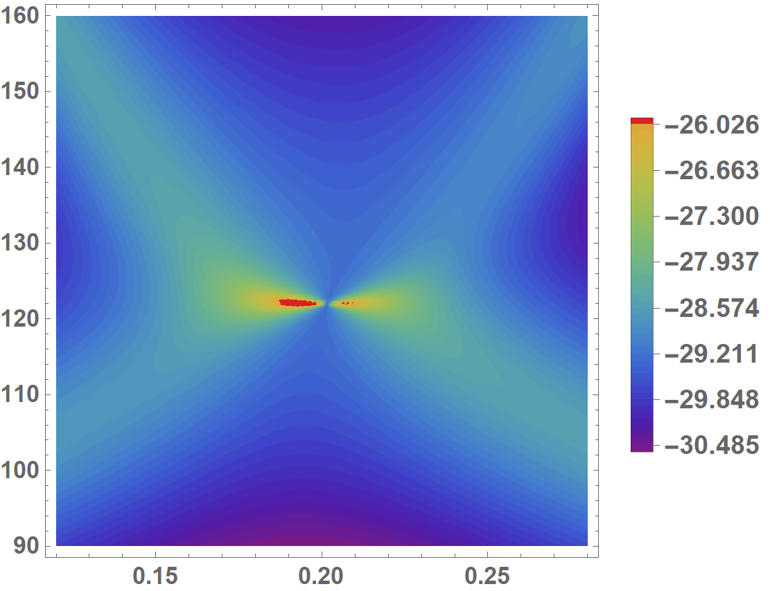
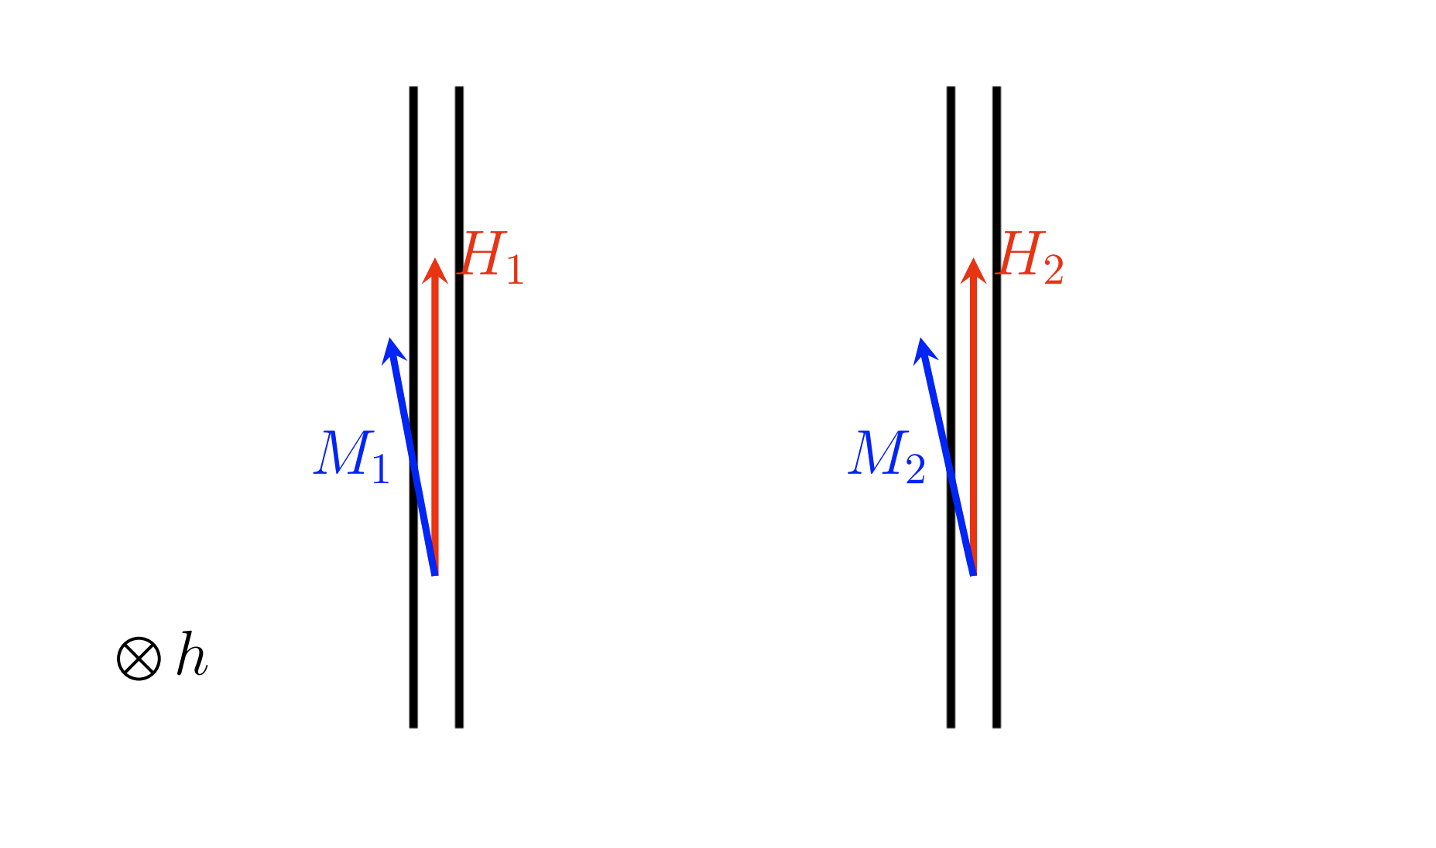
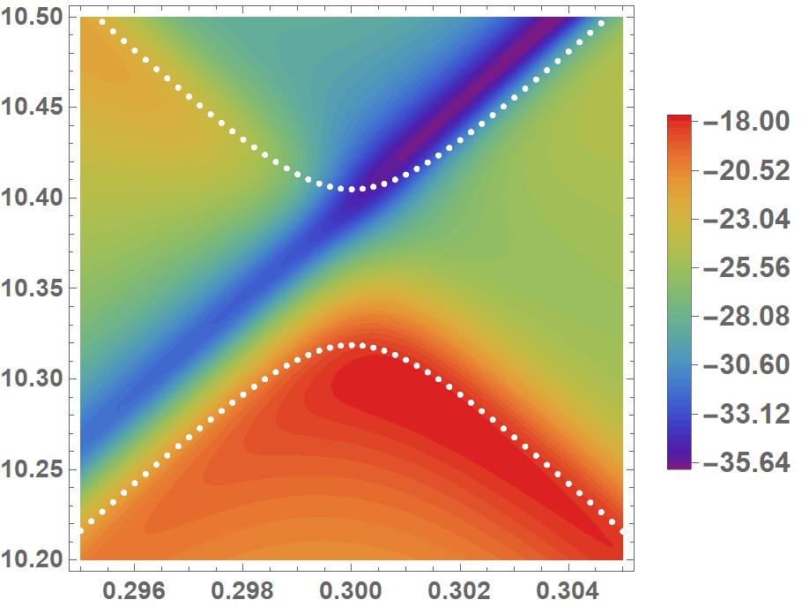
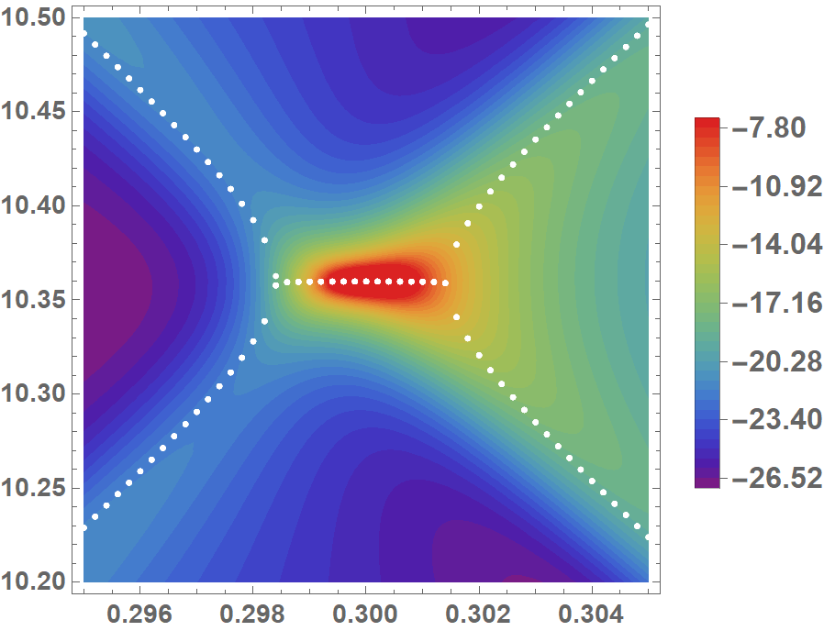
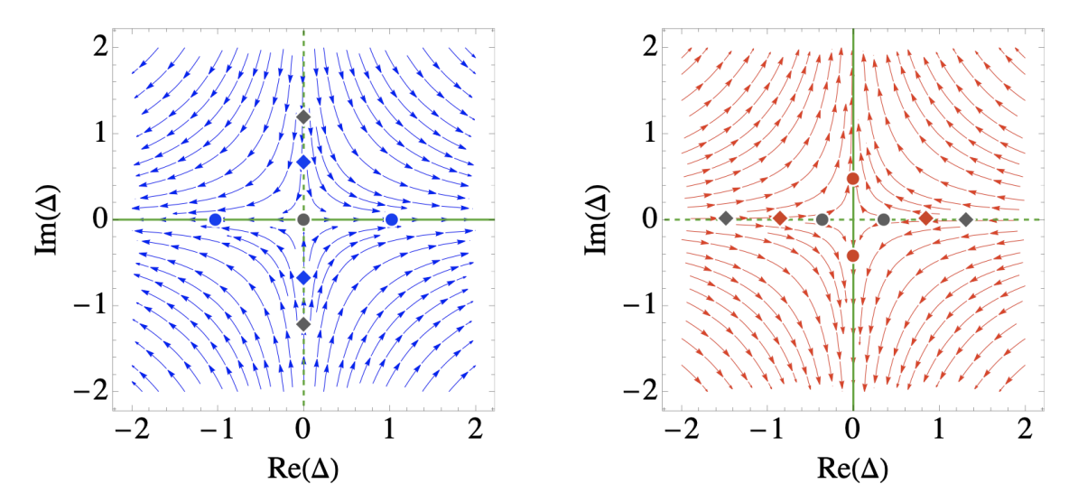
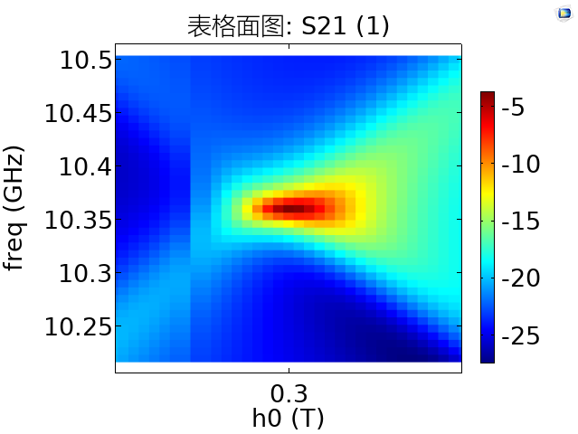
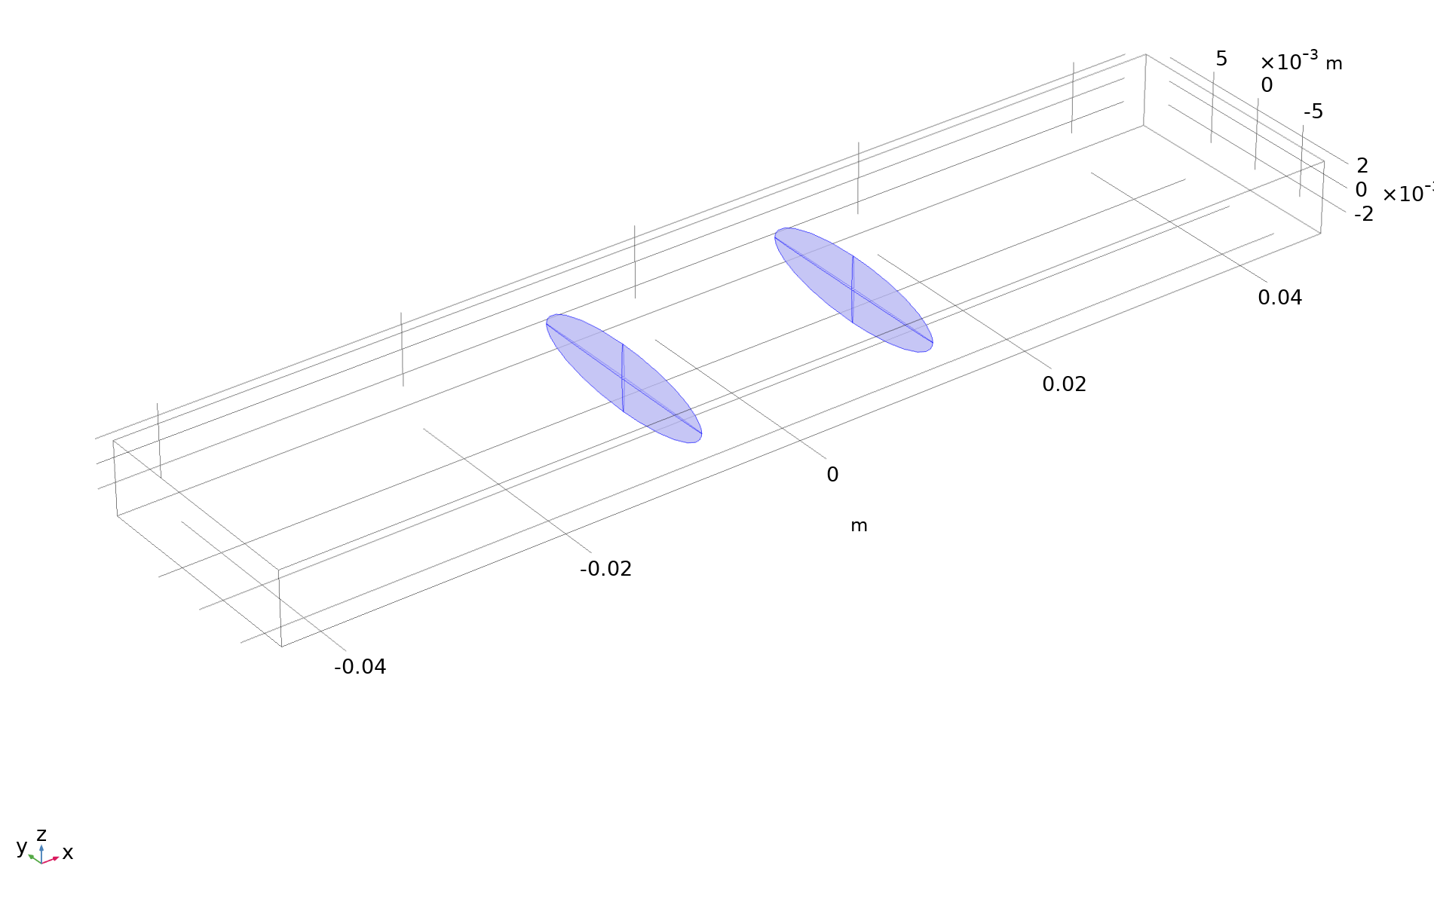
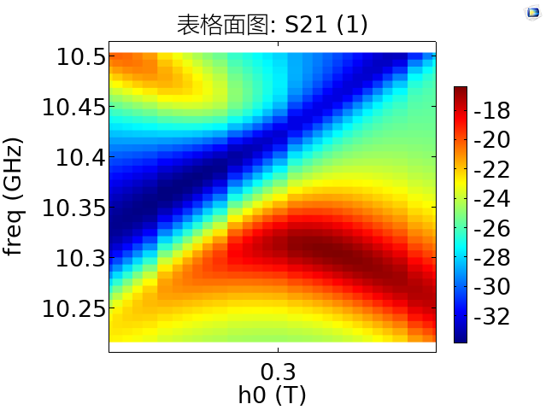
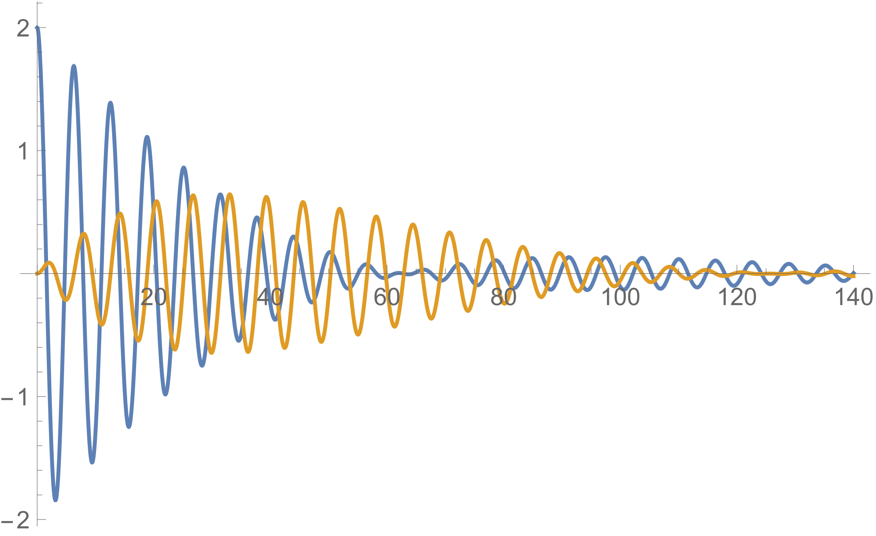
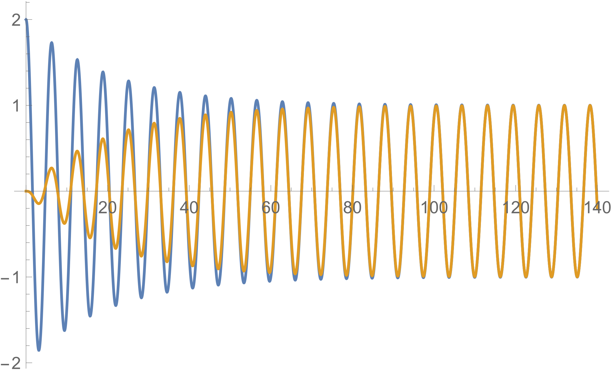
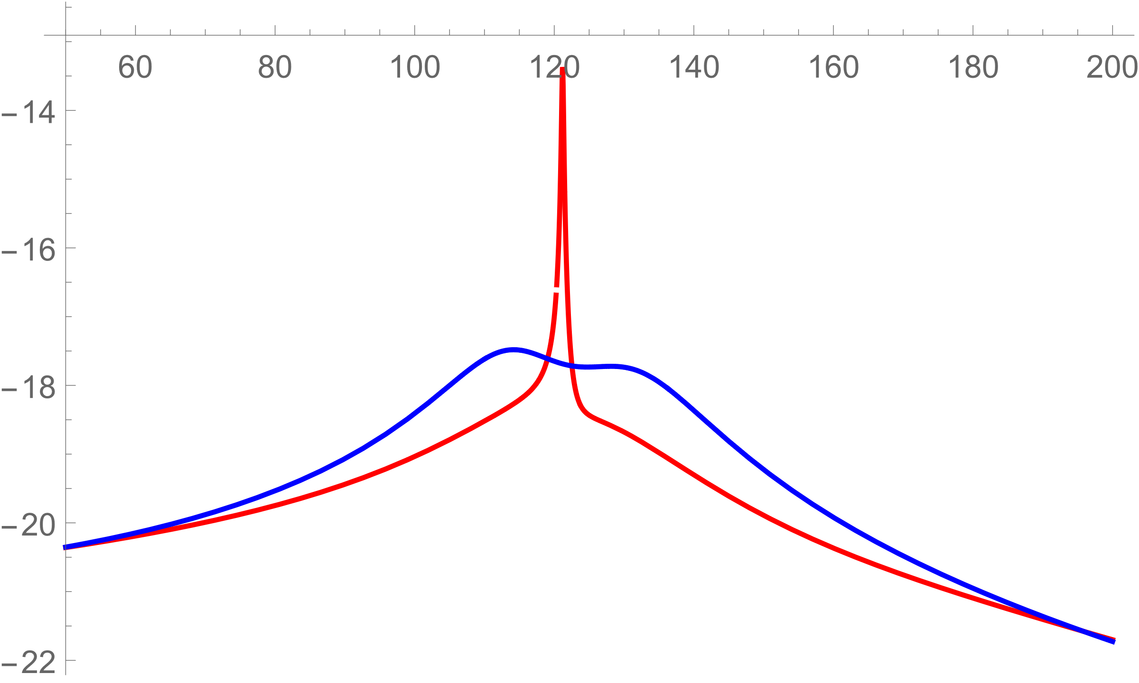
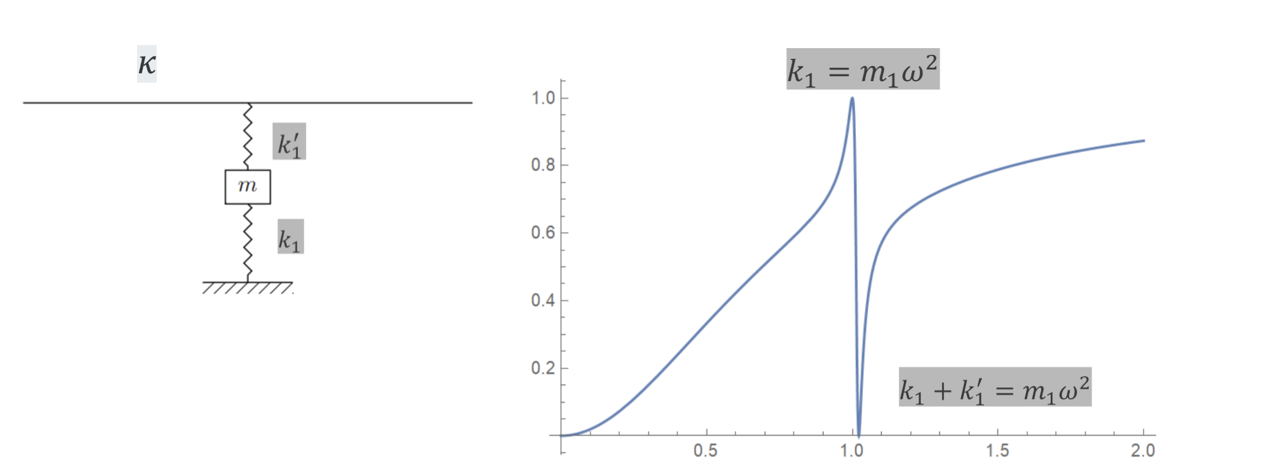
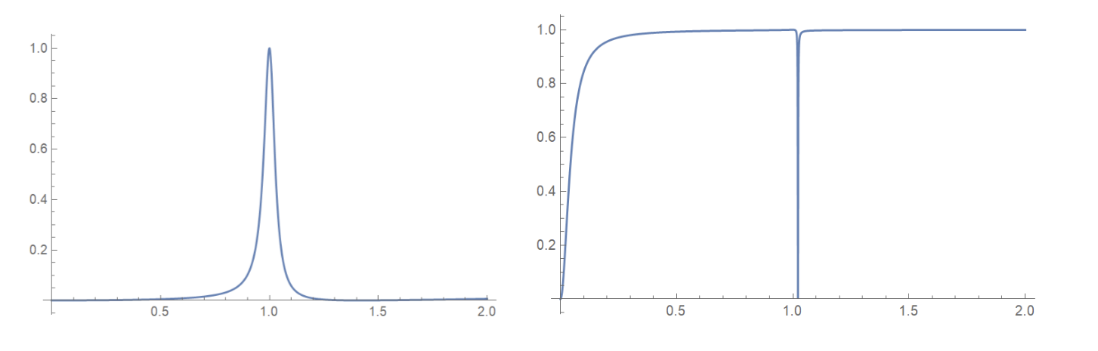
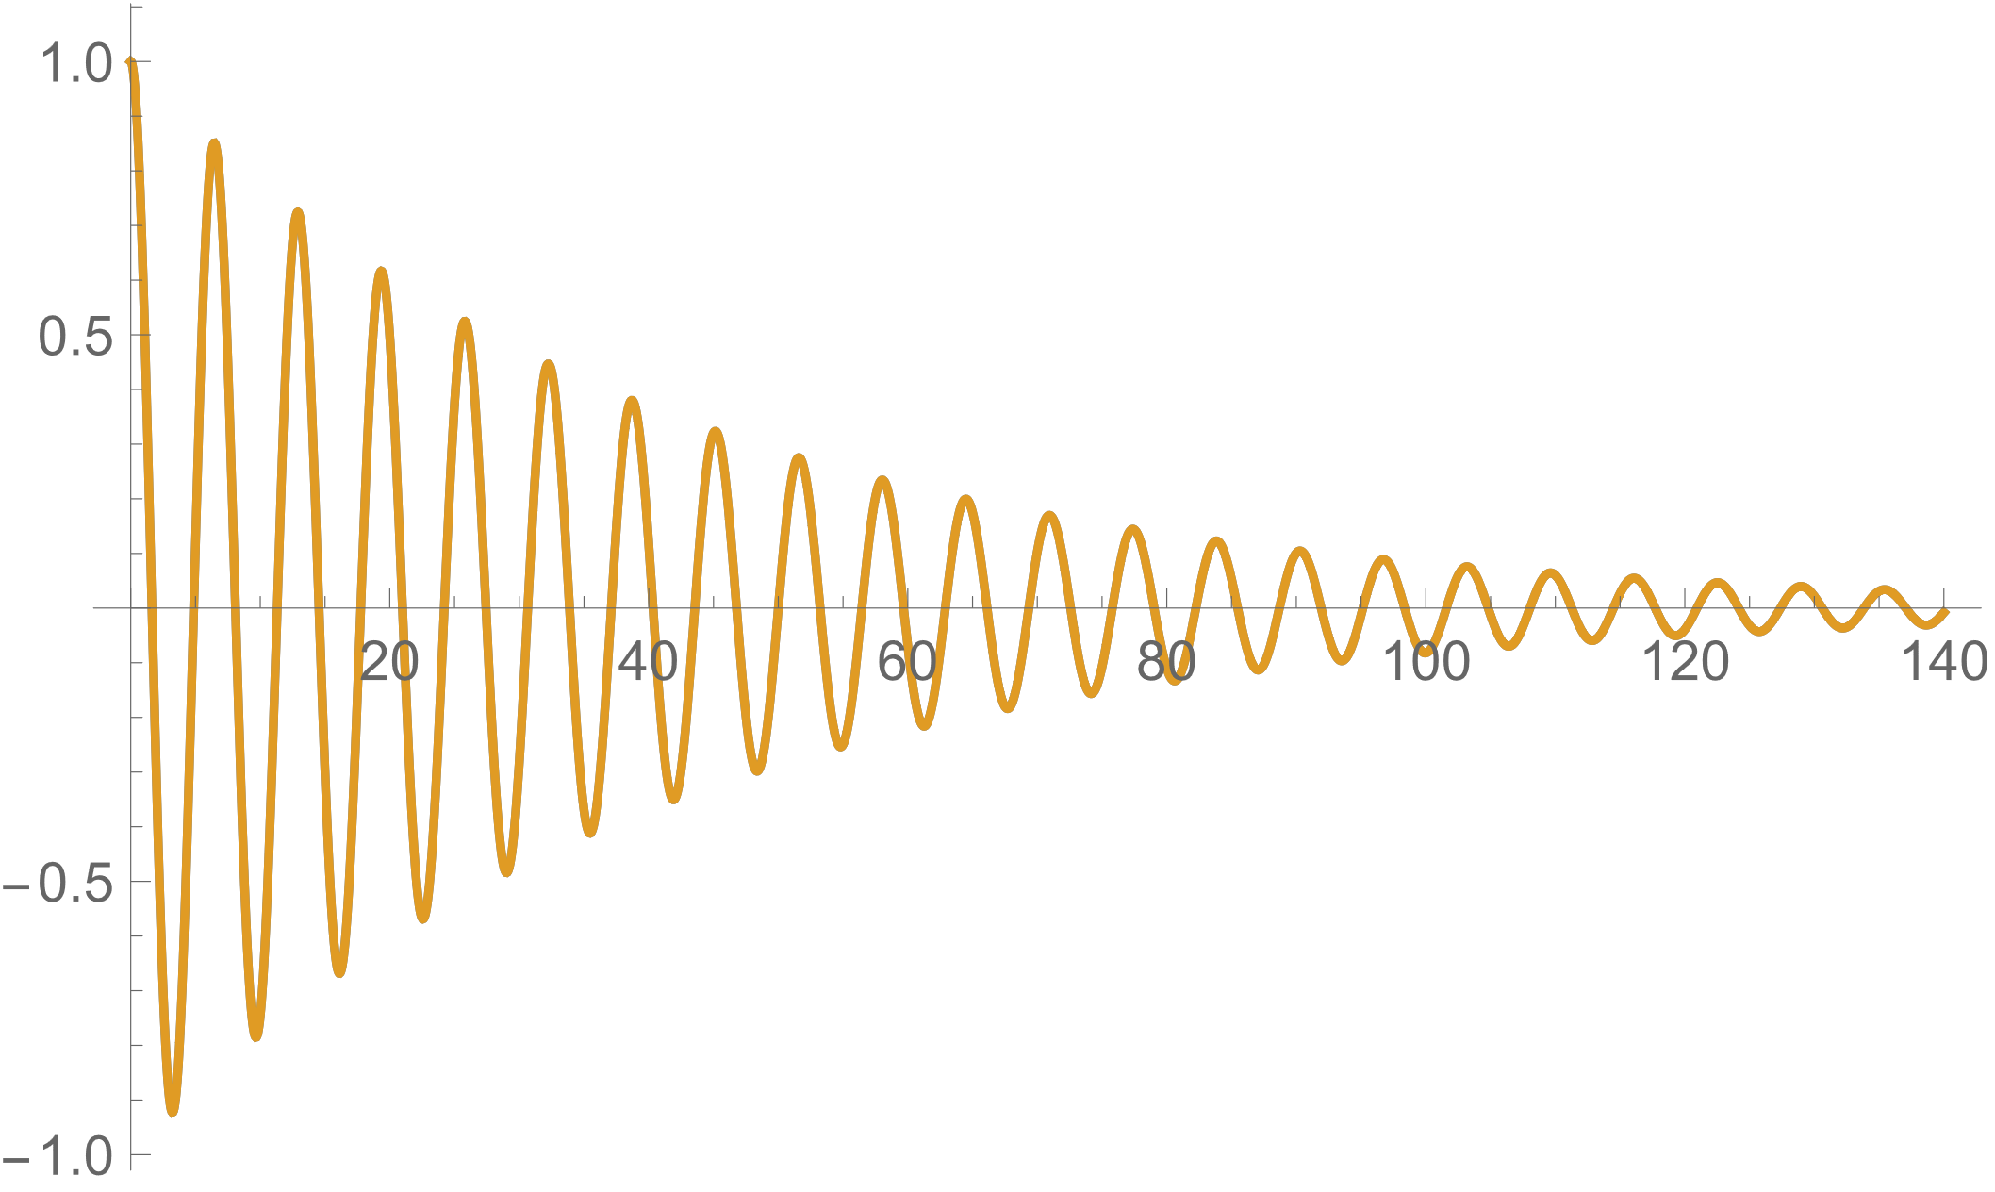
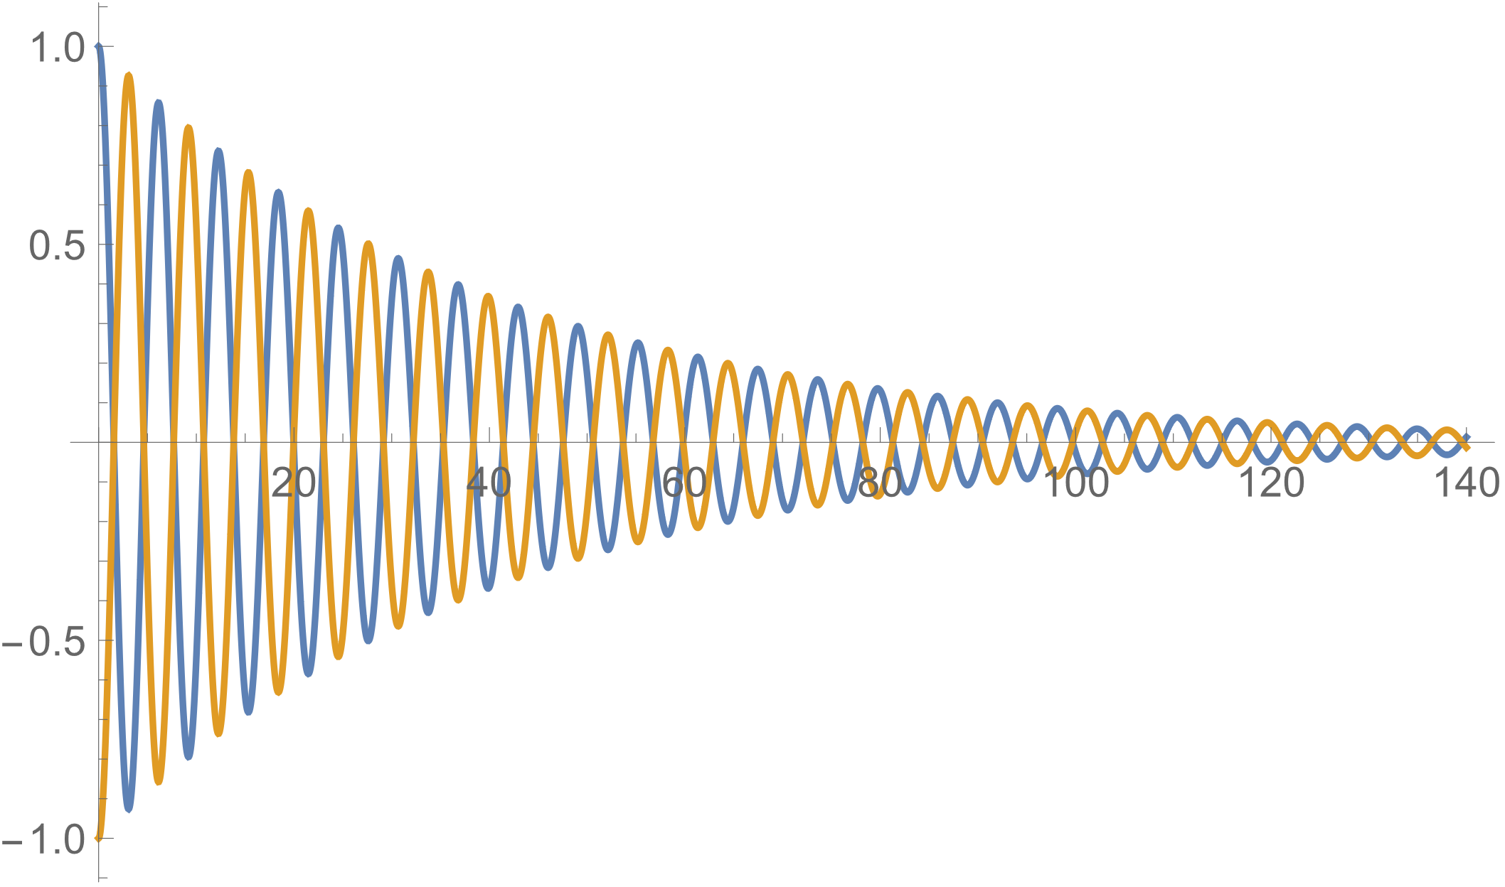
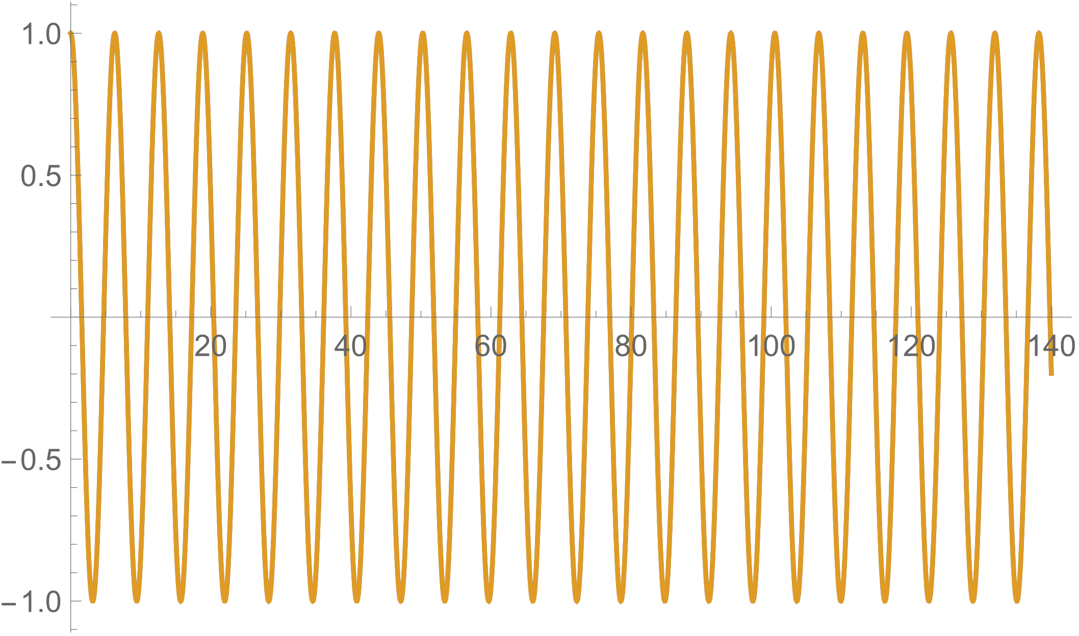
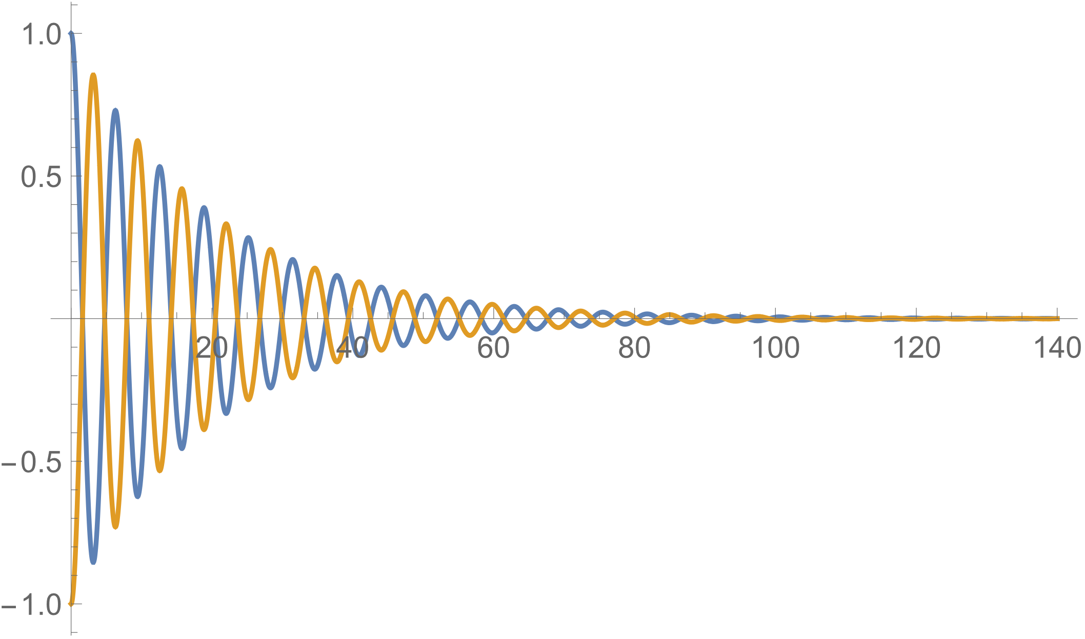
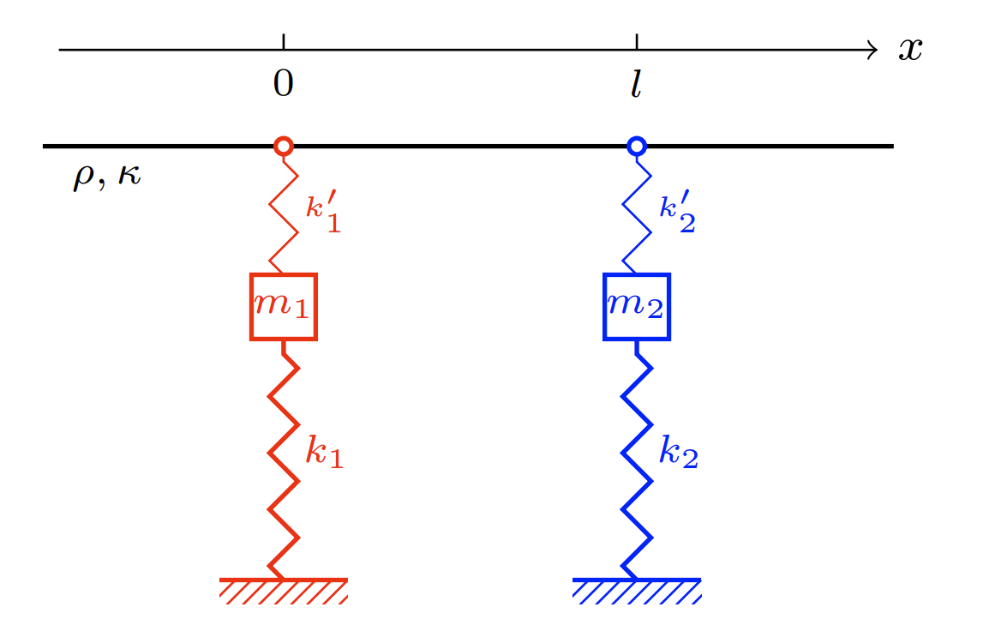




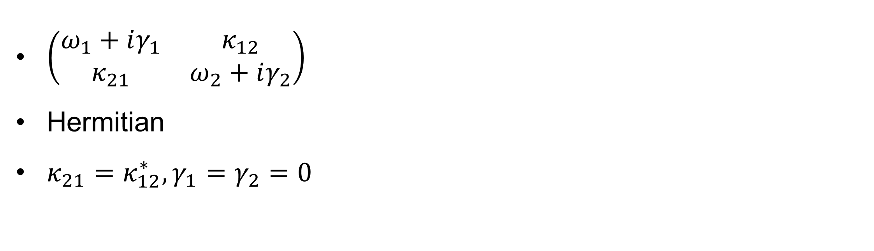
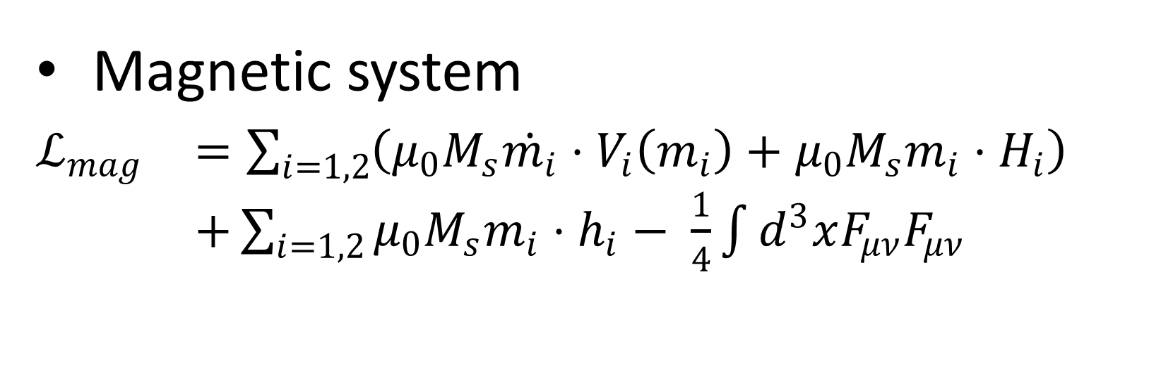







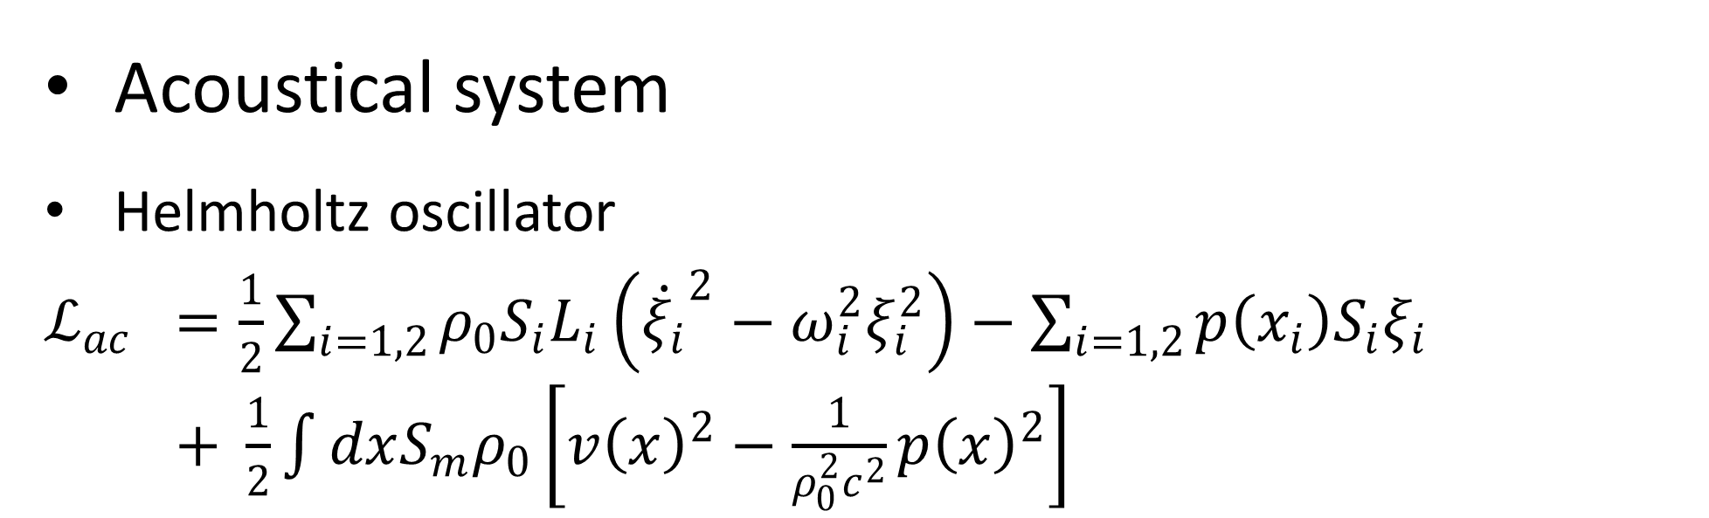
Tunable coherent and dissipative coupling via an open channel
Jiongjie Wang, ¹ Jiang Xiao¹ *
1 Department of Physics and State Key Laboratory of Surface Physics, Fudan University, Shanghai 200433, China * xiaojiang@fudan.edu.cn
Introduction
Two types of coupling: level attractive coupling^{[1]} and level attractive coupling. The latter one, accompanying with exceptional point (EP), often occurs at non-Hermitian system^{[2]-[4]}.
Acoustical system
Helmholtz oscillator
$ℒ_{ac}$ $=\frac{1}{2}\sum_{i=1,2}{ρ_{0}S_{i}L_{i}\left({\dot{ξ_{i}}}^{2}−ω_{i}^{2}ξ_{i}^{2}\right)}−\sum_{i=1,2}{p\left(x_{i}\right)S_{i}ξ_{i}}$
$+ \frac{1}{2}\int{dxS_{m}ρ_{0}\left[v{\left(x\right)}^{2}−\frac{1}{ρ_{0}^{2}c^{2}}p{\left(x\right)}^{2}\right]}$
$$g_{ij}=\frac{S_{i}}{L_{i}}\frac{ω^{2}}{2iqS_{m}}e^{iql}$$
Distance
Theoretical solution
Simulation result
$\left(\begin{matrix}ω_{1}+iγ_{1} & κ_{12} \\ κ_{21} & ω_{2}+iγ_{2}\end{matrix}\right)$
Hermitian
$κ_{21}=κ_{12}^{∗}, γ_{1}=γ_{2}=0$
$$λ/4$$
Level repulsive coupling and level attraction coupling
$λ$,log
$π/2$ Phase Delay
$\left(\begin{matrix}k_{1}−m_{1}ω^{2}+\frac{F_{1→1}}{y_{1}} & \frac{F_{2→1}}{y_{2}} \\ \frac{F_{1→2}}{y_{1}} & k_{2}−m_{2}ω^{2}+\frac{F_{2→2}}{y_{2}}\end{matrix}\right)\left(\begin{matrix}y_{1} \\ y_{2}\end{matrix}\right)$
$\left(\begin{matrix}ω_{1}^{2}−ω^{2} & κ_{12} \\ κ_{21} & ω_{2}^{2}−ω^{2}\end{matrix}\right)$
$\left(\begin{matrix}ω_{1}−ω & κ_{12} \\ κ_{21} & ω_{2}−ω\end{matrix}\right)$
Magnetic system
$ℒ_{mag}$ $=\sum_{i=1,2}{\left(μ_{0}M_{s}\dot{m_{i}}⋅V_{i}\left(m_{i}\right)+μ_{0}M_{s}m_{i}⋅H_{i}\right)}$
$+\sum_{i=1,2}{μ_{0}M_{s}m_{i}⋅h_{i}}− \frac{1}{4}\int{d^{3}xF_{μν}F_{μν }}$
$$λ$$
$$λ/4$$
$$κ_{12}∝\frac{F_{2→1}}{y_{2}}$$
S₂₁ and amplitude
$$κ/k_{1}^{′}→0$$
$$k_{1}^{′}/κ→0$$
Conclusion and Outlook
Calculation and Simulation
Different phase delay leads to different coupling.
Tunable coupling can be achieved via an open channel in acoustical and magnetic system.
We can “open” or “close” system by changing the coupling type of oscillators.
Mechanic system
$ℒ_{mag}$ $=\frac{1}{2}\sum_{i=1,2}{m_{i}\left({\dot{y}}^{2}−ω_{i}^{2}y_{i}^{2}\right)}$
$−\frac{1}{2}\sum_{i=1,2}{k_{i}^{′}{\left[y_{i}−u\left(x_{i}\right)\right]}^{2}}$
$+ \frac{1}{2}\int{dxρ\left[{\dot{u}\left(x\right)}^{2}−v^{2}{u^{′}\left(x\right)}^{2}\right]}$
Reference
[1] M. Harder, Y. Yang, B. M. Yao, C.H. Yu, J.W. Rao, Y.S. Gui, R.L. Stamps, and C. M. Hu, Phys. Rev. Lett.121.137203 (2018)
[2] Y. P. Wang, J. W. Rao, Y. Yang, P. C. Xu, Y. S. Gui, B. M. Yao, J. Q. You, and C. M. Hu, Phys. Rev. Lett.123.127202 (2019)
[3] W. C. Yu, J. J. Wang, H. Y. Yuan, and J. Xiao, Phys. Rev. Lett.123.227201 (2019)
[4] Y. Yang, Y. P. Wang, J. W. Rao, Y. S. Gui, B. M. Yao, W. Lu, and C. M. Hu, Phys. Rev. Lett.125.147202 (2020)

