Slide 1


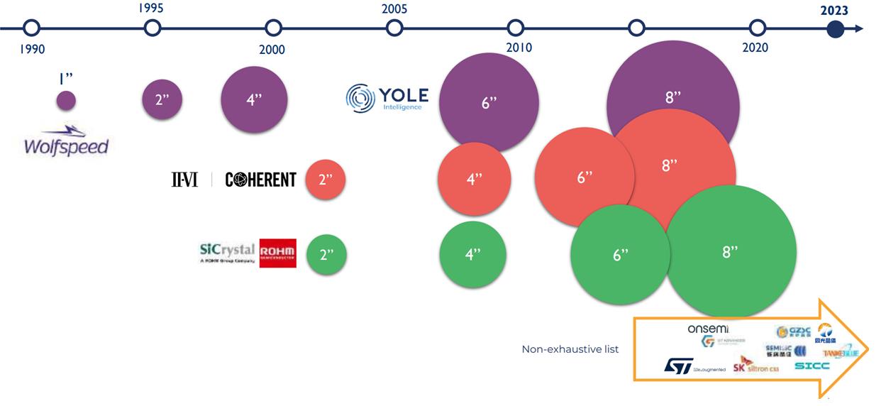
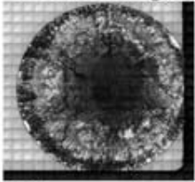
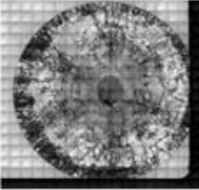
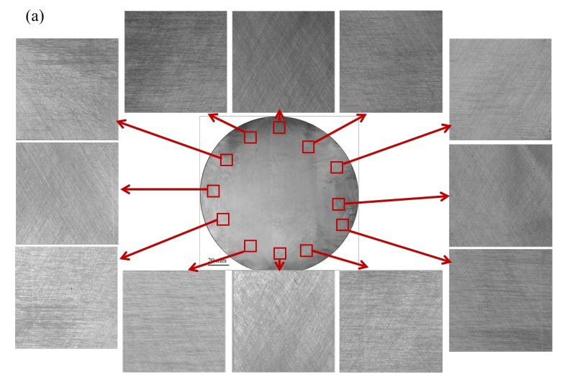
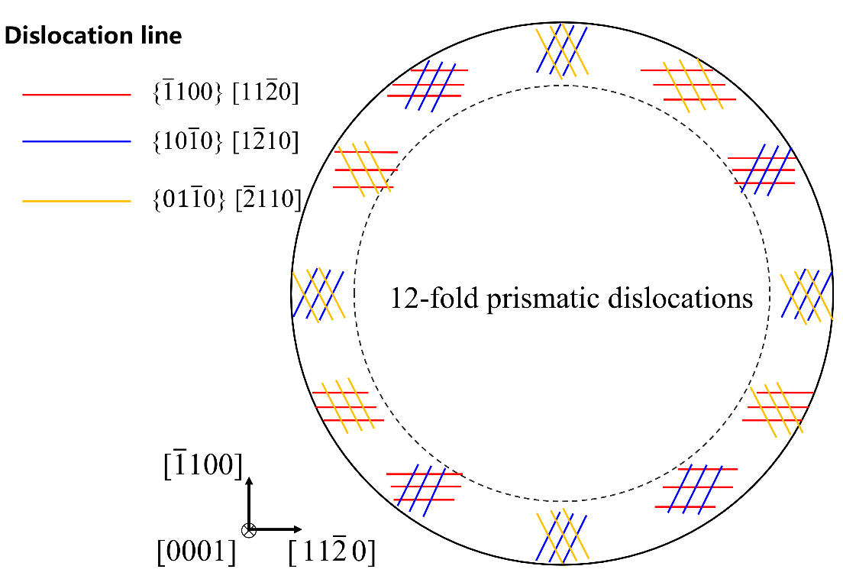
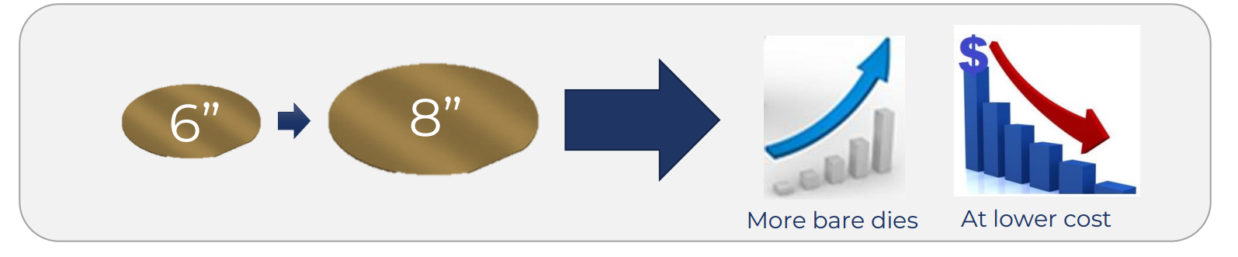
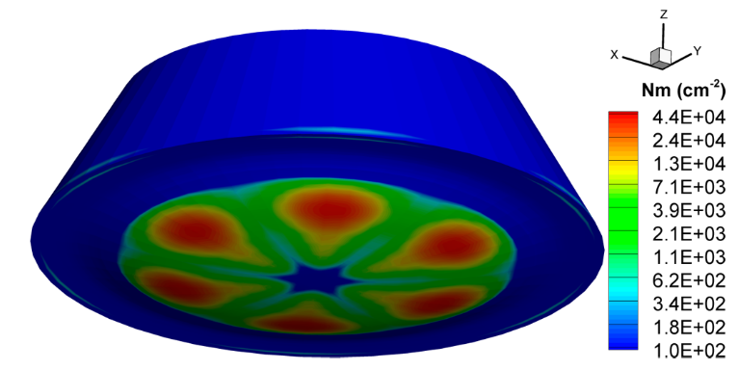
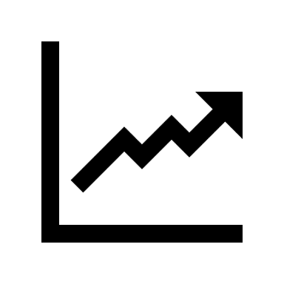
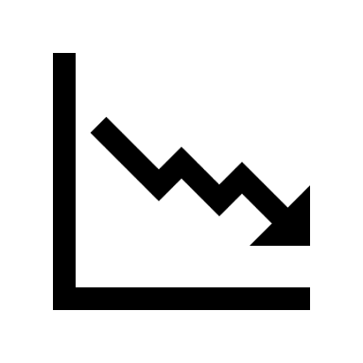
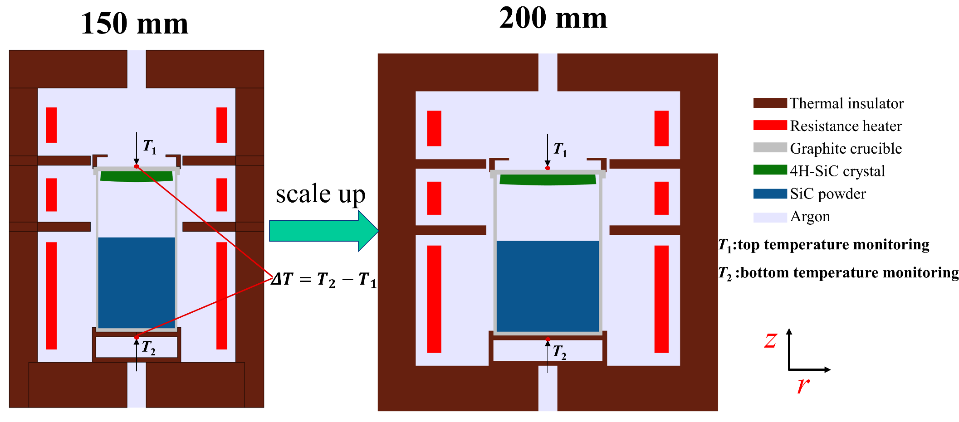
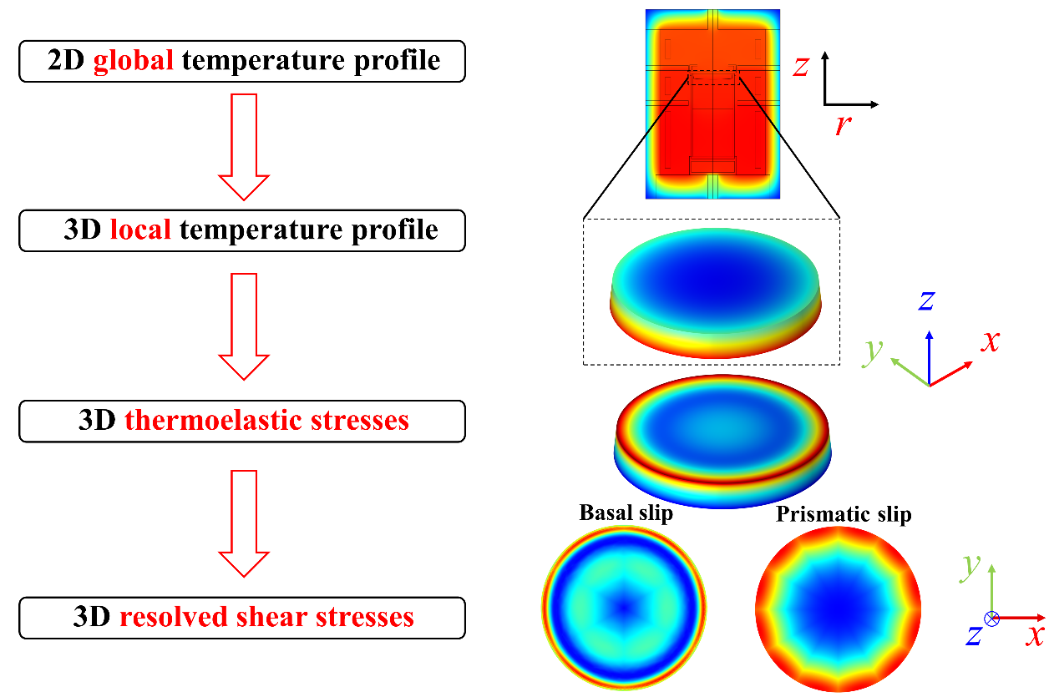
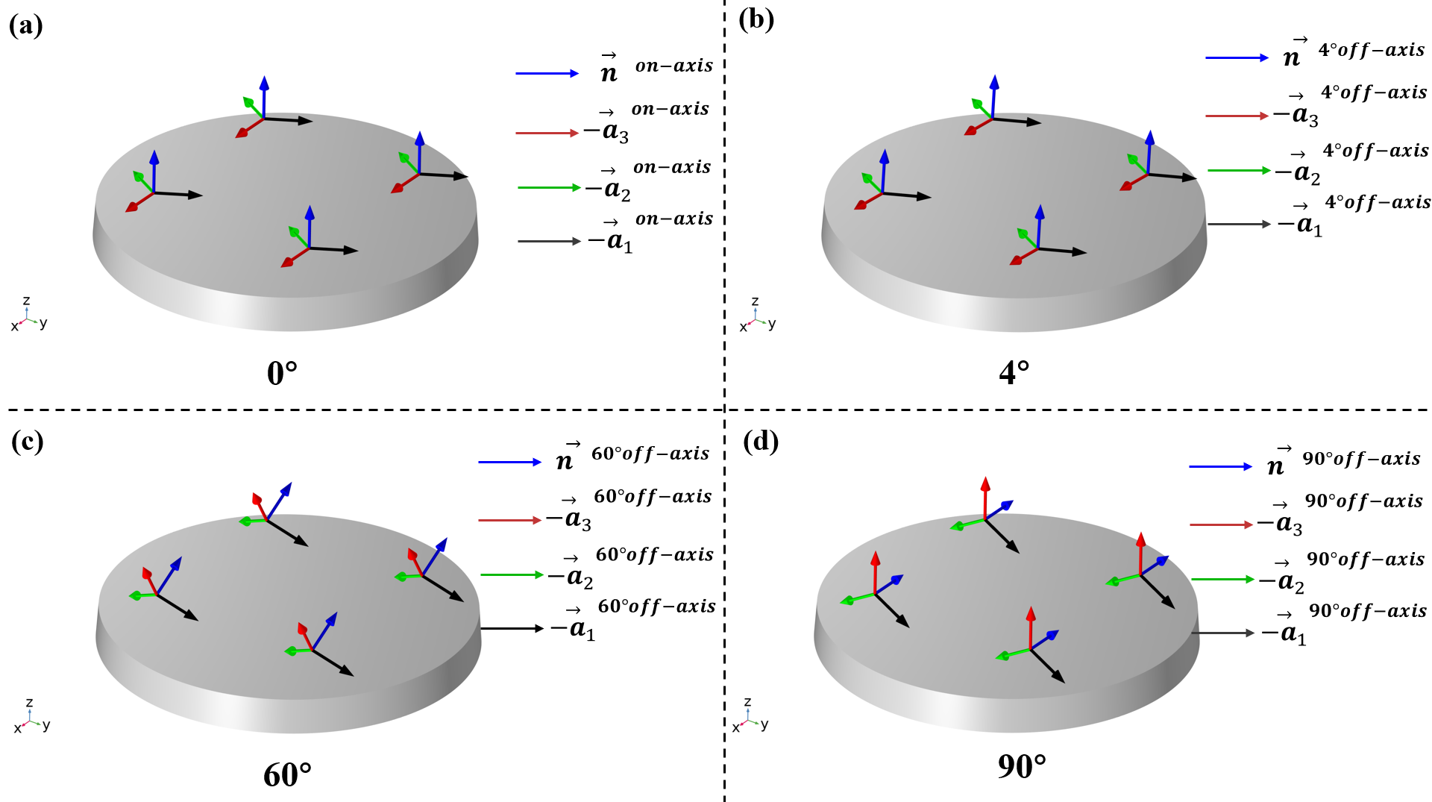


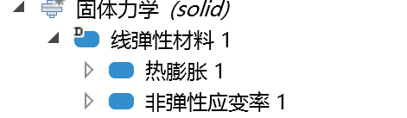
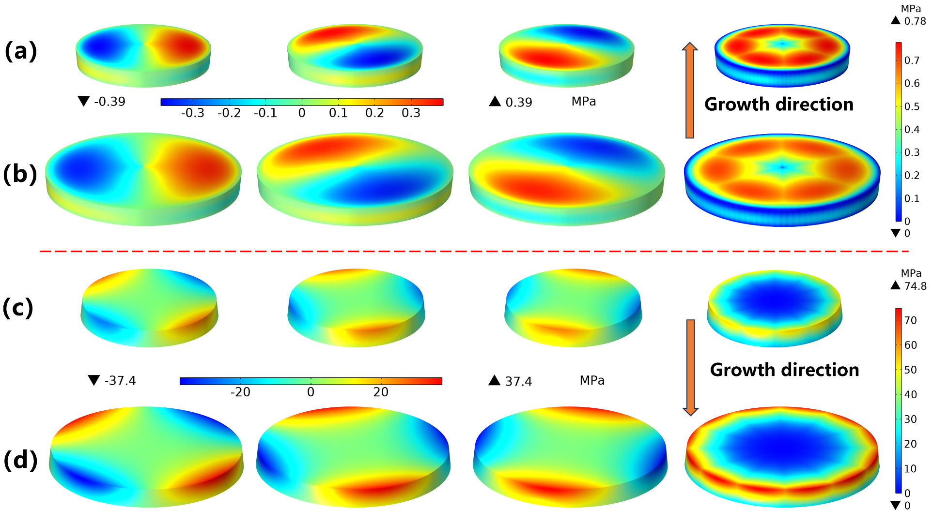
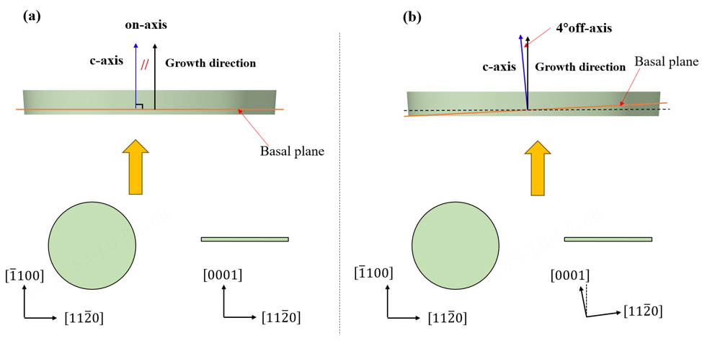
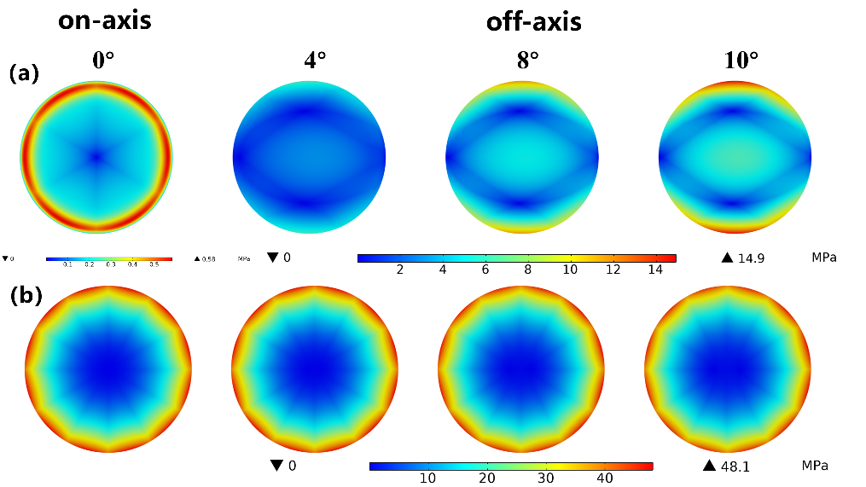
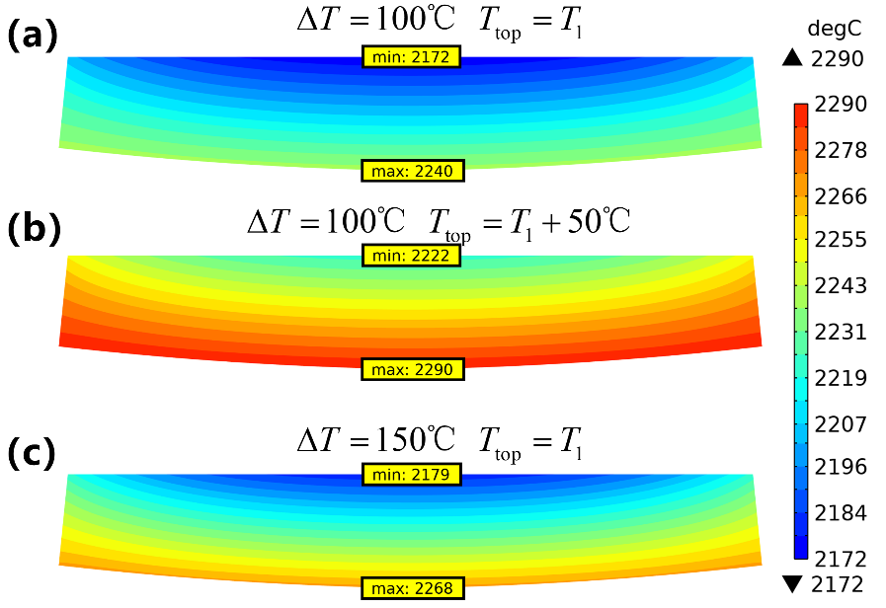
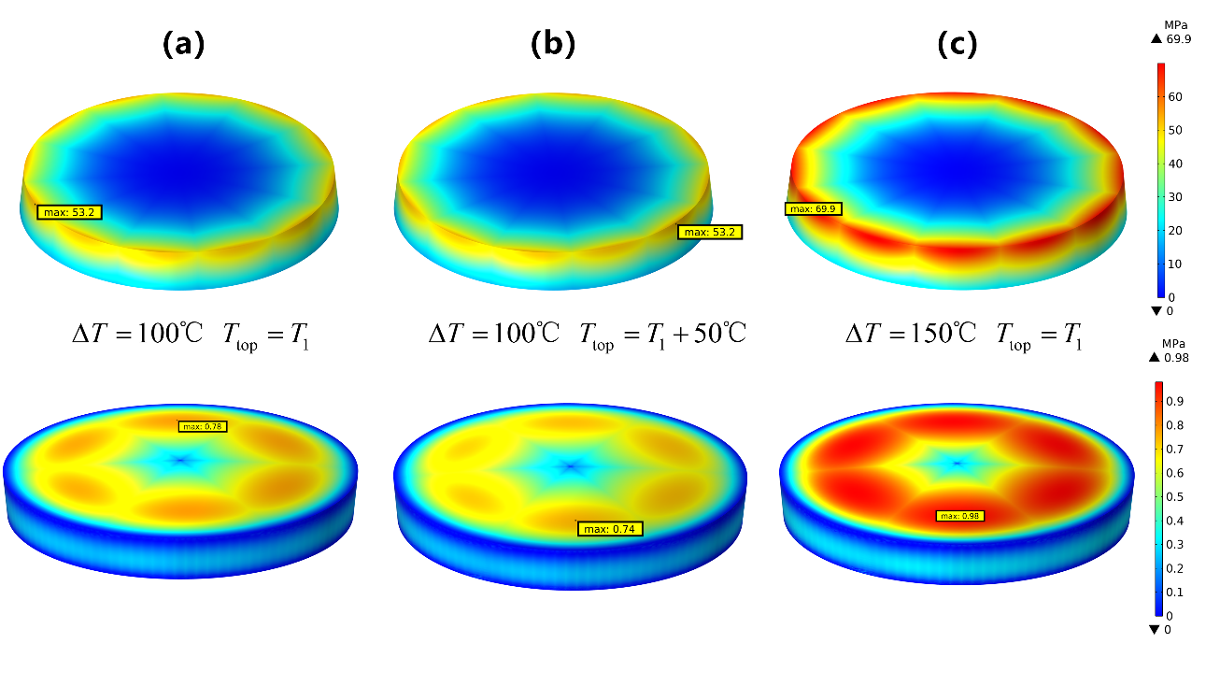
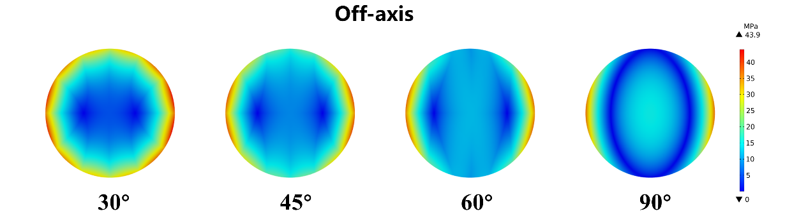
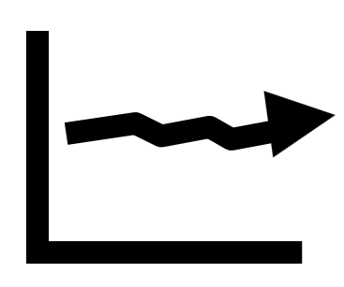
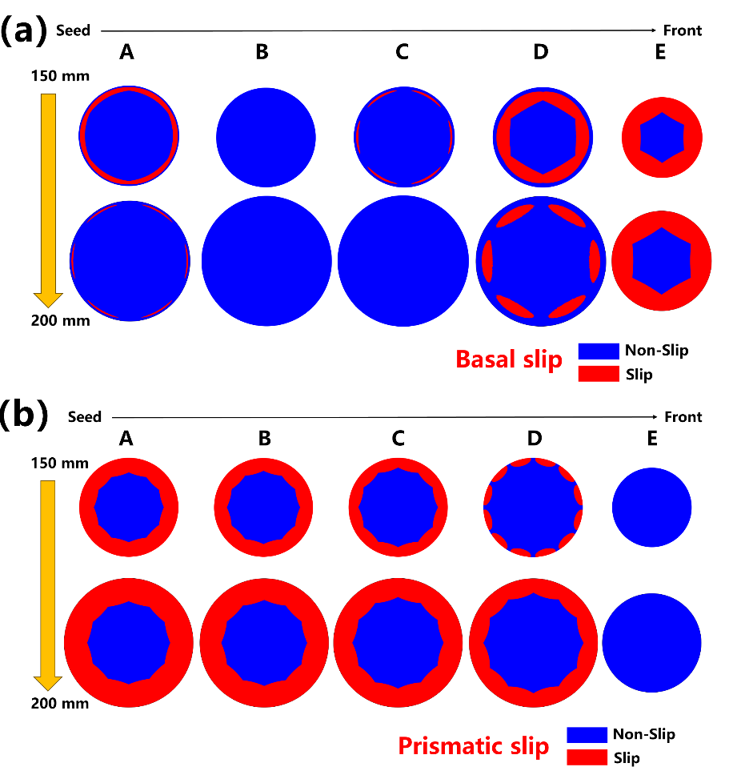
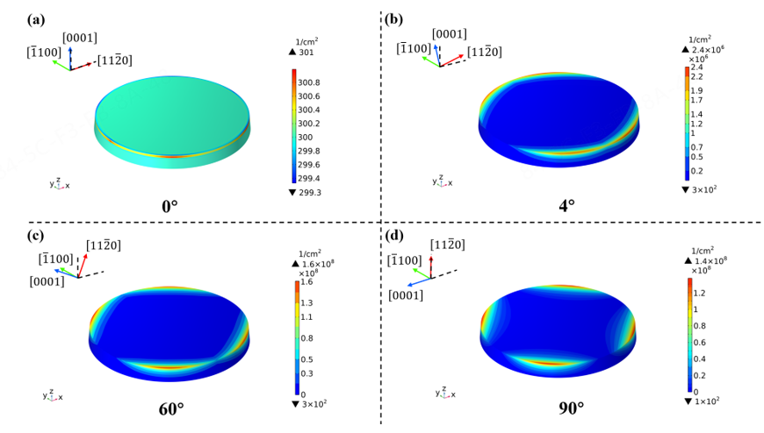
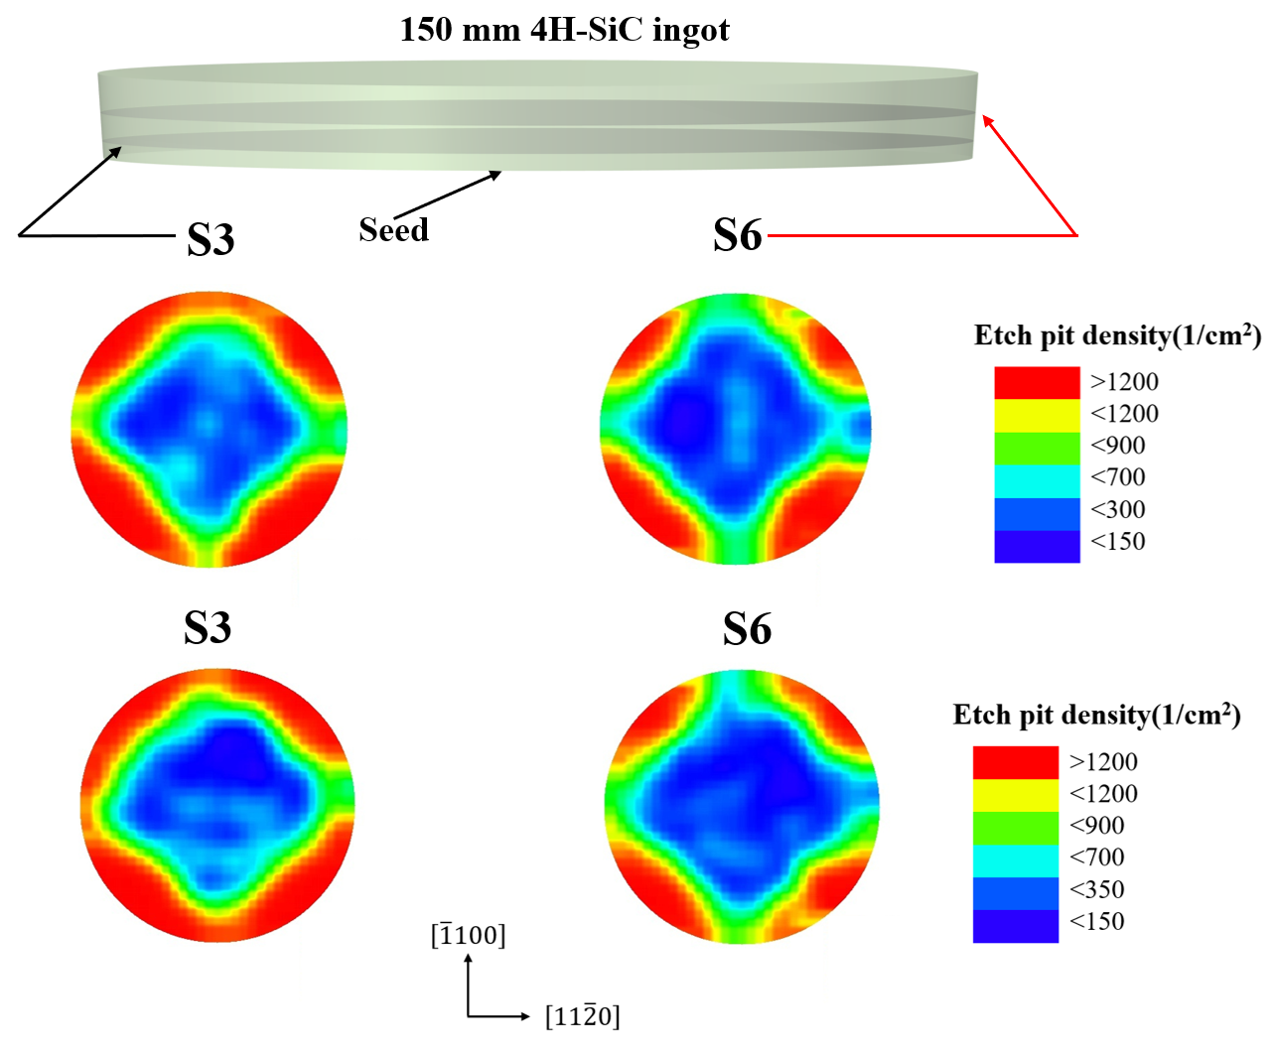
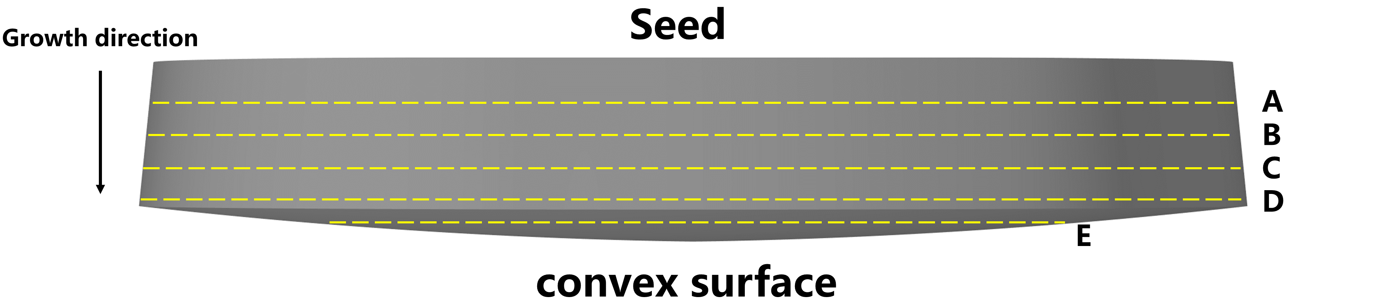
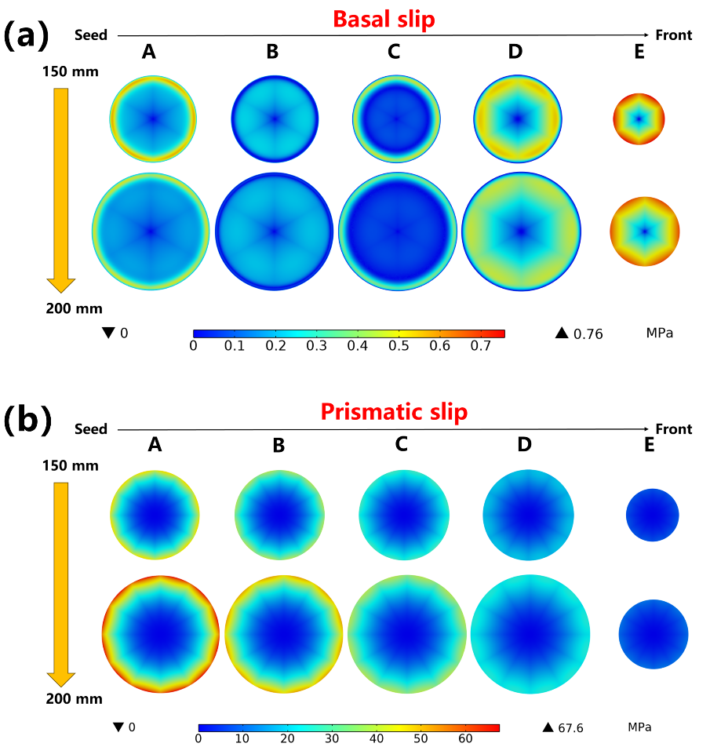
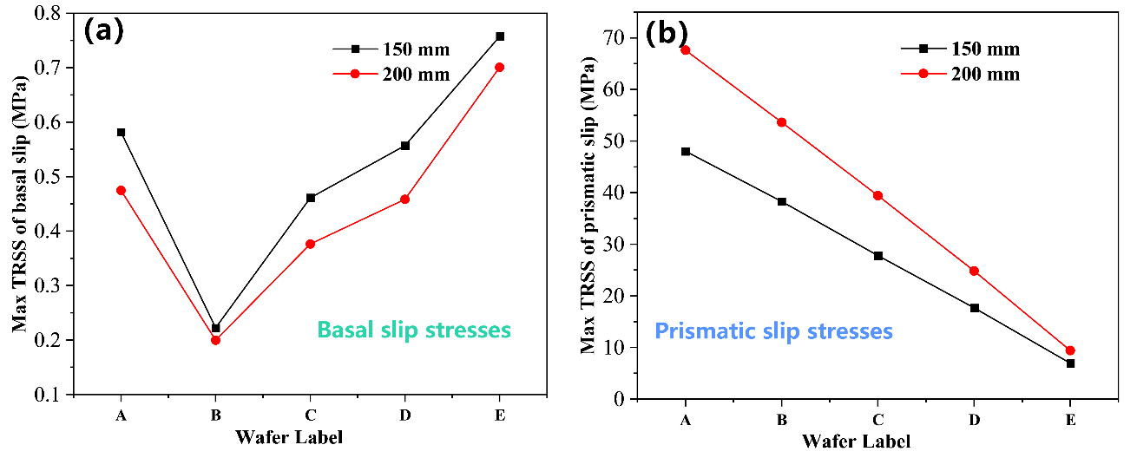
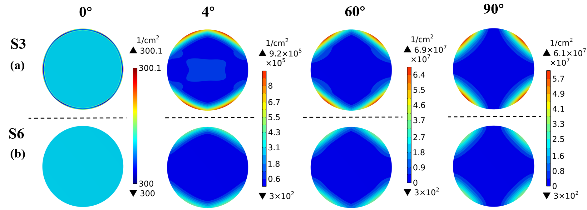




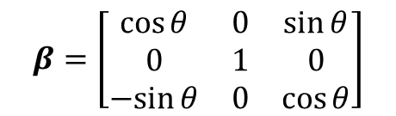





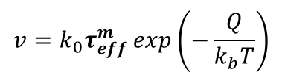






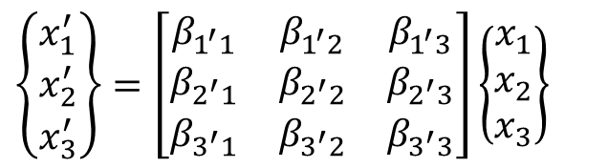





Modeling of basal and prismatic slip in 4H-SiC
Sheng’ou Lu, Binjie Xu, Lingling Xuan, Xiaodong Pi, Deren Yang, Xuefeng Han*
1. State Key Laboratory of Silicon and Advanced Semiconductor Materials & School of Materials Science and Engineering, Zhejiang University, China
2. Institute of Advanced Semiconductors, Hangzhou Global Scientific and Technological Innovation Center, Zhejiang University, China
E-mail: xuefenghan@zju.edu.cn
Introduction
Silicon carbide substrate
6-folds symmetry BPDs (4inch)
12-folds symmetry BPDs (6inch)
Goal:
Diameter
Defect
Peter Wellmann, et al, physica status solidi (b), 2008
S. Hu, et al, Materials Science Forum. 2023
Source: Power SiC 2023, Yole Intelligence
B. Gao and K. Kakimoto, Crystal Growth & Design, 2014
M. Dudley, et al, Journal of Electronic Materials, 2017
Methodology
Simulation model
Governing equations
Constitutive equation
Calculation process
Conservation of energy equation
$$σ_{ij}=C_{ijkl}\left(ε_{kl}−αθδ_{kl}\right),\left(θ=T−T_{0}\right)$$
Off-axis: COMSOL implementation
$$Q=∇⋅\left(−k∇T\right)+εσ\left(T_{σ}^{4}−T_{∞}^{4}\right)$$
$$σ_{ij}$$
Stress tensor
$$δ_{kl}$$
Kronecker Symbol
$$Q$$
Heat source
$$ε$$
Emissivity
$$C_{ijkl}$$
Elastic matrix
$$T_{0}$$
Reference temperature
$$k$$
Thermal conductivity
$$σ$$
Stephen Boltzmann constant
$$ε_{ij}$$
Strain tensor
$$α$$
Thermal expansion coefficient
Mechanical equilibrium equation
Vector system rotation
$$∇·σ=0$$
$$σ$$
Stress tensor
$$P_{ij}^{a_{k}}=\frac{1}{2}\left({\vec{s}}^{a_{k}}⊗{\vec{n}}^{a_{k}}+{\vec{n}}^{a_{k}}⊗{\vec{s}}^{a_{k}}\right)sign\left(τ_{RSS}^{a_{k}}\right)$$
$$\left\{\begin{matrix}x_{1}^{′} \\ x_{2}^{′} \\ x_{3}^{′}\end{matrix}\right\}=\left[\begin{matrix}β_{1^{′}1} & β_{1^{′}2} & β_{1^{′}3} \\ β_{2^{′}1} & β_{2^{′}2} & β_{2^{′}3} \\ β_{3^{′}1} & β_{3^{′}2} & β_{3^{′}3}\end{matrix}\right]\left\{\begin{matrix}x_{1} \\ x_{2} \\ x_{3}\end{matrix}\right\}$$
Alexander-Haasen model
Alexander-Haasen model : COMSOL implementation
$$\frac{dN_{m}}{dt}=KvN_{m}τ_{eff}^{λ}$$
$$\frac{dε_{ij}^{p}}{ dt}=\sum_{(k)}{bvN_{m}^{a_{k}}}P_{ij}^{a_{k}}$$
Two-dimensional axisymmetric global PVT model
$$β=\left[\begin{matrix}\cos{θ} & 0 & \sin{θ} \\ 0 & 1 & 0 \\ −sin{θ} & 0 & \cos{θ}\end{matrix}\right]$$
$$θ$$
off-axis degree
$$v=k_{0}τ_{eff}^{m}\exp\left(−\frac{Q}{k_{b}T}\right)$$
$$\frac{dN_{m}}{dt}=KvN_{m}τ_{eff}^{λ}$$
$$\frac{dε_{ij}^{p}}{ dt}=\sum_{(k)}{bvN_{m}^{a_{k}}}P_{ij}^{a_{k}}$$
B. Xu, et al, Journal of Crystal Growth, 2023.
S. o. Lu, et al, CrystEngComm, 2024
$$τ_{eff}=\max\left(\left|τ_{RSS}\right|−D\sqrt{N_{m}},0\right)$$
S. o. Lu, et al, submitted, 2024
N. Miyazaki, in Handbook of Crystal Growth, 2015
Results
Diameter effect
Temperature effect
Off-axis effect
Three different temperature distributions
on-axis VS 4° off-axis
90º
0º
4-fold
Basal slip
(a) vs (c)
Temperature difference
(a) vs (b)
Absolute temperature
Basal
6-fold
Prismatic
2-fold
6“
8“
Prismatic slip
Prismatic slip stress
12-fold
S. o. Lu, et al, submitted, 2024
S. o. Lu, et al, submitted, 2024
S. o. Lu, et al, CrystEngComm, 2024
S. o. Lu, et al, submitted, 2024
Trend of basal and prismatic slip
Experimental comparison
Stresses along growth direction
Off-angle effects on the dislocation distribution
CRSS
Basal slip 0.2 MPa
0º
90º
Prismatic slip 8 MPa
6-fold
4-fold
Critical slip stress
Prismatic slip
S. o. Lu, et al, submitted, 2024
A.Lara, et al, Ceramics International, 2012
M. Dudley, et al, Journal of Electronic Materials, 2017
S. o. Lu, et al, CrystEngComm, 2024
S. o. Lu, et al, submitted, 2024
Excerpt from the Proceedings of the COMSOL Conference 2024 Shanghai

