Slide 1
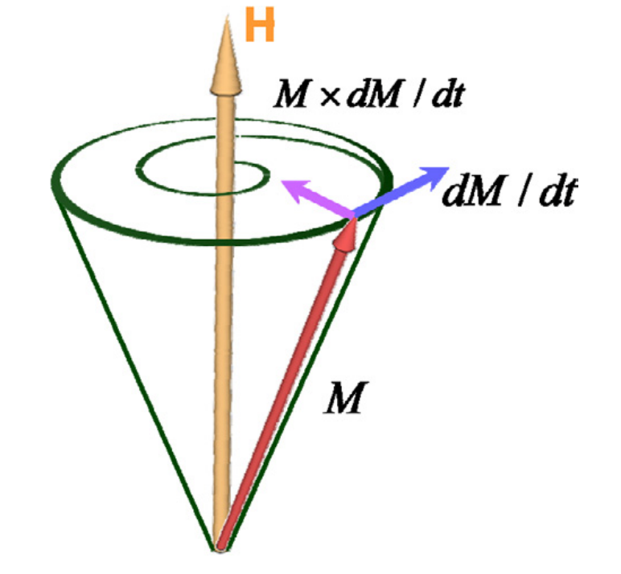
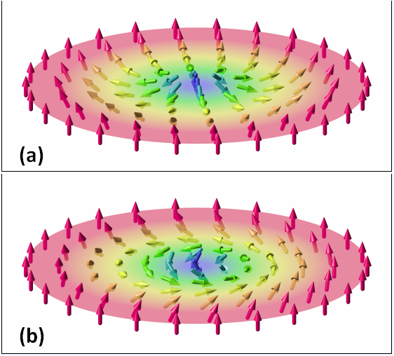
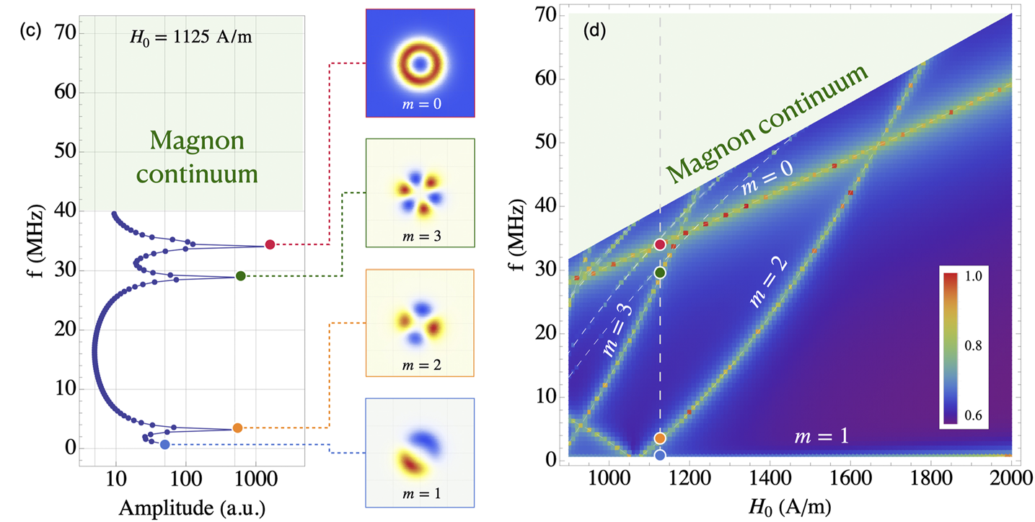
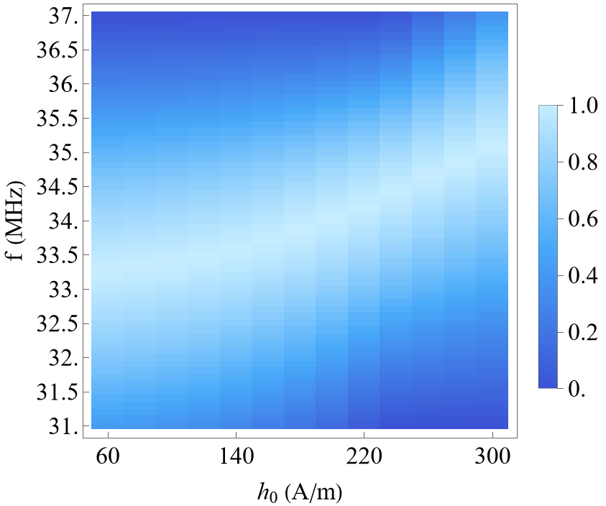
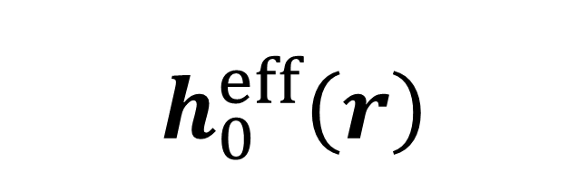
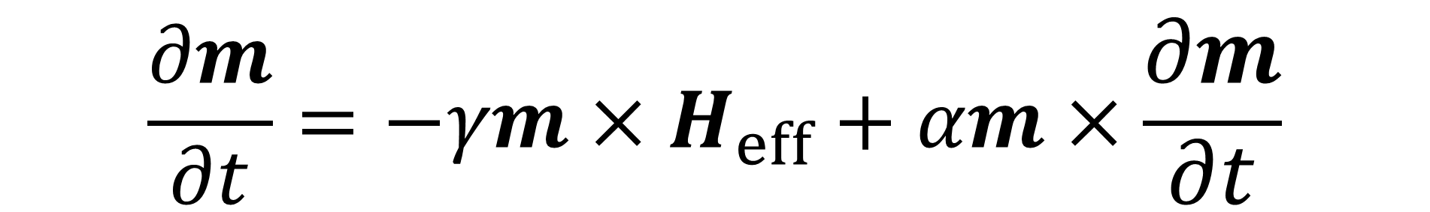
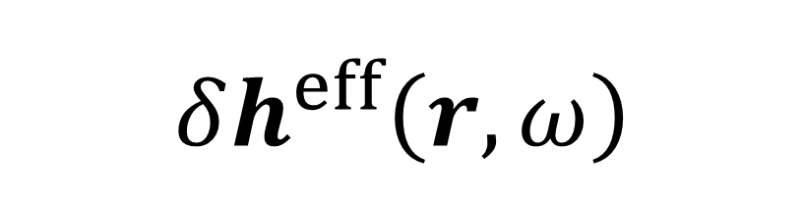
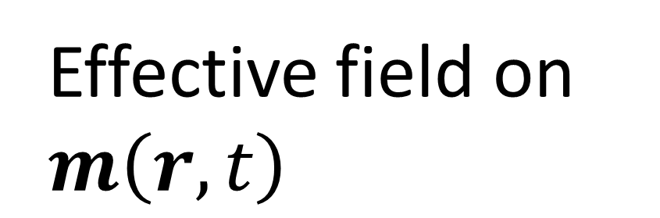

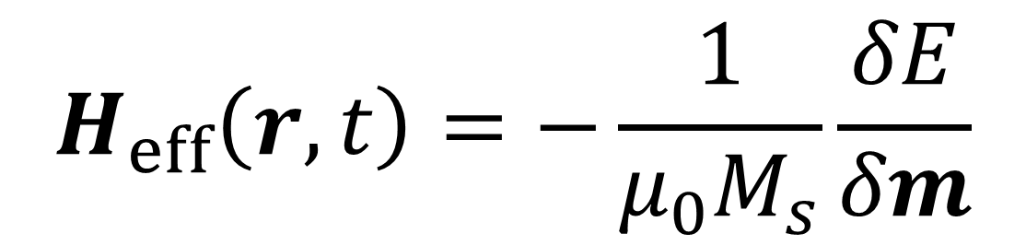

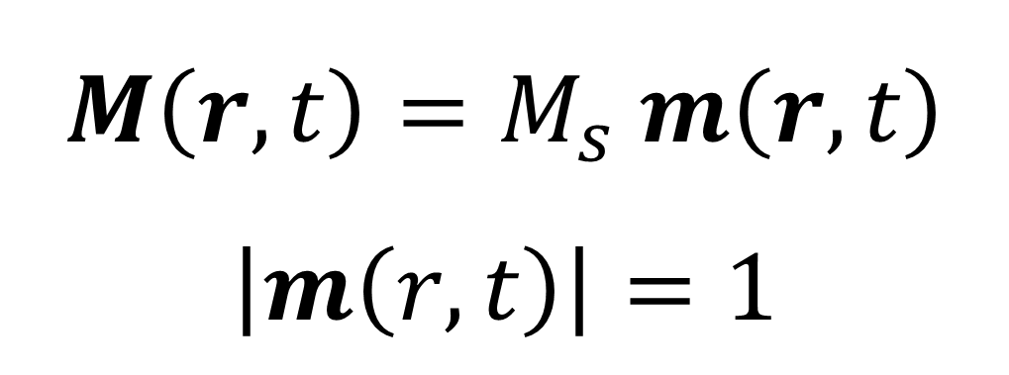
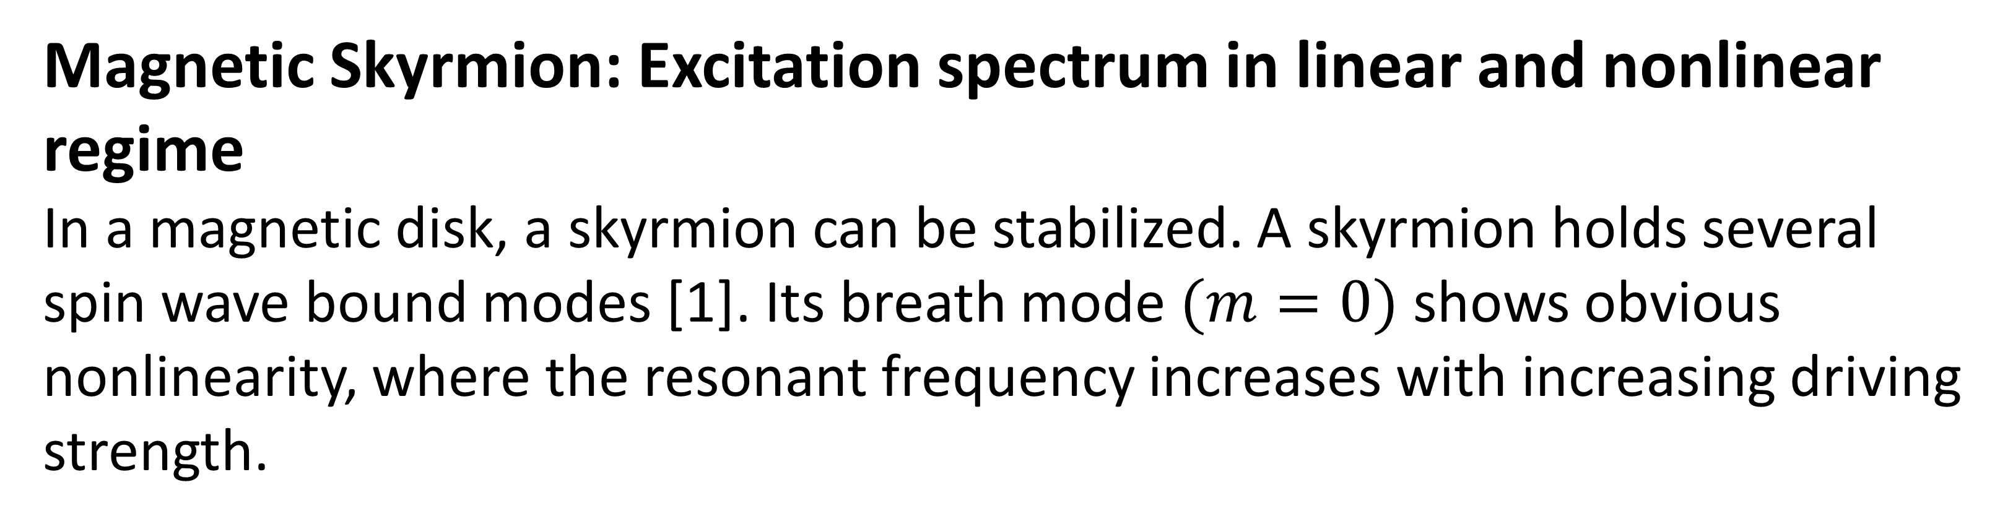
Spectrum of non-collinear textures by Micromagnetic simulation
Ruoban Ma (马若般), Jiabin Zhang (张家斌), and Jiang Xiao (肖江)
Department of Physics, Fudan University, Shanghai 200433, China
Introduction Spin-wave-based devices are expected to lay the foundation for new computation schemes. Designing these devices requires high-efficiency numerical simulation for the dynamics of spontaneous magnetization in ferromagnetic materials. The Micromagnetics module have been developed for this specific purpose.
Simulation in time domain
Landau-Lifshitz-Gilbert (LLG) equation
Simulation in frequency domain
Landau-Lifshitz-Gilbert equation in frequency domain
$$\frac{∂m}{∂t}=−γm×H_{eff}+αm×\frac{∂m}{∂t}$$
$$iωδm=−γ(m_{0}×δh^{eff}+δm×h_{0}^{eff})+iωαm_{0}×δm$$
$$M\left(r,t\right)=M_{s} m\left(r,t\right)$$
$$\left|m\left(r,t\right)\right|=1$$
$$δm\left(r,ω\right)$$
Linearized spin wave
Magnetization
$$m_{0}\left(r\right)$$
Stationary magnetic texture
Effective field on $m\left(r,t\right)$
$$H_{eff}\left(r,t\right)=−\frac{1}{μ_{0}M_{s}}\frac{δE}{δm}$$
$$h_{0}^{eff}\left(r\right)$$
Static field
$$δh^{eff}\left(r,ω\right)$$
Dynamical field due to linearized spin wave and external driving
Solving LLG equation in time domain gives the static magnetic texture or complete spin wave dynamics.
Solving LLG equation in frequency domain gives the spin wave eigenmodes and the linear excitation spectrum.
Magnetic Skyrmion: Excitation spectrum in linear and nonlinear regime
In a magnetic disk, a skyrmion can be stabilized. A skyrmion holds several spin wave bound modes [1]. Its breath mode $(m=0)$ shows obvious nonlinearity, where the resonant frequency increases with increasing driving strength.
Fig 1. Linear spectrum (Frequency domain) [1]
Fig 2. Nonlinear spectrum, $m=0$ mode
References
[1] Zhang, J., Yu, W., Chen, X., & Xiao, J. (2023). A frequency-domain micromagnetic simulation module based on COMSOL Multiphysics. AIP Advances, 13(5).
[2] Kim, S. K. (2010). Micromagnetic computer simulations of spin waves in nanometre-scale patterned magnetic elements. Journal of Physics D: Applied Physics, 43(26), 264004.
[3] Yu, H., Xiao, J., & Schultheiss, H. (2021). Magnetic texture based magnonics. Physics Reports, 905, 1-59.

