Slide 1
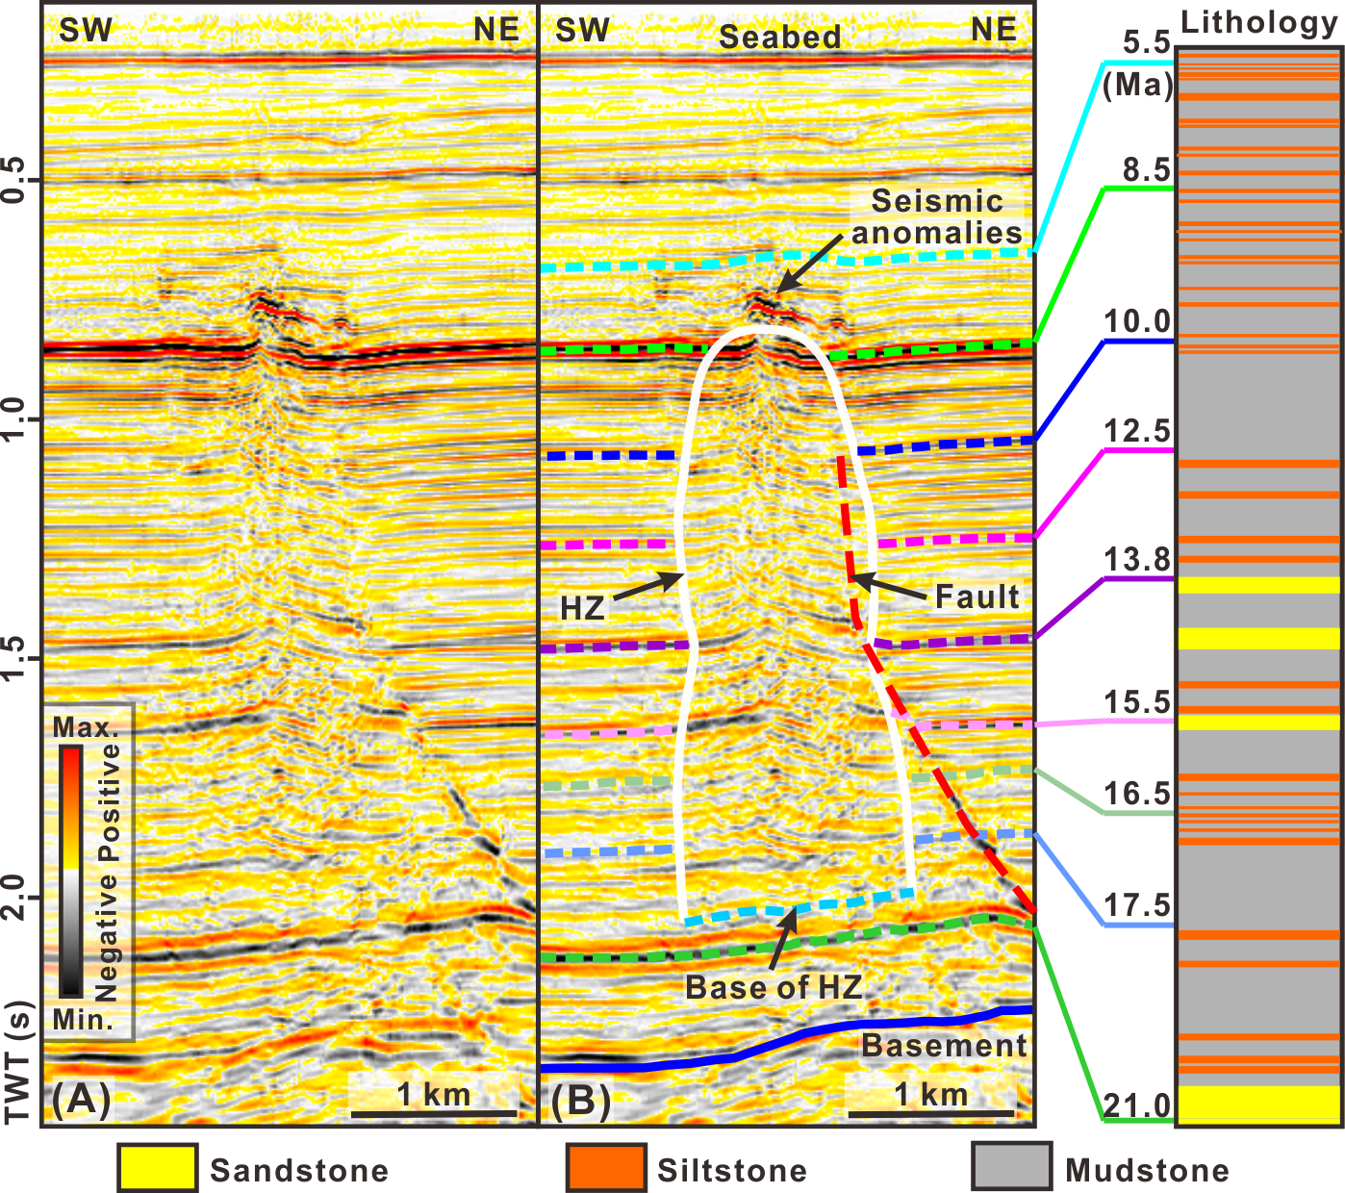
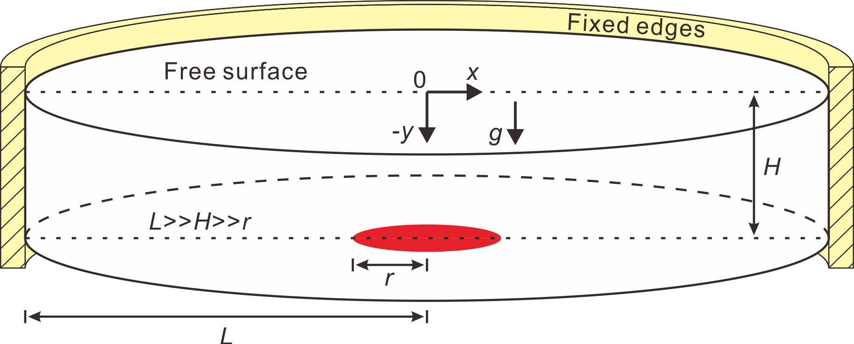
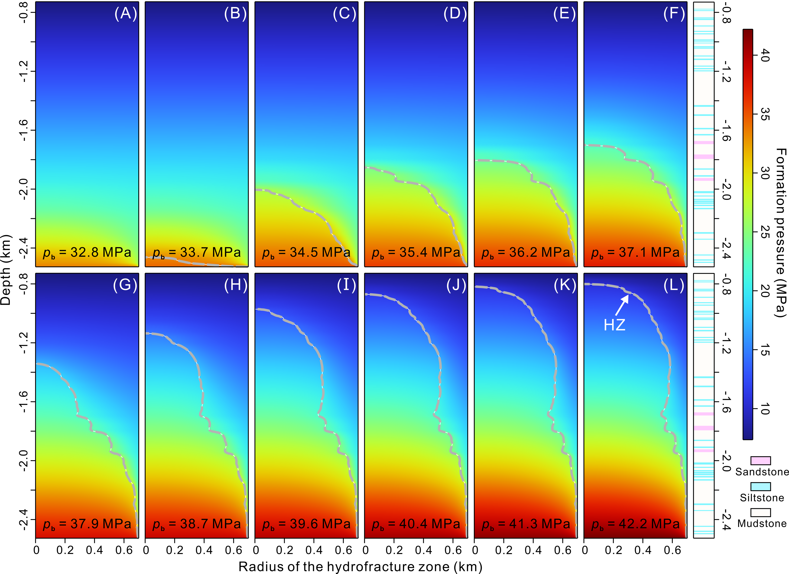
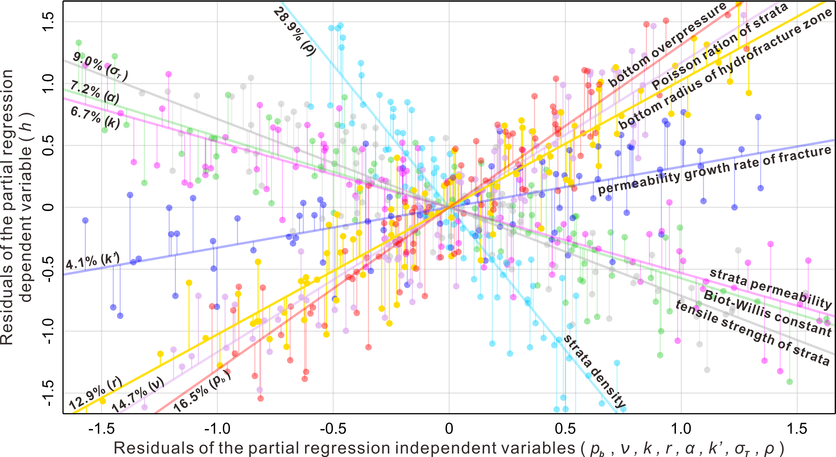
How do overpressure-driven hydrofractures grow in sedimentary basin?
Qing Wang¹, Qiliang Sun^{1,2}, Kehua You³, Martino Foschi^{4,5}
¹ Hubei Key Laboratory of Marine Geological Resources, China University of Geosciences, Wuhan 430074, China (qingwang@cug.edu.cn).
² Laboratory for Marine Mineral Resources, Qingdao National Laboratory for Marine Science and Technology, Qingdao 266061, China.
³ Institute for Geophysics, University of Texas at Austin, Austin, Texas 78758, USA.
⁴ Department of Earth Sciences, University of Oxford, Oxford, OX1 3AN, UK.
⁵ Shell International Exploration and Production BV, The Hague, 2596 HR, Netherlands.
Abstract
Overpressure-driven hydrofracturing pervasively occurs in sedimentary basins worldwide. Hydrofracture zones can vertically penetrate several kilometers of rocks and are dominant pathways for basin-scale fluid migration and energy circulations. Although hydrofracture zones have been extensively described and analyzed in the literature, the mechanisms on how hydrofracture zones form and evolve are still poorly understood.
In this study, we explore the formation and evolution of a hydrofracture zone in the northern South China Sea, using numerical models constrained by borehole and seismic data. We show that the radius of hydrofracture zone decreases with the strata permeability. The growth of hydrofracture zone is mainly controlled by rock density (𝜌), pressure at the origin of hydrofracture zone (p_{b}), Poisson’s ratio (v), and the radius of the hydrofracture zone at its origin (r).
Methodology
We use a cylindrical coordinate system and simulate an axisymmetric domain with radius L and height H (Fig. 1). There is an overpressured pore fluid source with radius (r) at the base of the domain. The radius (r) of the fluid source is much smaller than the height (H) of the simulation domain, and H is much smaller than the radius (L) of the simulation domain (r << H << L). L was set as above to prevent boundary effects. The model is layered, and the lithological/petrophysical parameters of each layer were constrained by Well L119-5-3, located in the study area. The upper boundary of the model is represented by the sea level. The lateral boundary (yellow part in Fig. 1) is set to the infinite element domain that represents a region stretching along horizontal axes with the effect of an infinitely large domain.
Figure 1. 3D view of the modeling domain with initial and boundary conditions.
Results
The simulation results (Figure 2) is about the strata pressure changes and the growth processes of hydrofracture zone. (A)-(L): Hydrofracture growth processes during the bottom pressure (pb; including the hydrostatic pressure and the overpressure) gradually increasing from 25.5 MPa (normal stratigraphic pressure) to 42.2 MPa. The values of pb are marked at the bottom of the subgraphs. The shapes of hydrofracture zone are depicted by the gray dashed lines that represent the pore-fluid pressure (𝑝) equaling to the fracture/critical pressure (𝑝_{c}). The lithological column is labeled on this figure.
Figure 2. growth process of the hydrofracture zone.
Figure 3 is the partial regression plots of independent variables (the bottom overpressure p_{b}, the bottom radius of the hydrofracture zone r, the strata density 𝜌, the permeability growth rate of fracture k’, the tensile strength of strata 𝜎_{T}, the Biot-Willis poro-elastic constant 𝛼, the Poisson ratio of strata v, the strata permeability k) in the standardization multiple linear regression. The colors represent independent variables. The line slopes fitted to the scatterplots represent the standardized regression coefficients of the independent variables. The numbers related to the lines represent the percentage influence of each independent variable on the dependent variable (the height of hydrofracture zone h).
Figure 3: sensitivity analysis of the model.
Excerpt from the Proceedings of the COMSOL Conference 2024 Shanghai

