Slide 1
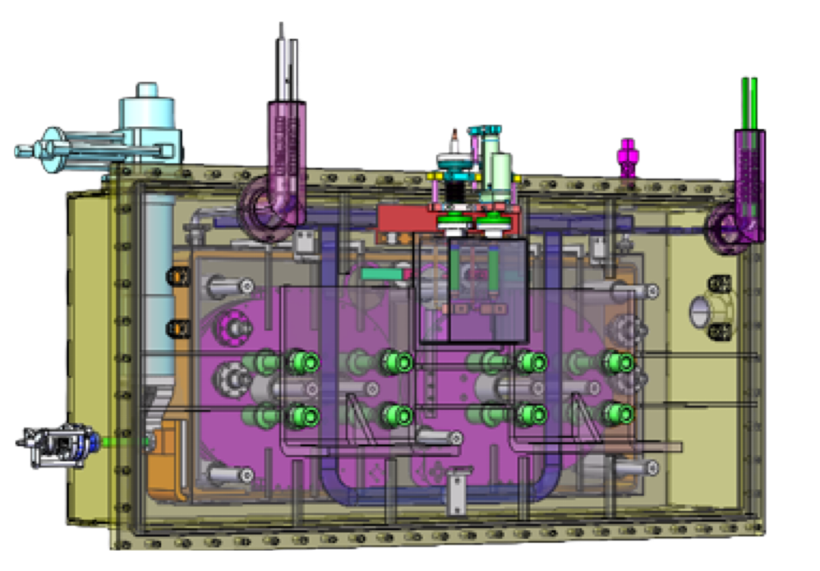
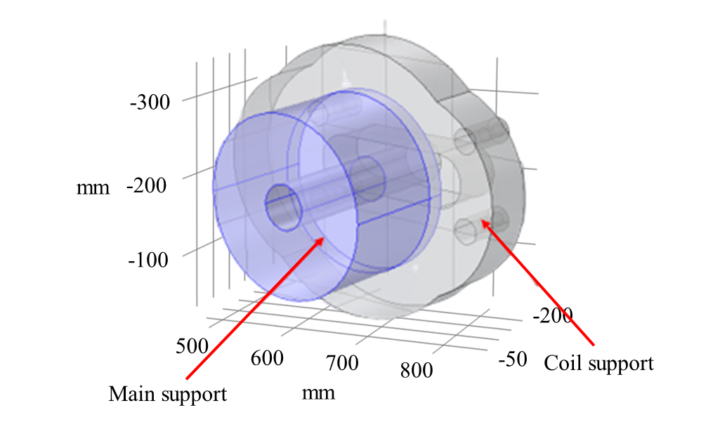
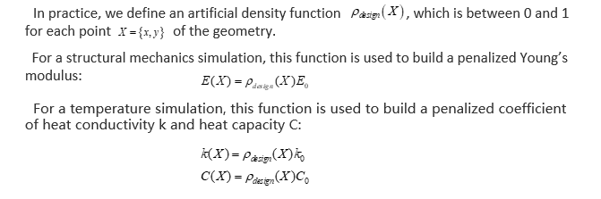
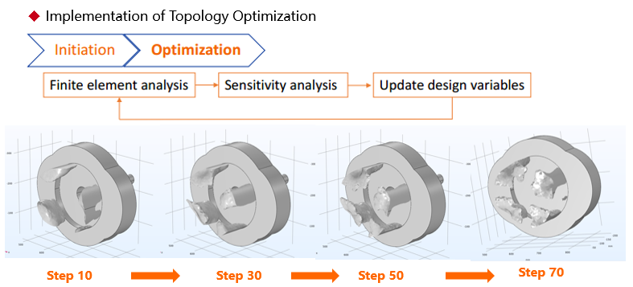
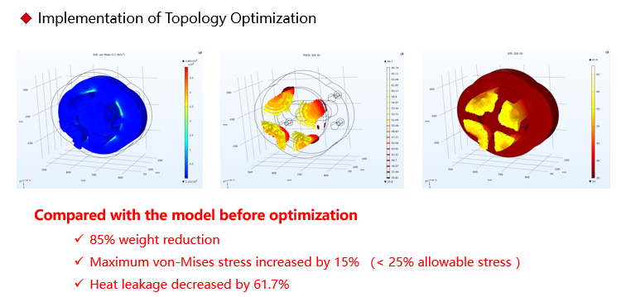
Multiphysics field topology optimization design of heat conduction structure of high-temperature superconducting magnets
Based on COMSOL Multiphysics software, he solid isotropic material with penalization (SIMP) topology optimization method was used to carry out the topological analysis of multi-physics.
Qing Shao, Kai Li, Miao Yu Maglev technology institute, CRRC Changchun Railway Vehicles Co., Ltd.
Abstract
The high-temperature superconducting magnet (HTS) is one of the core technologies of a superconducting maglev. The effects of multi-physics fields including electromagnetic, mechanical, and thermal should be taken into consideration in design. To solve the above problems, based on COMSOL Multiphysics software,
the innovative structure of main sup-port is obtained by multi-physics field topology optimization. The results show that the method adopted in this paper can reduce the heat leakage by 61.7% while reducing the weight of the main support by 85%, and the max Von-Mises stress does not exceed the yield limit of the material.
Methodology
FIGURE 1. The design area of the main support
Results
REFERENCES
M. Terai, M. Igarashi, S. Kusada, K. Nemoto, T. Kuriyama, S. Hanai, T. Yamashita, and H. Nakao, “The R&D Project of HTS Magnets for the Superconducting Maglev,” IEEE Trans. Appl. Supercond., vol. 16, no. 2, Jun. 2006.
K. Mizuno, M. Sugino, M. Tanaka, and M. Ogata, “Experimental Production of a Real-Scale REBCO Magnet Aimed at Its Application to Maglev,” IEEE Trans. Appl. Supercond., vol. 27, no. 4, Jun. 2017, Art. no. 3600205.

