Slide 1
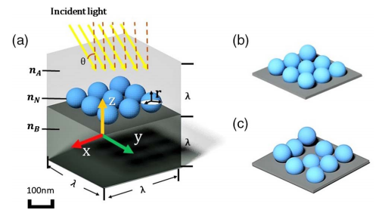
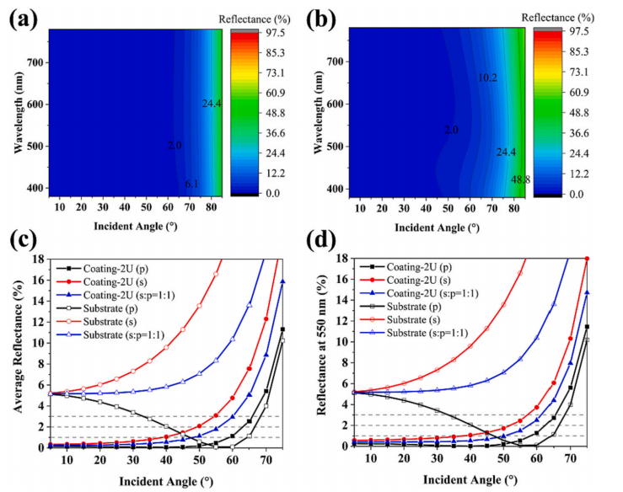
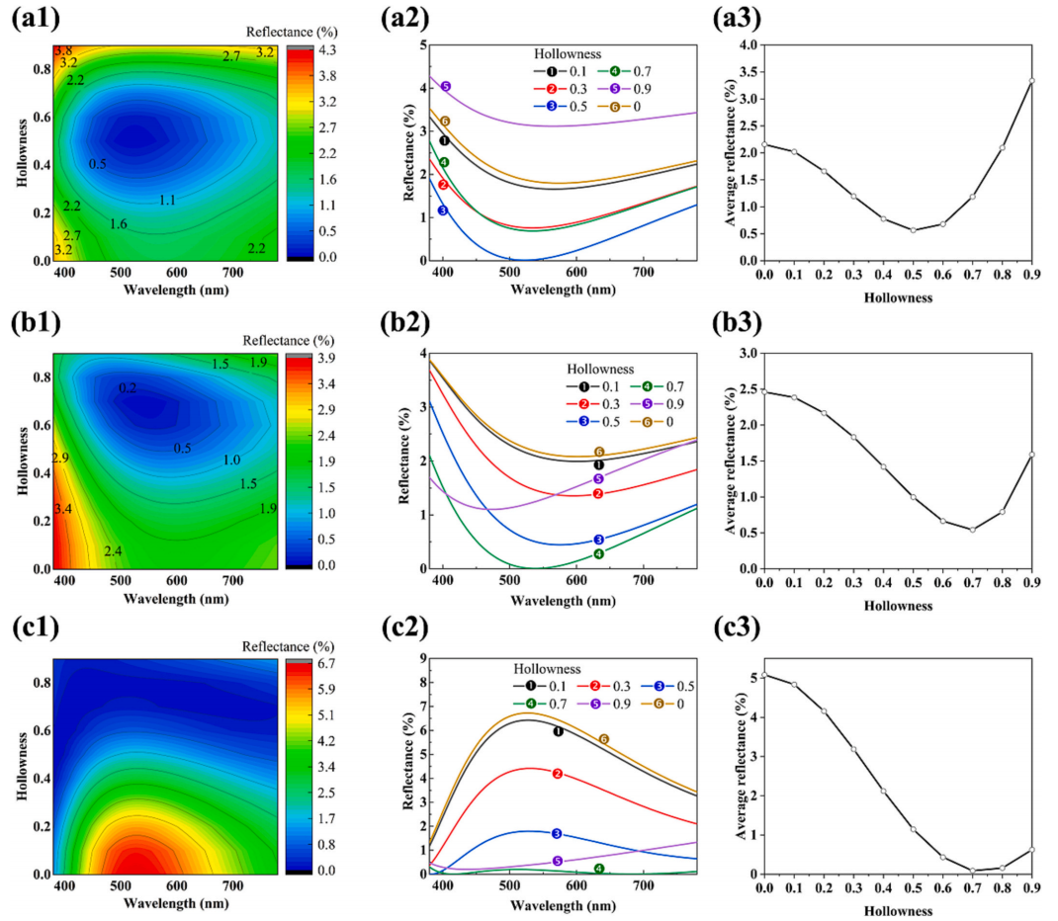
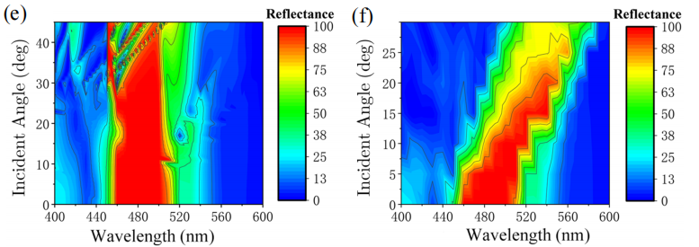
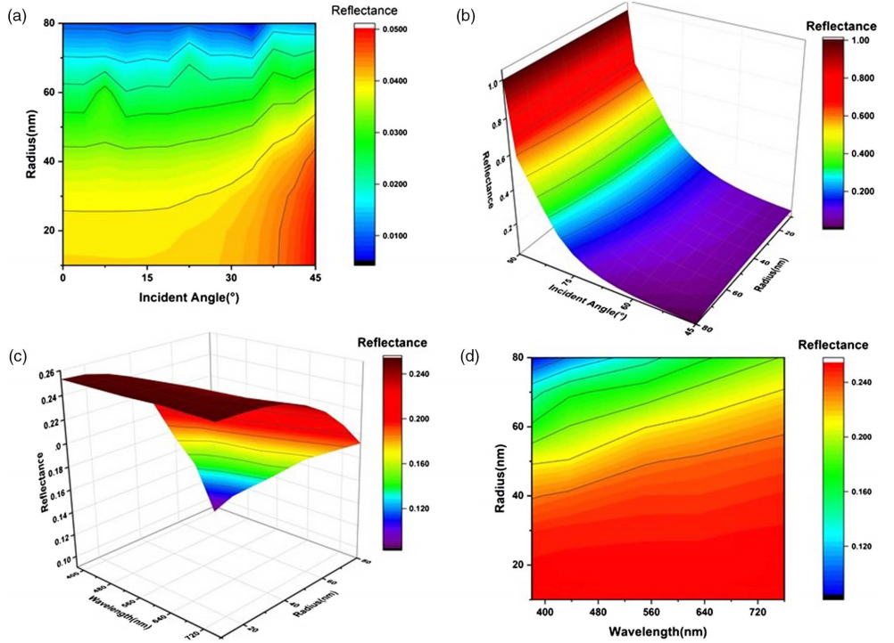
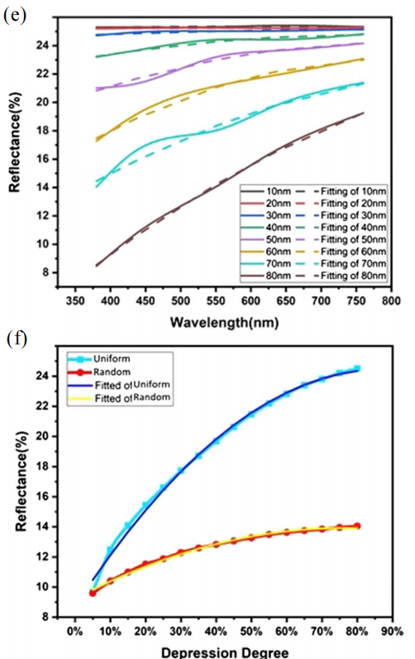

Interfacial reflectance regulation based on nanospheres
By constructing the structure of the nanosphere, the reflectivity is regulated by optimizing the parameters
X. H. Li¹, H. Lei², T. Yang¹, H. J. Li¹
1. School of Mathematics and Physics, Southwest University of Science and Technology, Mianyang 621010, P. R. China.
2. School of Materials and Chemistry, Southwest University of Science and Technology, Mianyang 621010, P. R. China.
Abstract
At present, the study of anti-reflection structure on the surface of plastic substrates focuses on hollow silica particles (HSP) and their mixing effect with solid particles, and the optical properties of HSP are investigated in the visible spectrum by using COMSOL Multiphysics® software. It was found that HSP of a specific size (100nm) combined with small size solid silica particles can achieve average reflectance as low as 0.24% in a hexagonal lattice arrangement by optimizing resin coverage and particle spacing. Inspired by Morpho butterflies, we propose a bionic nanosphere structure, which achieves a high reflectivity bandwidth of >99% by adjusting geometric and material parameters, and has little dependence on incident light Angle. The simplified structure is convenient for non-lithographic assembly, showing potential in laser resonators and optical filters. For flexible plastic substrates, the resin-anchored HSP strategy provides a new method to fabricate anti-reflective surfaces. A two-layer HSP structure with different dimensions was designed through two-dimensional simulation and optimization. Combining the bionic theory and the refractive index adjustment principle of the film layer, the ultra-low average reflectance of 0.14% was achieved, and the reflectance of wide Angle was <3% when the incidence Angle was <60°. In addition, we simulate the anti-reflection effect of oxide nanosphere monollayers, and propose a function describing the relationship between reflectivity and influencing factors, which significantly reduces the reflectivity of glass under certain conditions, providing innovative ideas for optical devices such as filters, polarization elements and camera lenses. These studies not only deepen the understanding of anti-reflection mechanism, but also point out the direction for future experiments and practical applications.
Methodology
We studied the effects of different factors on the reflectance of three coatings with different structures, and proposed a "resin-anchored double-layer HSPs" coating model with ultra-low reflectance (< 0.35%) in all visible wavelengths. In addition, we simplified the surface microstructure of the Morpho butterfly by replacing the surface cuticle with nanospheres and the surface microstructure with the void near the overlap of the nanospheres and the air layer. We simulated the structure of biomimetic butterfly nanospheres by using a three-dimensional periodic model. We also simulated the appearance of the film surface by building a three-dimensional periodic model. The influencing factors are combined with functions.
Fig. 1 The effect of incident Angle on reflectance at w¼300 nm, d¼0.84, and the effect of hollowness of the three coating materials on reflectance, deviating from the contour plot of reflectance variation with incident Angle of Coating-2U.
Results
It was found that HSP of a specific size (100nm) combined with small size solid silica particles can achieve average reflectance as low as 0.24% in a hexagonal lattice arrangement by optimizing resin coverage and particle spacing. By adjusting the geometry and material parameters, we also achieved a high reflectivity bandwidth of >99% with little dependence on the Angle of the incident light. The double-layer HSP structure designed by us combines the principle of bionics and refractive index adjustment of the film layer to achieve an ultra-low average reflectance of 0.14% with wide-angle anti-reflectance (<3% at <60° incidence Angle). In addition, we simulate the anti-reflection effect of oxide nanosphere monollayers, and propose a function describing the relationship between reflectivity and influencing factors, which significantly reduces the reflectivity of glass under certain conditions, providing innovative ideas for optical devices such as filters, polarization elements and camera lenses. These studies not only deepen the understanding of anti-reflection mechanism, but also point out the direction for future experiments and practical applications.
Fig. 2 Effects of radius and wavelength on reflectance and fittings of the results.
ckwx
REFERENCES
Hong Lei, et. al., Design of a novel anti-reflective coating with ultra-low reflectance based on resin-anchored hollow silica strategy, Progress in Organic Coatings, 186, 108033(2024).
王宇等，树脂锚定SiO2粒子构建减反射表面模拟，光学学报， 43(9)，0931004. （2023）。
Yaohui Wang, et. al., Mimicking the structure of Morpho butterfly wing surface: a highly reflective nanostructure assembled by nanospheres, Journal of Nanophotonics, 16(4), 046005(2022).
Yuxiao Hou, et. al., Simulation on antireflection of the oxide nanosphere monolayer film, Applied Optics, 58(18), 4826-4932(2019)

