Slide 1
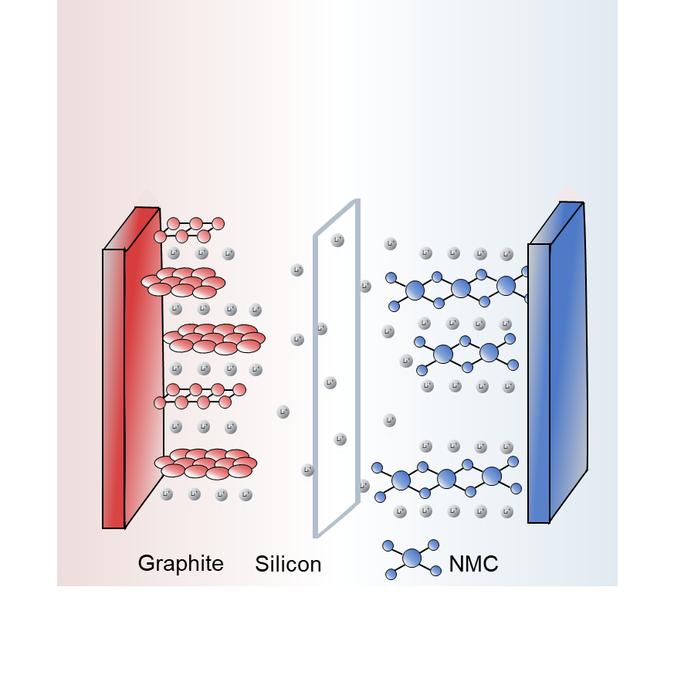

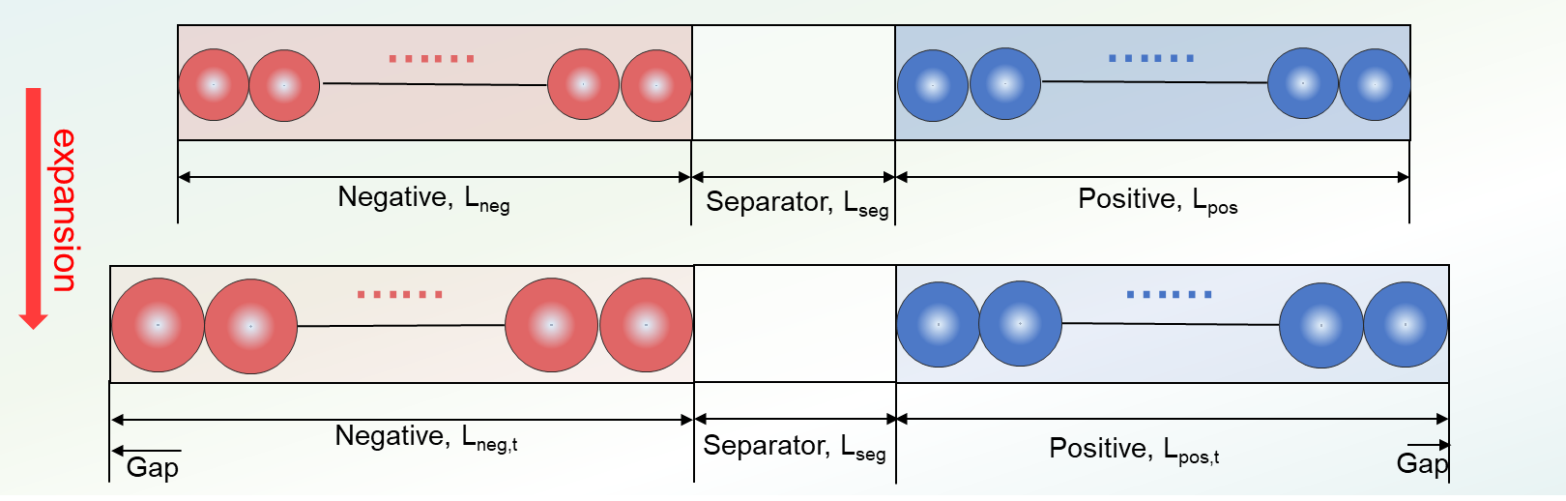
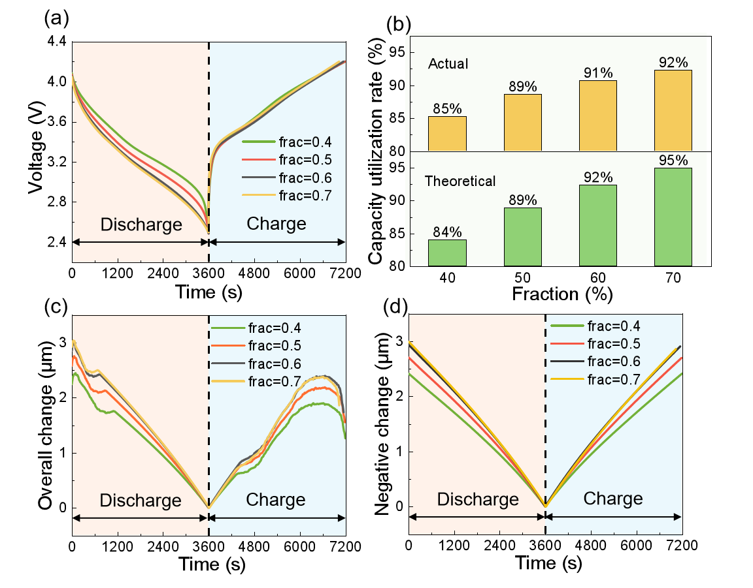
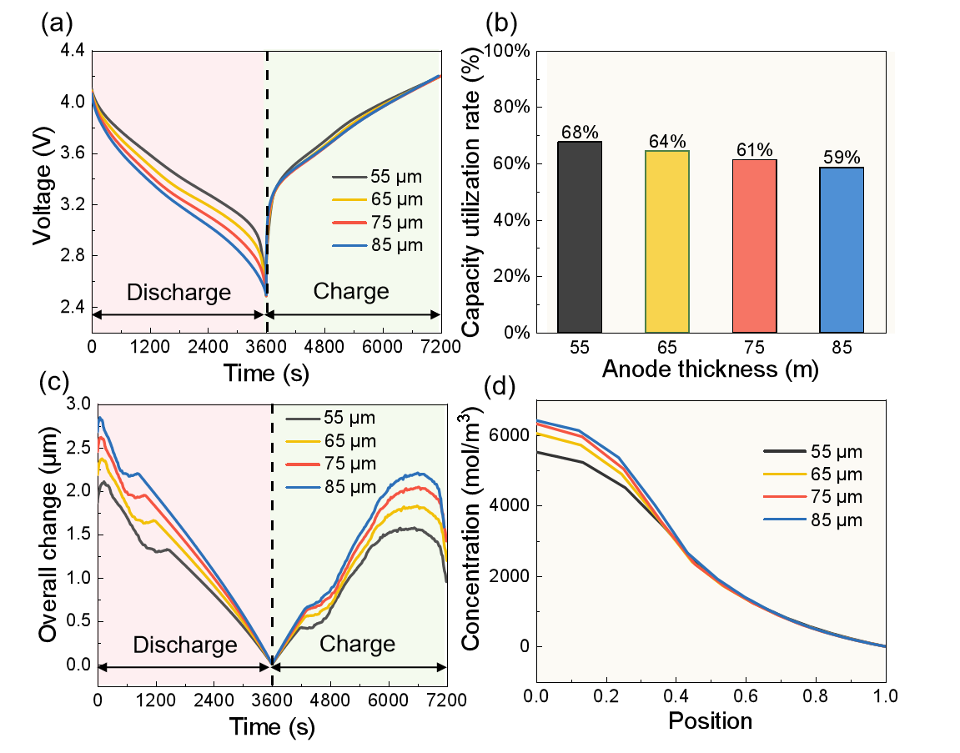
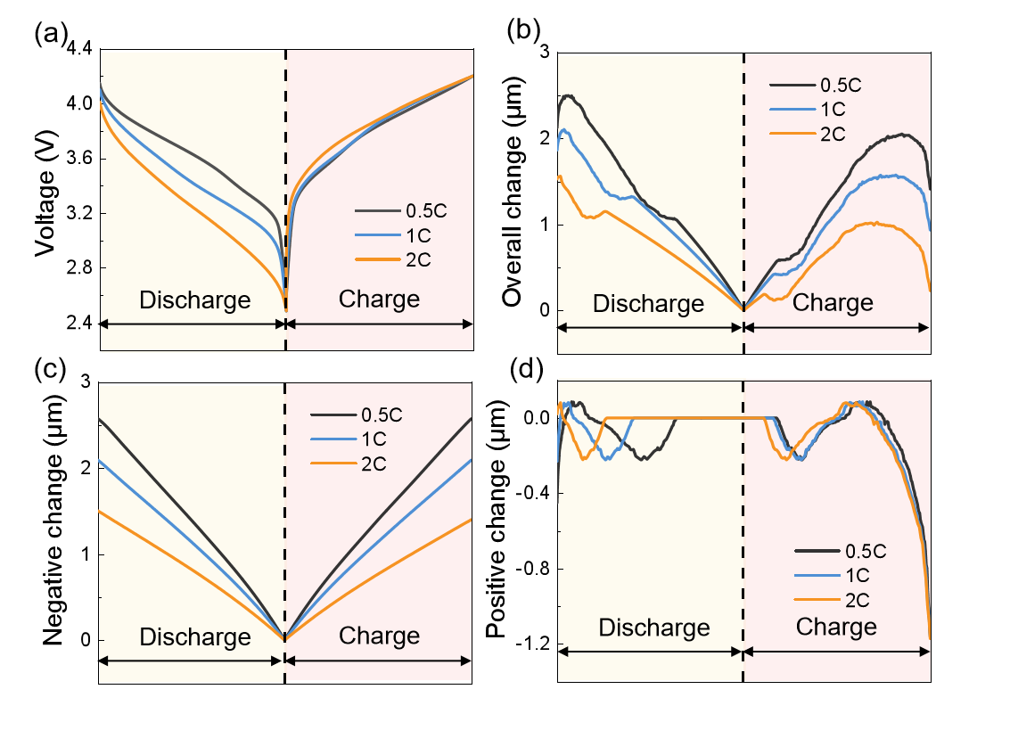
Modelling and analysis of the volume change behaviors of Li-ion batteries with silicon-graphene composite electrodes
By using a moving boundary method, the size changes of active particles during the (de)lithiation processes are translated into the evolution of battery thickness.
Xueyan Li¹, Zhiyuan Zhang^{1,2}, Lili Gong^{1,*}, Kang Fu¹, Haosong Yang¹, Chenyang Wang², Peng Tan^{1,*}
Department of Thermal Science and Energy Engineering, USTC
Gotion High-Tech Co., LTD
Abstract
Silicon-based composites are recognized as one of the most promising negative electrode materials owing to their high theoretical capacity. However, during (dis)charging, the silicon particles undergo significant volume changes, resulting in electrode thickness variation over the cycle. This maps to the cell scale as a change in cell thickness, which translates into outward pressure.
To demonstrate the impact of swelling on the cell thickness variation, a model is developed using the moving boundary approach. The ratios of the composites are classified to analyse the contribution of two materials to the capacity. The impacts of the electrode design and operating conditions on the electrochemical performance and thickness variation of the cell are also investigated.
Methodology
The effect of size variation of active particles on the thickness of anode and cathode is modeled by the equation:
Figure 1. Schematic diagram of the evolution of battery thickness.
Results
Figure 2. The electrochemical performance and thickness change of the cell under various compositions.
Figure 3. The electrochemical performance and thickness change of the cell under constant porosity but changing thickness.
Figure 4. The electrochemical performance and thickness change at various currents.
Silicon’ conductivity and diffusion rate is low. After increasing the silicon content, the capacity and the thickness change increases, the lithiation gradient inside the particles increases, and the concentration polarization increases.
Increase in the thickness of the active layer within a certain range: increase in active loading, rise in actual capacity thickness change exacerbates the growth of ion transport paths, increase in concentration polarization.
Increasing current makes the internal reaction imbalance increasing and the pressure dropping to be greater; particle utilization decreases and the cell thickness evolution declines, dominated by the negative electrode.
REFERENCES
1. Thomas F. Fuller et al. Simulation and Optimization of the Dual Lithium Ion Insertion Cell, J. Electrochem. Soc. 141 (1994 ) 1
2. H. Pegel et al. Volume and thickness change of NMC811|SiOx-graphite large-format lithium-ion cells: from pouch cell to active material level, J. Power Sources. 537 (2022) 231443.
3. M.N. Obrovac et al. Alloy Design for Lithium-Ion Battery Anodes, J. Electrochem. Soc. 154 (2007) A849.
Excerpt from the Proceedings of the COMSOL Conference 2024 Shanghai

