Slide 1
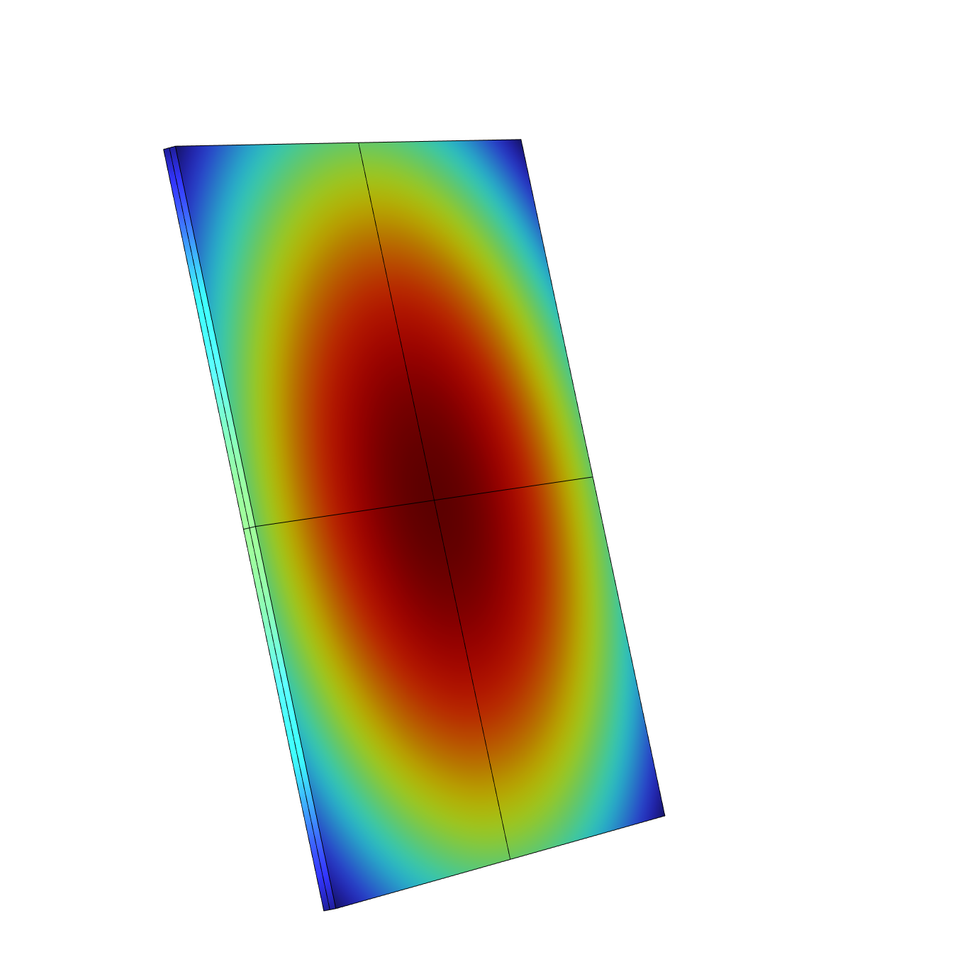
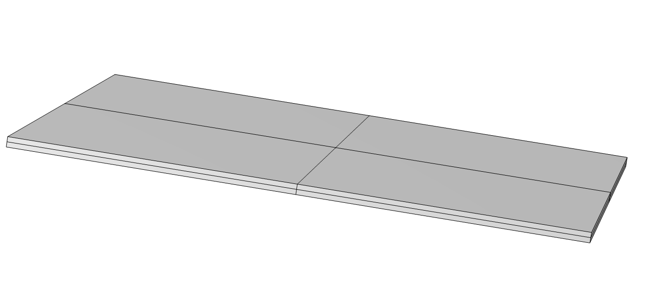
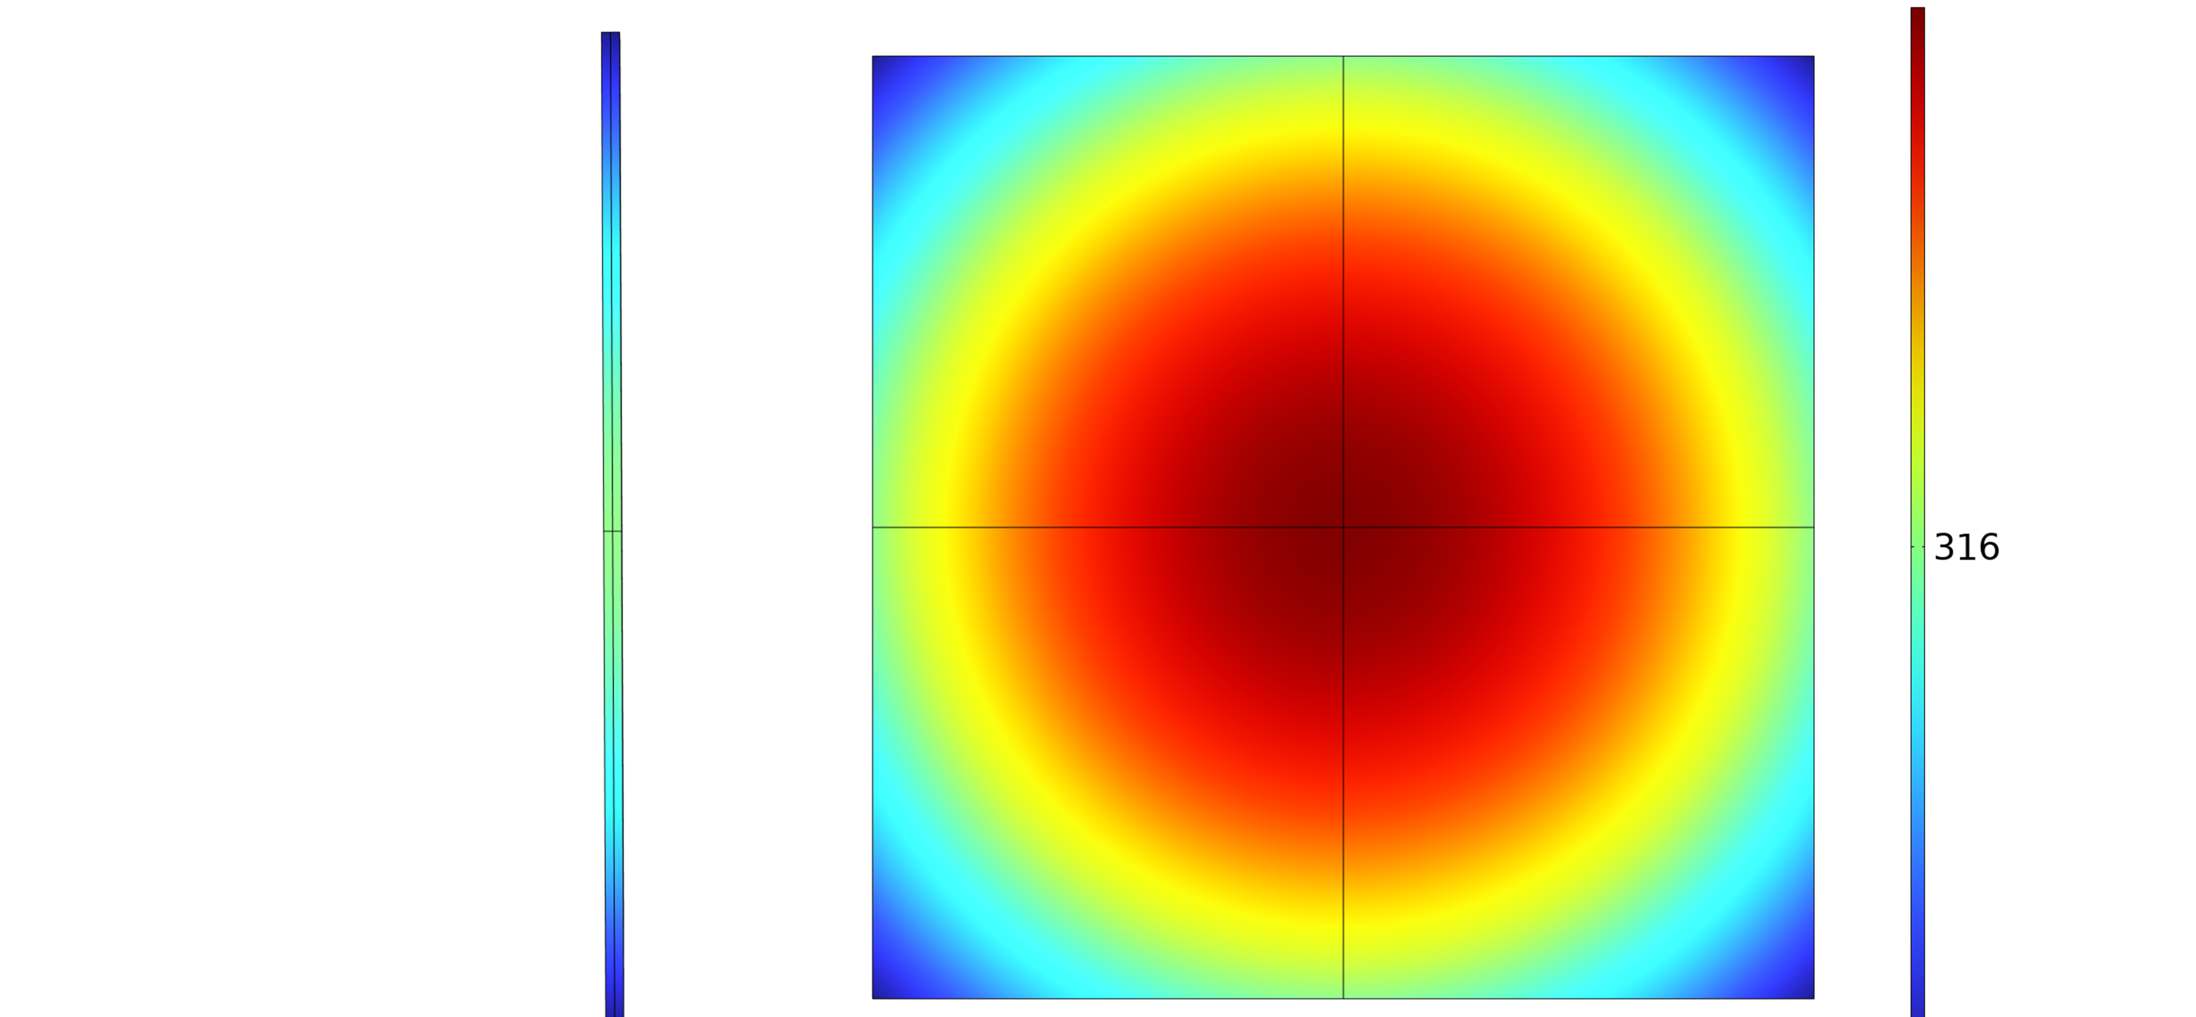

P2D-Three Dimensional Heat Transfer Coupling Modeling
Through the coupling of P2D model and 3D heat transfer model, the temperature and electrochemical reaction rate distribution of pouch cells in charge/discharge cycles are explored to find the balance point between calculation accuracy and calculation volume.
H.S. Yang¹, P. Tan¹
1 Department of Thermal Science and Energy Engineering, University of Science and Technology of China, Hefei, China
Abstract
The temperature distribution change of a pouch cell during charging and discharging is initially investigated by coupling a 3D heat transfer model with a P2D model, and it is found that the internal temperature rise of the battery is more than 20°C after one cycle at a rate of 1C, while the maximum temperature difference inside the battery is more than 0.2°C. Compared with the three-dimensional electrochemical-heat transfer model, the computation amount of this model is reduced by at least 80%, which guarantees a certain accuracy while releasing the arithmetic power.
Methodology
The heat transfer model consists of eight battery microelements with dimensions of 1 cm × 1 cm × 180 μm, each of which is considered to be a homogeneous heat source, using the solid heat transfer module in COMSOL Multiphysics. And 8 P2D models are used to calculate the charging and discharging processes and the reaction heat. Each P2D model corresponds to a battery microelement in the heat transfer model, and the reaction heat is considered as the heat production per unit volume of the battery microelement. A domain probe is implanted in each cell microelement of the 3D heat transfer model to measure the average temperature, and the temperature is transferred to the corresponding P2D model, realizing the coupling of electrochemical model and heat transfer model.
FIGURE 1. Structure of the heat transfer model of the cell.
Results
FIGURE 2 shows the temperature distribution on the surface of the battery after 10000 seconds of operation. Setting the charging/discharging rate as 1C, the resting time as 300s, the initial temperature as 293.15K, and the heat transfer coefficient of the surface as 1 W m⁻² K⁻¹, the battery was operated for 10000 s. The maximum temperature rise of the battery as a whole during the period was about 24.4 K, and the maximum temperature difference inside the battery was about 0.2 K.
FIGURE 2. Temperature distribution on the cell element surface at 10000 seconds.
Marc Doyle, et. al. Modeling of Galvanostatic Charge and Discharge of the Lithium/Polymer/Insertion Cell. J. Electrochem. Soc. 140 1526(1993).
2. Das Goswami BR, et. al.A combined multiphysics modeling and deep learning framework to predict thermal runaway in cylindrical Li-ion batteries. J Power Sources 595:234065(2024).

