Slide 1
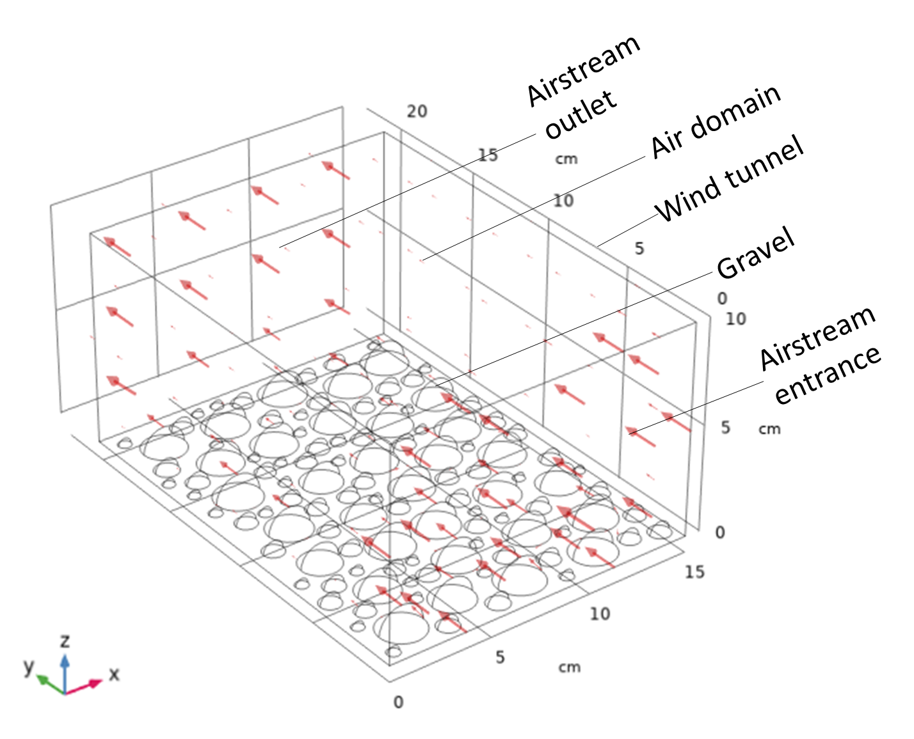
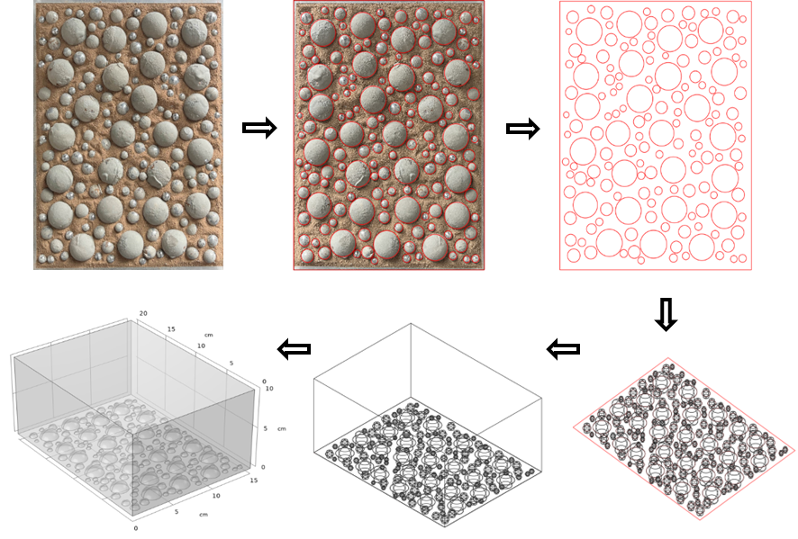
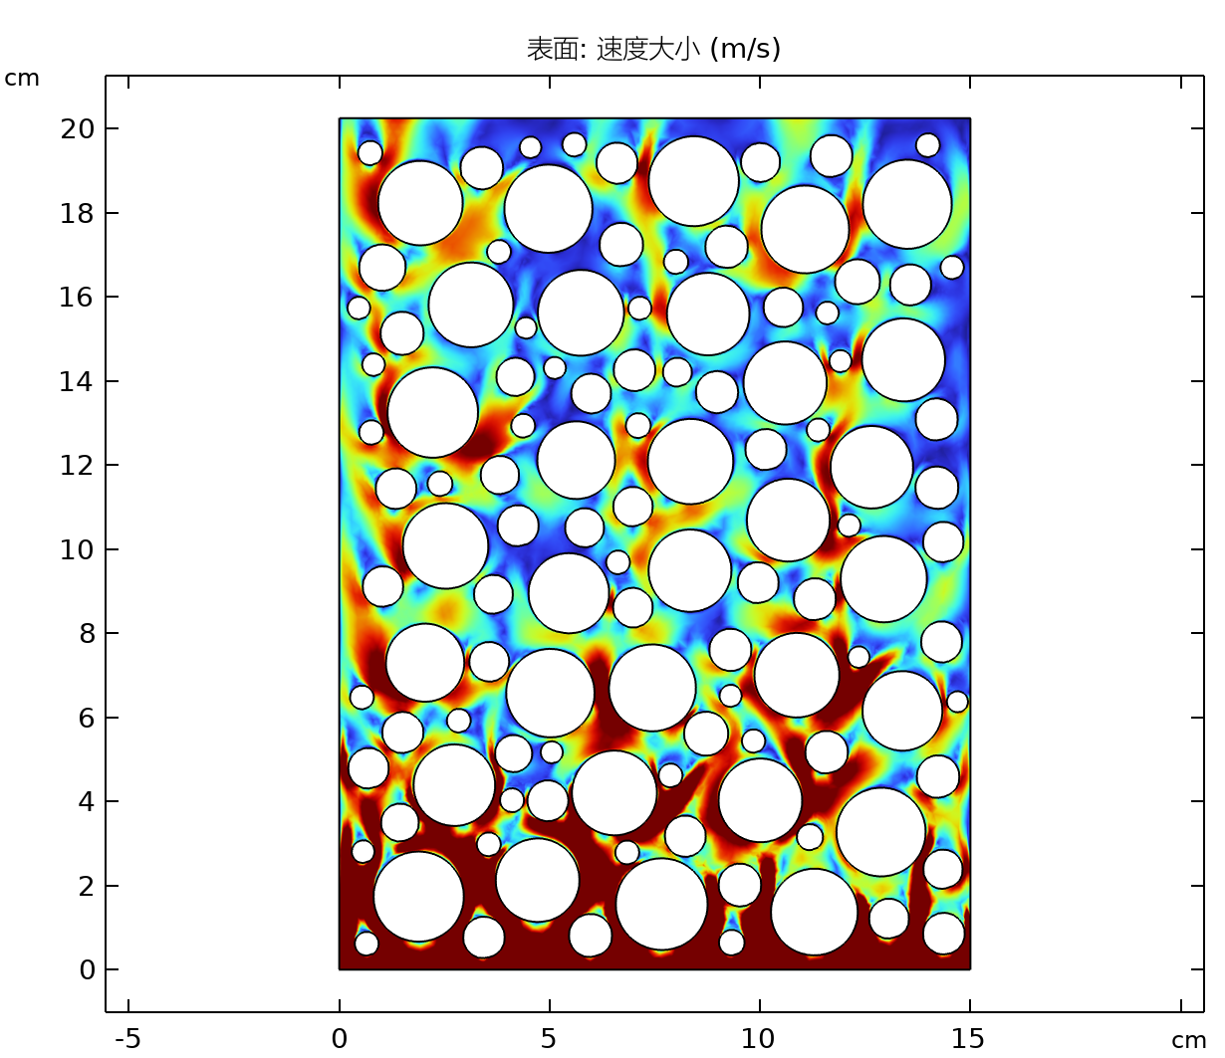
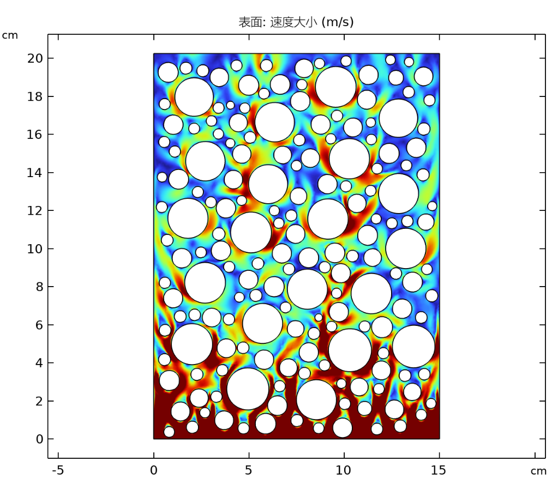
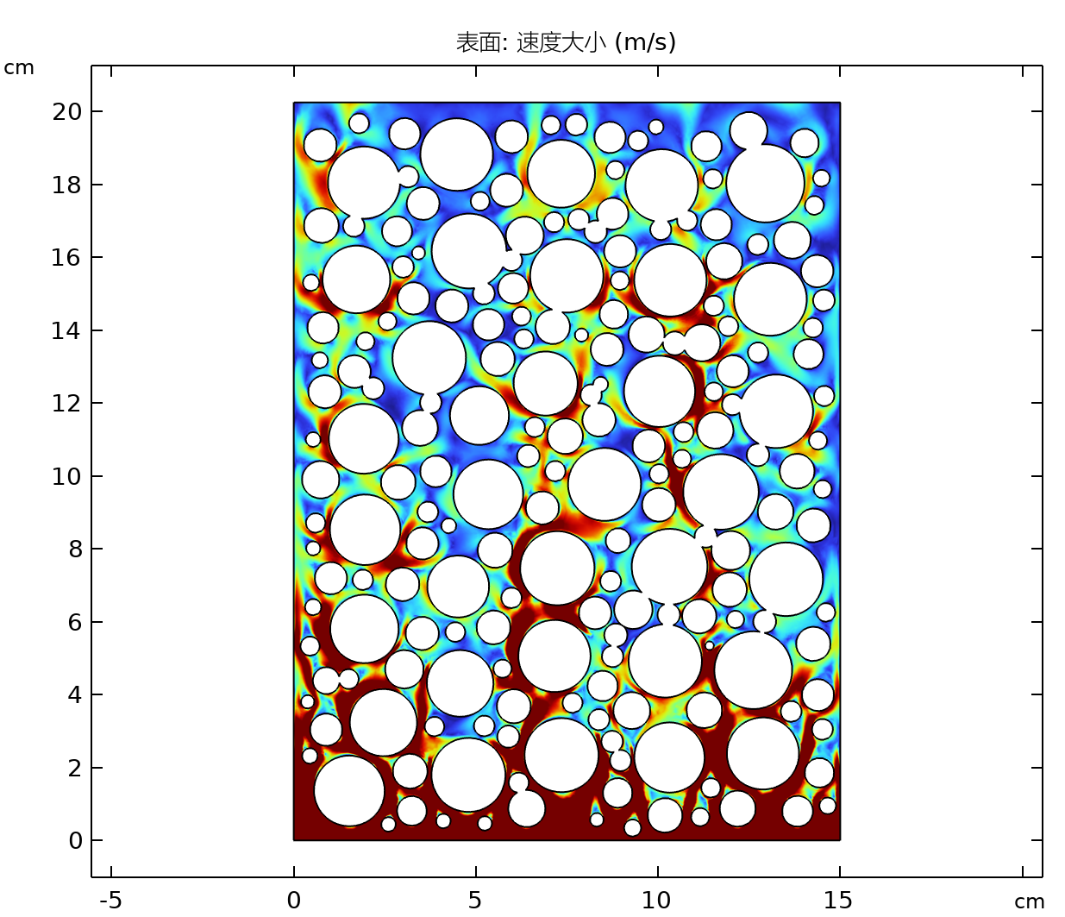

Wind-erosion resistance mechanism of the gravel curtain layer in desert mining area of Xinjiang, China
The influence pattern and mechanism of gravel cover degree and cover type on the wind erosion resistance of gravel layer were investigated.
J. W. Li¹, W. M. Guan¹, Y. Zheng¹
1. School of Geology and Mining Engineering, Xinjiang University, Urumqi, China.
Abstract
The gravel layer is a special surface cover in the desert area of northwest China, which is composed of soil crust and surface gravel, and has the function of inhibiting soil erosion. Combined with the previous wind tunnel experiments, a three-dimensional simulation model of gravel curtain layer erosion was established by
using COMSOL numerical simulation software to investigate the damage mechanism of gravel layer erosion under different gravel distribution types (different gravel diameter ratios) and coverage degrees.
Methodology
The gravel distribution on the surface of the specimen and the corresponding wind speed settings were restored from the previous wind tunnel test, and the “unidirectional flow - turbulence (low Reynolds index k - ε)” module of the software was invoked to obtain the distribution of velocity field on the surface of the gravel layer with different types of gravel distribution and coverage after the calculation.
FIGURE 1. Reduction process of gravel distribution model on the surface of the gravel layer
Results
The results can be seen in Figure 2, with the proportion of large-size gravel gradually increasing, the area of the specimen surface exceeding the threshold friction velocity gradually increases; with the gradual increase of the covered area, the area of the specimen surface exceeding the threshold friction velocity gradually decreases; the larger the grain size of the gravel, the larger the surrounding wind speed, which leads to the larger the amount of wind erosion in the area around it.
FIGURE 2. Surface velocity field distribution for different distribution types, coverage, and particle sizes
REFERENCES
1. G. Q. Qian, Z. B. Dong, W. Y. Luo, “Gravel morphometric analysis based on digital images of different gobi surfaces in Northwestern China”, Journal of Desert Research, 34(3), 625-633, 2014.
2. X. Wang, Y. H. Wang, Y. Y. Xu, “Morpho-logical characteristics based on digital images of gravels from gravels beaches in the Changshan Island, Shandong Province”, Haiyang Xuebao, 43(1), 110-121, 2021.

