Slide 1
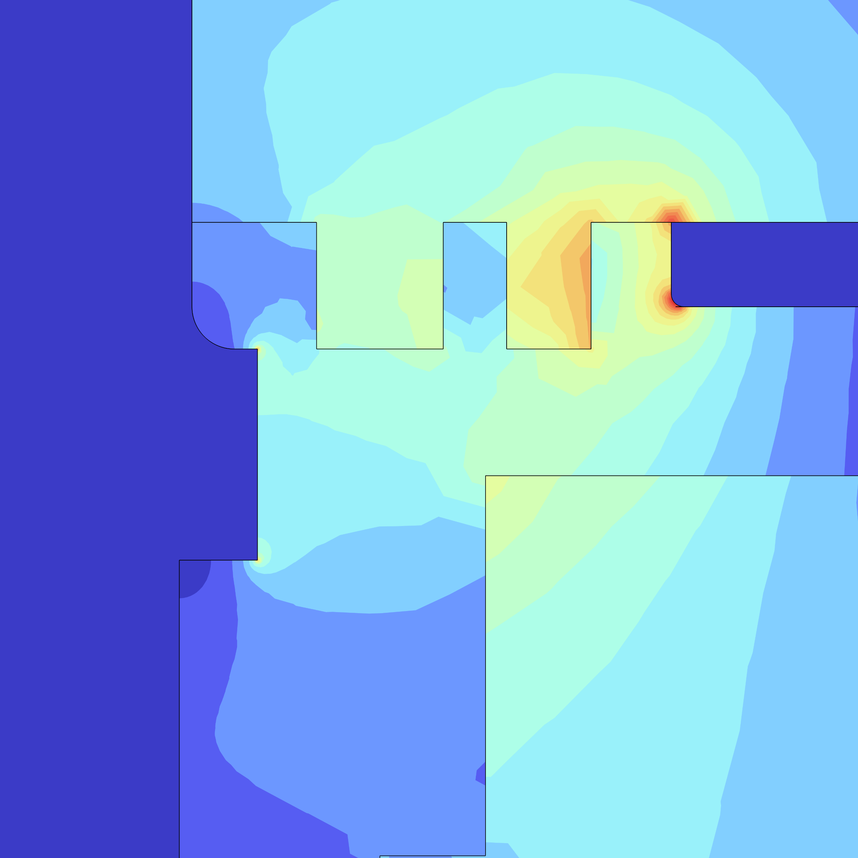
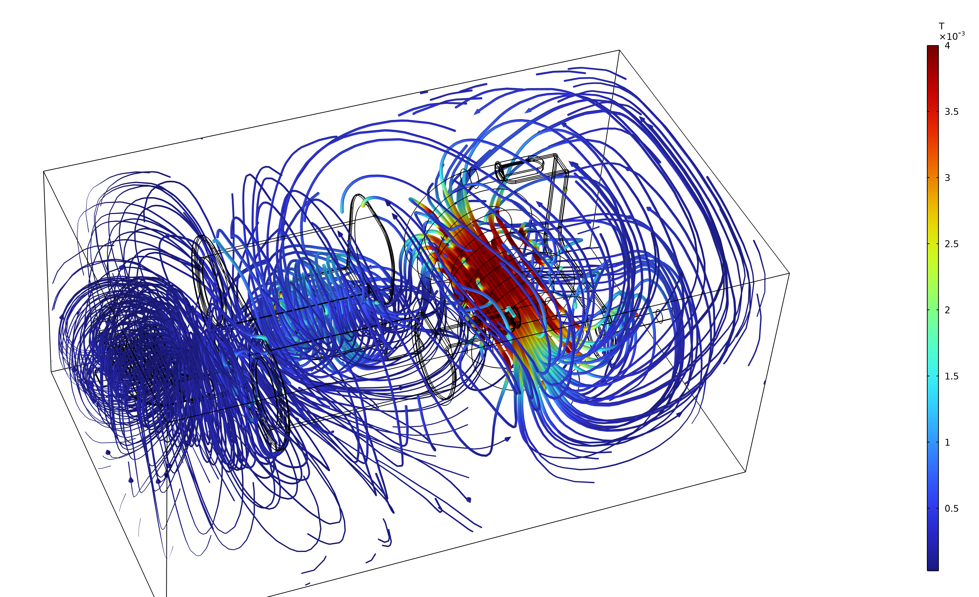

Electromagnetic Compatibility (EMC) Simulation Of RF Matching Network For Plasma Application
Simulation analysis of the detailed distribution of theelectromagnetic field within the matchbox offers valuable insights for the further optimization of its design.
Yujiao Zhang¹, Wenjie Liu¹
1. Application Department , TRUMPF Hüttinger Electronics (Taicang) CO., Ltd, Suzhou, China.
Abstract
The RF matching network is a critical component positioned between the RF generator and the plasma chamber, designed to transform the plasma impedance to a value suitable for the RF generator. Because the matching network design must be highly customized based on the specific conditions within the plasma chamber, accurate simulation during the design phase is crucial. The simulation team at Hüttinger China employs a hybrid simulation approach that
integrates electromagnetic field and circuit modeling to accurately represent the electromagnetic compatibility (EMC) conditions within the matching network. This simulation methodology has been validated through experimental measurements, demonstrating its reliability. By optimizing multiple parameters, further improvements in the design of the RF matching network can be achieved.
Type | Test | COMSOL | Deviation (%)
Vin_rms(V) | 223.61 | 225.17 | 0.70
Iin_rms(A) | 4.47 | 4.44 | 0.67
C0(pF) | 1150.35 | 1159.90 | 0.83
C1(pF) | 99.50 | 105.36 | 5.89
Vout_rms(V) | 1565.42 | 1611.73 | 2.96
I_out_rms(A) | 45.40 | 46.74 | 2.95
Methodology
The AC/DC module was applied, utilizing the Magnetic Fields and the Circuit interfaces to conduct EMC simulations of the Matchbox. A lumped port served as the excitation source at the input terminal and the output port was coupled with the Circuit interface to represent the load impedance, significantly reducing the simulation’s computational demands.
In the laboratory, a test bench was established to measure current and voltage at both the input and output ports of the Matchbox during impedance matching, along with the values of the matching capacitors, to validation of the simulation results.
FIGURE 1. Test data and simulation data comparison.
Results
The deviation between the simulation and experimental results ranged from 0.7% to 5.9%, indicating a strong correlation between the two datasets.
As illustrated in Figure 2, the regions with stronger magnetic fields are concentrated around the center of the large coil and its surroundings, whereas the electromagnetic field at the input port is comparatively weaker. Additionally, the voltage at the output port is notably high, which may present a risk of arcing.
FIGURE 2. Magnetic flux density distribution inside the Matchbox
REFERENCES
1. [1] David M. Pozar，微波工程（第四版）[M]. 电子工业出版社，北京市，2019.10.

