Slide 1
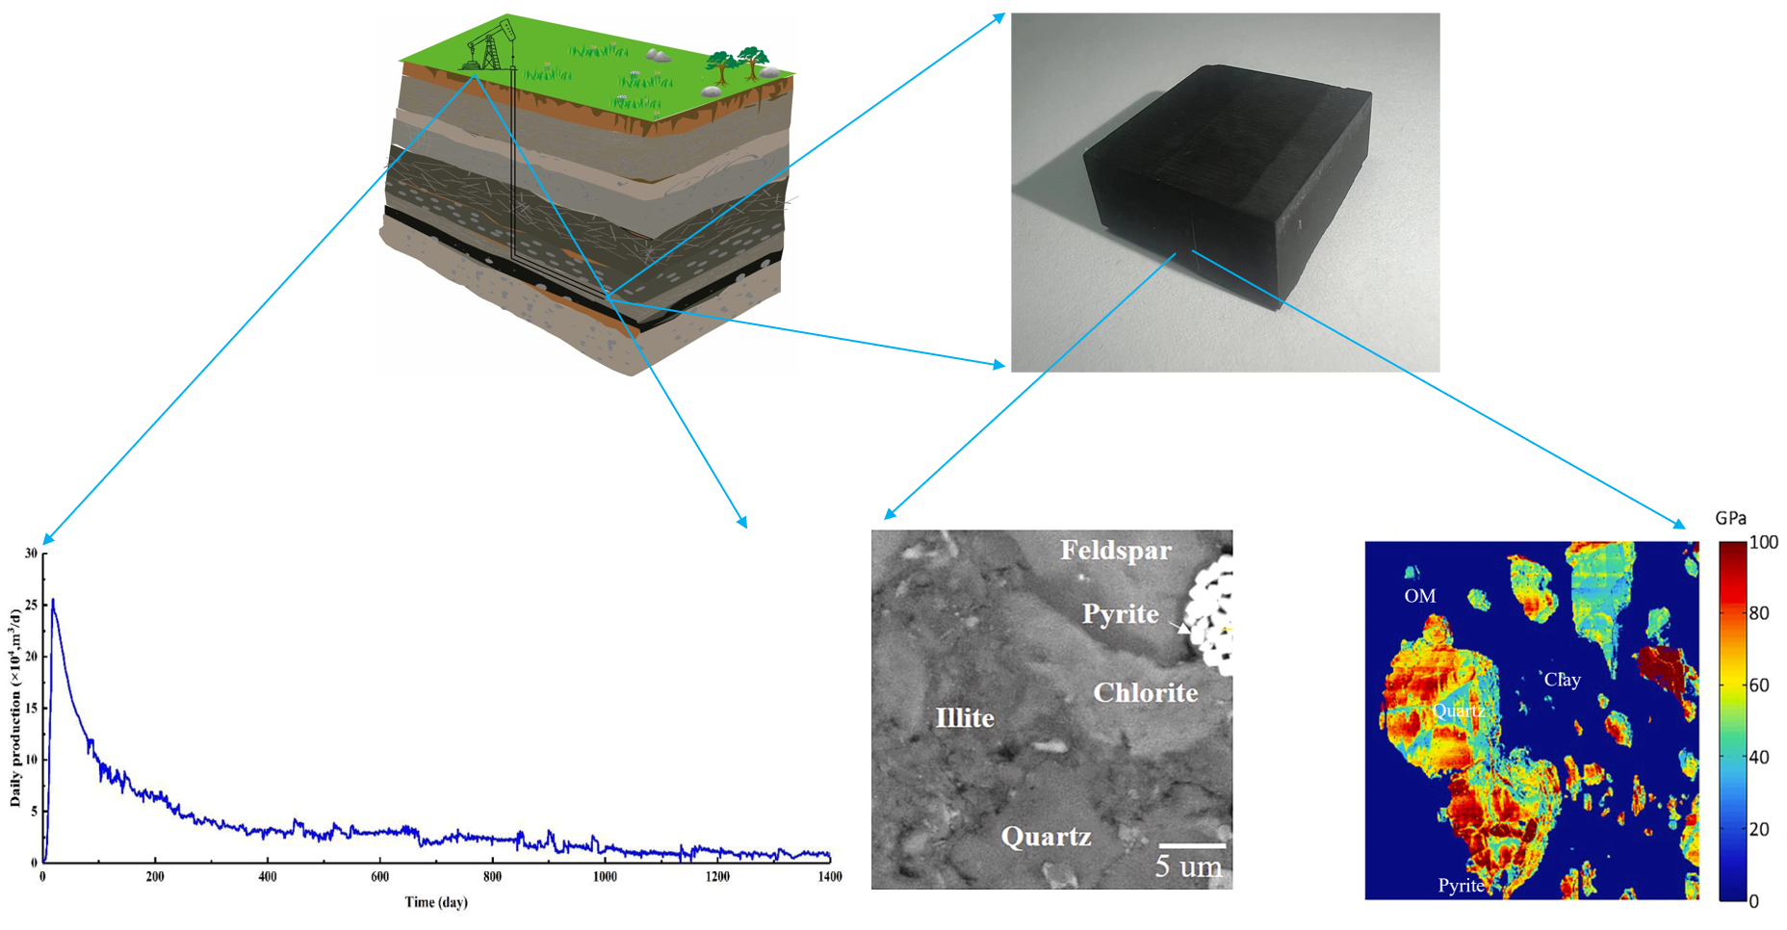
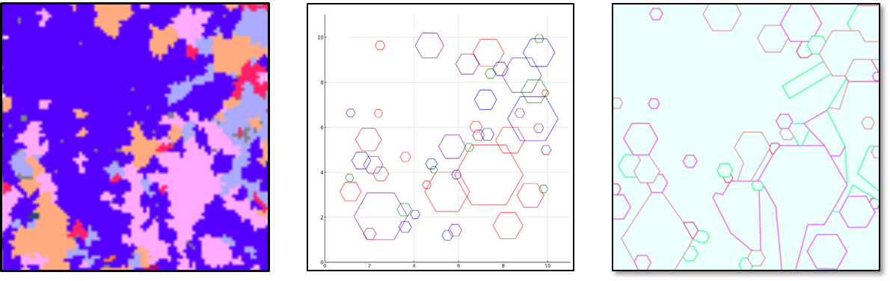
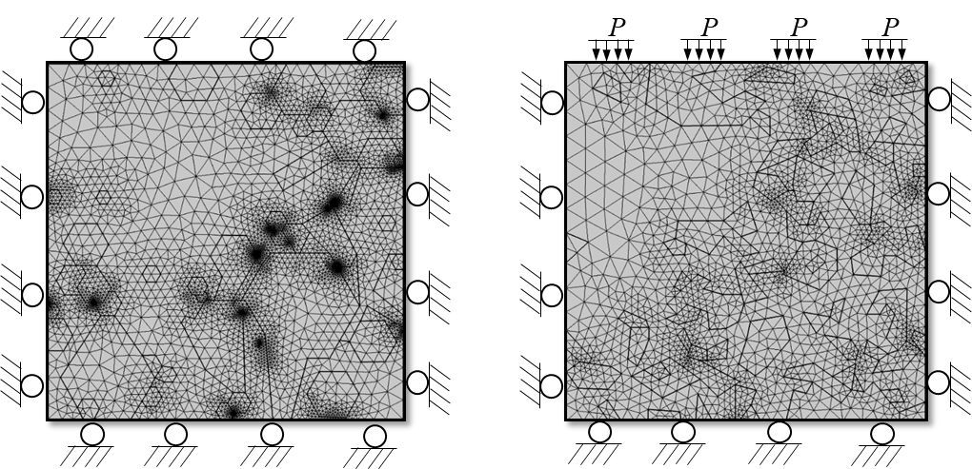
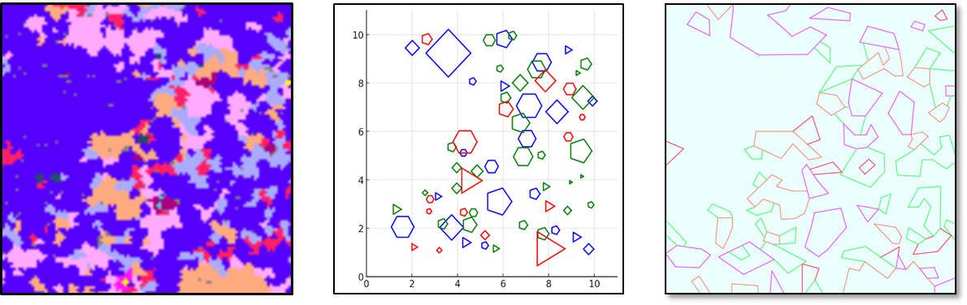

Study on mesoscopic creep characteristics of shale reservoir and its influence mechanism on shale gas production
The interaction between mass transfer and mechanics and its influence on the transport characteristics of mineral gases are elucidated.
Guanglei Cui¹, Yingjie Guo²
1. Key Laboratory of Ministry of Education on Safe Mining of Deep Metal Mines, Northeastern University, Shenyang, China
2. Key Laboratory of Ministry of Education on Safe Mining of Deep Metal Mines, Northeastern University, Shenyang, China
ABSTRACT
With the increasing demand for natural gas, shale gas, as an important unconventional energy, is of great significance to national energy security and economic development. However, the effective exploitation of shale gas is limited by the in-depth understanding of the micromechanical properties of its reservoir, and it is difficult to obtain the mechanical properties of each component of shale at macro scale. Therefore, nano-indentation technology is used to study the microscopic mechanical properties of shale, and based on advanced technology analysis such as X-ray diffraction (XRD) and Automatic Mineral Analysis System (TIMA), a solid deformation-gas flow control model [1] at the microscopic scale is established to analyze and evaluate the influence mechanism of microscopic gas production.
METHODOLOGY
Nanoindentation experiments were carried out to obtain the mechanical parameters of shale at the microscopic scale by using holding load experiments at different loading angles, as well as the mineral composition of shale samples and their spatial distribution characteristics were analyzed in detail by using the TIMA technique.
The geometrical model(Figure 1) was inscribed based on machine learning and the relationship between creep flexibility and Young's modulus with hardness was calculated based on the derivation of the creep intrinsic model.
Based on the results of micromechanical parameter characterization and mineral composition analysis, a mathematical model describing the microscopic flow and creep behavior of shale gas was constructed to explore the specific influence mechanism of creep on the gas production process.
(a)
(b)
Figure 1. Mineral geometric model inscribed (a) level plane; (b) vertical plane.
RESULTS
Figure 2(a) illustrates the contributions of various components to the gas production rate. As depicted, the gas in the inorganic minerals is initially discharged at a high flow rate, which then rapidly decreases. When the reduced extraction pressure reaches the organic matter, the adsorbed gas in the organic matter begins to desorb, serving as a supplementary supply. In the shale gas production process, the early stage primarily involves the recovery of free gas from inorganic minerals, whereas the later stage mainly involves adsorbed gas recovery from organic matter.
Figure 2(b) indicates that for a log-log scale, the shale gas production data reveal two stages with distinct slopes. The first stage is dominated by gas flow from the inorganic matter, while the second stage is mainly governed by gas flow from the organic matter..
(a)
(b)
Figure 2. Comparison of model results with field gas production data: (a) Contribution of different components to gas production; (b) Two stages of gas production in log-log scale.
[1] Cui G, Xia-Ting F, Pan Z, Chen T, Liu J, Elsworth D, et al. Impact of shale matrix mechanical interactions on gas transport during production. Journal of Petroleum Science and Engineering 2020;184.

