Slide 1
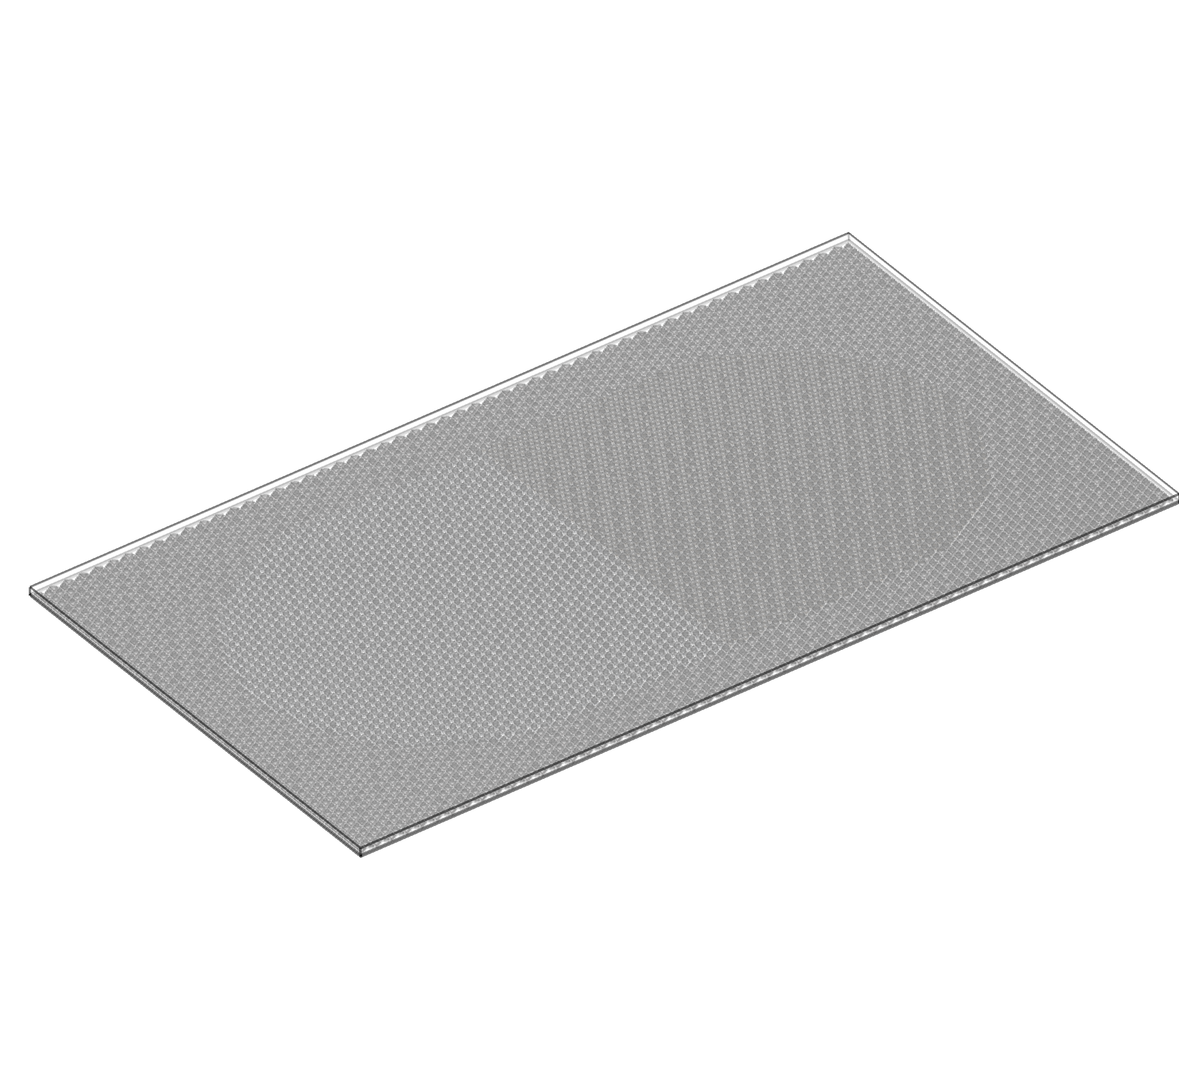
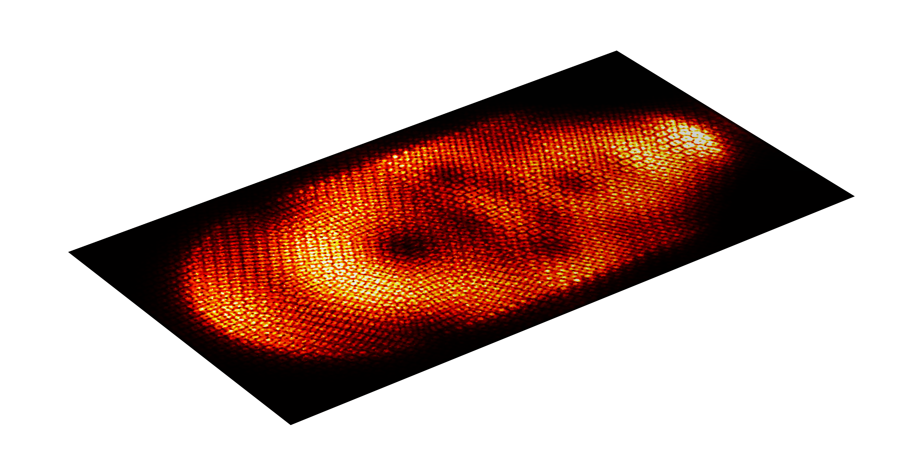
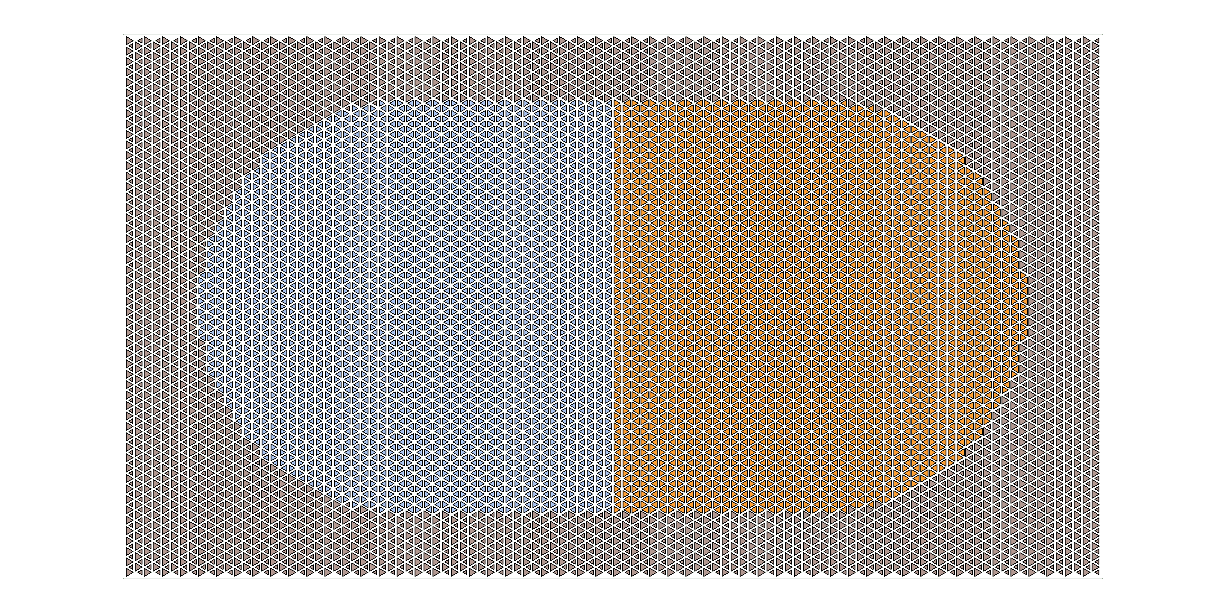
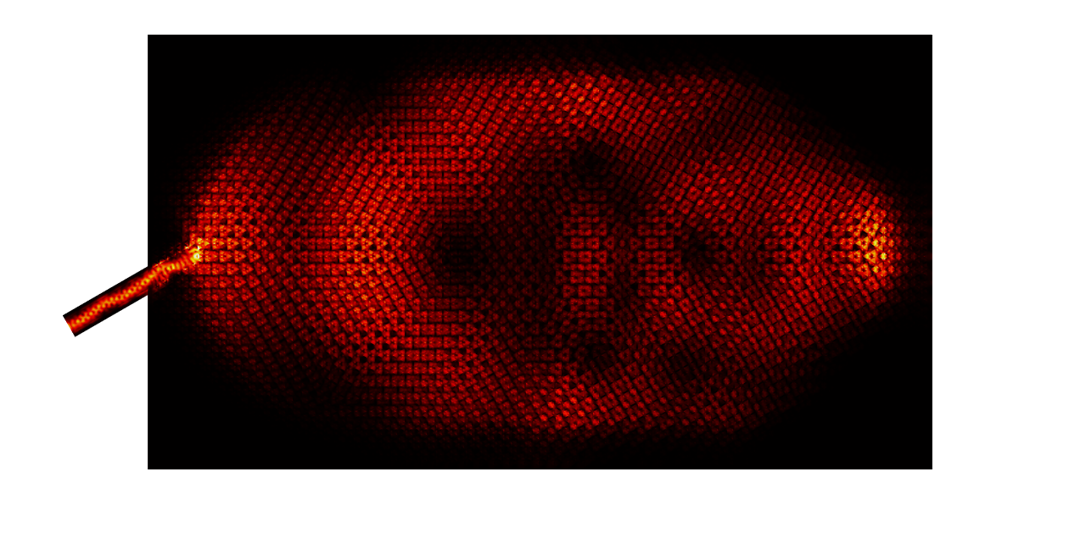




Dirac Photonic Crystal Microcavity
On-chip photonic simulation of relativistic wave chaos.
Xinyu Wang^{1,2,3}，Quwen Yang^{1,2,3}
School of Physical Science and Technology, Lanzhou University, Lanzhou, China.
Lanzhou Center for Theoretical Physics, Lanzhou, China.
Key Laboratory of Quantum Theory and Applications of MoE, Lanzhou, China.
Abstract
Photonic crystals are artificial optical structures with varying optical parameters, e.g. dielectric constants, arranged periodically in space. One characteristics feature is that they possess band-structures akin to those of electronic materials. By choosing appropriate spatial configurations and modulating the structure parameters, one can achieve a linear dispersion relation at the high symmetry point in the first Brillouin zone. Such a band-structure can host quasi-particles effectively obeying the Dirac equation in the long-wave approximation. Thus, photonic crystals can provide a desktop experimental platform for simulating relativistic Dirac particles. We use COMSOL Multiphysics simulations to implement a triangular aperture plate type photonic crystal 1, by which a novel photonic crystal microcavity with Dirac quasi-particle excitations as shown in Fig. 1 is designed to simulate relativistic wave chaos. In particular, based on the scale invariance of the photonic crystals, we adjust the aperture size to manipulate the frequency of the Dirac point to achieve a step potential in the microcavity, and realize a chaotic Dirac billiard model with Klein tunneling effect. We calculate the eigen-modes and obtain the scar state condensed near the classical periodic orbitals.
Methodology
A silicon-based 3D Dirac photonic crystal microcavity model was constructed in COMSOL Multiphysics. The computational effort of the model in TM-like mode was reduced by using the perfect magnetic conductor (PMC) boundary condition. Subsequently, the eigenfrequencies of the model were calculated using the 'electromagnetic wave-frequency domain' module, thereby obtaining the electromagnetic field distribution of the model. On this basis, a silicon waveguide inlet was designed to guide light into the microcavity, thereby exciting the eigenstates and obtaining the corresponding electromagnetic field distribution. In order to effectively confine the electromagnetic waves in the microcavity, the lattice symmetry is broken in order to create a bandgap in the vicinity of the Dirac point. The material is then used to completely wrap the cavity (depicted in brown on the exterior of Fig. 1), thereby ensuring that the majority of the energy is ultimately confined within the microcavity.
$$f_{Dirac}^{2}=198.39 THz$$
$$V$$
$$f_{Dirac}^{1}=184.06 THz$$
FIGURE 1. Dirac photonic crystal microcavity with equivalent step potential under non-integrable constraint (2D design drawing).
Results
By solving the Dirac photonic crystal microcavity model, we compute the electromagnetic field distributions of the eigenstates whose frequencies are in the Klein tunneling region. This analysis reveals the existence of a series of quantum scar states in these eigenstates that satisfy certain quantization conditions and are thus periodically distributed. Concurrently, the effective excitation of some of the quantum scar states is successfully achieved in the analogue simulation.
FIGURE 2. Excitation of scarred states satisfying quantization conditions
REFERENCES
1. Shalaev, M.I., Walasik, W., Tsukernik, A. et al. Robust topologically protected transport in photonic crystals at telecommunication wavelengths. Nature Nanotech 14, 31–34 (2019).

