Slide 1



Simulation of heat transfer in fibrous materials system
纤维隔热材料中的
热传递模拟
邹冠宇
guanyu.zou@manchester.ac.uk
Prof. Bill Sampson & Prof. Ian Kinloch

Slide 2
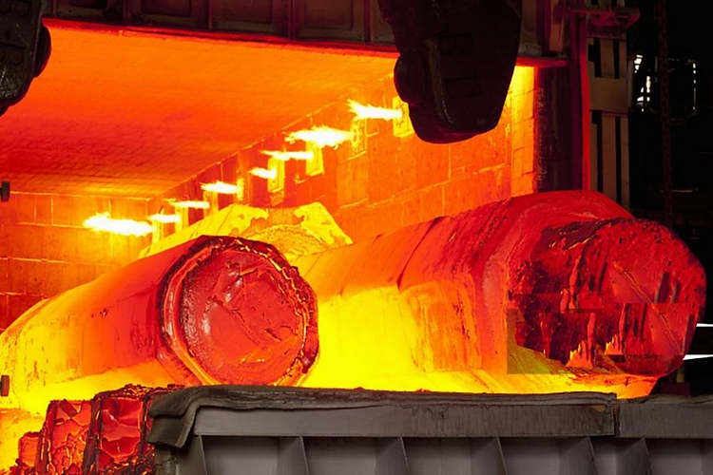
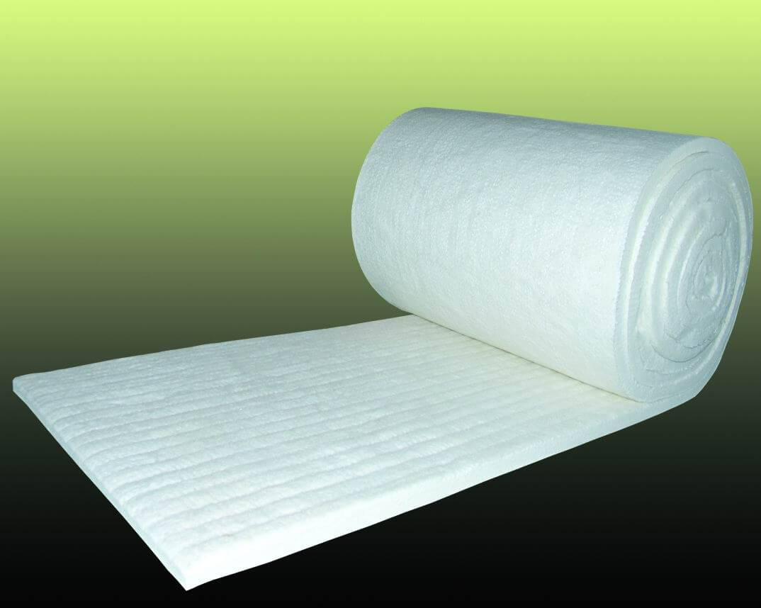
背景介绍

Slide 3
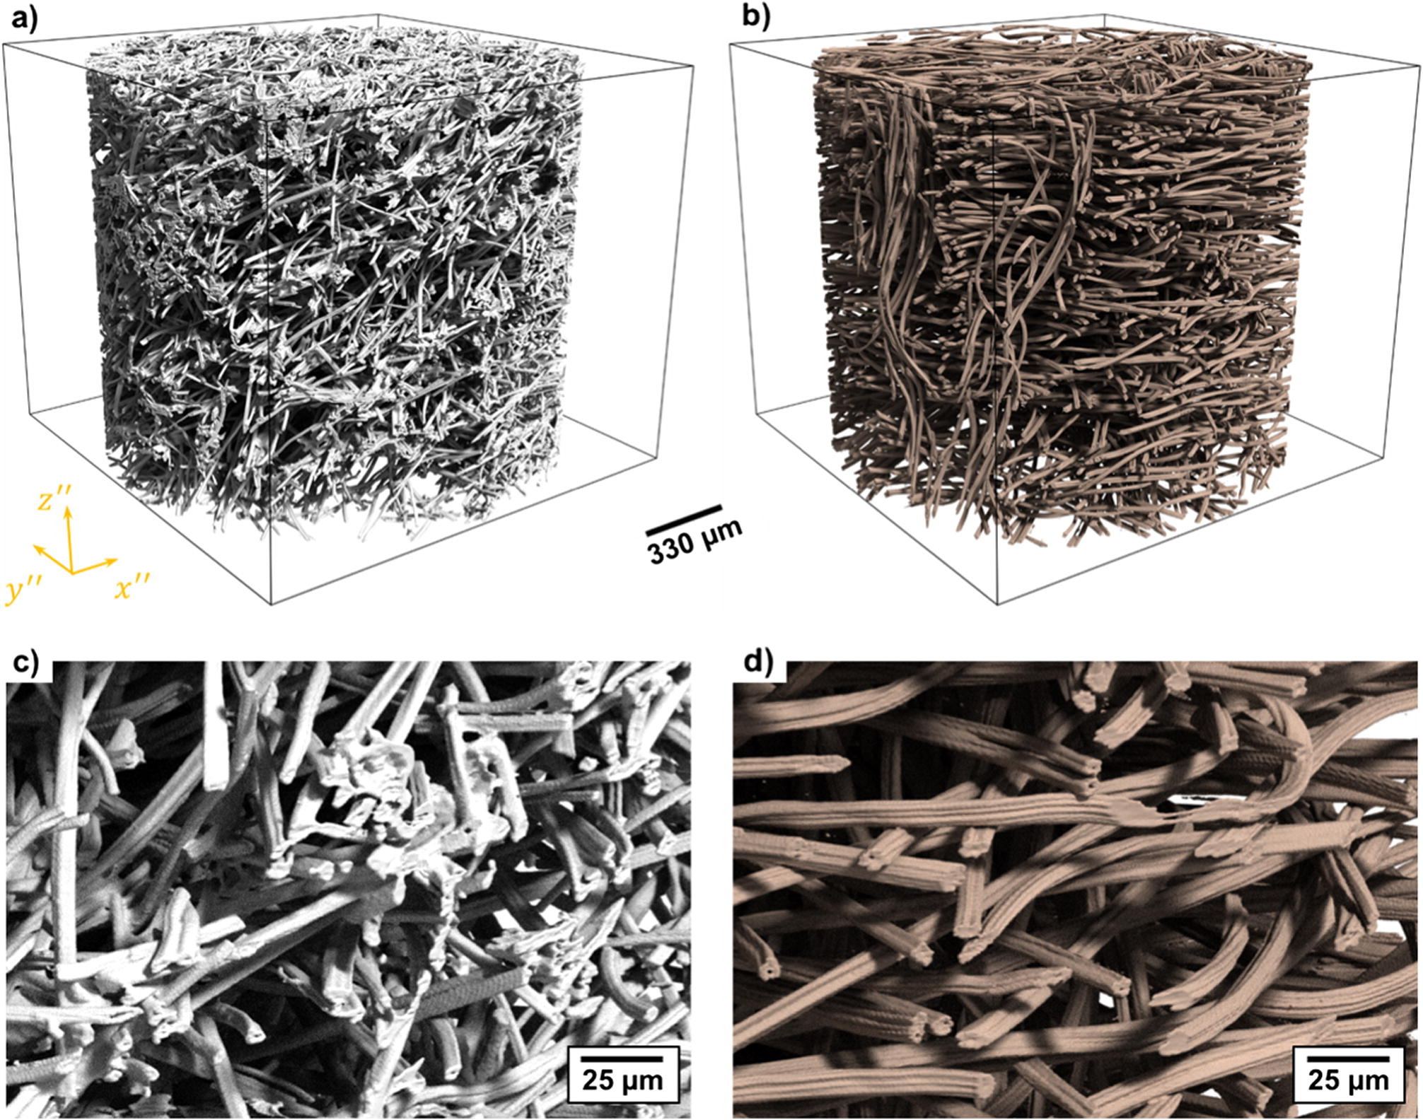
背景介绍
图 1 （a）FiberForm和（b）Morgan碳纤维毡的Micro-CT射线追踪图。两种材料（c和d）的放大图显示了人造丝纤维的典型小叶横截面和内腔的存在。[1]
Notes:
The first question we always ask when starting research is 'why?’
Why should we explore the insulation materials?
Due to the increased demand in the industrial and aerospace sectors, there is a growing need for advanced insulation materials. These materials aim to save energy, reduce costs, and meet stringent thermal performance requirements.
Why did we choose fibrous structures as our research object?
Fibrous materials are the most common structural insulation materials. They provide solid support to withstand pressure, which is essential for various applications. Additionally, their high porosity makes them efficient insulators.
From the early use of glass fibres to advanced fibres today, researchers are continually adjusting the network to achieve better properties. Therefore, it's crucial to understand the relationship between structure and material properties.

Slide 4
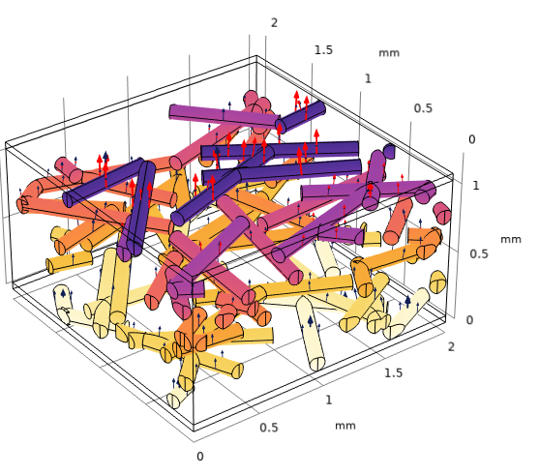
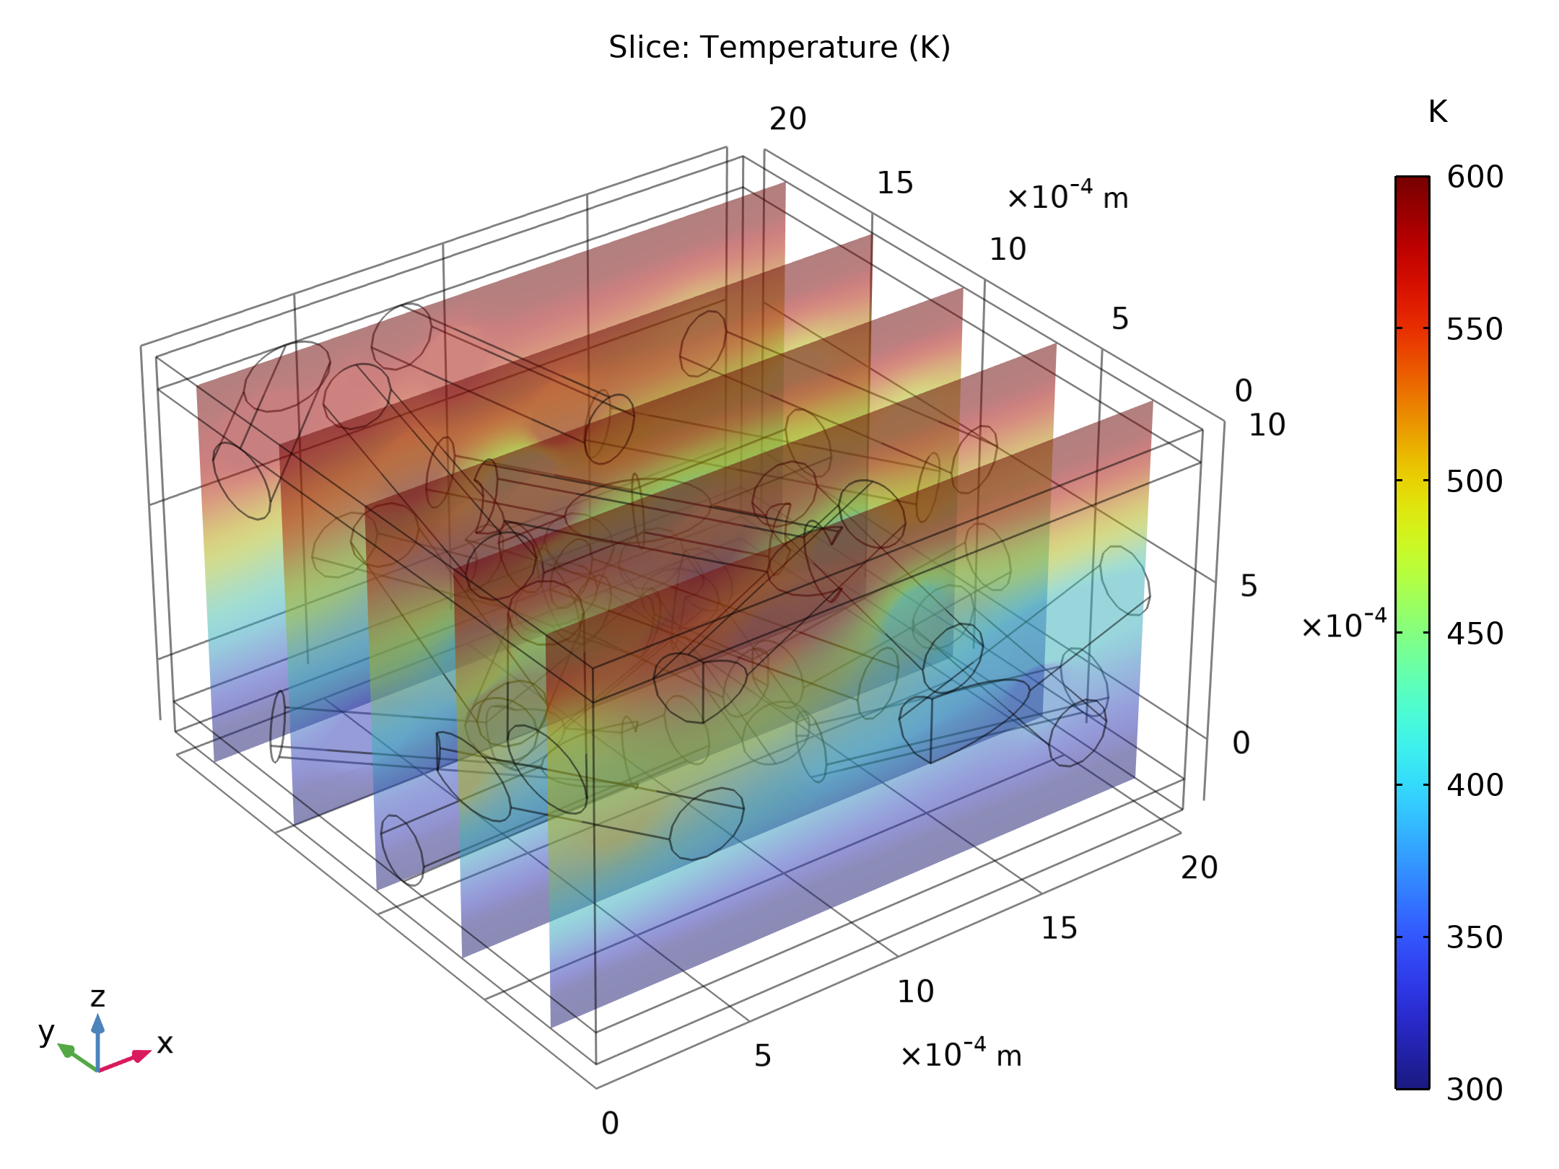
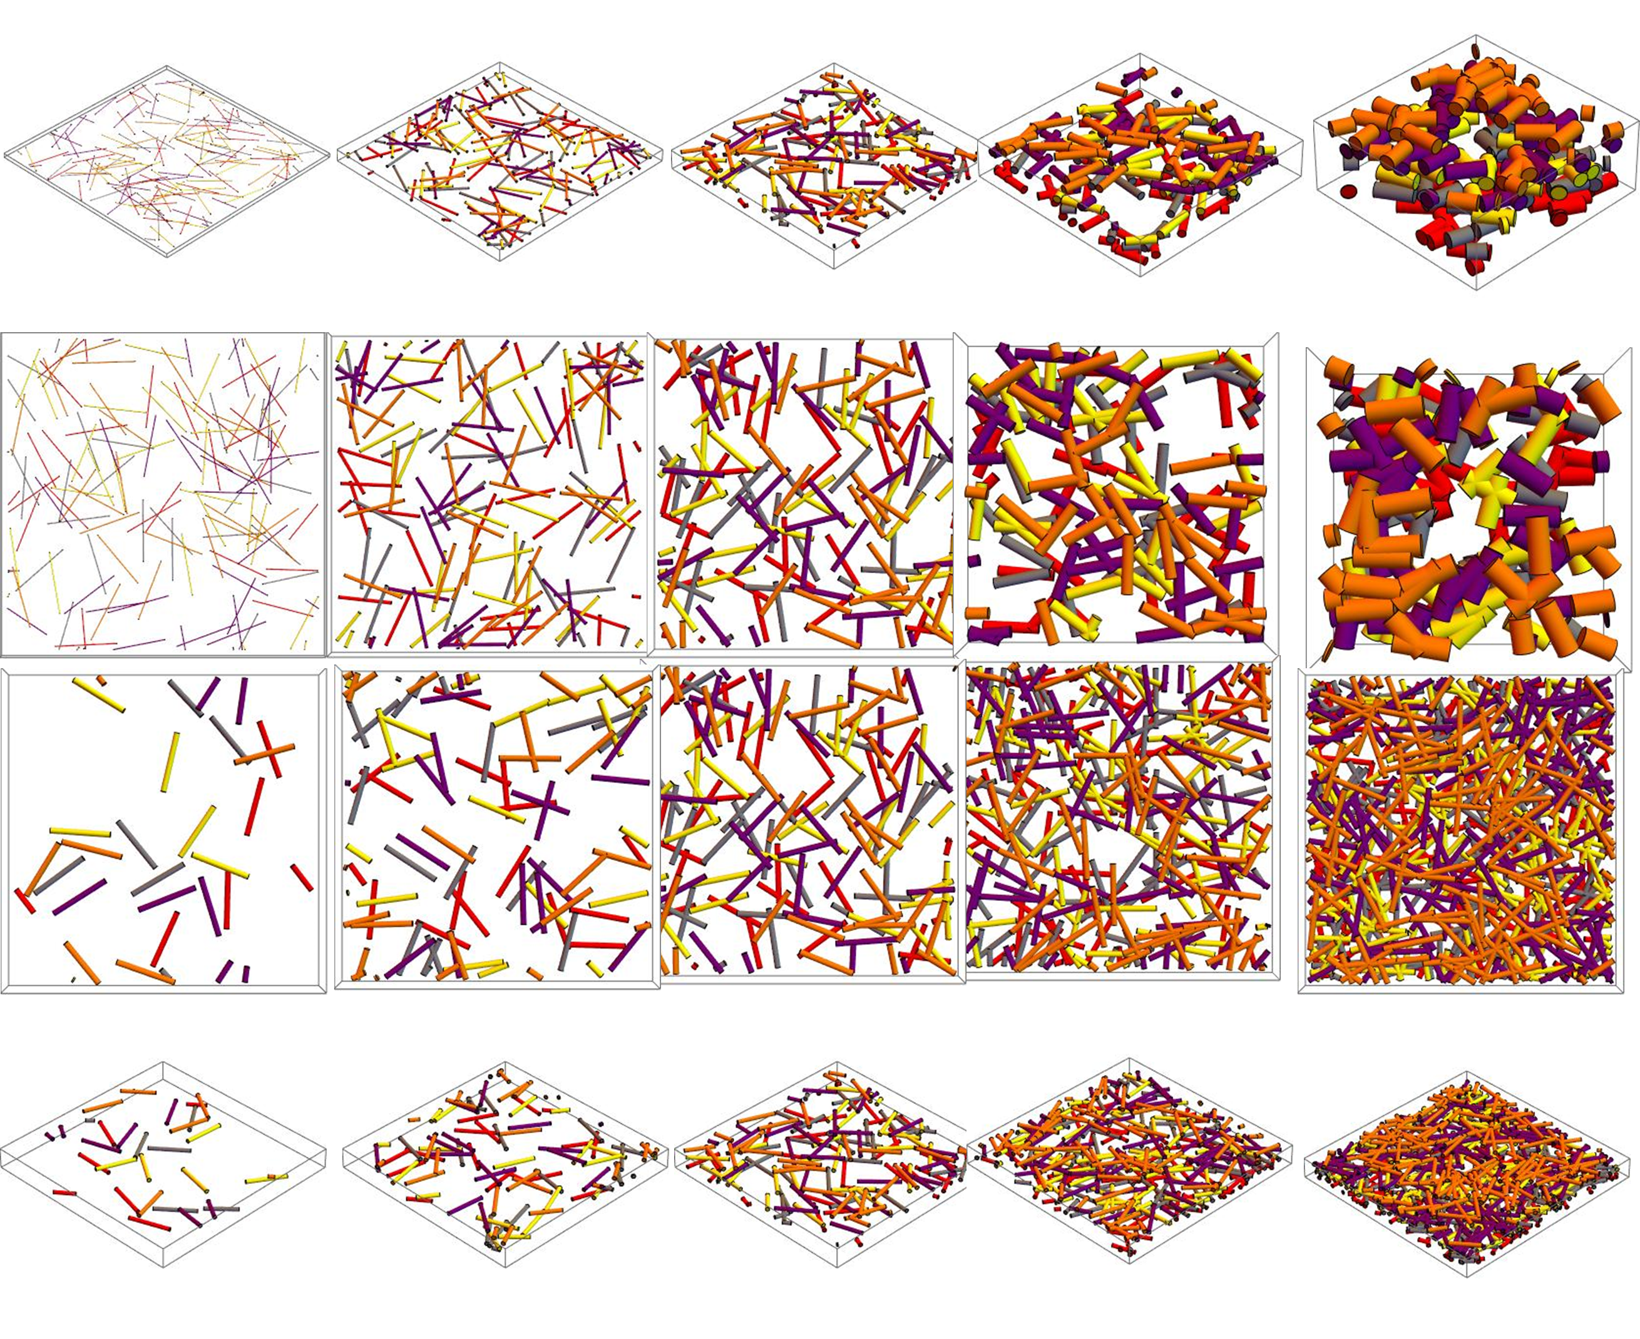
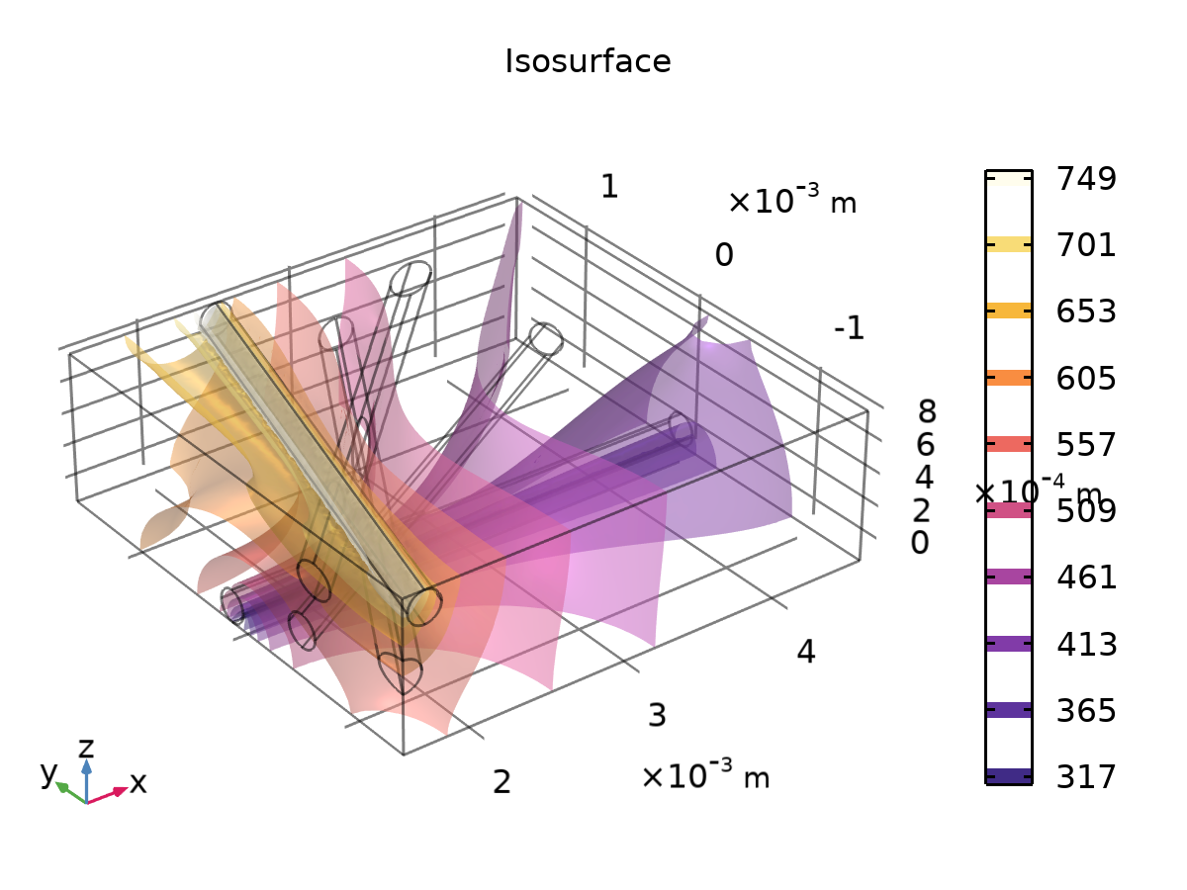
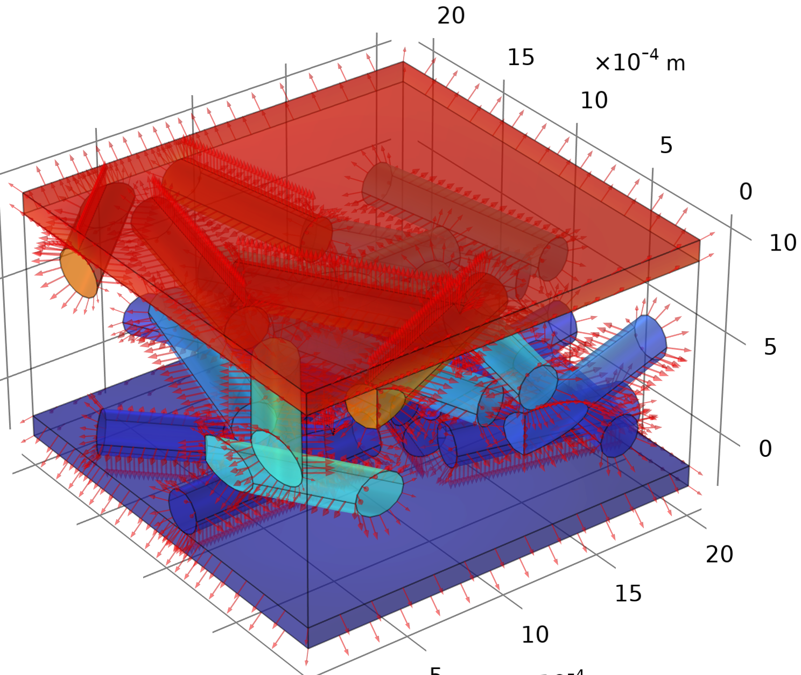
研究目的
定性和定量
多尺度热理论
有限元分析数值模拟
材料纤维尺度结构与传热性能的相关性
图 2 通过调整纤维半径或纤维数量在 MMA 中实现所需的孔隙率。 顶部：半径增加。底部：数量增加。
图 3 COMSOL 中的传热仿真结果
Notes:
After discussing why we chose this research direction, let's delve into what we're actually doing. Our approach combines both qualitative and quantitative methods. We apply multi-scale thermal theory and utilize finite element analysis for numerical simulations. These methods collectively help us establish the relationship between fibre structure and the material's thermal performance.
As the figures below, once we defined our structural properties such as fibre diameter or the number of those we could utilize Mathematica to program a Monte Carlo method to generate a random fibrous network with the desired porosities.
Then the COMSOL will couple the geometry and the multi-physics and gain a varying heat transfer performance as shown.

Slide 5
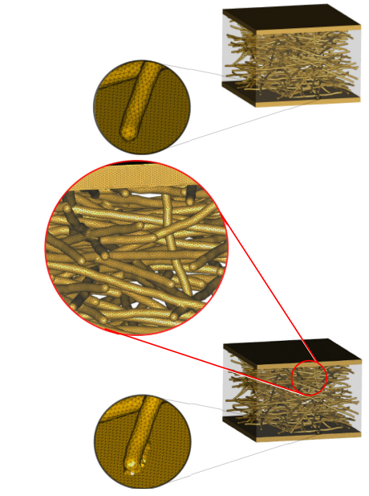
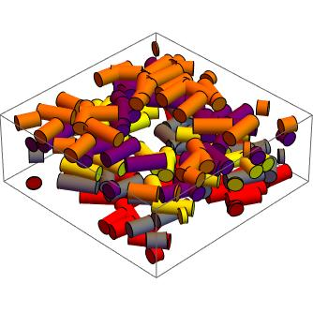
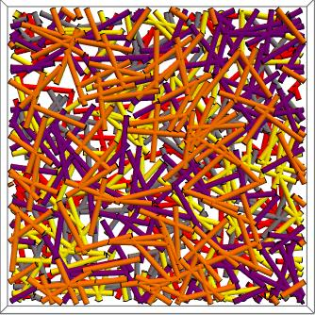
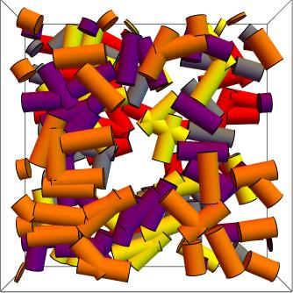
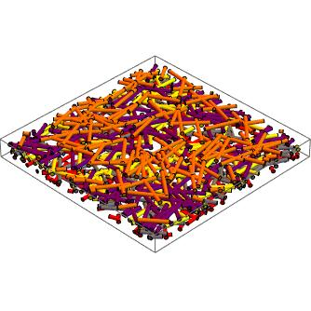
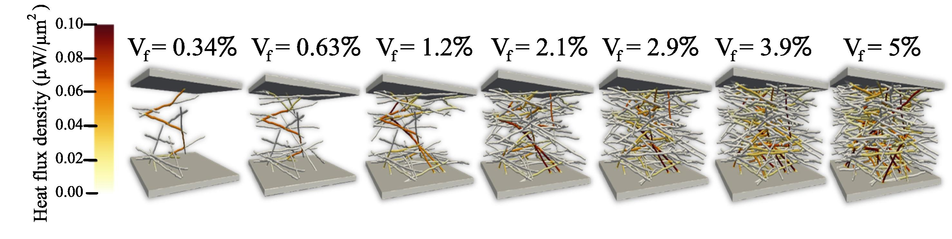
研究方法
三种结构模型
纤维交集度与网格划分[3,4]
多平面杆模型
三维不相交杆模型[2]
Notes:
Since we're studying the relationship between structure and performance, modeling the structure is crucial. Let's discuss simulating fiber materials.
Our model for fiber materials is built on a strong theoretical foundation. Using Mathematica, we can create diverse fiber structures with varying pore characteristics. This flexibility is essential for capturing the complexities of fiber materials under different conditions.
To enhance the accuracy and realism of our simulations, we incorporate various material models. Some fibers may intertwine to form complex structures, while others remain separate. We can even control how fibers interweave to simulate different structures under varying production conditions.
This adaptable approach ensures that our simulations are not only theoretically sound but also closely match the complex behavior of fiber materials in diverse production scenarios.
Additionally, an important factor we need to consider is the intersection degree of the fiber and the meshing.
In summary, the modeling of the structure and the meshing technique play crucial roles in determining the heat transfer characteristics of our materials.

Slide 6
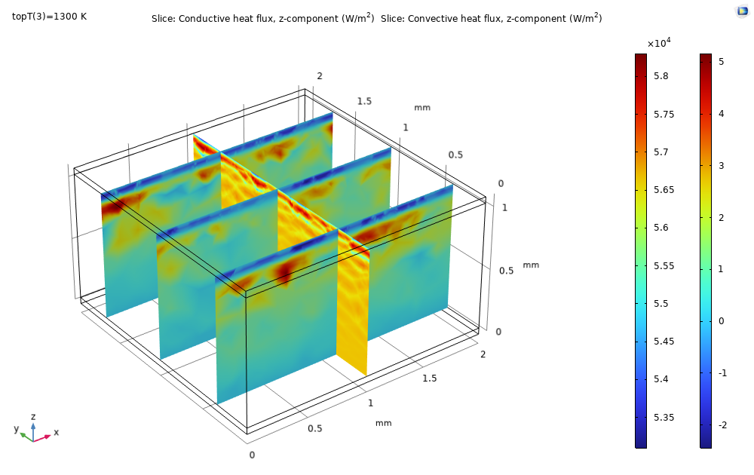
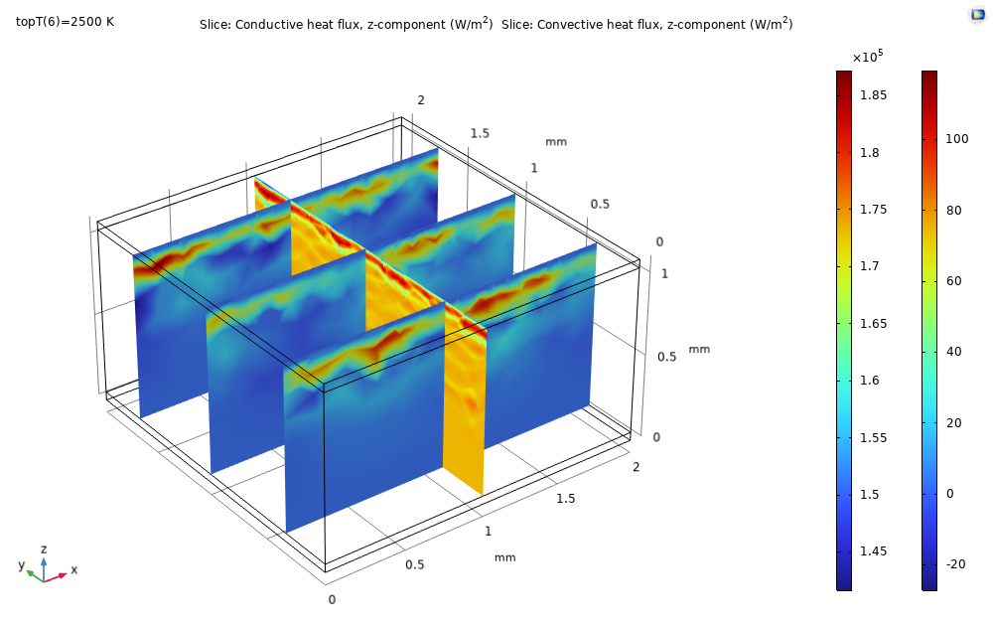
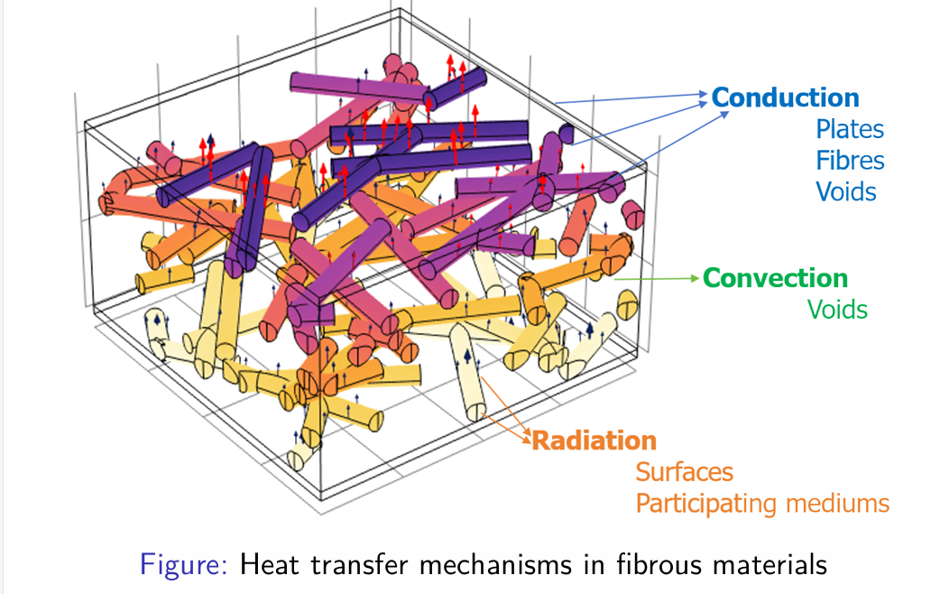
研究方法
一个多物理场

Slide 7
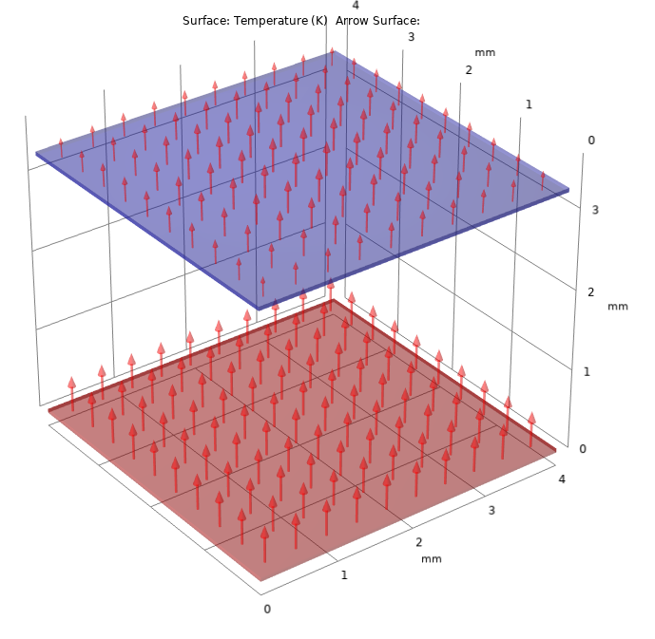
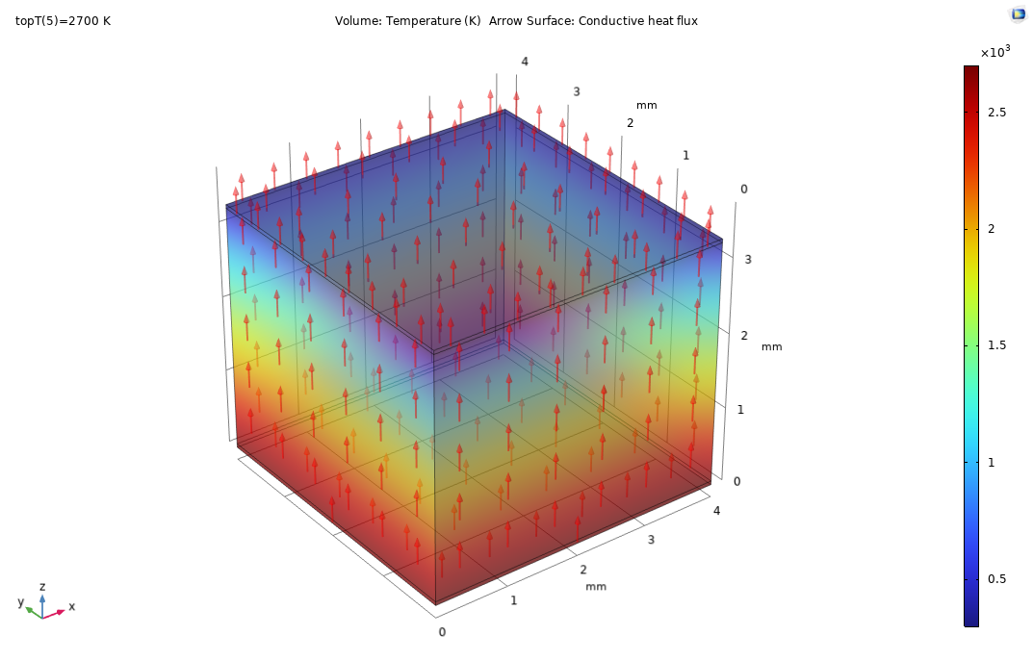
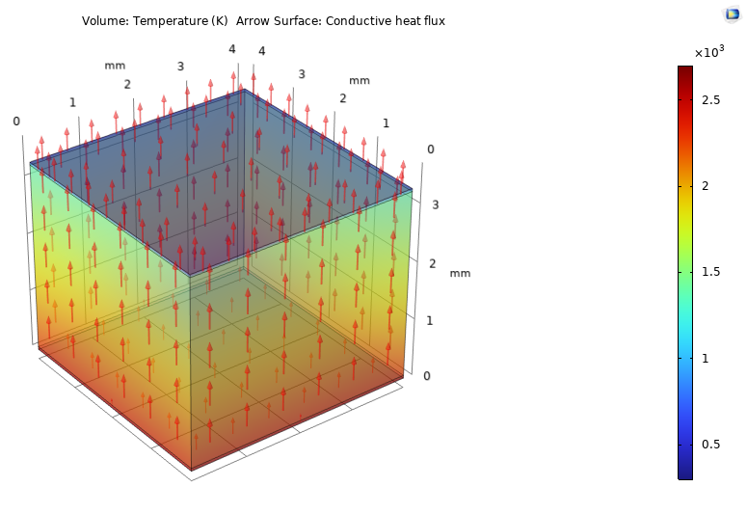
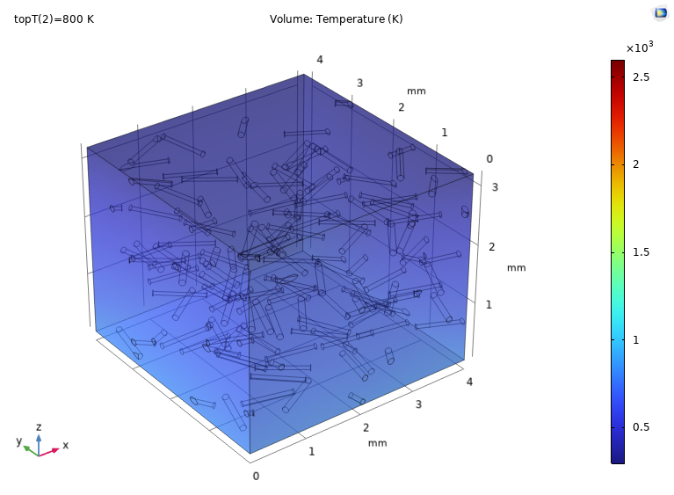
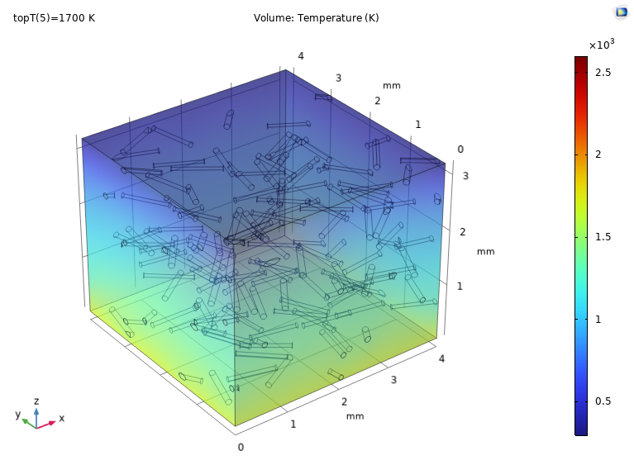
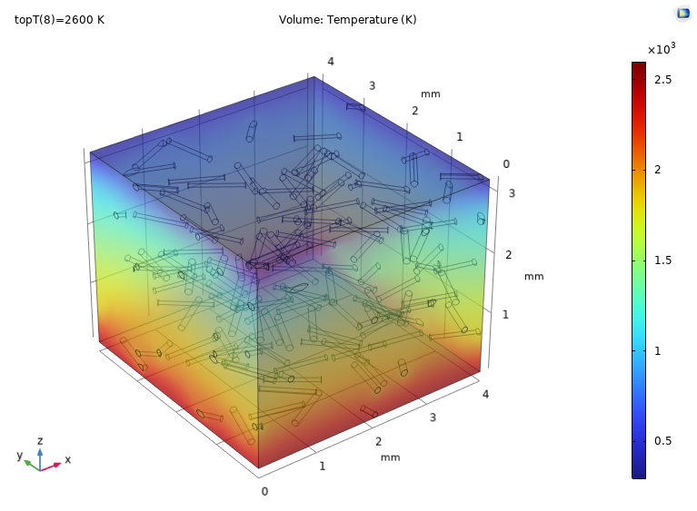
仿真结果
基准模型
真空
空气
固体
纤维材料模型

Slide 8
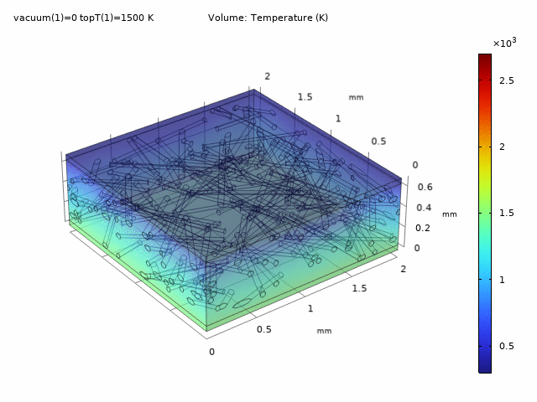
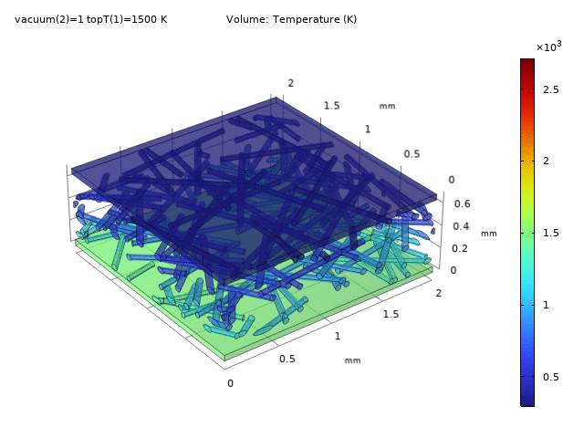
仿真结果
空隙材料
Air
Fibrous
Materials
Notes:
Next, we explored fibrous materials by comparing the heat transfer differences when the pores in the fibre structure are filled with air and vacuum. From the temperature distribution, the differences mainly appear in the insulation layer when we fixed the working temperatures of the upper and lower surfaces. Under the same void material conditions, as the working temperature increases, the temperature gradient changes significantly, but the distribution remains largely similar.

Slide 9
结论
隔热层中的传热机制
a)
b)
c)
Conduction
Radiation
Vacuum
Gas
Solid
Convection
Fibrous material in Vacuum
Fibrous material in Air
Notes:
While the graphs in this Data Analyzer section are due for updates, they still provide valuable insights from multiple perspectives. Whether it's observing variations in heat transfer mechanisms within different insulating layers or understanding changes in thermal performance due to these variations, we can draw conclusions and derive insights

Slide 10
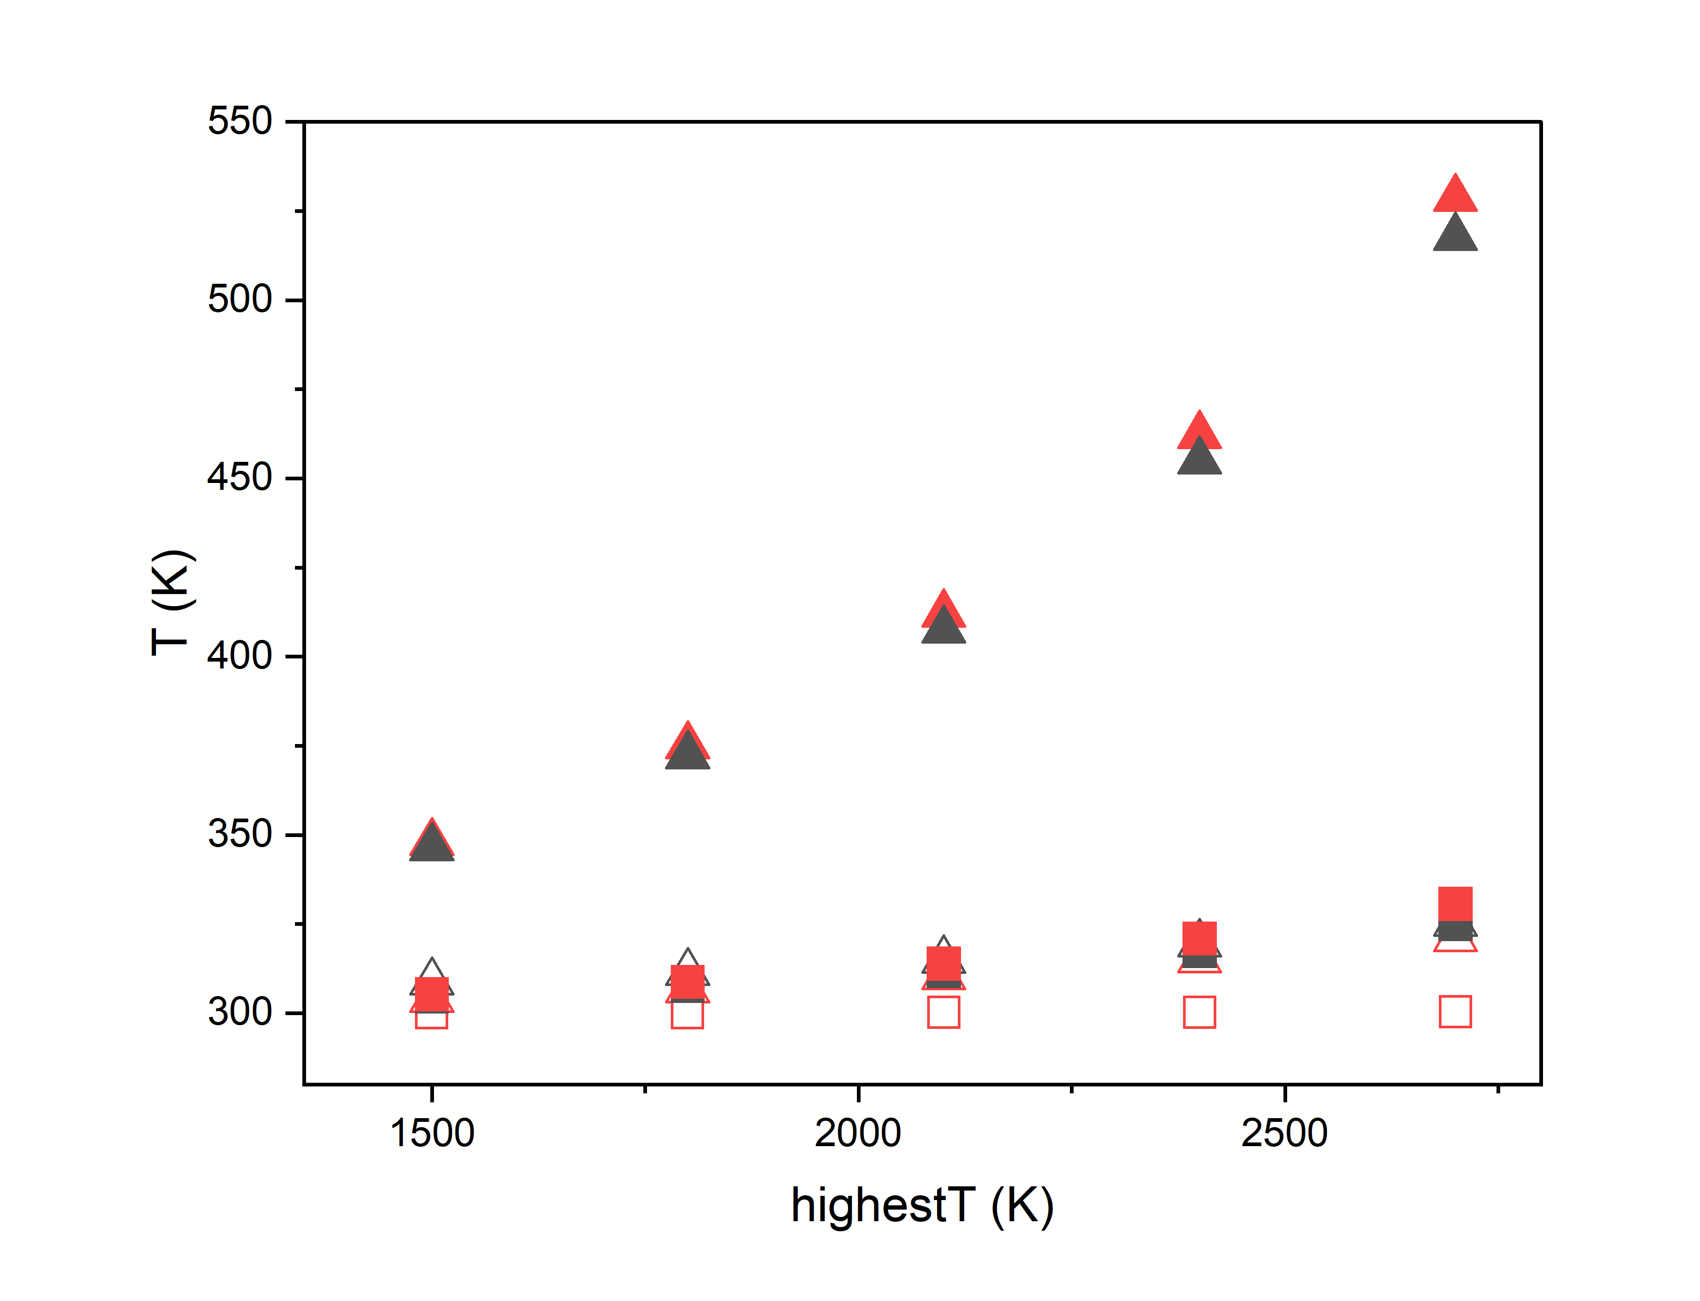
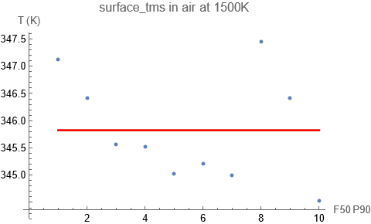
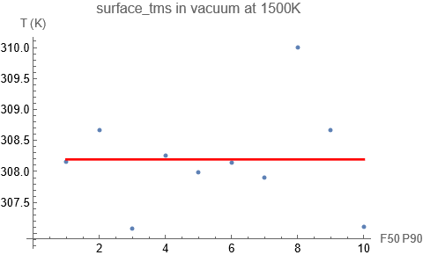
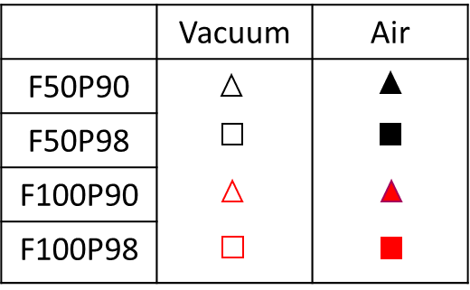
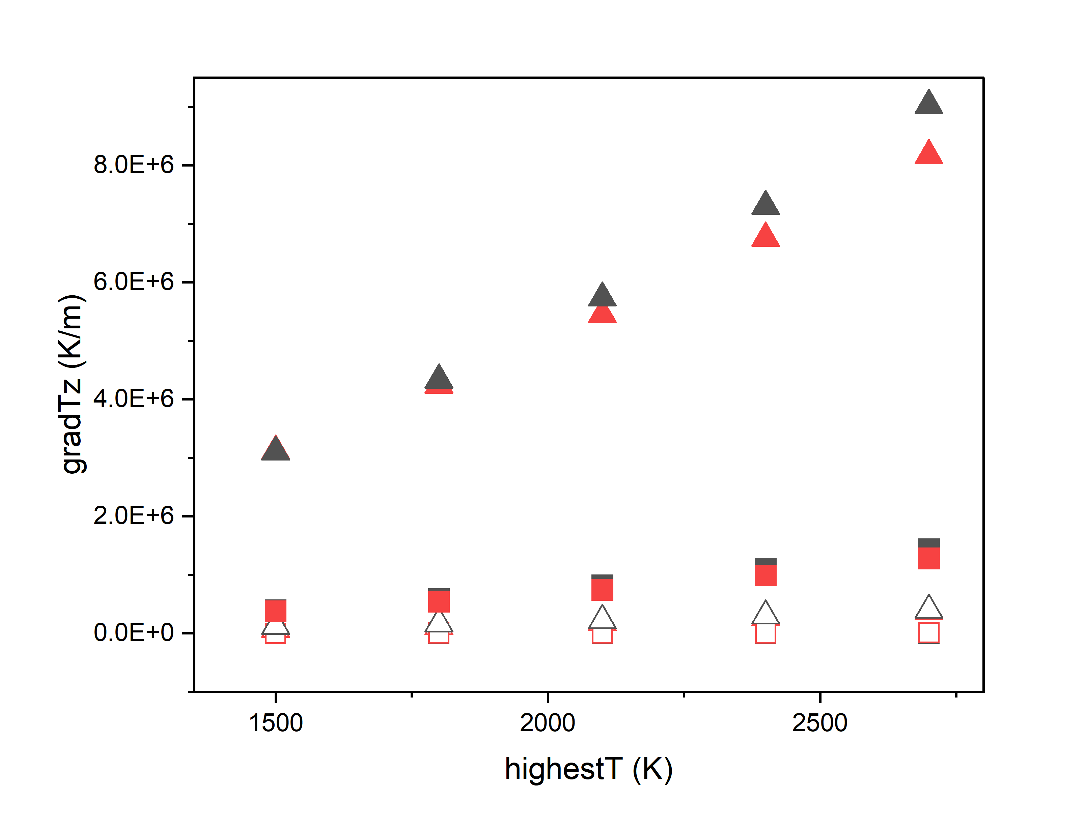
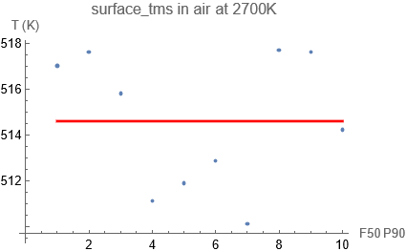
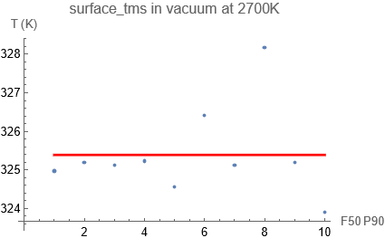
结论
纤维直径和网络孔隙率
网络随机性
Air
Vacuum
Notes:
As previously mentioned, we used a randomly oriented fibre structure, so it is necessary to compare the effects of orientation while ensuring the robustness of our model. In the charts on this page, we compared the temperature differences on the top surface of the insulation layer for 10 random samples under the same structural conditions. The graphs show that under different temperature conditions, the influence of randomness on the results is not significant. In the table, we can see that the coefficient of variation (CV) remains at a low level under all conditions, and, as we expected, it increases with rising temperatures. Additionally, the void material significantly affects the temperature distribution.

Slide 11
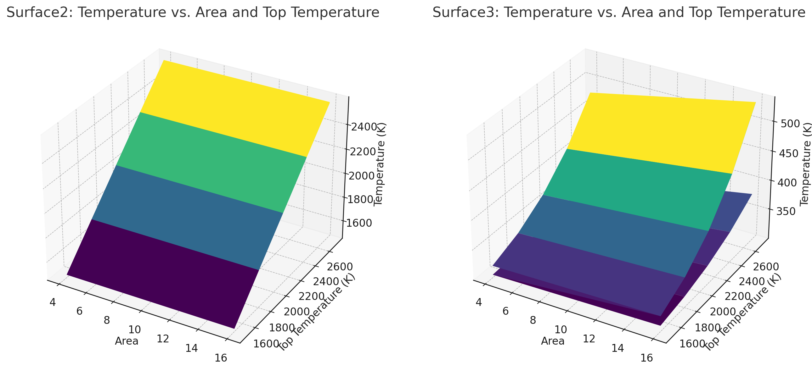
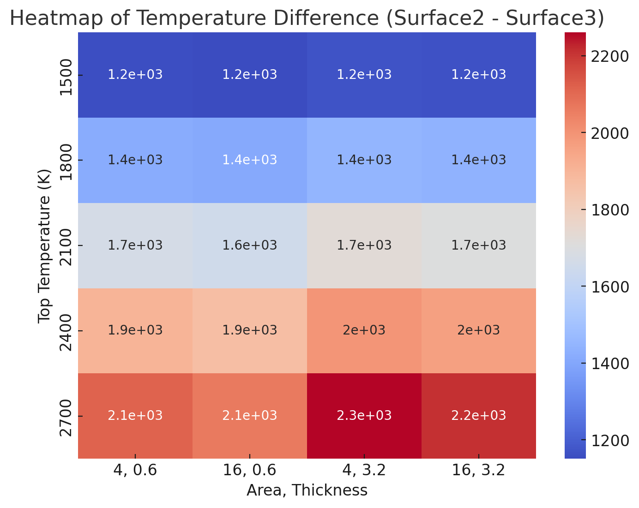
Vacuum
模拟块尺寸影响

Slide 12
模型鲁棒性
参数灵敏度
SINGLE
PLATE
Scattering Coefficient
Absorption Coefficient
Plate
Fibre
Scattering Coefficient
Notes:
We need to examine the sensitivity of the parameters to understand their impact on the results.
In the real world, getting precise material properties can be tricky. When that happens, we do parameter sensitivity testing to figure out what needs attention. In past tests, we found certain variables that really matter, helping us deal with uncertainties in material properties. It's all about making our simulations smarter and more reliable.
Additionally, it's crucial to validate the robustness of the model to ensure its reliability and accuracy
Centre Line T Distributions
Parameter Sensitivities
&
Model Robustness
Conclusion:
1.The absorption or scattering coefficient change exhibited minimal impact on the temperature distribution.
reasons:
small size of system or small range of parameter(10⁻¹-10²)
impact other result such as Heat flow
2.The stability and robustness of the model has been confirmed within a certain range.
From the perspective of curve fitting, the model demonstrates overall stability across all tested conditions. However, certain conditions, such as larger-sized plates (thickness > 10mm) or fibres (radius > 1mm), exhibit non-convergence of the model when employing the DOM method at elevated temperatures (>1700K) in COMSOL calculation.

Slide 13
总结
纤维材料传热特性：通过模拟和分析，研究表明纤维结构在导热和辐射热传递机制中扮演了重要角色。不同的纤维直径、孔隙率和空隙材料（空气或真空）对温度分布和传热效率产生显著影响。
模型验证与适用性：基于P1近似和Rosseland方法的传热模型验证了其在特定条件下的准确性，并证明了它们能够在计算复杂性和精度之间取得平衡。

Slide 14
进一步研究
多层结构设计：未来的研究可以探索不同纤维层之间的协同作用，优化多层纤维结构以增强其隔热性能。这将特别有助于在高温环境下的应用，如工业绝缘。
模型拓展：通过引入更多复杂的几何结构和材料参数，进一步提升模拟模型的准确性。例如，研究不同纤维材料的异质性，或者引入时间动态因素，模拟纤维结构在长时间高温条件下的退化行为。
其他传热机制：进一步研究结合传导、辐射与对流的综合传热模型，尤其是在更复杂的环境下如多物理场耦合的条件下，可能带来更多创新性成果。
Reference: [1] Eze, A.H. and Lakatos, Á., 2023, October. Applications of thermal insulation materials by aircraft. In Journal of Physics: Conference Series (Vol. 2628, No. 1, p. 012018). IOP Publishing.
[2] Faruk, O., Tjong, J. and Sain, M. eds., 2017. Lightweight and sustainable materials for automotive applications. Boca Raton: CRC Press.
[3] Tang, B., Wang, Y., Hu, L., Lin, L., Ma, C., Zhang, C., Lu, Y., Sun, K. and Wu, X., 2019. Preparation and properties of lightweight carbon/carbon fiber composite thermal field insulation materials for high-temperature furnace. Journal of Engineered Fibers and Fabrics, 14, p.1558925019884691.
[4] Marble, E. and Boles, T., 2022. A Review of the Structural Characteristics of Aerospace Composites. Science Insights, 41(7), pp.749-753.

