Slide 1
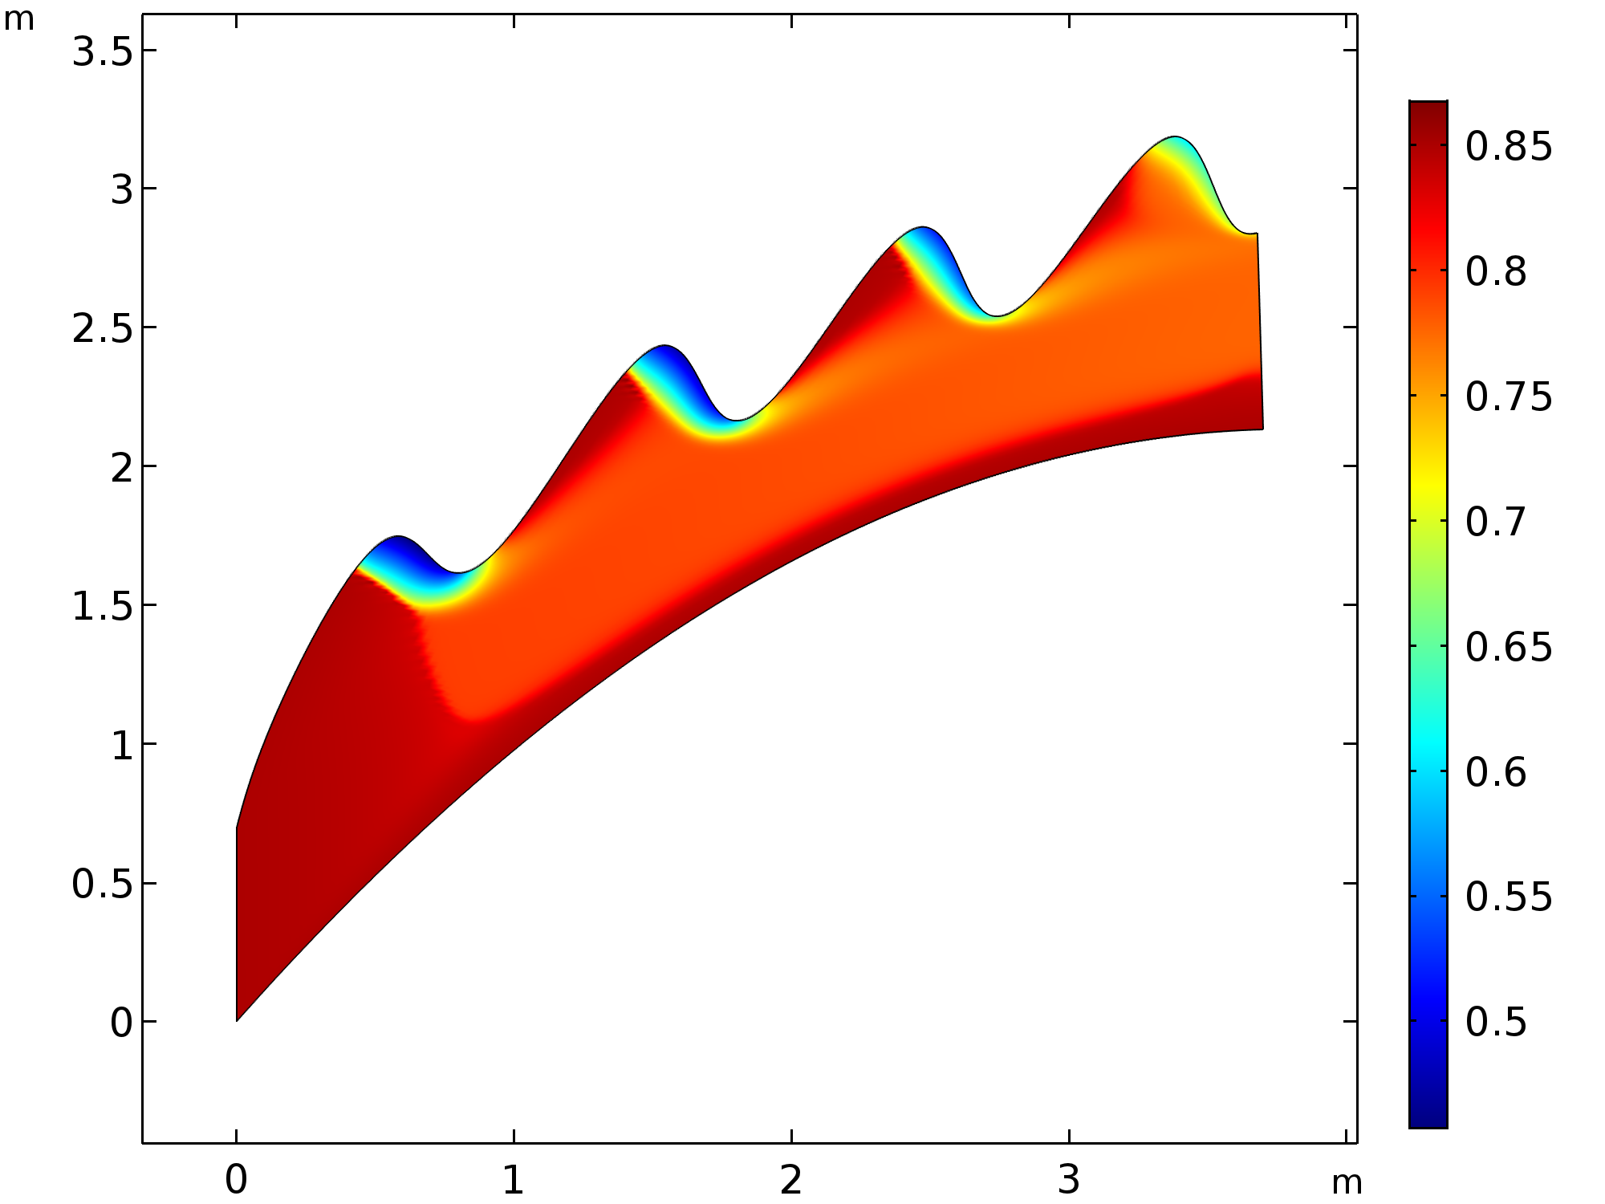
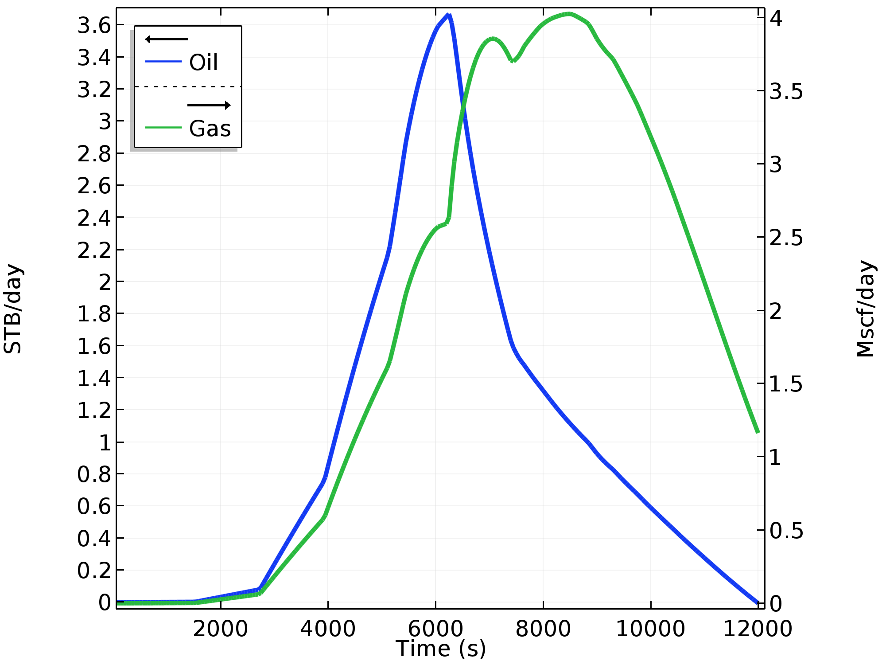
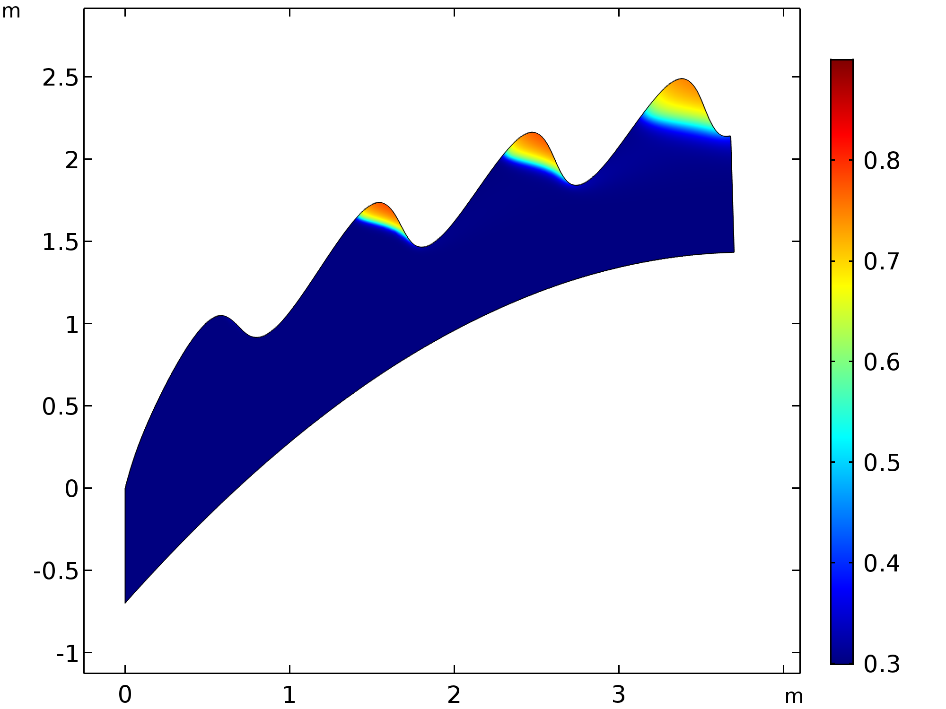
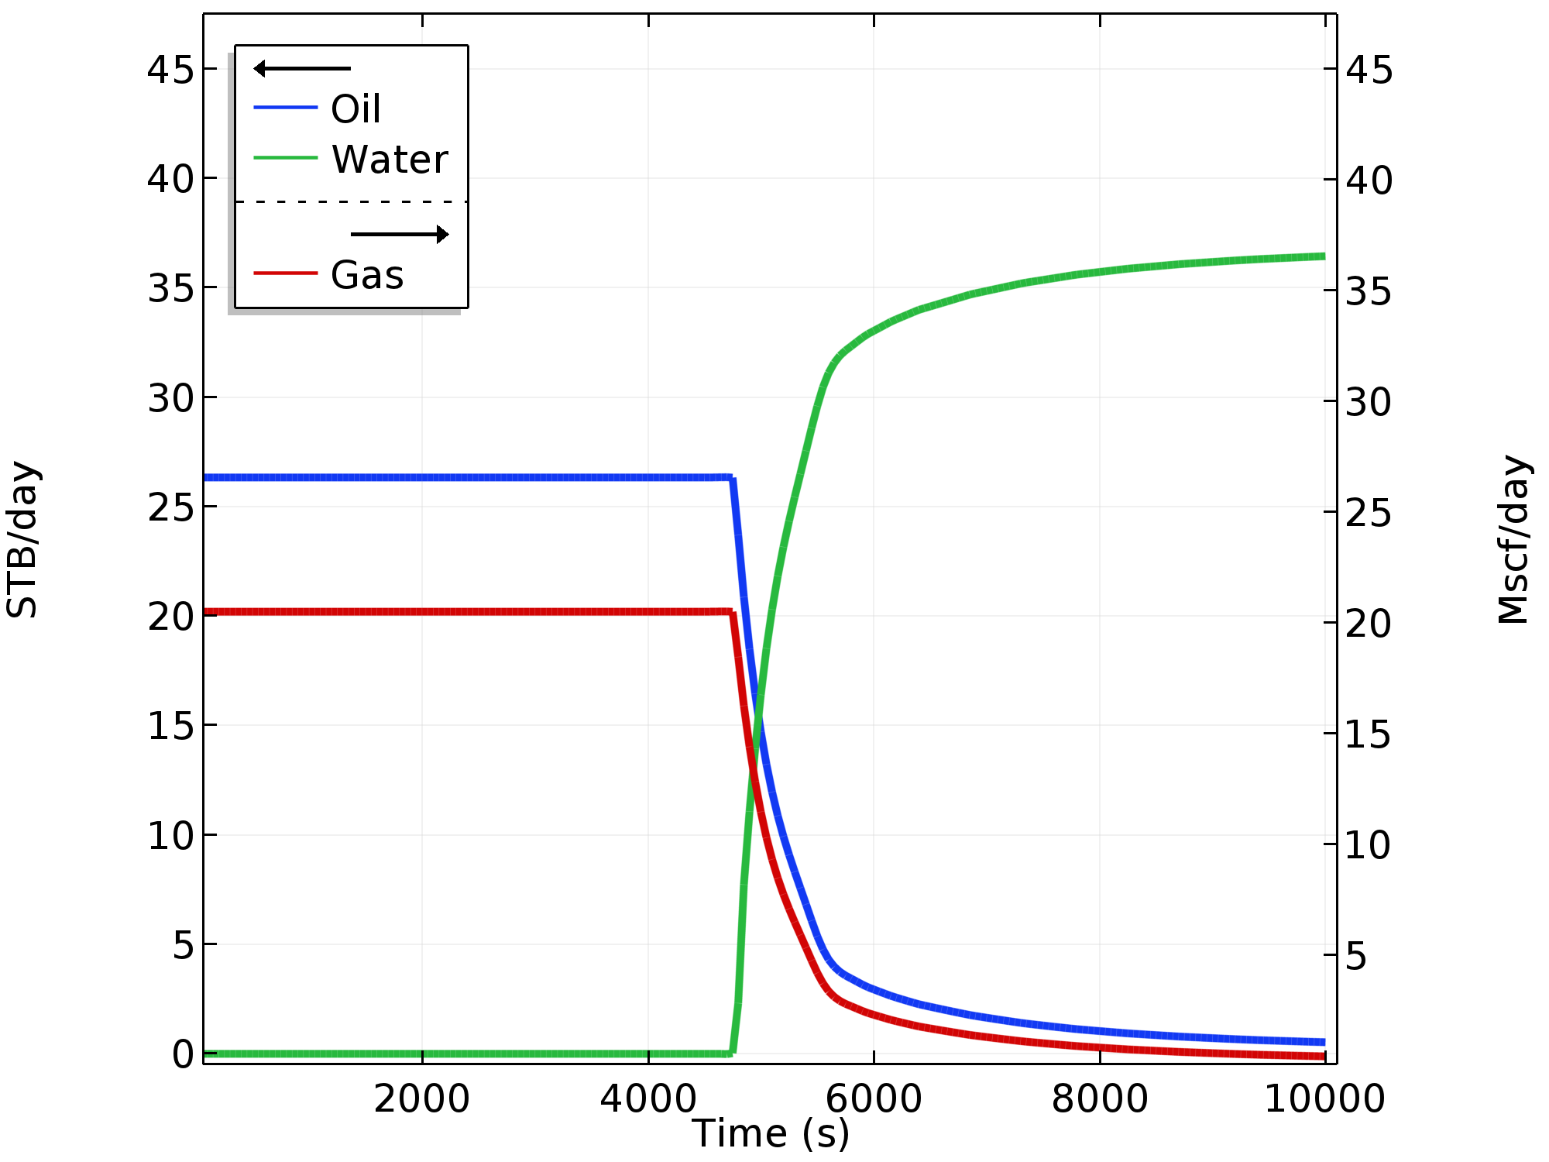
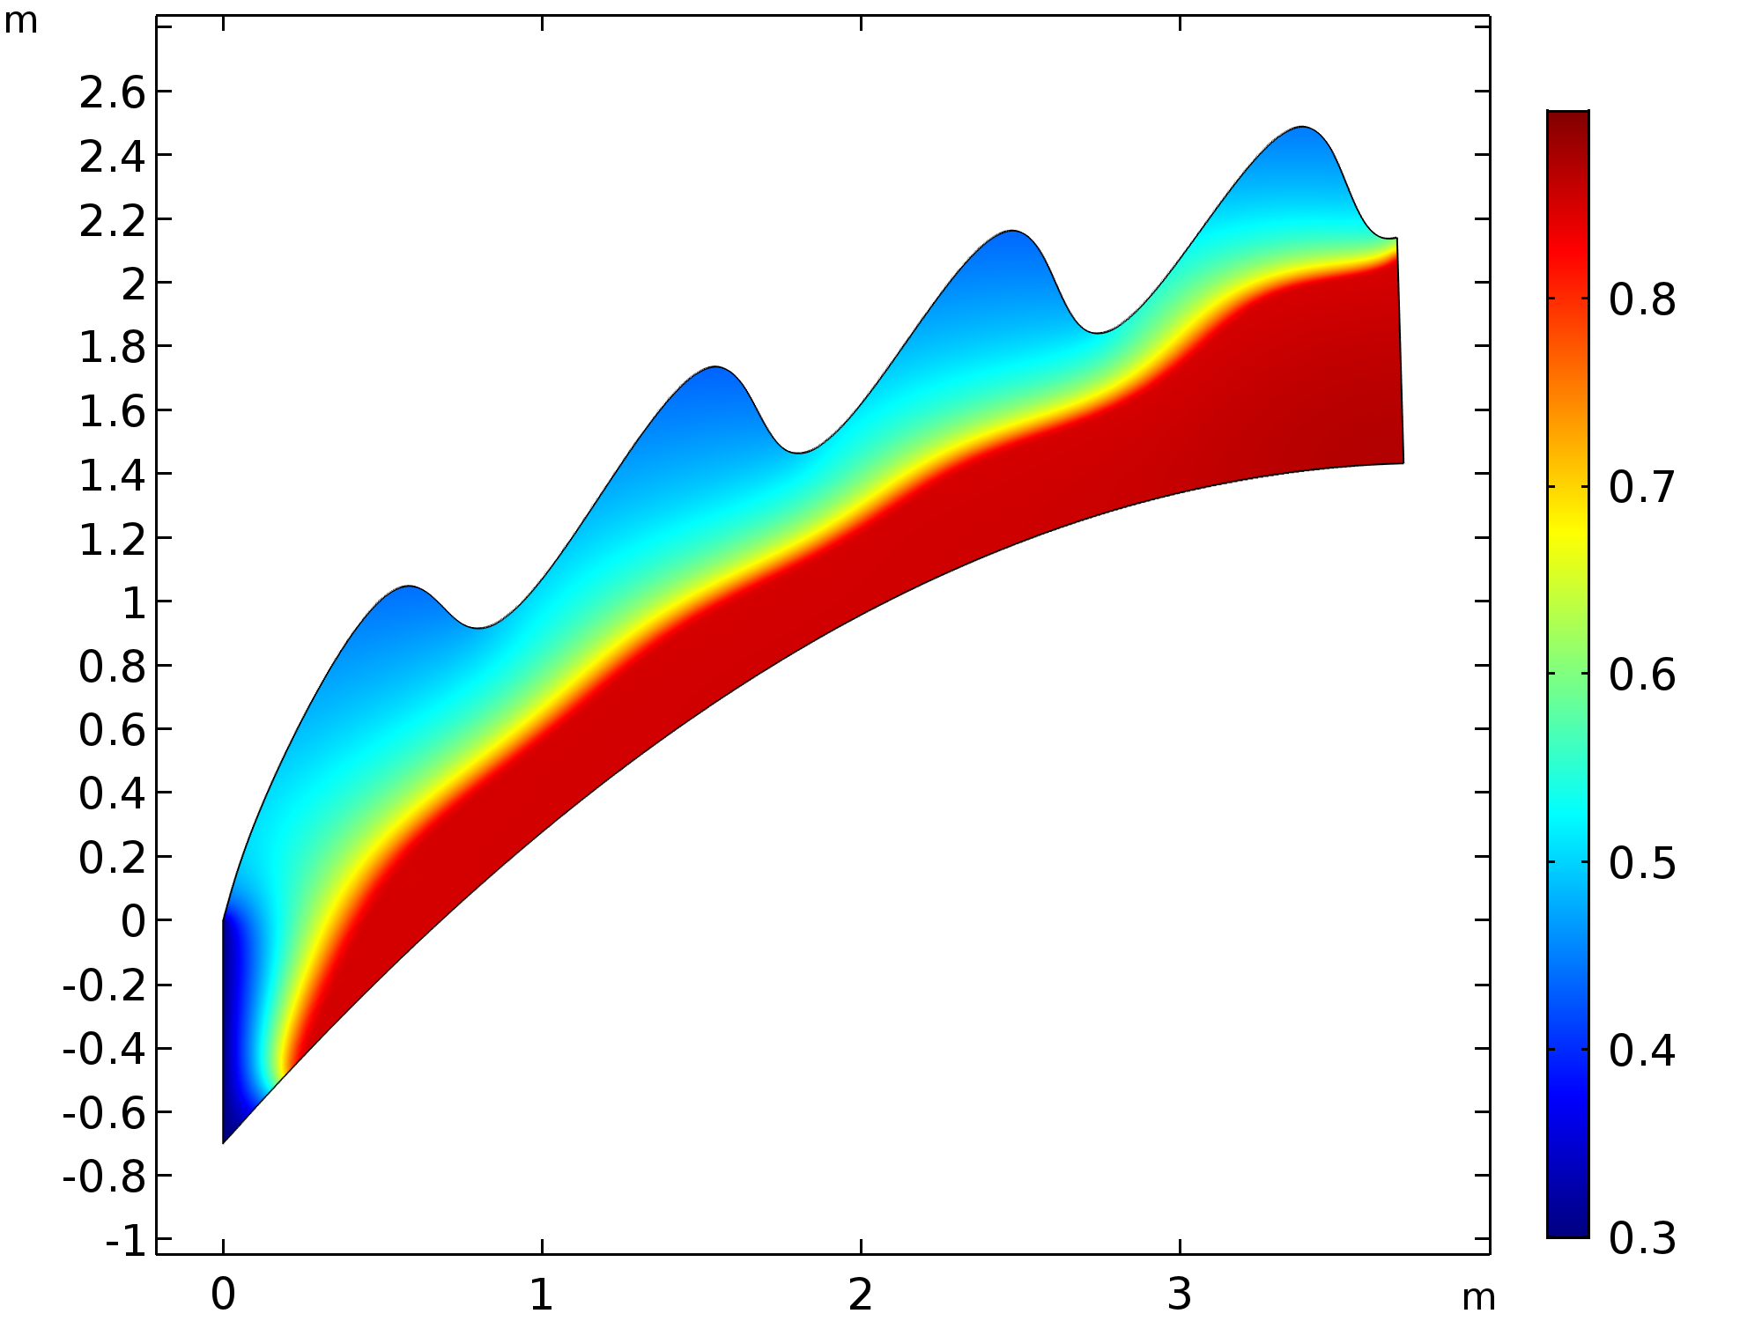
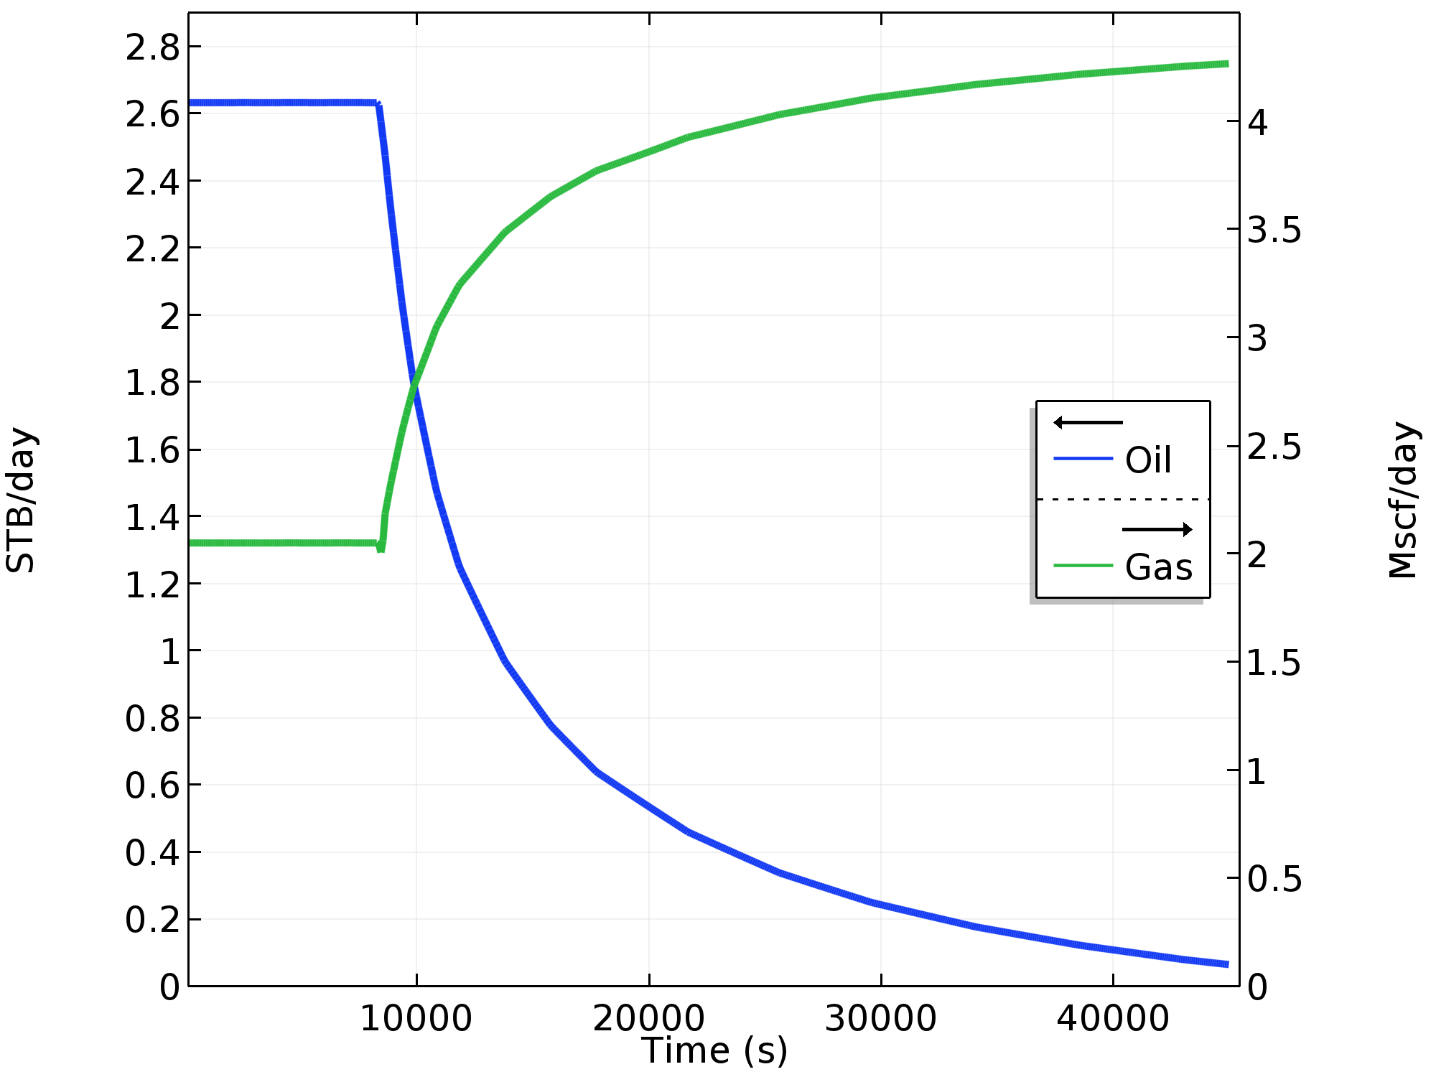
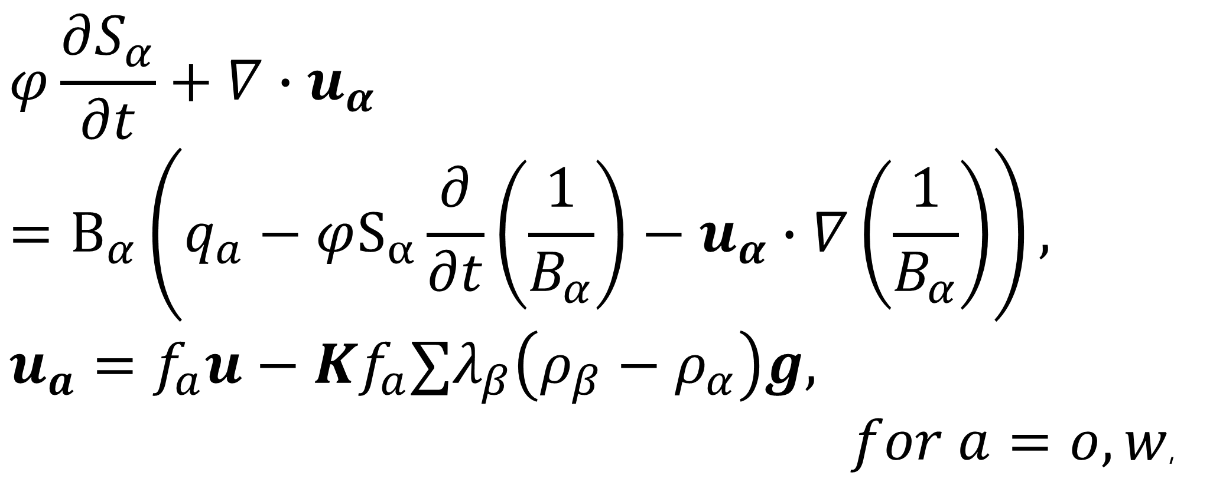
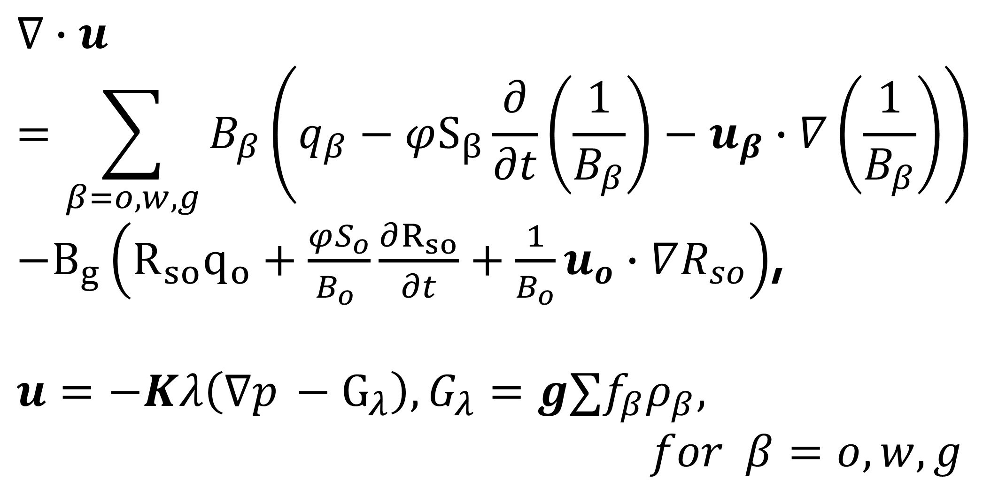
A Black-oil Model for Primary and Secondary Oil-Recovery in Stratified Petroleum Reservoirs
A. Dollari*, Ch. Chatzichristos and A. G. Yiotis
Environmental Research Laboratory, NCSR "Demokritos", Athens, Greece
*Email: natasa@ipta.demokritos.gr
INTRODUCTION: Black-oil simulators are commonly used in petroleum reservoir engineering for the prediction of oil production, especially during the earlier stages of oil-field exploitation, while also serving to guide pressure maintenance strategies in the longer term. They account for fluid flow in porous media, where it is assumed that there are three distinct phases: water (w), oil (o), gas (g)¹.
A numerically stable formulation of the black-oil model is developed and its performance during three common oil-recovery processes in a homogeneous, anisotropic petroleum reservoir is evaluated.
RESULTS:
Process: Pressure Depletion, Solution-gas Drive Mechanism
Figure 1. Oil phase saturation
at the end of primary recovery
Figure 2. Production rates
at standard conditions during
primary recovery
Process: Waterflooding
COMPUTATIONAL METHODS: The phase formulation based on oil pressure and total velocity with negligible capillary forces is applied²:
1 Pressure Equation General form PDE
$$∇∙u=\sum_{β=o,w,g}{B_{β}\left(q_{β}−φS_{β}\frac{∂}{∂t}\left(\frac{1}{B_{β}}\right)−u_{β}∙∇\left(\frac{1}{B_{β}}\right)\right)}$$
$−B_{g}\left(R_{so}q_{o}+\frac{φS_{o}}{B_{o} }\frac{∂R_{so}}{∂t}+\frac{1}{B_{o}}u_{o}∙∇R_{so}\right)$,
$$u=−Kλ\left(∇p_{ }−G_{λ}\right), G_{λ}=g∑f_{β}ρ_{β},$$
$for β=o,w,g$
Figure 3. Oil phase saturation
at the end of waterflooding
Figure 4. Production rates
at standard conditions during
waterflooding
Process: Gas Injection
2 Saturation Equations Coefficient form PDE
$$φ\frac{∂S_{α}}{∂t}+∇∙u_{α}$$
$$=Β_{α}\left(q_{a}−φS_{α}\frac{∂}{∂t}\left(\frac{1}{B_{α}}\right)−u_{α}∙∇\left(\frac{1}{B_{α}}\right)\right),$$
$$u_{a}=f_{a}u−Kf_{a}∑λ_{β}\left(ρ_{β}−ρ_{α}\right)g,$$
$for a=o,w$,
Figure 5. Oil phase saturation
at the end of gas injection
Figure 6. Production rates
at standard conditions during
gas injection
CONCLUSIONS: Successful description of the physical phenomenon and accurate estimation of recoveries. Simulation of more complex problems in EOR by implementing the appropriate PDEs.
Initially: Reservoir in undersaturated state with prevailing hydrostatic pressure, saturated with 90% PV oil and 20% PV water
Primary recovery: Pressure reduction BC at outlet
Water- & Gas-flooding: Constant rate BD at inlet & Constant pressure BC at outlet
REFERENCES:
D. Peaceman, Fundamentals of Numerical Reservoir Simulation, (1977)
2. Z. Chen, Formulations and Numerical Methods of the Black Oil Model in Porous Media, Society for Industrial and Applied Mathematics, 38, 489-514 (2000)
Notes:
1

