Slide 1


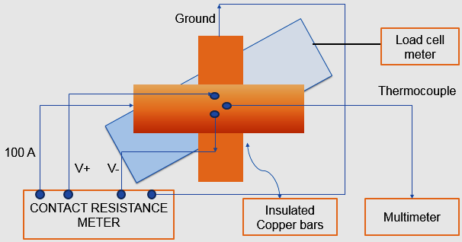
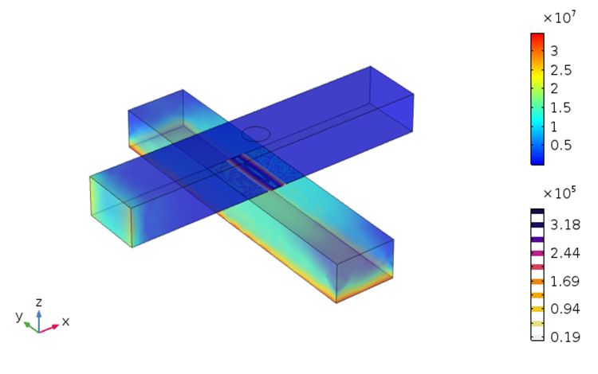
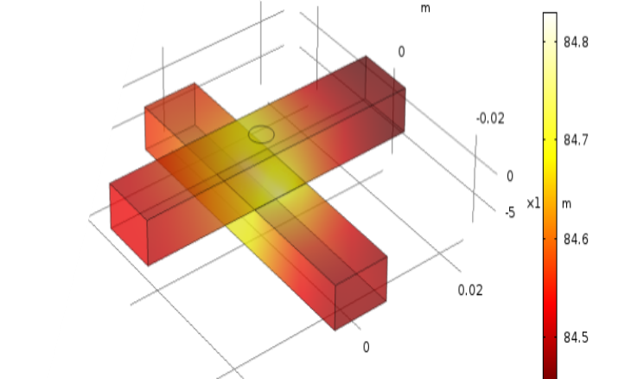
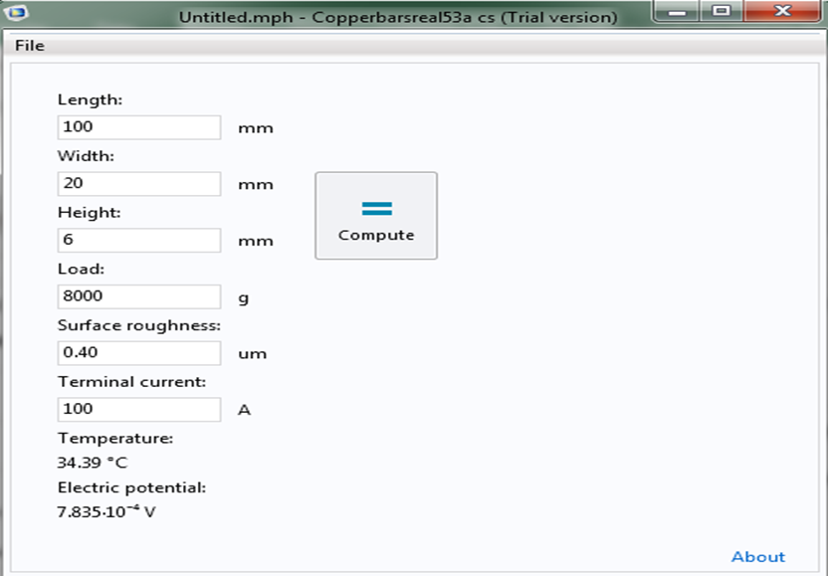
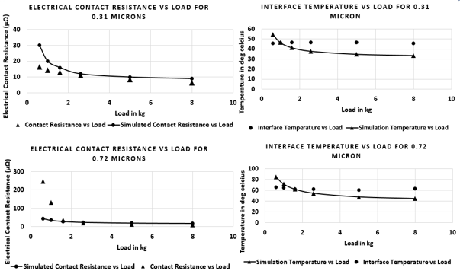
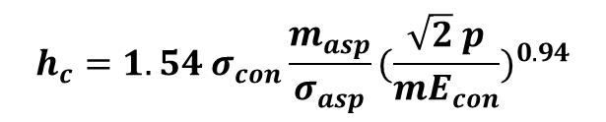

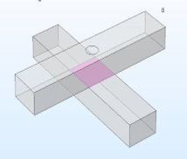
Electro-Thermal Analysis of Contact Resistance
Nitin Pandey, Ishant Jain
Materials & Processing, Raychem RPG, Vadodara, GJ, India
Introduction: Flow of current between two conductors in contact generates heat at the interface which depends on certain mechanical parameters such as surface roughness and load applied. The irregularities at microscopic level leads to constriction of current, leading to an additional resistance across interface, called contact resistance (CR). Simulation is performed to compare the results obtained by the experiment performed (Fig. 1). Equivalent Greenwood¹ model is predicted for the real electrical contacts and an application is developed using App builder to obtain contact resistance and interface temperature (T_{m}).
Results: Contact Pressure is obtained at each combination of load and roughness (Fig. 3) and Holm’s radius³ (α) is calculated using first approximation⁴. CR & Holm’s radius values is put into GW equation¹ for multiple spots to approximately predict microscopic distribution & size of asperities, according to the second equation mentioned above. T_{m} is also obtained (Fig. 4) from results section. The simulation and experimental results are plotted for both the selected roughness levels (Fig. 6). The first two graphs show CR and T_{m} plots for the surface with 0.31 µm roughness and the other two graphs show responses for 0.72 µm level. An application is developed using COMSOLTM App builder to instantly predict CR and T_{m} (Fig. 5) and validated with Raychem propriety connectors for eg. plug-in connector⁵ used in RayfeedTM.
Figure 1. Line diagram of Experimental Setup
Computational Methods: Solid Mechanics (SM) is used to apply constraints, load and to define the contact. Current is applied under Electric Currents (EC) and contact is paired electrically using Mikic-Elastic correlation² according to the first equation given below. Heat flux is applied by obtaining Nusselt number as per the dimension of bus-bars and contact is also paired thermally under Heat Transfer (HT).
Load is applied at the upper bus-bar, current is applied at the boundary of the upper bar and lower bar is grounded (Fig. 2). Value of important parameters like surface roughness, slope of asperities, contact Young’s modulus are put in “Pair Electrical Contact” and “Pair Thermal Contact” boundary conditions. In these conditions, the value of contact pressure is obtained from the SM physics. The stationary study is performed and parametric sweep is applied to obtain the interface temperature at all the values of load.
Figure 3. Contact Pressure
Figure 4. Temperature distribution
Figure 5. Application Interface
Figure 6. Simulation vs Experimental Results
Load
Conclusions: CR is significant for load values range 0.6 - 1.6 kg & then decreases uniformly as load further increases. For load greater than 1.6 kg experimental results match with simulation results & for load lesser than 1.6 Kg slight variation is found, since the Mikic-Elastic correlation is empirical. Temperature results are almost similar, even for lower values of load. This is due to varying ambient conditions. Mikic-elastic correlation predicts better CR values at higher loads. Thus supporting research work of Sridhar & Yovanovich⁶.
Terminal 100 A
Contact
R_{a}
References:
J. A. Greenwood et al., Contact of nominally flat surfaces, Proc. R. Soc. Lond. A., London (1966)
B. B. Mikic, Thermal Contact Conductance Theoretical Consideration, Int. J. Heat Mass Transf. (1974)
R. Holm, Electric Contacts, Springer-Verlac, New York (1967)
Roland S. Timsit, Electrical Contact Resistance, Properties of Stationary Interfaces, IEEE transactions on component and packaging technology, vol. 22, no. 1 (1999)
I. Jain and S. Reddy, Electrical Connector, India Patent 201721021314, (2017)
Sridhar, M. R. et al., Review of Elastic and Plastic Contact Conductance Models: Comparison with Experiment, Journal of Thermophysics and Heat Transfer
Ground
Figure 2. Geometric Modelling of Busbars

