Slide 1
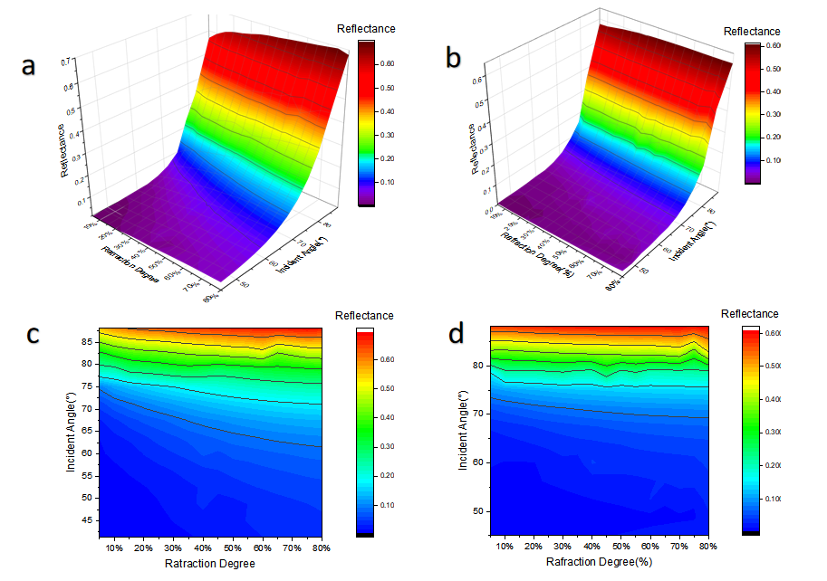
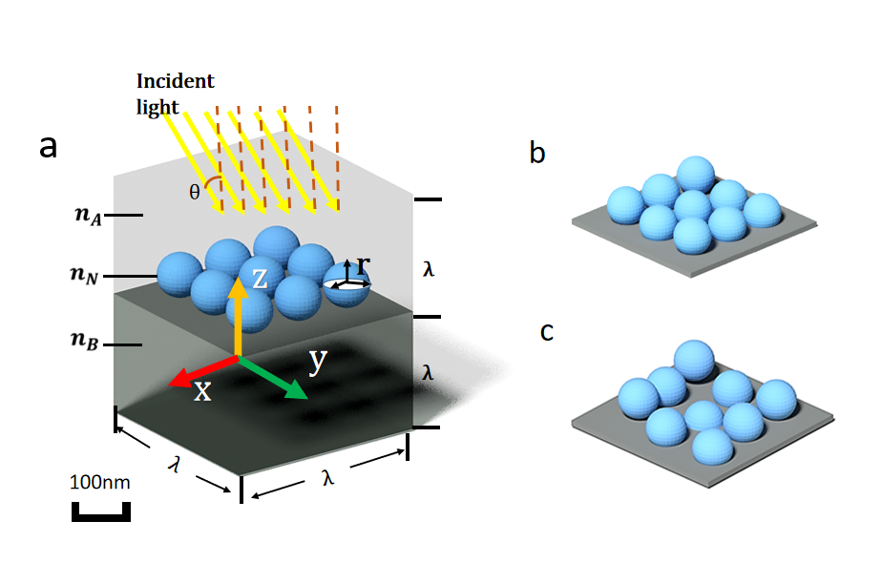
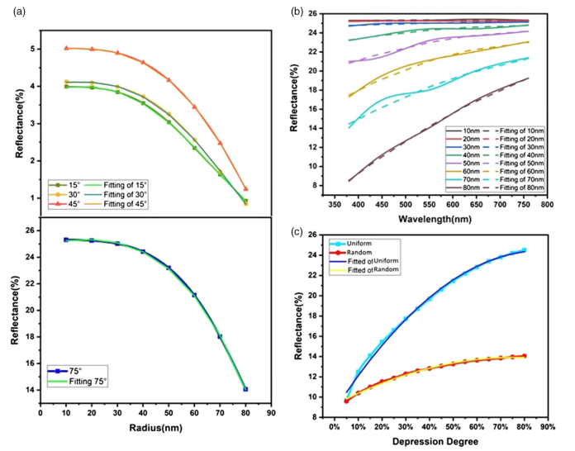
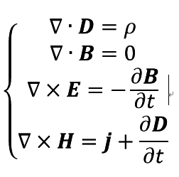
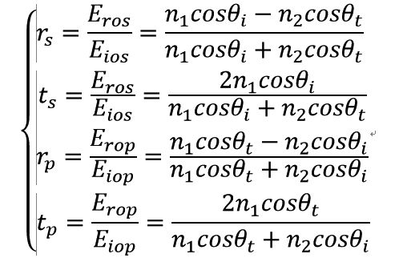
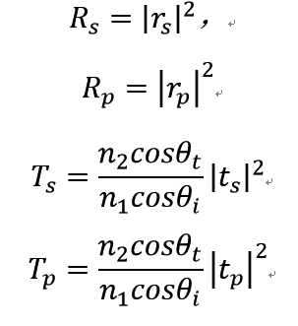
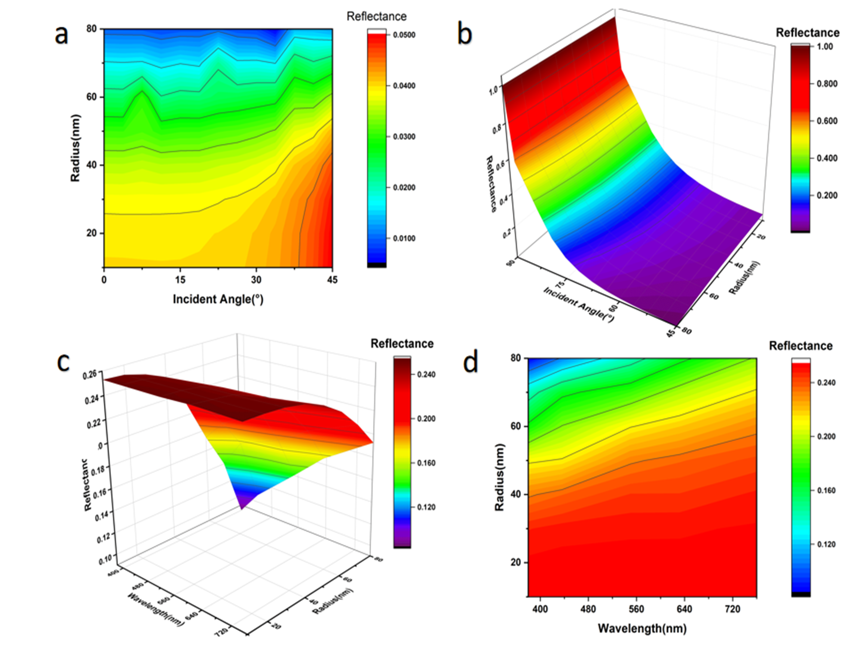
和
Simulation on antireflection of the oxide nanosphere monolayer film
YUXIAO HOU¹ XIAOHONG LI¹ HANG LUO¹ WEI LEI¹ AND HONG LEI² 1.School of Science, Southwest University of Science and Technology, Mianyang 621010, China
2.State Key Laboratory for Environment-friendly Energy Materials, Southwest University of Science and Technology, Mianyang 621010, China
简介: 光反射会带来光电子器件能量转换效率低、眩光污染等问题。我们设计仿真了单层纳米介质球减反结构，探讨了SiO₂纳米微球半径、均匀度、入射光波长以及偏振态对反射率透射率的影响。
Fig. 3 Effects of the surface depressions’degree and uniformity. (a),(c) Uniform depression’s effect on the reflectance. (b),(d)Random depression’s effect on the reflectance. (c) Reflectance distribution of (a) in two dimension. (d) Reflectance distribution of (b) in two dimension.
Fig. 1. (a) Model of the nanosphere coating film. (b) Uniform depression on the surface of the nanosphere film. (c) Random depression on the surface of the nanosphere film.
计算方法: 应用COMSOL Multiphysics中的波动光学模块基于麦克斯韦方程进行研究。建立了一个三维长方体作为模拟单元，上下底面设为端口，四周设为周期性条件。在二分之一处设置平面作为上下不同介质的分界面，将上面部分设为空气，中间设置球体阵列，下面部分设置为玻璃基底。通过改变纳米SiO₂微球尺寸大小、间隔周期、下陷均匀度、入射光波长、入射角度以及偏振态，理论上探究氧化纳米膜抗反射规律。
结果:
Fig. 4 Fittings of the results. (a) Radius effect on reflectance with incident angle θ = 15°, 30°, 45°, and 75°. (b) Wavelengths’ effect on reflectance. (c) Reflectance comparison between uniform and random depression. Both (b) and (c) are under 75° incidence. All incidence with polarization state s:p = 1:1.
结论: 当小球半径为70nm时在入射角小于1.4399rad时，微球透射率最佳。对应透射率最佳微球半径70nm，确定偏振态在s:p为0：1及1：0时反射率调控的两种边界。可以通过增加P偏振光的比例提高透射率。在凹陷为20%d时，透射率均达到最大值。氧化纳米膜抗反射规律在太阳能电池、发光二极管、透镜、柔性移动显示设备、红外隐身伪装、交通工具显示元件等方面有很大的应用价值。
Fig.2 Effects of radius and wavelength on reflectance. (a) Nanosphere radius’s effect on the reflectance when θ = 0°–45°. (b) Nanosphere
radius’s effect on the reflectance when θ = 45°–90°. (c),(d)Wavelength’s effect on the reflectance when θ = 45°–90°.
参考文献：
Yuxiao Hou, Xiaohong Li, Hang Luo, Wei Lei, and Hong Lei, “Simulation on antireflection of the oxide nanosphere monolayer film”, Applied Optics, 2019, 58(18): 4926-4932.
Excerpt from the Proceedings of the 2019 COMSOL Conference in Beijing

