Slide 1

Acoustic Topology Optimization – Implementation and Examples
René Christensen, PhD
Senior Specialist Vibroacoustics
25 September, 2019

Slide 2
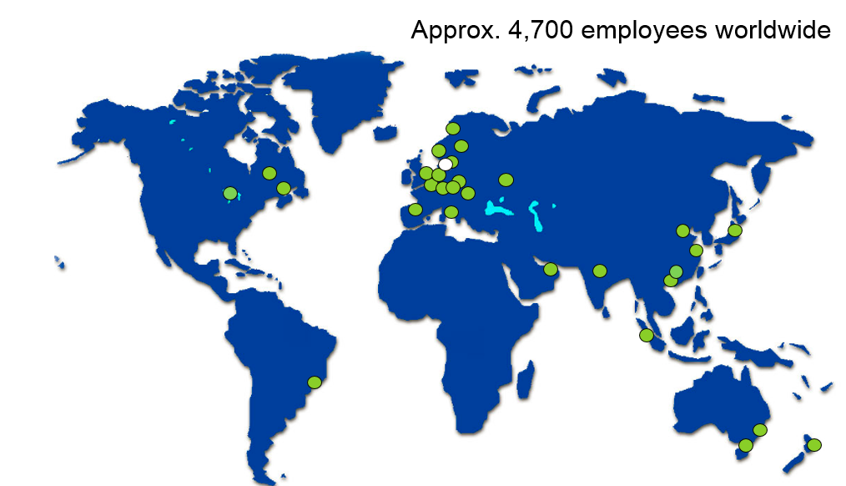
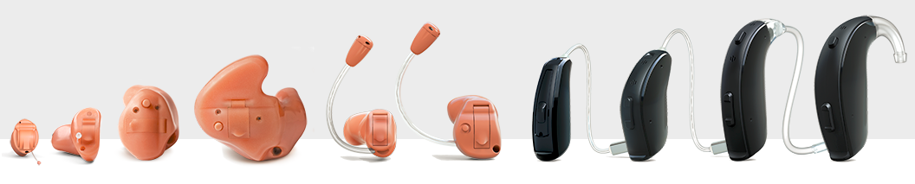

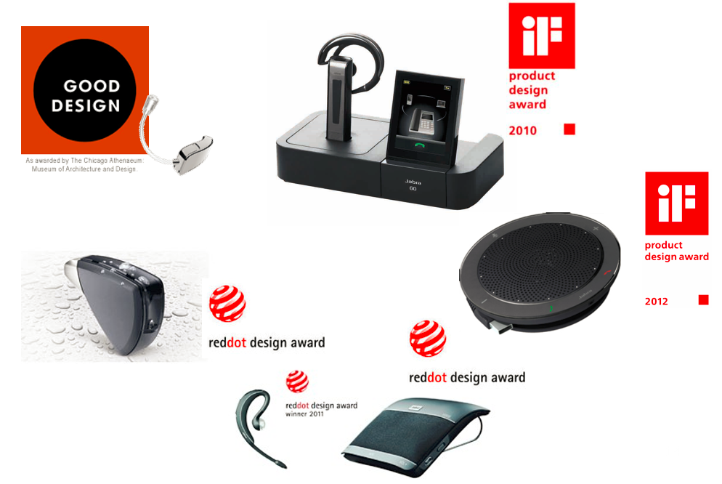
Company
GN Hearing | GN Audio
Vibroacoustics
Microacoustics
Optimization

Slide 3
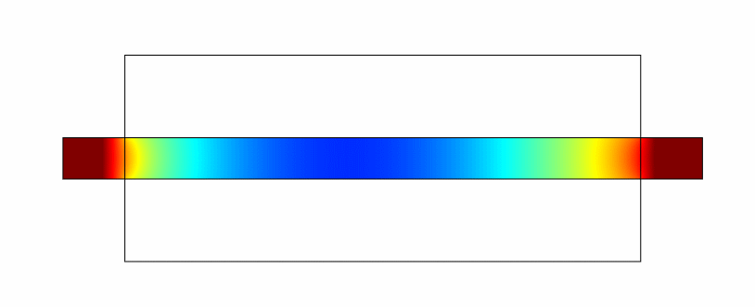
Optimization in Physics
Types
Trial-and-error
Parameter optimization
Shape optimization
Topology optimization
Types
Structural Mechanics
Fluid Flow
Electromagnetics
Acoustics

Slide 4
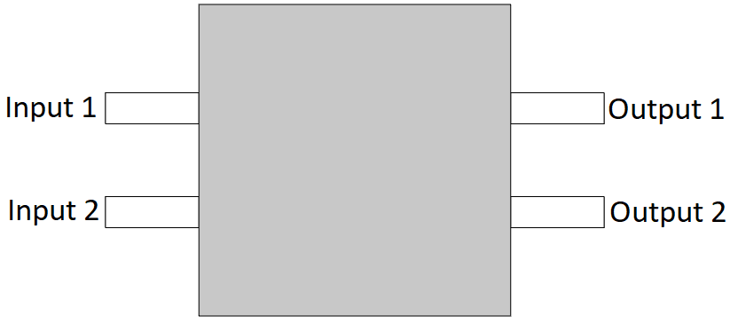
Criss-cross Splitter
Initial:
Configuration:
2D
Plane wave radiation input with excitation and plane wave radiation output
Objective:
Have two different frequency input cross paths

Slide 5


Criss-cross Splitter
Definitions:
Configuration:
2D
Plane wave radiation input with excitation and plane wave radiation output
Design domain
Objective:
$$\underset{\overline{ξ}}{max:}{\min_{f_{i,j}}{\frac{\left.I_{out,i}(\overline{ξ},f_{i,j}\right)}{\left.I_{in,j}(\overline{ξ},f_{i,j}\right)}}}$$
$$\frac{\int_{Ω_{d}}{\overline{ξ}}dΩ_{d}}{Ω_{max}}−1≤0$$
Area constraint:

Slide 6

Criss-cross Splitter
$$0<ξ(x)≤1 ∀ x∈Ω_{d}$$
$$−r^{2}∇^{2}\tilde{ξ}+\tilde{ξ}=ξ, \frac{∂\tilde{ξ}}{∂n}=0$$
$$\overline{ξ}=\overline{ξ}\left(\tilde{ξ}\left(ξ\right)\right)=\frac{\tanh\left(βη\right)+\tanh\left(β(\tilde{ξ}−η)\right)}{\tanh\left(βη\right)+\tanh\left(β(1−η)\right)}$$
$$ρ\left(\overline{ξ}\right)=ρ_{0}+{\overline{ξ}}^{P}(ρ_{s}−ρ_{0})$$
$$K\left(\overline{ξ}\right)=K_{0}+{\overline{ξ}}^{P}(K_{s}−K_{0})$$
$$∇∙\left(\frac{1}{ρ\left(\overline{ξ}\right)}∇p\right)+\frac{ω^{2}}{K\left(\overline{ξ}\right)}p=0$$
Definitions:
Configuration:
2D
Plane wave radiation input with excitation and plane wave radiation output
Design domain
Objective:
$$\underset{\overline{ξ}}{max:}{\min_{f_{i,j}}{\frac{\left.I_{out,i}(\overline{ξ},f_{i,j}\right)}{\left.I_{in,j}(\overline{ξ},f_{i,j}\right)}}}$$
$$\frac{\int_{Ω_{d}}{\overline{ξ}}dΩ_{d}}{Ω_{max}}−1≤0$$
Area constraint:

Slide 7
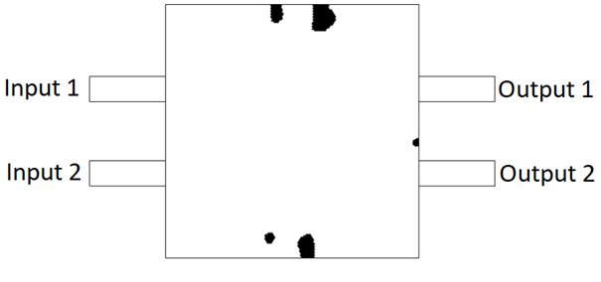
Criss-cross Splitter
Optimized ‘geometry’ field:
Configuration:
2D
Plane wave radiation input with excitation and plane wave radiation output
Objective:
$$\underset{\overline{ξ}}{max:}{\min_{f_{i,j}}{\frac{\left.I_{out,i}(\overline{ξ},f_{i,j}\right)}{\left.I_{in,j}(\overline{ξ},f_{i,j}\right)}}}$$

Slide 8
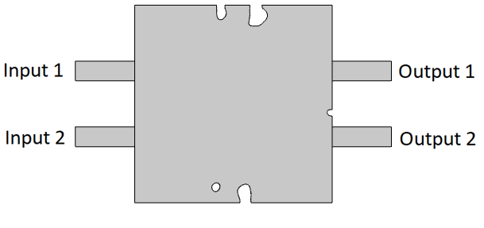
Criss-cross Splitter
Test geometry:
Configuration:
2D
Plane wave radiation input with excitation and plane wave radiation output
Objective:
$$\underset{\overline{ξ}}{max:}{\min_{f_{i,j}}{\frac{\left.I_{out,i}(\overline{ξ},f_{i,j}\right)}{\left.I_{in,j}(\overline{ξ},f_{i,j}\right)}}}$$

Slide 9
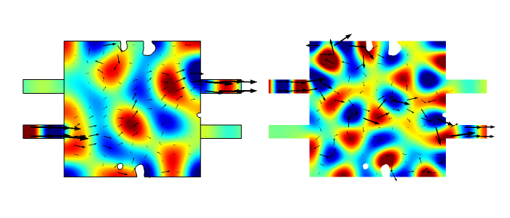
Criss-cross Splitter
Test:
Configuration:
2D
Plane wave radiation input with excitation and plane wave radiation output
900 Hz
1,260 Hz
Objective:
$$\underset{\overline{ξ}}{max:}{\min_{f_{i,j}}{\frac{\left.I_{out,i}(\overline{ξ},f_{i,j}\right)}{\left.I_{in,j}(\overline{ξ},f_{i,j}\right)}}}$$

Slide 10
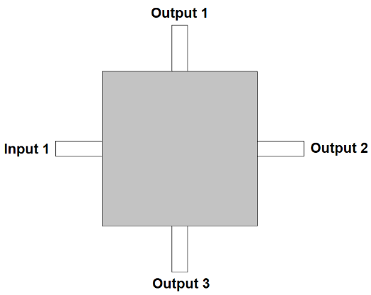
Acoustic Demultiplexer
Initial:
Configuration:
2D
Plane wave radiation input with excitation and plane wave radiation output
Objective:
Direct different frequencies to different outputs

Slide 11
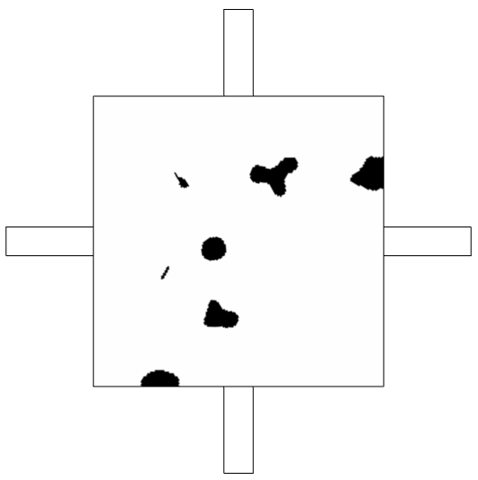
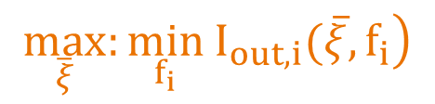
Acoustic Demultiplexer
Optimized:
Configuration:
2D
Plane wave radiation input with excitation and plane wave radiation output
Objective:
$$\max_{\overline{ξ}}:{\min_{f_{i}}\left.{ I}_{out,i}(\overline{ξ},f_{i}\right)}$$

Slide 12
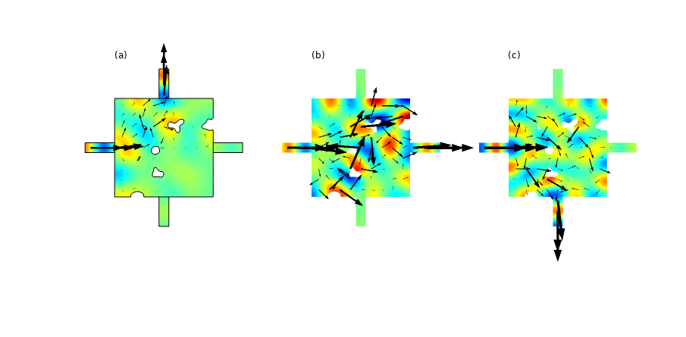
Acoustic Demultiplexer
Test:
Configuration:
2D
Plane wave radiation input with excitation and plane wave radiation output
Objective:
$$\max_{\overline{ξ}}:{\min_{f_{i}}\left.{ I}_{out,i}(\overline{ξ},f_{i}\right)}$$
800 Hz
960 Hz
1,120 Hz

Slide 13
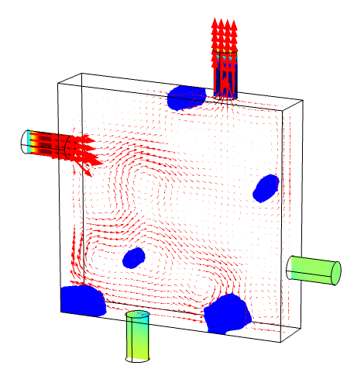
Acoustic Demultiplexer, 3D
Test:
Configuration:
3D
Plane wave radiation input with excitation and plane wave radiation output
Objective:
$$\max_{\overline{ξ}}:{\min_{f_{i}}\left.{ I}_{out,i}(\overline{ξ},f_{i}\right)}$$

Slide 14
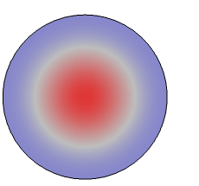
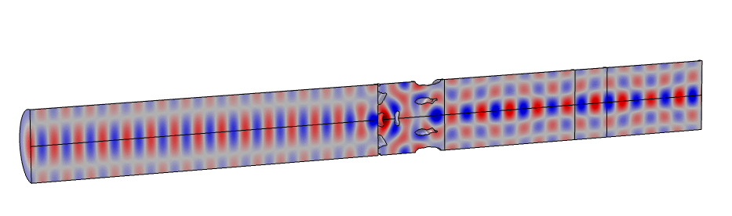
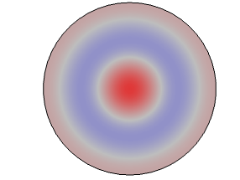
Mode conversion – I
Test:
Configuration:
2Daxi
Port input with excitation and port output
Objective:
(0,1)-to-(0,2) output

Slide 15
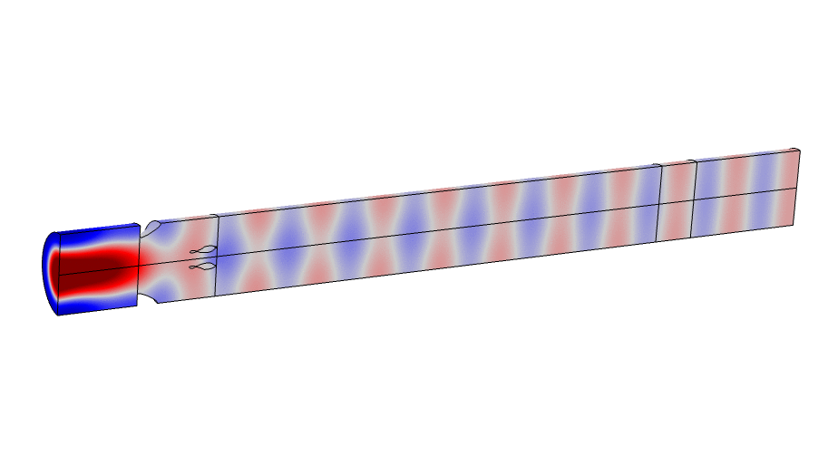
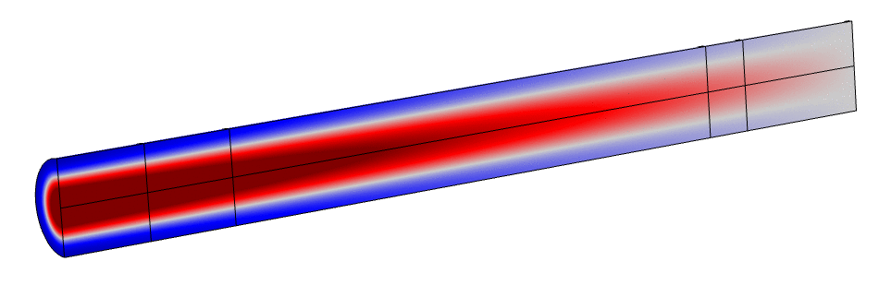
Mode conversion – II
Test:
Configuration:
2Daxi
Port input with excitation and port output
Objective:
Evanescent (0,1)-to-(0,0) output

Slide 16
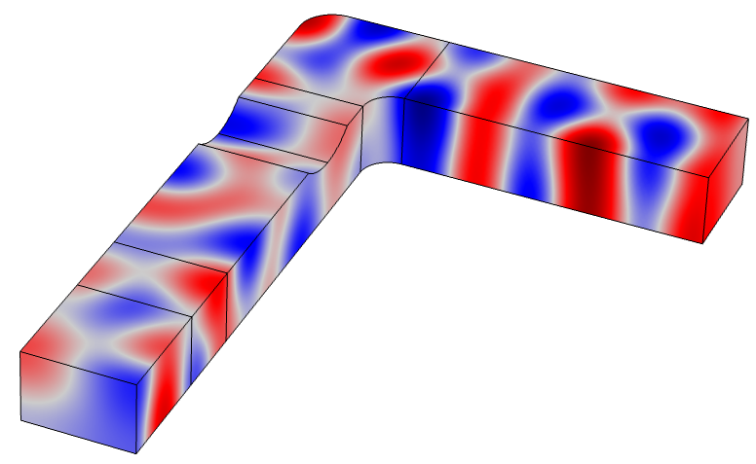
Mode conversion – III
Initial:
Configuration:
3D
Plane wave input
Port input and output
Application library’s
“duct_right_angled_bend”
+
Topology Optimization
Objective:
Plane wave output

Slide 17
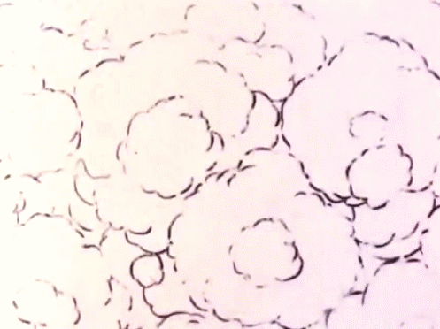
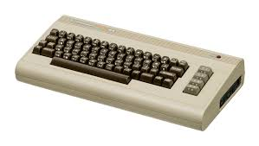
Mode conversion – III
(3D takes some time…)
Configuration:
3D
Plane wave input
Port input and output
Objective:
Plane wave output

Slide 18
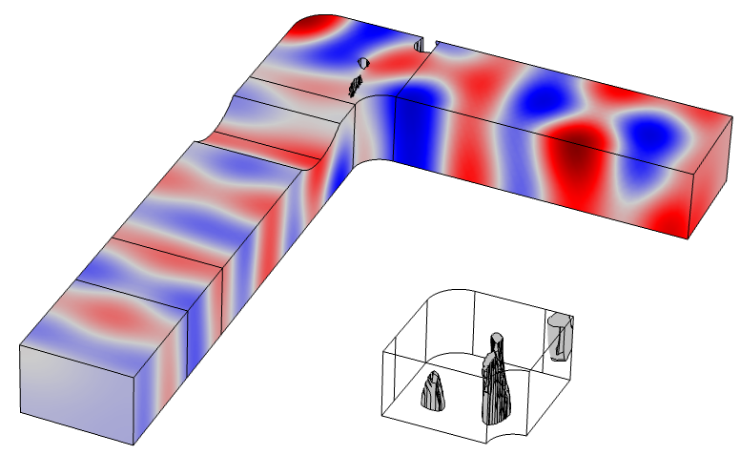
Mode conversion – III
Test:
Configuration:
3D
Plane wave input
Port input and output
Objective:
Plane wave output

Slide 19
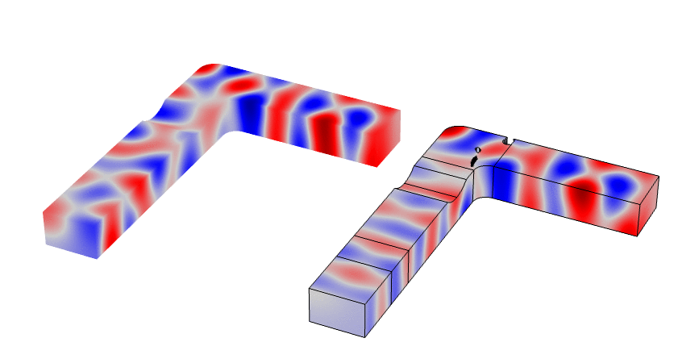
Mode conversion – III
Comparison:
Configuration:
3D
Plane wave input
Port input and output
Objective:
Plane wave output

Slide 20
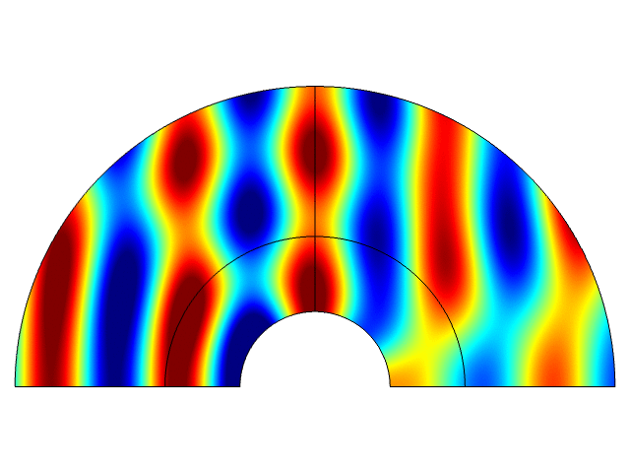
Acoustic Cloaking
Application library’s
“acoustic_cloaking”
+
Topology Optimization
Initial:
Configuration:
2D
Plane wave background field.
Objective:
Cloak the hemicylinder

Slide 21
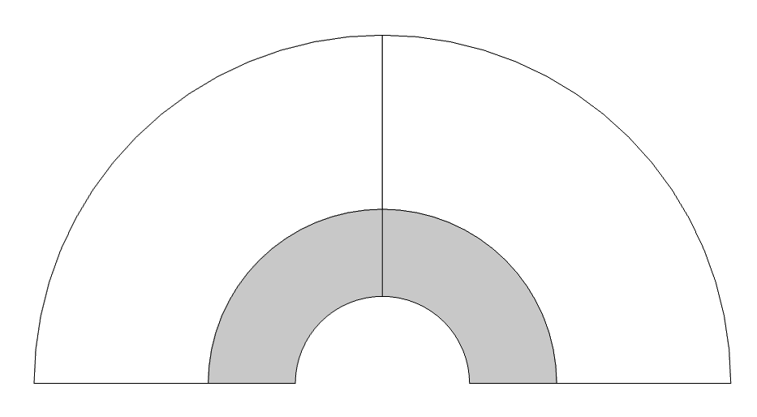
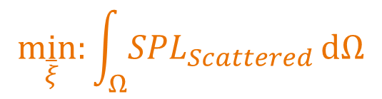
Acoustic Cloaking
Design domain:
Configuration:
2D
Plane wave background field.
Objective:
$$\underset{\overline{ξ}}{min:}\int_{Ω}{{SPL}_{Scattered}}dΩ$$

Slide 22
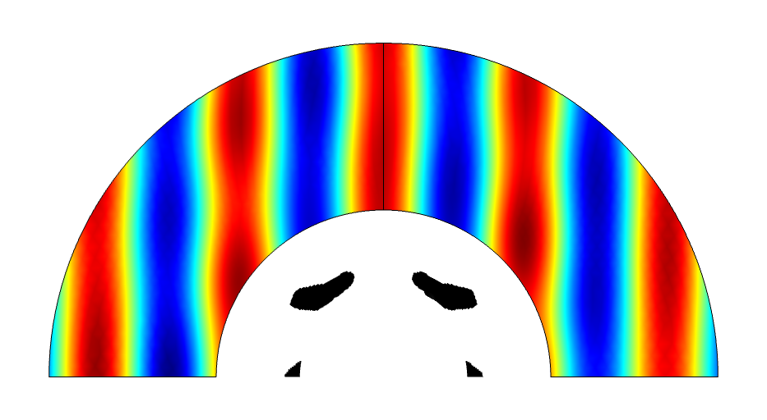
Acoustic Cloaking
Optimized:
Configuration:
2D
Plane wave background field.
Objective:
$$\underset{\overline{ξ}}{min:}\int_{Ω}{{SPL}_{Scattered}}dΩ$$

Slide 23
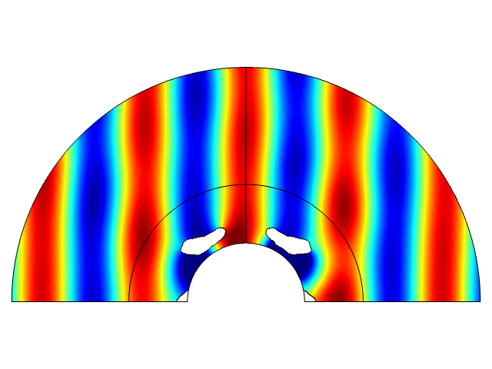
Acoustic Cloaking
Test:
Configuration:
2D
Plane wave background field.
Objective:
$$\underset{\overline{ξ}}{min:}\int_{Ω}{{SPL}_{Scattered}}dΩ$$

Slide 24
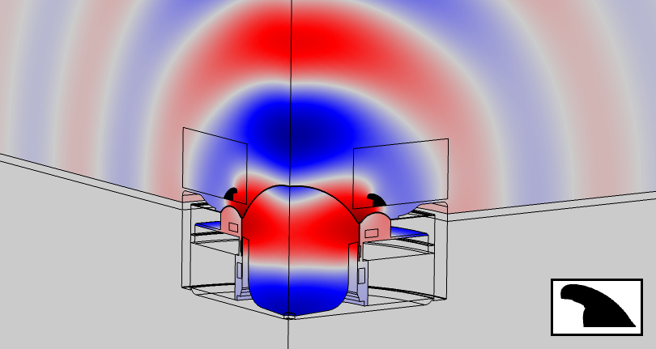
Tweeter Phase Plug
Test:
Configuration:
2Daxi
Fully coupled electromagnetic-elastic-acoustic
Voltage input
Objective:
Flatten frequency response above 10 kHz

Slide 25
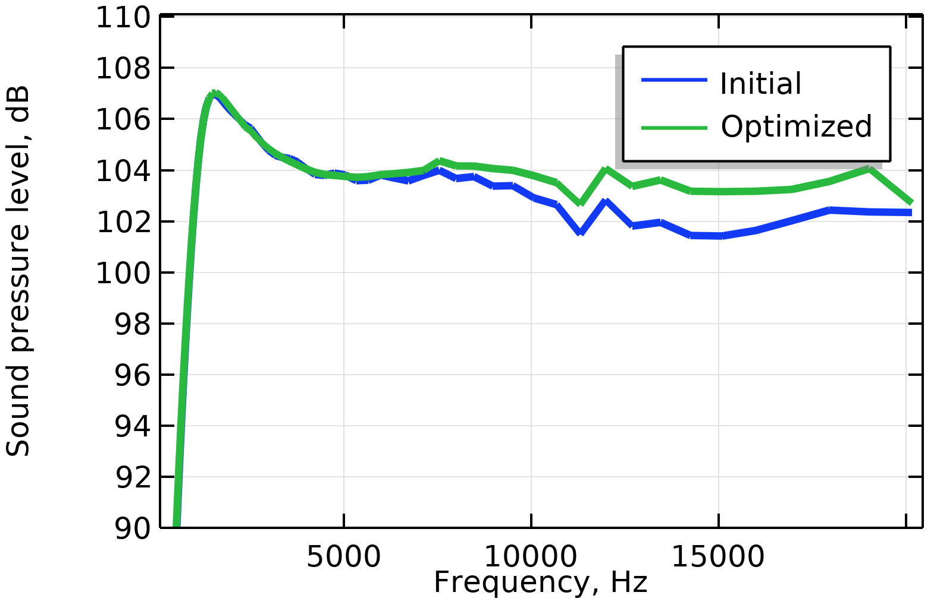
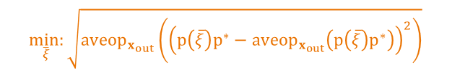
Tweeter Phase Plug
Test:
Configuration:
2Daxi
Fully coupled electromagnetic-elastic-acoustic
Voltage input
Objective:
$$\underset{\overline{ξ}}{min:}{\sqrt{{aveop}_{x_{out}}\left({\left(p{\left(\overline{ξ}\right)p}^{∗}−{aveop}_{x_{out}}\left({p\left(\overline{ξ}\right)p}^{∗}\right)\right)}^{2}\right)}}$$

Slide 26
Conclusion
Acoustic topology optimization will be a tool in the engineering toolbox within a few years.
Objectives can span across frequencies and multiple outputs/domains.
We will see organic, non-intuitive designs that meet certain objectives.
Discussion
Filters
Robustness of designs
Future perspective

Slide 27
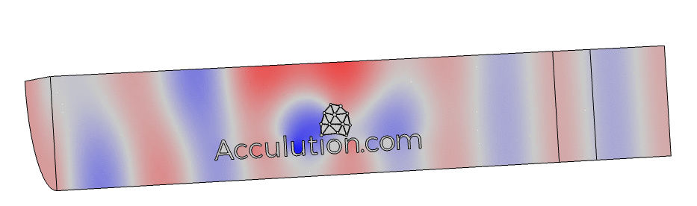
Thank you!

