Slide 1

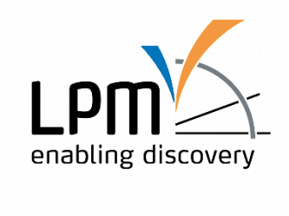
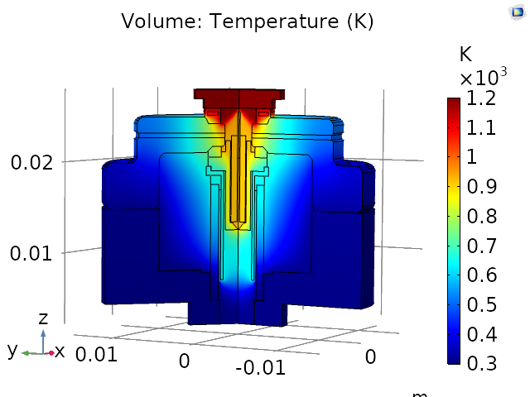
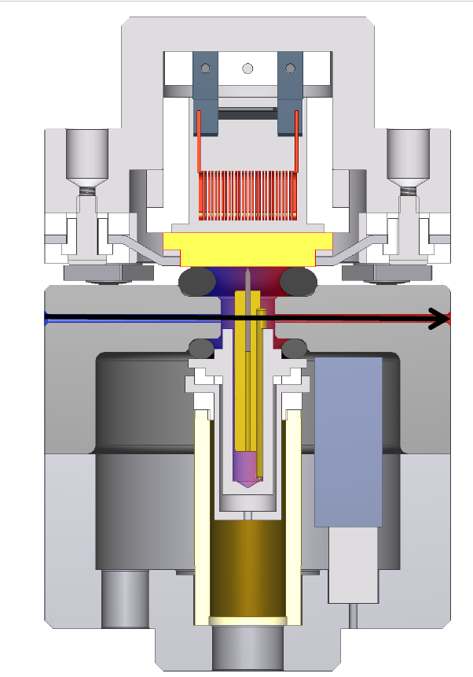
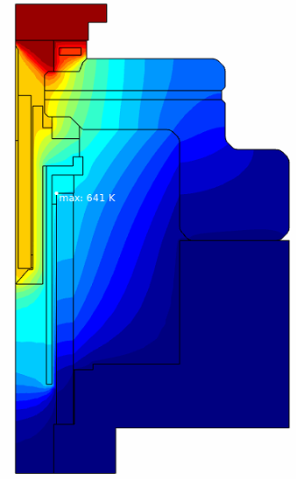
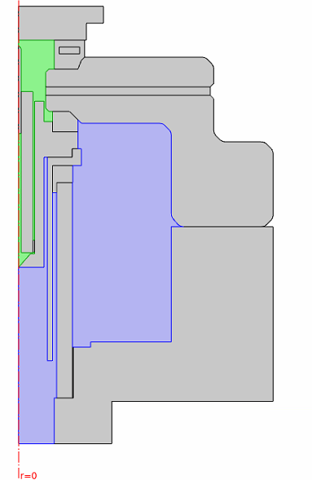


Heat Transfer Simulation for Heat Management
in the Design of a New ReactorSTM
Elahe Motaee¹, Freek Groenewoud¹, Gijsbert Verdoes¹, Peter van der Tuijn²,
Gertjan van Baarle² and Irene Groot¹
¹ Catalysis and Surface Chemistry, Leiden Institute of Chemistry, Leiden, the Netherlands
² Leiden Probe Microscopy B.V., Leiden, the Netherlands
INTRODUCTION:
RESULTS:
Operando scanning tunneling microscopy (STM) of catalyst by new ReactorSTM, why?
(1) Imaging active sites of catalyst
(2) Investigating catalysis in situ under industrial
conditions (current version since 2010)
(3) New version of this instrument to enable
catalysis research at higher temperature & pressure
In current design of ReactorSTM, piezo tube of STM can operate in maximum temperature of 423 K, which based on simulation it reaches to 444 K while catalyst has been set in 600 K. If catalyst temperature has been set in 1200 K, piezo temperature reaches to 641 K which is beyond operation temperature of piezo.
Catalyst
Reactant (g)
Product (g)
m
Figure 3. Catalyst Temperature: 1200 K,
Gas Reactants: CH₄ + O₂ 1 bar with 1.3 m/s velocity
Reactor Wall
Piezo & Scanner
Table 1. Temperature Prediction in ReactorSTM
Figure 1. Schematic of ReactorSTM
Assumption in Simulation |  | Max. Temperature Piezo (K)
Metal Catalyst Temperature | 600 K | 444
 | 1200 K | 641
Gas Reactant Component | CH₄ | 647
 | CH₄ + O₂ | 641
Reactor Pressure | 1 bar | 641
 | 10 bar | 781
Gas Velocity | V_{r}= 1.3 m/s, V_{z}= -0.1 m/s | 428
 | V_{r}= 1.3 m/s, V_{z}= -1.3 m/s | 641
Radiation | Not Considered | 629
 | Considered | 641
Continuing previous work [1,2] we are developing a new version of ReactorSTM which is micro reactor (0.5 ml) equipped with STM to enable catalysis research at more elevated temperatures and pressures (1200 K and 20 bar), opening up the possibility to investigate a larger range of interesting relevant catalytic chemical processes, e.g. partial oxidation of methane.
For the heat transfer simulations and temperature profiles in our ReactorSTM, heat transfer in solid and fluid coupled with the surface-to-surface radiation module in a 2D axisymmetric dimension and under stationary conditions has been used.
HEAT TRANSFER SIMULATION:
Gas Domain
Catalyst at 1200 K
CONCLUSIONS:
UHV Domain
Since the max. operational temperature of Piezo is lower than temperature which has been predicted by simulation, considering thermal stability & geometry in the new design is necessary.
By reason of reactor operational conditions, while cold gas flows on the top of the reactor, it seems it may improve active cooling, while in prediction it shows the reverse. ReactorSTM is cylindrically symmetric but in/outlets of gas are not designed cylindrically symmetric, in this case, 3D model will predict the temperature profile more accurately.
Figure 2. 2D model of ReactorSTM
COMPUTATIONAL METHODS:
Simulation approach to solving the problem was based on following equations: (Eq.1) Heat transfer in solid & fluid & (Eq.2) Surface to surface radiation:
Eq.1
Eq.2
$ρC_{p}u. ∇T+ ∇.q$ = Q
Heat Source
REFERENCES:
Convection
Conduction
M.A. van Spronsen, G.J.C. van Baarle, C.T. Herbschleb, J.W.M. Frenken, I.M.N. Groot, High-pressure operando STM studies giving insight in CO oxidation and NO reduction over Pt(1 1 0), Catalysis Today, 244, 85–95 (2015)
C. T. Herbschleb, P. C. van der Tuijn, S. B. Roobol, V. Navarro, J. W. Bakker, Q. Liu, D. Stoltz, M. E. Cañas-Ventura, G. Verdoes, M. A. van Spronsen, M. Bergman, L. Crama, I. Taminiau, A. Ofitserov, G. J. C. van Baarle, and J. W. M. Frenken, The ReactorSTM: Atomically resolved scanning tunneling microscopy under high-pressure, high-temperature catalytic reaction conditions, Review of Scientific Instruments 85, 083703 (2014).
$$εe_{b}\left(T\right)+ ρ_{d}G=J$$
Energy leaving from surface
Emitted energy
Incident energy
Excerpt from the Proceedings of the 2020 COMSOL Conference

