Slide 1
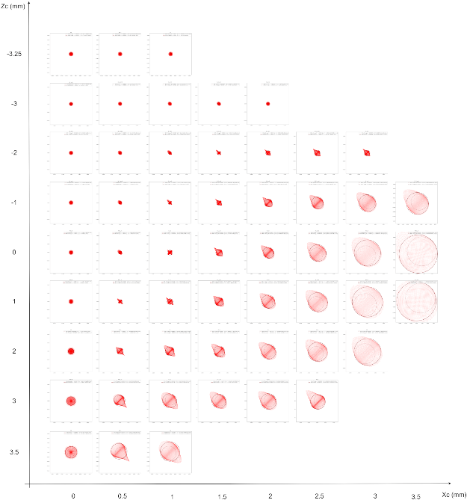
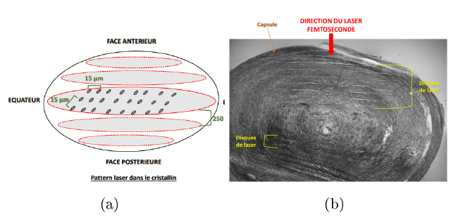
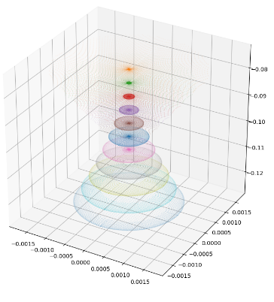
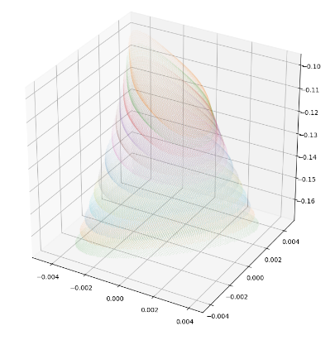
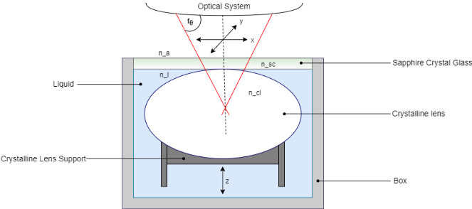
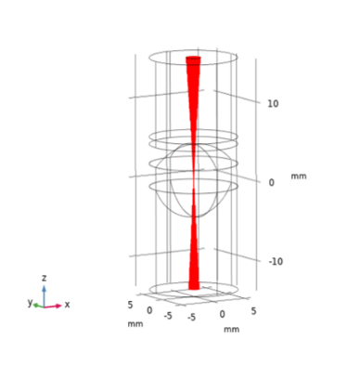
Crystalline Lens aberration during Laser Surgery
J. Minardi¹, A. Maurer², R. Rozsnyo¹, R. Boulandet¹, D. Enfrun²
1. HEPIA, HES-SO, Geneva, GE, Switzerland
2. R&D, Kejako SA, Geneva, GE, Switzerland
INTRODUCTION: Kejako SA develops an innovative femtosecond-laser-based solution for presbyopia. Femtosecond (10⁻¹⁵s) lasers uses ultra-short pulses to interact with tissues and produce a wide range of effects, depending, for example, on interaction time and energy density¹. For its ex-vivo testing, Kejako has developed an enclosure (fig. 2) to test various laser parameters on ex vivo pig lenses and understand the laser tissue interaction.
First experimental results have showed that the lens is not responding homogeneously to laser pulse (fig. 1) that’s why we use simulation to understand how the laser beam shape is affected by focusing through different lens areas.
RESULTS: Fig.4 displays the cross-sectional area of laser spot shapes for different target in the lens (Zc, Xc)
Anterior surface
Femtosecond Laser Direction
Lens Equator
LASER MARKS
Posterior surface
Laser Pattern in crystalline lens
LASER MARKS
Figure 1. The lens is submitted to homogeneously spaced impact on different planes (a). The lens cross section response to the laser show non homogenous reaction (b)
Figure 4. Aberration map in the lens created using the spot diagram
map at the min RMS diameter location. Circles containing 50% and 87%
of the energy are displayed.
COMPUTATIONAL METHODS: Using the geometric optic module, the laser beam is considered as perfectly sharp and focused ray emission in the air, and the lens is modelled with a simplified gradient of refractive index (fig. 3). No absorption or diffraction of the tissue is considered
Figure 5. Laser shape map reconstruction in 3D around the spot at
two different locations.
CONCLUSIONS: The laser shape is strongly affected by the location targeted in the lens. This is only the result of the refraction of the lens shape in this simplified model as it’s not taking into account the fiber orientation, the diffraction or the absorption of the lens. The central and anterior part of the lens receive a concentrated amount of energy 600 times higher than the periphery, explaining the difference of the lens response observed in the experiment. This highlight the need to take into account the lens shape in the development of a laser surgery such as FLACS* and of a specific optical system to achieve a controlled and homogeneous treatment.
Figure 2. Experimental set up. The lens is contained in a close water filled
transparent enclosure, and the laser is swept through an f-theta lens
(a)
(b)
REFERENCES:
M. H.Niemz, Laser Tissus Interactions, Fundamentals and Applications. Springer, 2007.
Figure 3. The setup modelled in COMSOL (a) with the gradient of refractive index (b)
* FLACS : Femtosecond Laser Assisted Cataract Surgery
Excerpt from the Proceedings of the 2020 COMSOL Conference

