Slide 1
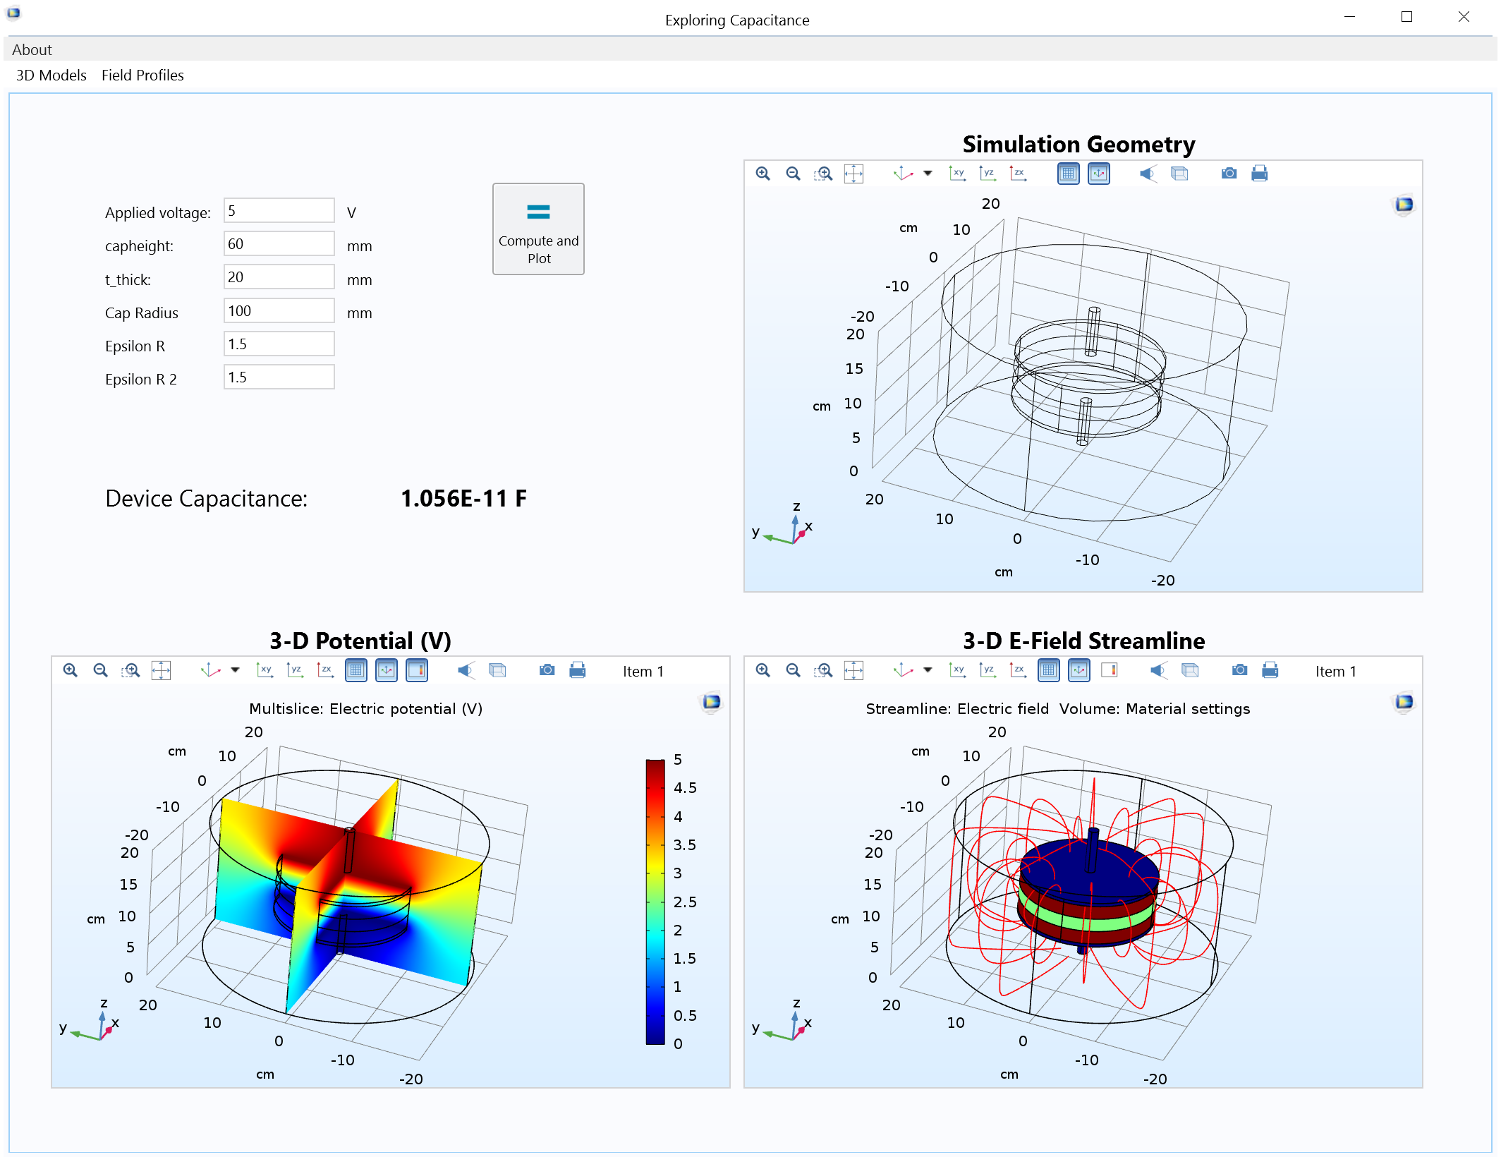
VIRGINIA COMMONWEALTH UNIVERSITY Teaching Electromagnetics with Simulation Apps
Electrical engineering students can have a hard time visualizing EM concepts
e.g., magnetic field around a dipole
Professor Nate Kinsey at VCU introduced simulation apps into curriculum
Combines simulation lab, hands-on experiments, and lecture
Apps enable students to visualize 3D electromagnetics problems
“Illuminating the Physics Behind Electromagnetics Concepts with Applications”
Multiphysics Simulation 2019: Nate Kinsey, Virginia Commonwealth University, Virginia, USA
Simulation app used to study capacitor fringe fields
Notes:
Engineers at Volkswagen Kassel turned to multiphysics simulation to perform electromagnetic and structural analyses of rotor laminations in electric drives for EV motors
They then built and distributed simulation applications to automate these analyses and standardize their development processes throughout the organization

Slide 2
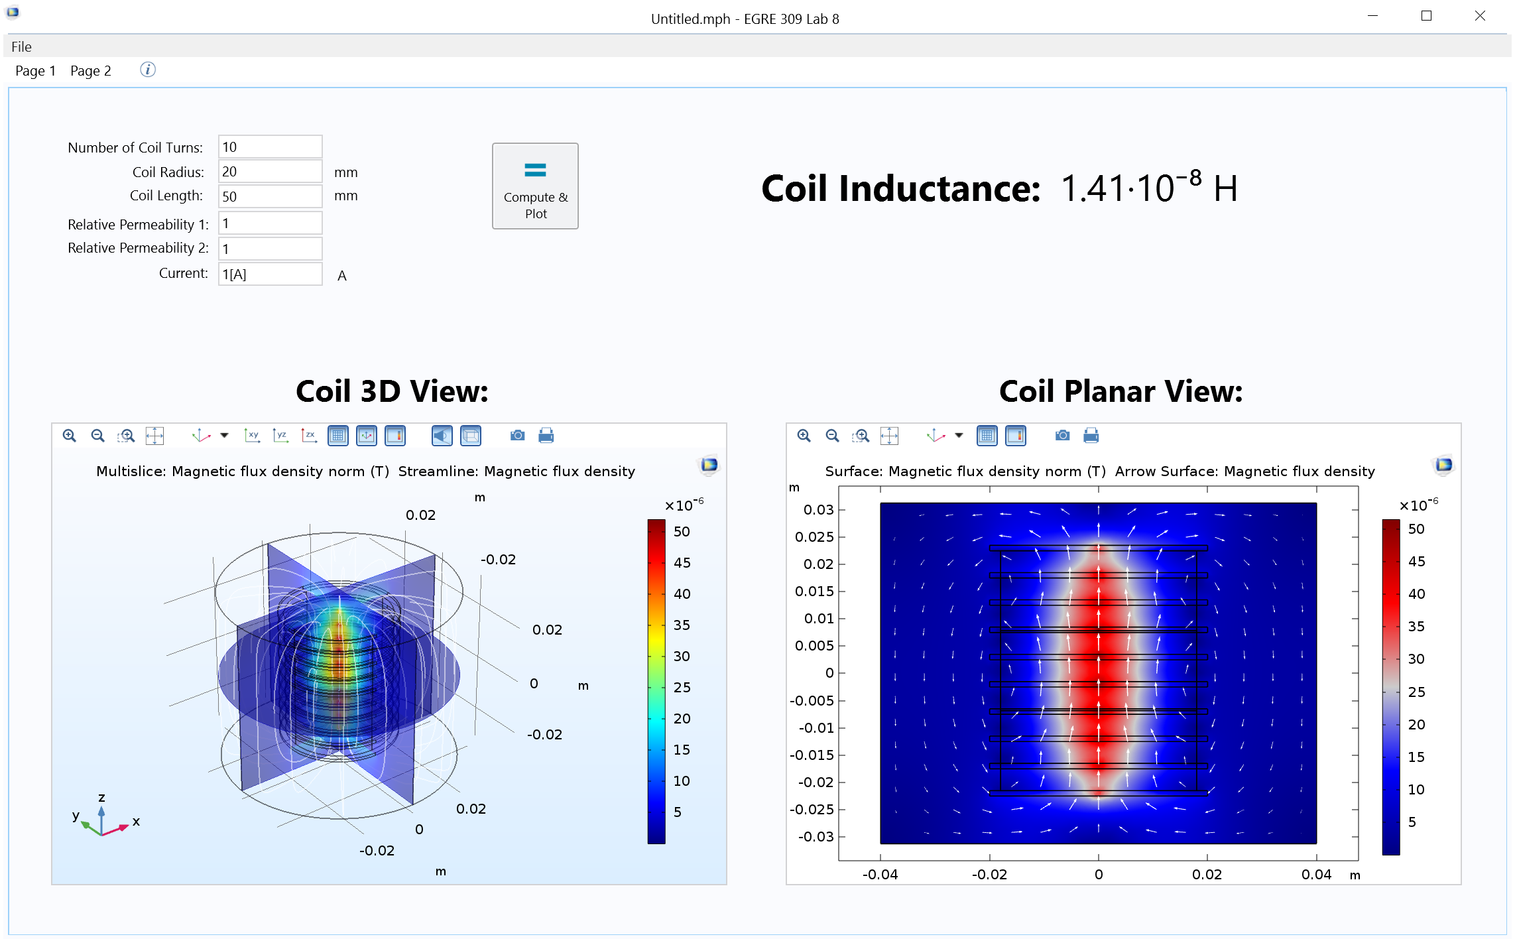
VIRGINIA COMMONWEALTH UNIVERSITY Teaching Electromagnetics with Simulation Apps
Apps help students develop:
Better intuition
Agile critical thinking skills
Higher-level understanding of electrical engineering concepts
“Applications enable students to see and interact with a phenomenon themselves, and at their own pace.”
Professor Kinsey
“Illuminating the Physics Behind Electromagnetics Concepts with Applications”
Multiphysics Simulation 2019: Nate Kinsey, Virginia Commonwealth University, Virginia, USA
Simulation app students can use to compute coil inductance and fringe fields
Notes:
Engineers at Volkswagen Kassel turned to multiphysics simulation to perform electromagnetic and structural analyses of rotor laminations in electric drives for EV motors
They then built and distributed simulation applications to automate these analyses and standardize their development processes throughout the organization

