Slide 1
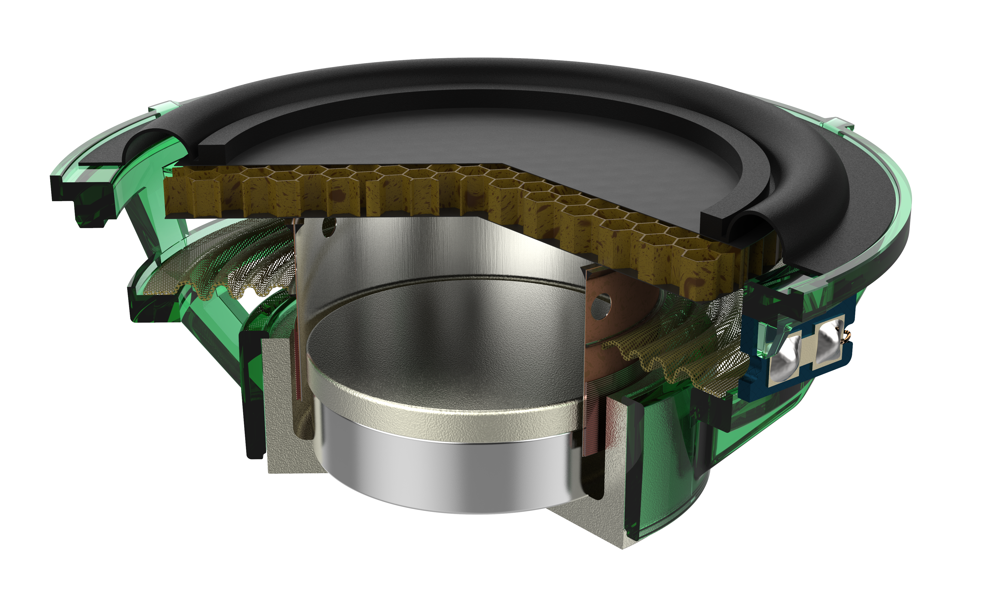
TECTONIC AUDIO LABS
AND VALVE CORPORATION
Designing Virtual Reality Headsets with Multiphysics Simulation
Valve Corporation, a leading developer in the gaming industry, sought to develop a virtual reality (VR) headset that could provide suspension of disbelief
The Valve team opted against using traditional headphones as they are designed to isolate sound, cancel noise, and exaggerate frequency response — not to create audio immersion
To achieve the desired sound quality in their headset design, Valve used Tectonic Audio Lab’s balanced mode radiator (BMR) speakers
“Designing the Gold Standard of Immersive Audio for Virtual Reality”
COMSOL News 2020: Tim Whitwell, Tectonic Audio Labs, Washington, USA
A cutaway view of the BMR speaker

Slide 2
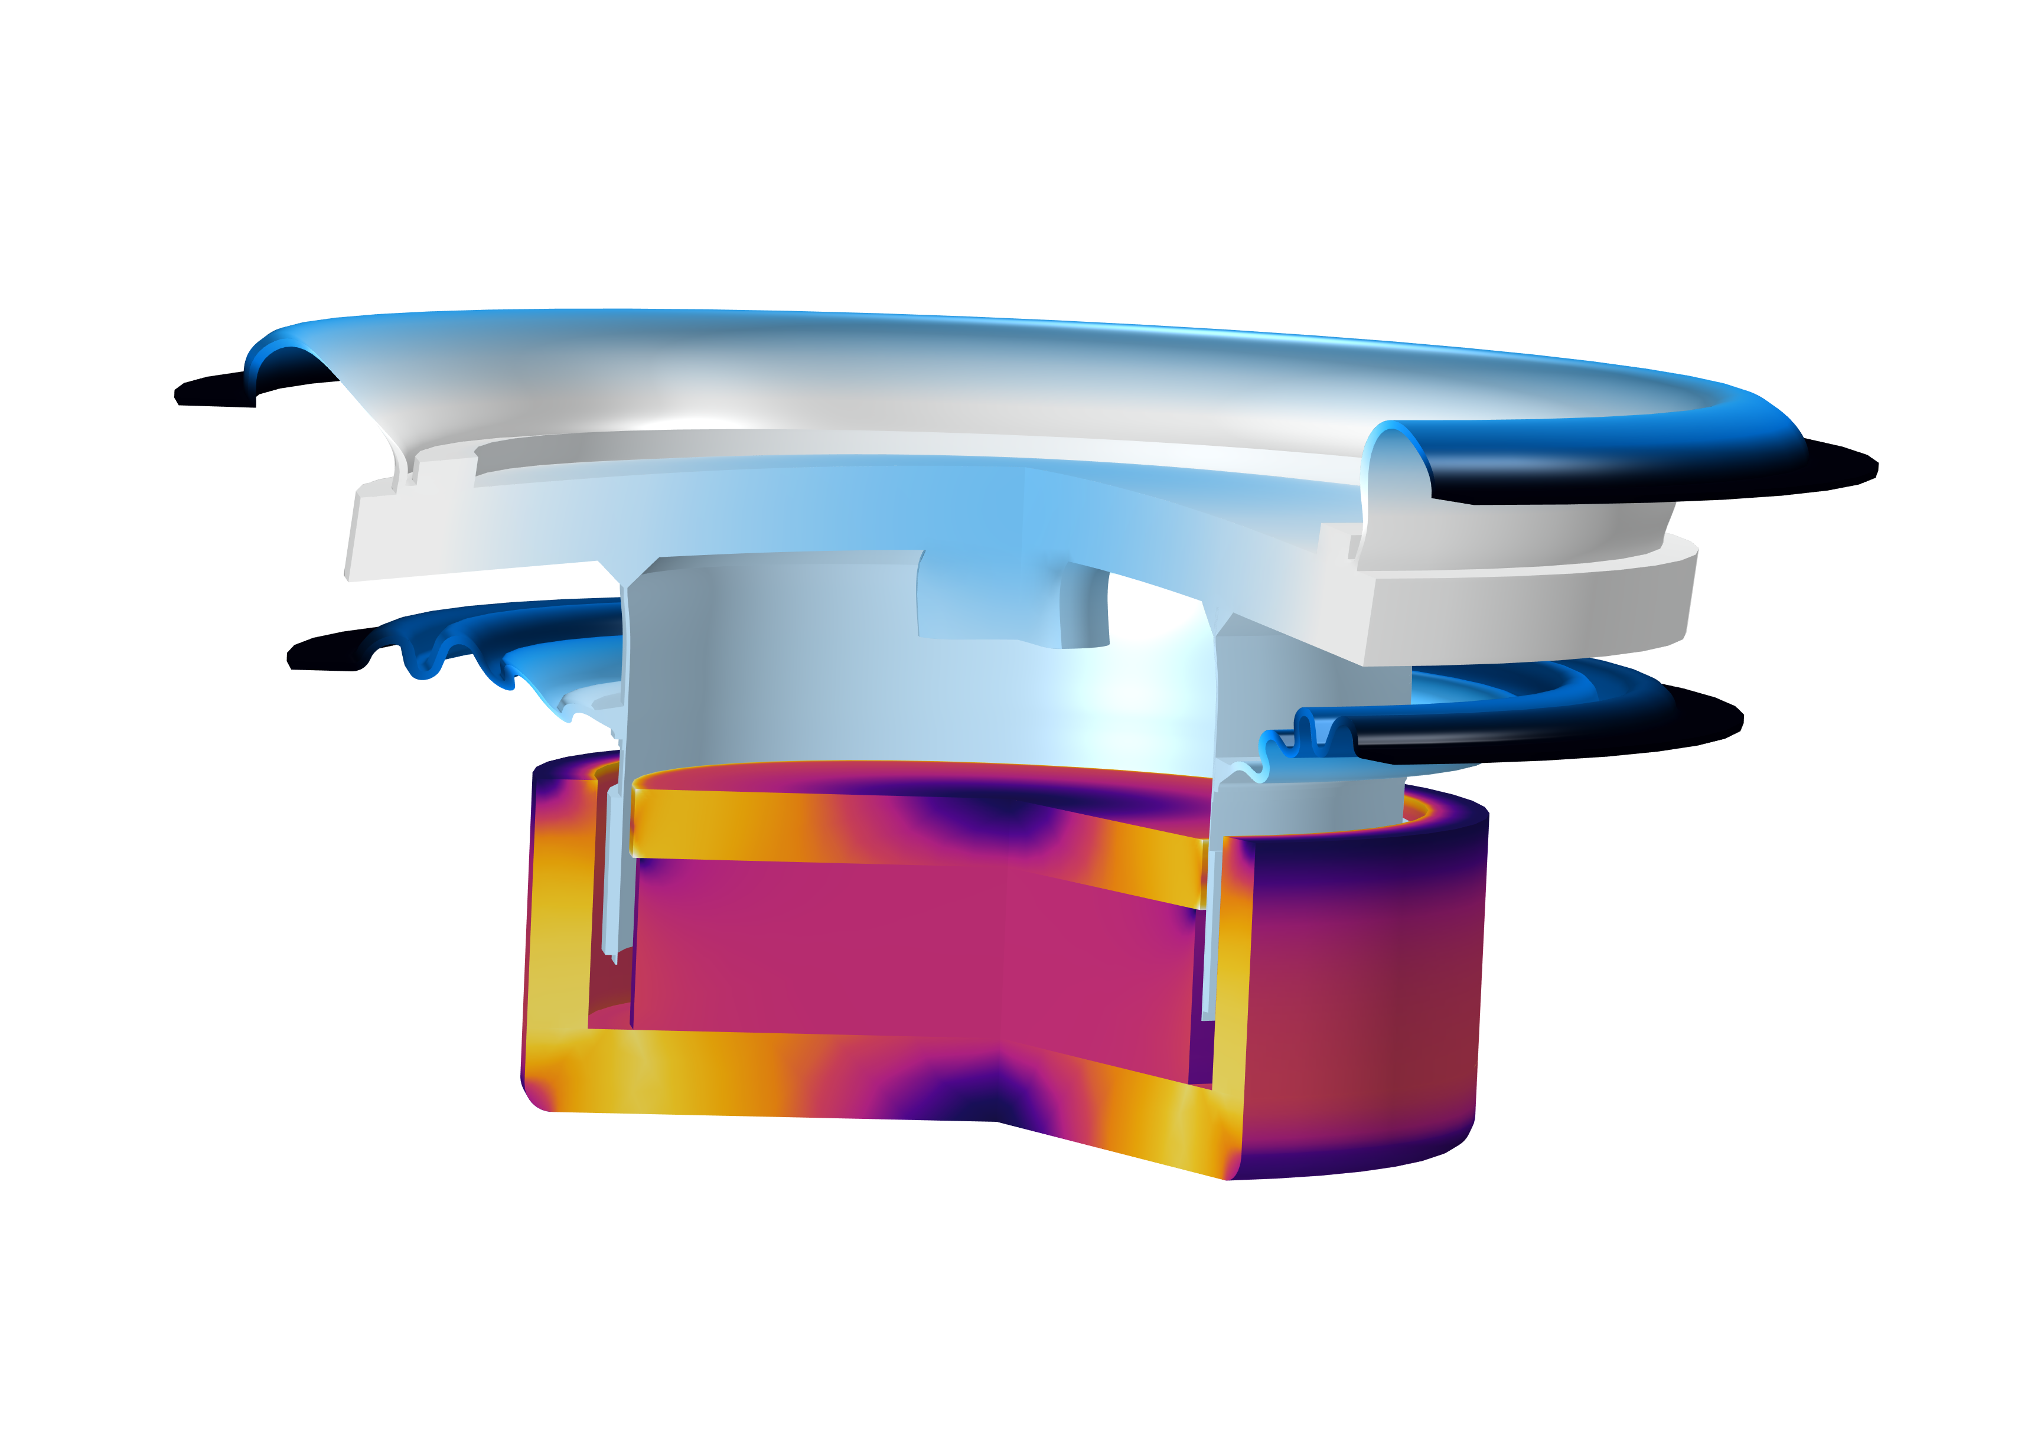
TECTONIC AUDIO LABS
AND VALVE CORPORATION
Designing Virtual Reality Headsets with Multiphysics Simulation
BMR speakers are different than traditional speakers because they embrace bending waves, versus avoiding them
Using electromagnetics, mechanical, and acoustics simulation, Tectonic Audio Labs specifically designed a BMR speaker for use in Valve Corporation’s VR headset
The final design, the Valve Index® Headset, is considered the gold standard for VR audio
“Designing the Gold Standard of Immersive Audio for Virtual Reality”
COMSOL News 2020: Tim Whitwell, Tectonic Audio Labs, Washington, USA
Fully coupled BMR model visualizing the magnetic flux density in the motor and total displacement in the moving parts (diaphragm, coil surround, and spider) at 5 kHz

