Slide 1
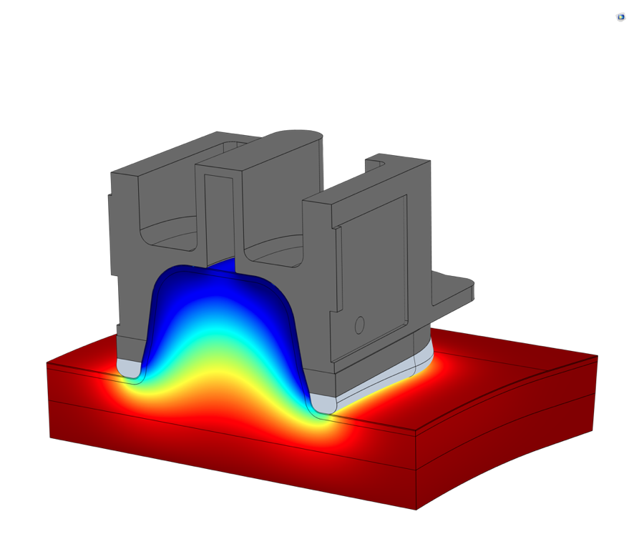
ALLERGAN AESTHETICS Simulating Noninvasive Cosmetic Procedures
Allergan Aesthetics, an AbbVie company, designs technology for cosmetic procedures with multiphysics simulation
CoolSculpting®: noninvasive fat reduction via cryolipolysis
CoolTone®: nonsurgical body contouring via magnetic muscle stimulation
Heat transfer simulation used to:
Study tissue temperatures and their transient changes during treatment
Design optimized applicators
Electromagnetics simulation used to study:
Electromagnetic muscle stimulation
Effects of electric currents on tissue
“Shaping the Design of Noninvasive Cosmetic Procedures with Multiphysics Simulation” Joel Jimenez Lozano, Allergan Aesthetics, California, USA
Temperature distribution in tissue during the CoolSculpting® treatment

