Slide 1
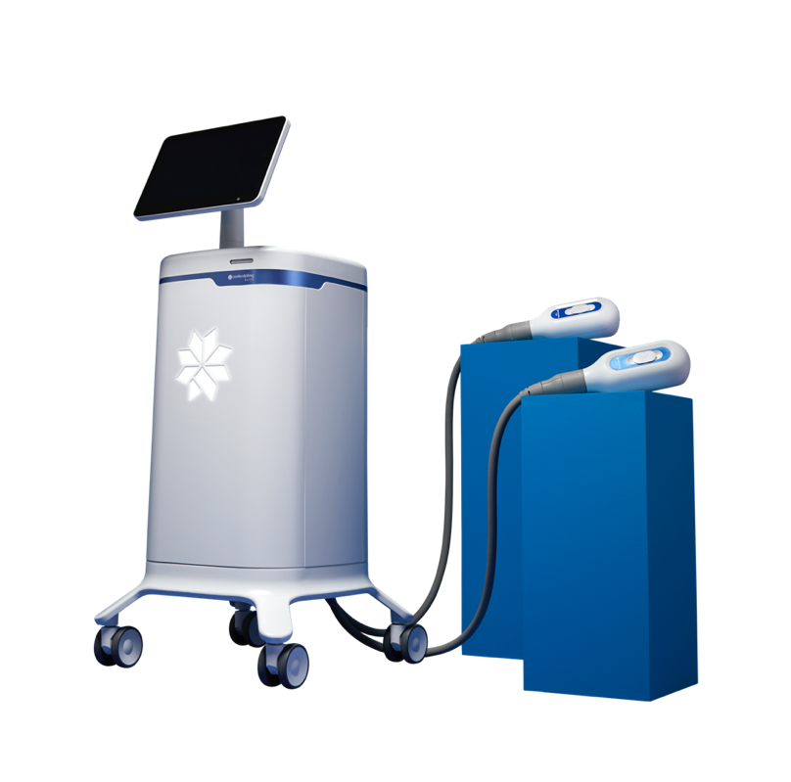
ALLERGAN AESTHETICS
Shaping the Design of Nonsurgical Procedures
Allergan Aesthetics designs and develops technology for popular medical aesthetic procedures, including:
  CoolSculpting®
  CoolTone®
CoolSculpting®
  Noninvasive fat reduction
  Uses a fat-freezing method known as cryolipolysis
CoolTone®
  Nonsurgical body contouring
  Designed to help strengthen and tone muscles with magnetic muscle stimulation
“Shaping the Design of Noninvasive Cosmetic Procedures with Multiphysics Simulation”
Joel Jimenez Lozano, Allergan Aesthetics, California, USA
The CoolSculpting® Elite System is composed of a portable control unit with a user interface

Slide 2
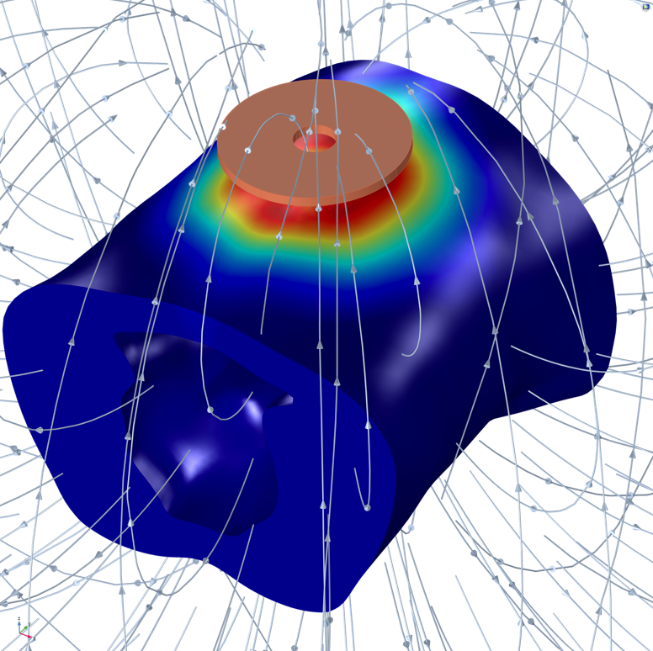
ALLERGAN AESTHETICS
Shaping the Design of Nonsurgical Procedures
Multiphysics simulation used to:
  Study tissue temperatures and transient changes during CoolSculpting® treatment
  Understand physics behind electromagnetic muscle stimulation
  Analyze effect of electrical currents on tissue during CoolTone® treatment
  Design optimized applicators for both CoolSculpting® and CoolTone® treatments
Built and distributed simulation applications to:
  Showcase simulations at conferences
  Provide supporting data for regulatory agency submissions
“Shaping the Design of Noninvasive Cosmetic Procedures with Multiphysics Simulation”
Joel Jimenez Lozano, Allergan Aesthetics, California, USA
Peak magnetic field (curved lines) and induced electric field in the abdominal muscles during the CoolTone® treatment

