Slide 1
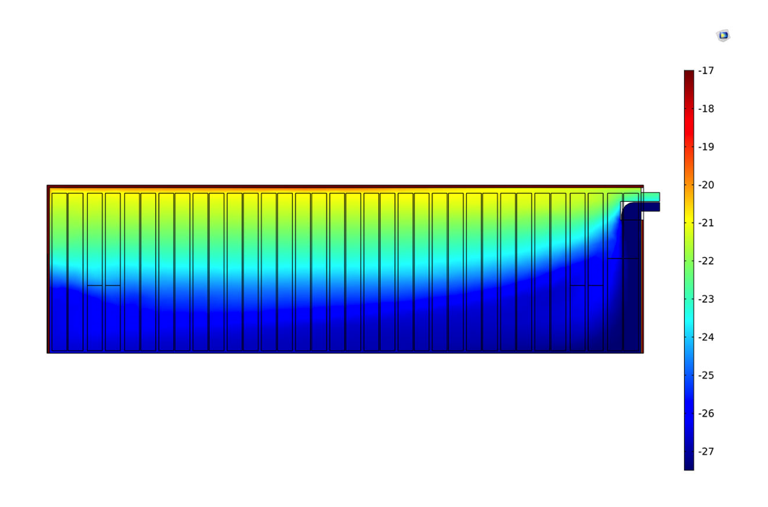
THERMOFIN GMBH
Designing Optimized
Heat Exchangers with Simulation
thermofin GmbH designs heat exchangers for use in air conditioning and refrigeration systems around the world
Multiphysics simulation is used to:
  Analyze airflow and material properties of gas coolers
  Design optimized inner finned tubes for heat exchangers
  Optimize cold storage warehouses
"In our future research plans, we want to design [heat exchangers with a] new fin shape. For a new fin geometry, we would have to simulate it before we buy the tools to produce it ourselves.” – Julius Heik, thermofin GmbH
“Optimizing Heat Exchanger Designs for Refrigeration and Cooling Technology”
Julius Heik, thermofin GmbH, Germany
Temperature distribution in a cold storage room

