Slide 1
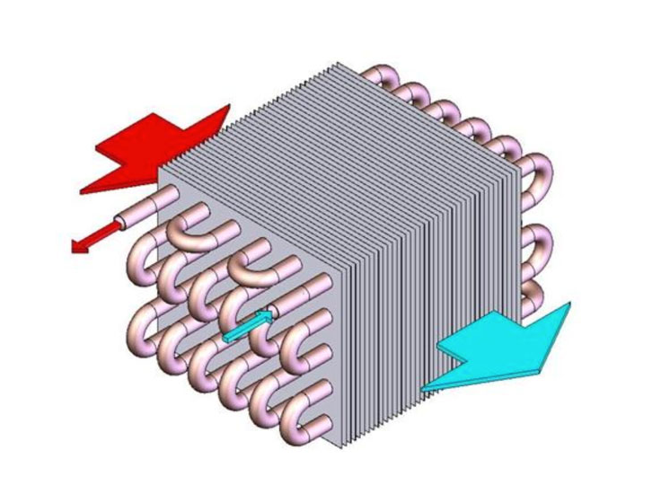
THERMOFIN GMBH
Designing Optimized Heat Exchangers with Simulation
thermofin GmbH designs heat exchangers that are used in commercial and industrial buildings around the world, such as:
  Supermarkets
  Cold storage facilities
  Ice arenas
Simulation is used to:
  Design optimized heat exchangers
  Perform cold storage room simulations
“Optimizing Heat Exchanger Designs for Refrigeration and Cooling Technology”
Julius Heik, thermofin GmbH, Germany
Geometry of a thermofin® heat exchanger

Slide 2
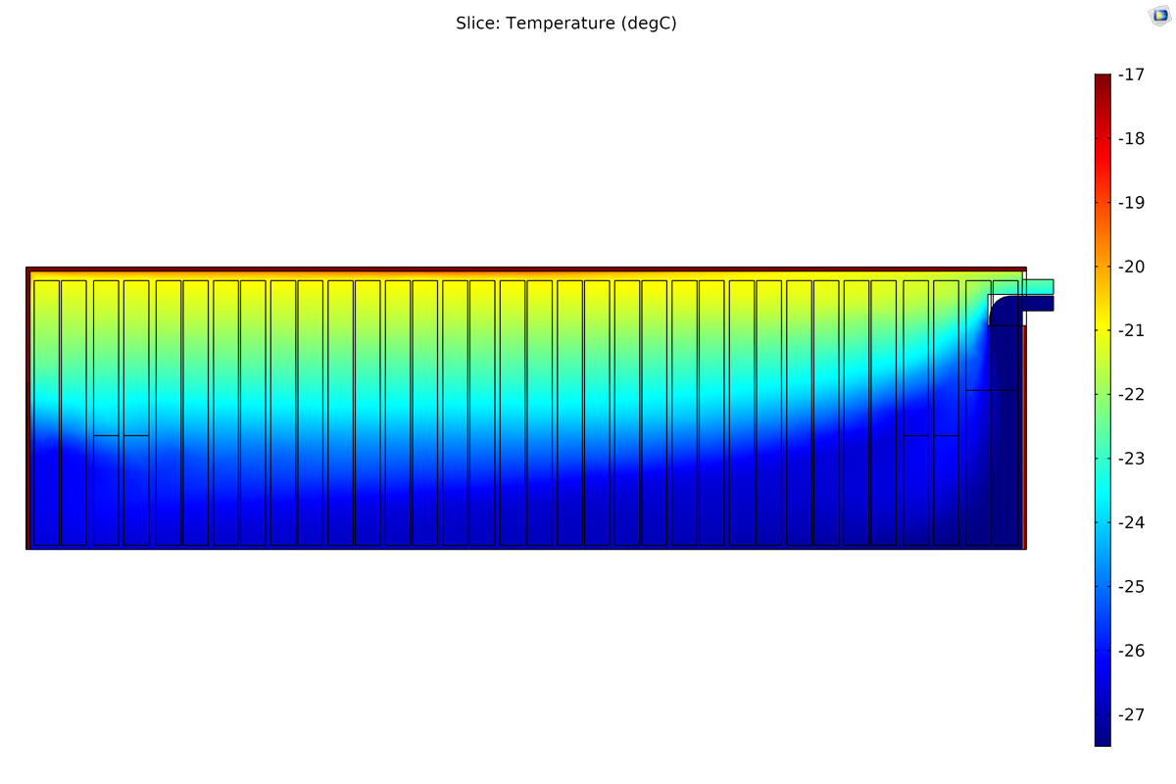
THERMOFIN GMBH
Designing Optimized Heat Exchangers with Simulation
Optimized inner finned tubes
  Transform hot fluid into cold fluid (or vice versa) in heat exchangers
  Arrangement, diameter, material, and spacing all affect heat exchanger design
Cold storage room simulations
  Help customers design cold storage warehouses
  Show customers how many devices a cold storage room needs for optimal air distribution
thermofin GmbH plans to use simulation to design heat exchangers with a new fin shape
“Optimizing Heat Exchanger Designs for Refrigeration and Cooling Technology”
Julius Heik, thermofin GmbH, Germany
Simulation of a cold storage room’s temperature distribution

