Slide 1
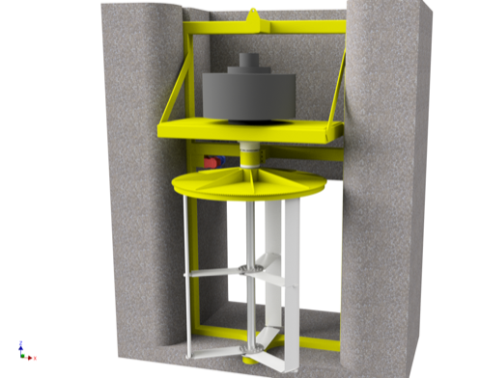
PHYSIXFACTOR Designing a Water Turbine for Fish-Friendly Hydropower
Physixfactor developed a new type of hydropower turbine for installation in Dutch tidal flood control structures
Existing designs were not well-suited to this application
Flood control structures are part of sensitive tidal estuary ecosystem
Typical hydropower rotors generate high turbulence and contact with sea life
New design replaces Kaplan screw-type turbine rotor with adjustable vertical-blade design
Reduce harm to fish and other sea life
Potential to increase power output
“Producing Power, Protecting Fish with a Darrieus Water Turbine” Helger Van Halewijn, Physixfactor, The Netherlands
The water turbine design developed by Physixfactor for Water2Energy. Rotor mechanism, including vertical blades, illustrated in white.

Slide 2
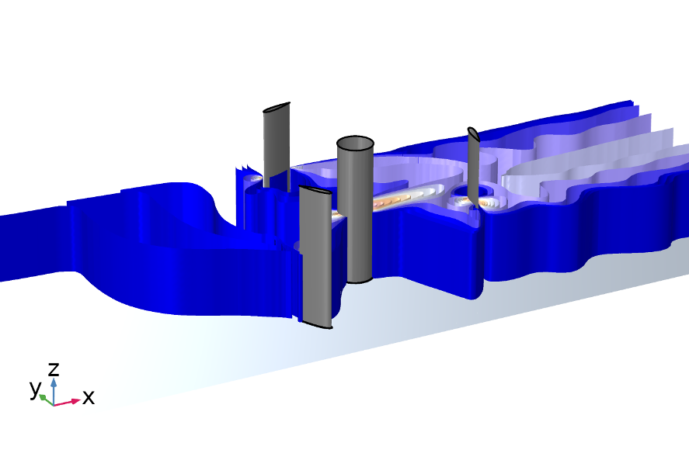
PHYSIXFACTOR Designing a Water Turbine for Fish-Friendly Hydropower
Used fluid flow simulation to:
Refine turbine rotor blade profile to reduce turbulence
Determine optimal angle of attack throughout blades’ path of rotation
Demonstrate safe movement of fish past turbine blades in motion with animations
Results:
40% increase in power output over fixed-rotor design
Reduced fish mortality rate from 20% to less than 1%
“Producing Power, Protecting Fish with a Darrieus Water Turbine” Helger Van Halewijn, Physixfactor, The Netherlands
Fluid flow through the Water2Energy water turbine, showing three vertical blades and central axle

