Slide 1
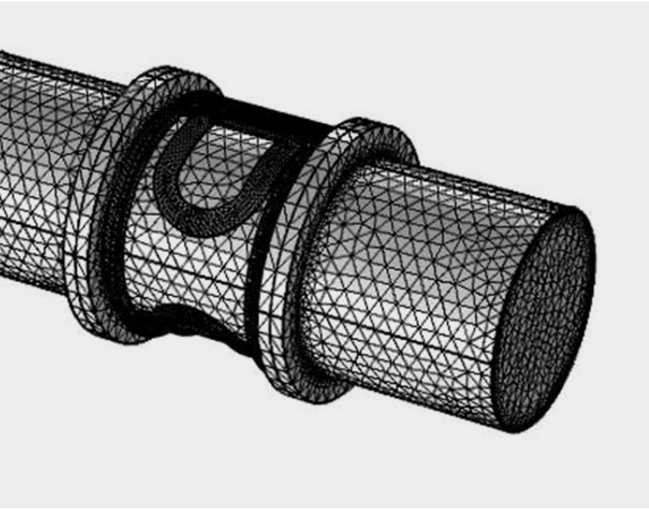
ABB Predicting Flowmeter Performance with a Digital Twin
Electromagnetic flowmeters
Simplicity of installation
Negligible impact on pressure drop
High accuracy
Enable accurate measurement at low flow rates
ABB seeks to improve flowmeter designs to meet:
High performance standards
Cost optimization demands
Digital twin
Based on predictive model
Can predict flowmeter performance
Minimizes the need for testing
“ABB’s Electromagnetic Flowmeter Digital Twin Drives Performance” COMSOL News 2019, Subhashish Dasgupta and Vinay Kariwala, ABB, India
Meshed model of an EM flowmeter used to create a digital twin

Slide 2
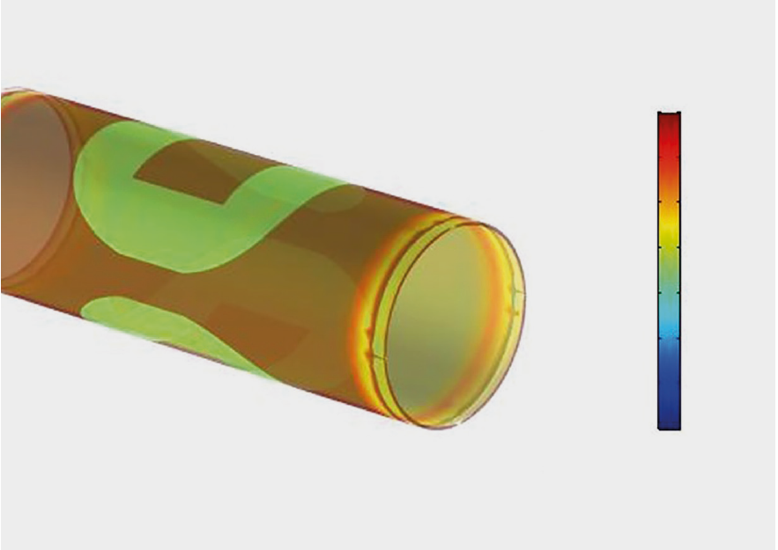
ABB Predicting Flowmeter Performance with a Digital Twin
Multiphysics model of an electromagnetic flowmeter
Electromagnetism
Fluid dynamics
Thermal propagation
Structural dynamics
95% agreement between model results and field tests for calculated sensitivities
Digital twin based on multiphysics model enables ABB to:
Predict flowmeter performance
Improve the design of flowmeters
“ABB’s Electromagnetic Flowmeter Digital Twin Drives Performance” COMSOL News 2019, Subhashish Dasgupta and Vinay Kariwala, ABB, India
Hydraulic stress field in an electromagnetic flowmeter

