Slide 1

RADIOTELEVISIONE ITALIANA
Improving the Recording Process of Live Sports Events with Simulation
Radiotelevisione Italiana (RAI), Italy’s national public broadcasting company, has recorded live sports events for decades
In an effort to enhance their live-recording process, RAI is designing new circularly polarized (CP) antennas
These new antennas need to:
  Operate in a dual-band, very-high-frequency/ultrahigh frequency (VHF/UHF), configuration
  Be compact enough to fit in a motorcycle top case
“Prototyping Antennas for Mobile Recording of TV Sports Events with Simulation”
COMSOL News 2020: Assunta De Vita, Alessandro Lucco Castello, and Bruno Sacco, Radiotelevisione Italiana, Italy
Motorcycles used for RAI’s live-recording process

Slide 2
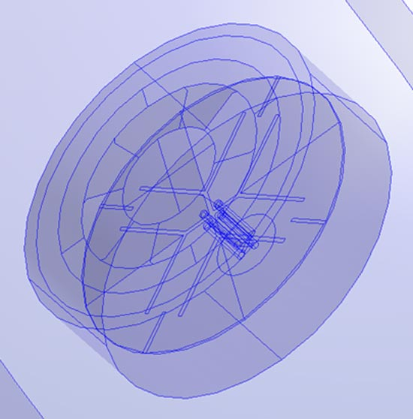
RADIOTELEVISIONE ITALIANA
Improving the Recording Process of Live Sports Events with Simulation
To design a compact antenna solution that met their desired requirements, RAI turned to simulation
They tested several antenna designs in the frequencies' band of interest, including:
  An Archimedean spiral CP antenna
The simulated results have been confirmed in the prototypes by means of:
  Laboratory measurements
  Field tests
At present, RAI is designing a new dual-crossed, double-folded dipole (DCDFD) antenna
“Prototyping Antennas for Mobile Recording of TV Sports Events with Simulation”
COMSOL News 2020: Assunta De Vita, Alessandro Lucco Castello, and Bruno Sacco, Radiotelevisione Italiana, Italy
Geometry of the DCDFD circularly polarized UHF antenna

