Slide 1
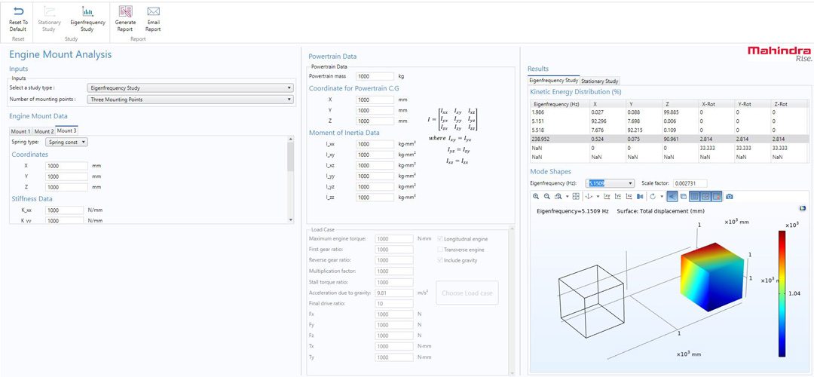
MAHINDRA & MAHINDRA LIMITED (M&M)
Accelerating Automotive Product Development with Simulation Apps
Methods Development team at M&M created nearly 20 simulation apps to enhance their development workflow
The apps are being used across teams working in different domains:
  Design
  Testing
  Noise, vibration, and harshness (NVH) analysis
Use of apps:
  Makes concept evaluation and finalization more accessible
  Accelerates design evaluation
  Allows designers to easily visualize concept designs
“Advancing Automotive Product Development with Simulation Apps”, Mahindra & Mahindra Limited, India
A simulation app developed at M&M

