Slide 1
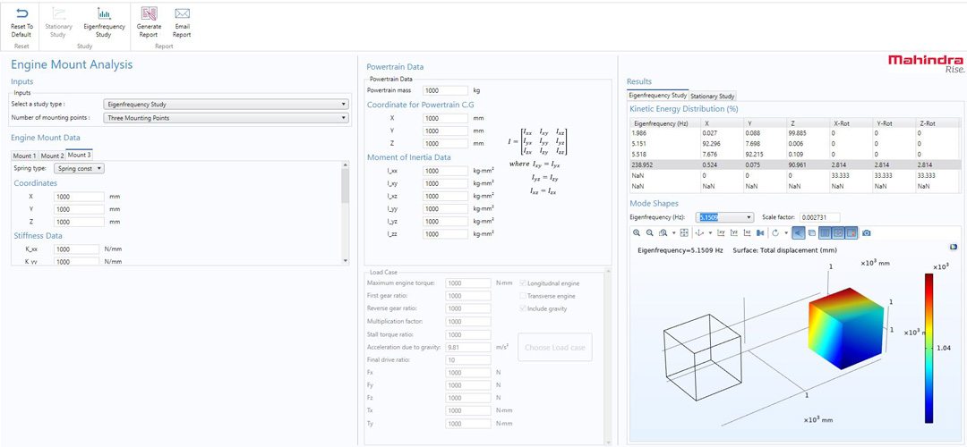
MAHINDRA & MAHINDRA LIMITED (M&M)
Accelerating Automotive Product Development with Simulation Apps
M&M is a multinational original equipment manufacturer (OEM) in the automotive industry in India
To enhance their development workflow, the Methods Development team developed ~20 simulation apps
Used COMSOL Server™ and COMSOL Compiler™ to distribute apps to teams working in different domains, including:
  Design
  Testing
  Noise, vibration, and harshness (NVH) analysis
“Advancing Automotive Product Development with Simulation Apps”
Mahindra & Mahindra Limited, India
The Engine Mount Analysis app

Slide 2
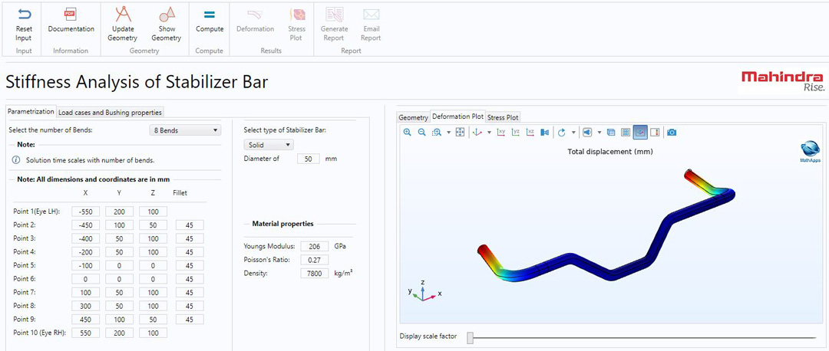
MAHINDRA & MAHINDRA LIMITED (M&M)
Accelerating Automotive Product Development with Simulation Apps
At M&M, simulation apps help:
  Empower the design team by giving them access to engineering analysis tools
  Make concept evaluation and finalization more accessible
  Speed up design evaluation
  Visualize different design concepts
  Support collaboration across teams
This innovative approach helps M&M shorten the product development life cycle and gain an advantage over their competitors
“Advancing Automotive Product Development with Simulation Apps”
Mahindra & Mahindra Limited, India
Stabilizer Bar app for modal analysis

